Slide 1
Introduction to MS Dynamics NAV (Stock Keeping Units)
Ing.J.Skorkovský,CSc.
MASARYK UNIVERSITY BRNO, Czech Republic
Faculty of economics and business administration
Department of corporate economy

Slide 2
Stockkeeping Units (SKU)
Stockkeeping units are a supplement to item cards, they do not replace them, although they are related to them.
Stockkeeping units allow you to differentiate information about an item for a specific location (such as a warehouse or distribution center) or a specific variant (such as different shelf numbers and different replenishment information), for the same item.

Slide 3
How to create a new SKU
Open an Item Card (e.g. 1928-S) – see if we do have any SKU already created
To see all SKU in the system remove existing filter for 1928-S

Slide 4
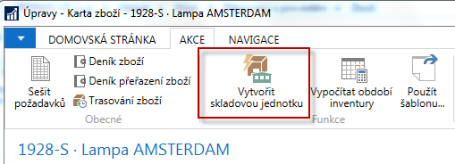
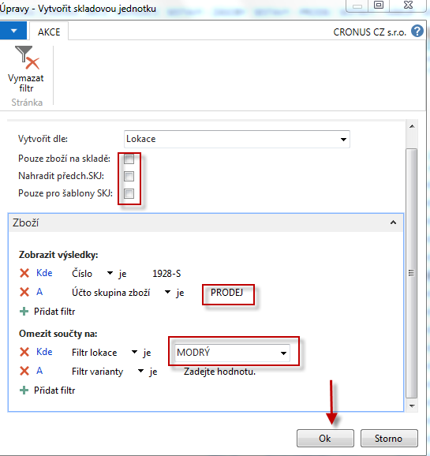
How to create a new SKU
Open an Item Card (e.g. 1928-S)
It can be created for Location, Variant and Location & Variant

Slide 5
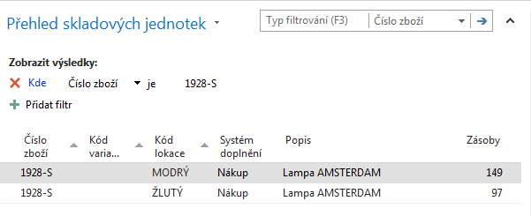
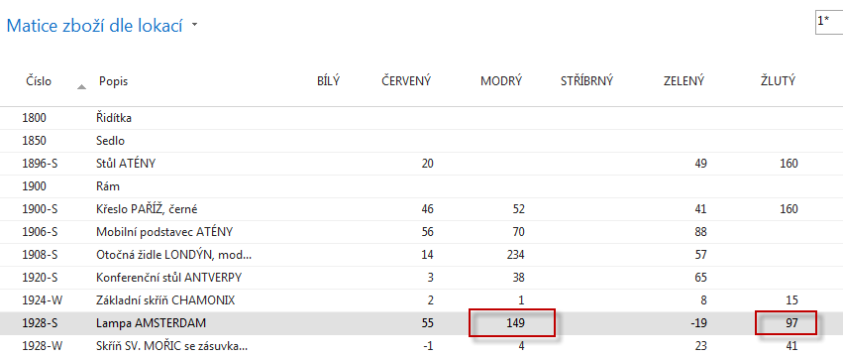
How to create a new SKU

Slide 6
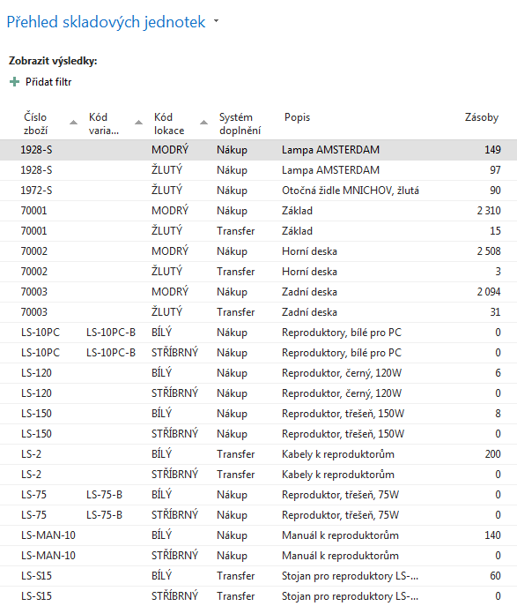
SKU list

Slide 7
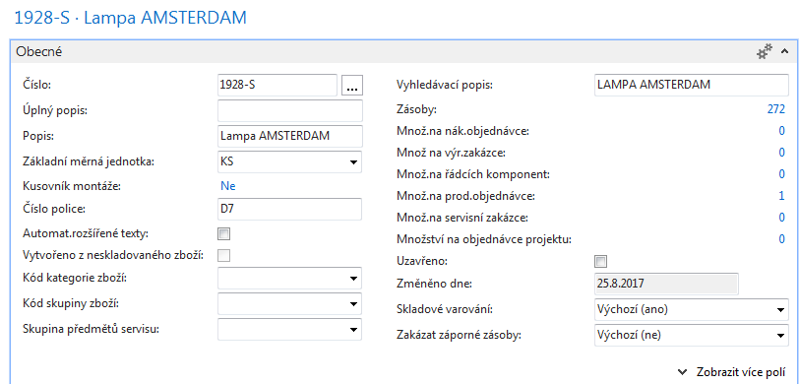
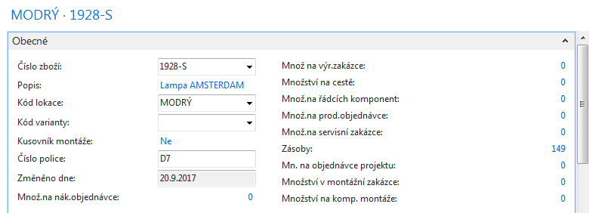
SKU Card is more simpler than original Item Card
SKU has priority over original Item Card !!!
Standard
See other tabs during session !
SKU

Slide 8
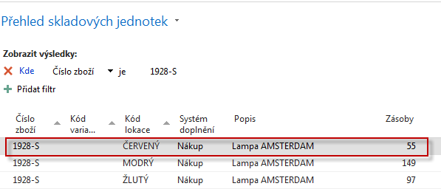
Transfer from SKU Blue->SKU Red
Firstly you have to create SKU RED for Item in question (do not use SKU template!!)

Slide 9
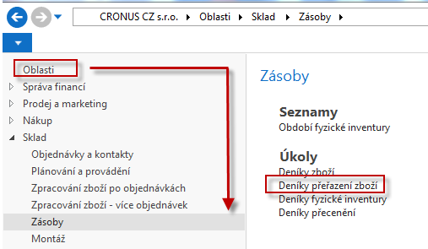
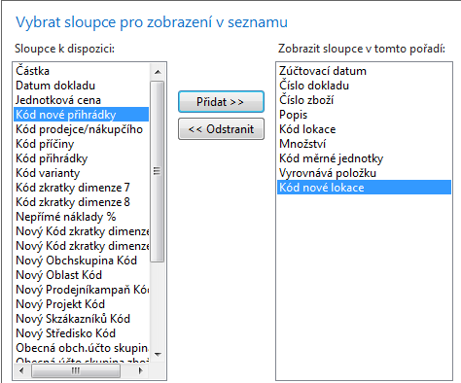
Inventory Reclassification Journal
Adding field
Code of new location !!

Slide 10
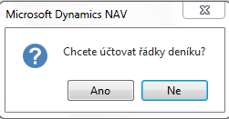
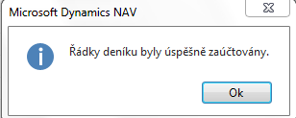
Transfer from SKU Blue->SKU Red
F9

Slide 11
Item Ledger Entries and SKU cards
1928-S
Ctrl-F7

Slide 12
End of the section SKU.

