Slide 1
MS Dynamics NAV- nothing simpler-repetition or introduction
Skorkovský
KPH-ESF-MU Brno

Slide 2
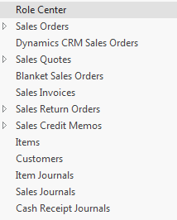
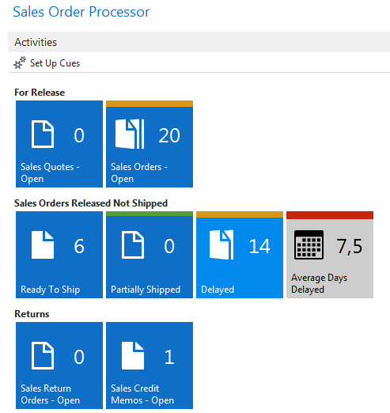
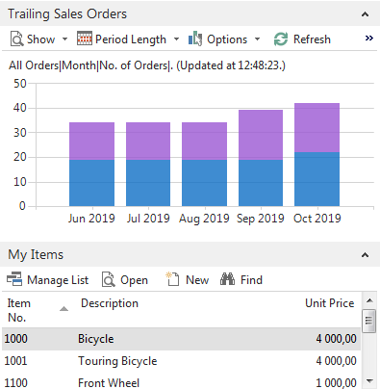
Areas
ERP – what is it - see material ( Introduction scenario MS Dynamics NAV 2016-Word- so far 41 pages)- only few first pages
Objects and resource data (4 main tables)
Operation areas – see next slide

Slide 3
Operation areas
Backward and forward button
Address bar
Searching window
Ribbon
Application menu
Navigation pane
Main „task“ window page (list, card,…)
Faxbox pane
Link to existing PWP Basic NAV Principles II.

Slide 4
Access to web client NAV
See file describing access to web client NAV
Link to PWP bilingual file :
Czech : Rozdíly ovládání MS Dynamics NAV 2016 (2017) English : Windows Client <-> WEB Client
For MPH_AOMA and MPH_AOPR this file will be used later !!!

Slide 5
Basic terminology
Link to English PWP :
Simple scenario of the first and second ERP MS NAV (text file)

Slide 6
Real basic
This 10 bullets represent basic sections during introduction of this course
Discuss the concept of the ribbon and its different components
Demonstrate how to use the Navigation pane
Explain how to customize the Microsoft Dynamics NAV user interface
Use function keys and basic keyboard shortcuts
Enter and edit information
Use zooms, search, filters, and other navigation functions
Integrate with Microsoft Office products such as OneNote, Word, and Excel. (One Note will be not used in these courses)
Introduction to customer cards, vendor cards and item cards and G/L account as well
Describe the different client types
Explain the multi-language functionality
How to enter data (numbers, dates, periods)

