Slide 1
Econometrics - Lecture 4
Heteroskedasticity

Slide 2
Contents
Violations of V{ε} = σ² I_{N}: Illustrations and Consequences
Heteroskedasticity
Tests against Heteroskedasticity
GLS Estimation
Autocorrelation

Slide 3
Gauss-Markov Assumptions
Observation y_{i} is a linear function
  y_{i} = x_{i}'β + ε_{i}
  of observations x_{ik}, k =1, …, K, of the regressor variables and the error term ε_{i}
  for i = 1, …, N; x_{i}' = (x_{i1}, …, x_{iK}); X = (x_{ik})
In matrix notation: E{ε} = 0, V{ε} = σ² I_{N}
A1 | E{ε_{i}} = 0 for all i
A2 | all ε_{i} are independent of all x_{i} (exogeneous x_{i})
A3 | V{ε_{i}} = σ² for all i (homoskedasticity)
A4 | Cov{ε_{i}, ε_{j}} = 0 for all i and j with i ≠ j (no autocorrelation)

Slide 4
OLS Estimator: Properties
Under assumptions (A1) and (A2):
1. The OLS estimator b is unbiased: E{b} = β
Under assumptions (A1), (A2), (A3) and (A4):
2. The variance of the OLS estimator is given by
V{b} = σ²(Σ_{i} x_{i} x_{i}’)⁻¹ = σ²(X‘ X)⁻¹
3. The sampling variance s² of the error terms ε_{i},
s² = (N – K)⁻¹ Σ_{i} e_{i}²
is unbiased for σ²
4. The OLS estimator b is BLUE (best linear unbiased estimator)

Slide 5
Violations of V{ε} = σ²I_{N}
Implications of the Gauss-Markov assumptions for ε:
V{ε} = σ²I_{N}
Violations:
Heteroskedasticity
V{ε} = diag(σ₁², …, σ_{N}²)
with σ_{i}² ≠ σ_{j}² for at least one pair i ≠ j, or using σ_{i}² = σ² h_{i}²,
V{ε} = σ²Ψ = σ² diag(h₁², …, h_{N}²)
Autocorrelation: V{ε_{i}, ε_{j}} ≠ 0 for at least one pair i ≠ j or
V{ε} = σ²Ψ
with non-diagonal elements different from zero

Slide 6
Example: Household Income and Expenditures
70 households (HHs):
monthly HH-income and expenditures for durable goods
2400
2000
1600
1200
expentidures for durable goods
800
400
0
0
2000
4000
6000
8000
10000
12000
HH-income

Slide 7
Household Income and Expenditures, cont‘d
Residuals e = y- ŷ from
Ŷ = 44.18 + 0.17 X
X: monthly HH-income
Y: expenditures for durable goods
the larger the income, the more scattered are the residuals
600
400
200
0
residuals e
-200
-400
-600
0
2000
4000
6000
8000
10000
12000
HH-income

Slide 8
Typical Situations for Heteroskedasticity
Heteroskedasticity is typically observed
in data from cross-sectional surveys, e.g., surveys in households or regions
in data with variance that depends of one or several explanatory variables, e.g., variance of the firms’ turnover depends on firm size (in number of staff)
in data from financial markets, e.g., exchange rates, stock returns

Slide 9
Example: Household Expenditures
Variation of expenditures for food, increasing with growing income; from Verbeek, Fig. 4.1

Slide 10
Autocorrelation of Economic Time-series
Consumption in actual period is similar to that of the preceding period; the actual consumption „depends“ on the consumption of the preceding period
Consumption, production, investments, etc.: to be expected that successive observations of economic variables correlate positively
Seasonal adjustment: application of smoothing and filtering algorithms induces correlation of the smoothed data

Slide 11
Example: Imports
Scatter-diagram of by one period lagged imports [MTR(-1)] against actual imports [MTR]
Correlation coefficient between MTR und MTR(-1): 0.9994

Slide 12
Example: Import Function
MTR: Imports
FDD: Total Demand
(from AWM-database)
Import function: MTR = -227320 + 0.36 FDD
R² = 0.977, t_{FFD} = 74.8

Slide 13
Import Function: Residuals
MTR: Imports
FDD: Total Demand
(from AWM-database)
RESID: e_{t} = MTR - (-227320 + 0.36 FDD)

Slide 14
Import Function: Residuals, cont‘d
Scatter-diagram of by one period lagged residuals [Resid(-1)] against actual residuals [Resid]
Serial correlation!

Slide 15
Typical Situations for Autocorrelation
Autocorrelation is typically observed if
a relevant regressor with trend or seasonal pattern is not included in the model: miss-specified model
the functional form of a regressor is incorrectly specified
the dependent variable is correlated in a way that is not appropriately represented in the systematic part of the model
Warning! Omission of a relevant regressor with trend implies autocorrelation of the error terms; in econometric analyses, autocorrelation of the error terms is always to be suspected!
Autocorrelation of the error terms indicates deficiencies of the model specification
Tests for autocorrelation are the most frequently used tool for diagnostic checking the model specification

Slide 16
Some Import Functions
Regression of imports (MTR) on total demand (FDD)
MTR = -2.27x10⁹ + 0.357 FDD, t_{FDD} = 74.9, R² = 0.977
Autocorrelation (of order 1) of residuals:
  Corr(e_{t}, e_{t-1}) = 0.993
Import function with trend (T)
MTR = -4.45x10⁹ + 0.653 FDD – 0.030x10⁹ T
t_{FDD} = 45.8, t_{T} = -21.0, R² = 0.995
Multicollinearity? Corr(FDD, T) = 0.987!
Import function with lagged imports as regressor
MTR = -0.124x10⁹ + 0.020 FDD + 0.956 MTR₋₁
t_{FDD} = 2.89, t_{MTR(-1)} = 50.1, R² = 0.999

Slide 17
Consequences of V{ε} ≠ σ²I_{N} for OLS estimators
OLS estimators b for β
are unbiased
are consistent
have the covariance-matrix
V{b} = σ² (X'X)⁻¹ X'ΨX (X'X)⁻¹
are not efficient estimators, not BLUE
follow – under general conditions – asymptotically the normal distribution
The estimator s² = e'e/(N-K) for σ² is biased

Slide 18
Consequences of V{ε} ≠ σ²I_{N} for Applications
OLS estimators b for β are still unbiased
Routinely computed standard errors are biased; the bias can be positive or negative
t- and F-tests may be misleading
Remedies
Alternative estimators
Corrected standard errors
Modification of the model
Tests for identification of heteroskedasticity and for autocorrelation are important tools

Slide 19
Contents
Violations of V{ε} = σ² I_{N}: Illustrations and Consequences
Heteroskedasticity
Tests against Heteroskedasticity
GLS Estimation
Autocorrelation

Slide 20
Example: Labor Demand
Verbeek’s data set “labour2”: Sample of 569 Belgian companies (data from 1996)
Variables
  labour: total employment (number of employees)
  capital: total fixed assets
  wage: total wage costs per employee (in 1000 EUR)
  output: value added (in million EUR)
Labour demand function
labour = β₁ + β₂*wage + β₃*output + β₄*capital

Slide 21
Labor Demand and Potential Regressors

Slide 22
Inference under Heteroskedasticity
Covariance matrix of b:
V{b} = σ² (X'X)⁻¹ X'ΨX (X'X)⁻¹
with Ψ = diag(h₁², …, h_{N}²)
Use of σ² (X'X)⁻¹ (the standard output of econometric software) instead of V{b} for inference on β may be misleading
Remedies
Use of correct variances and standard errors
Transformation of the model so that the error terms are homoskedastic

Slide 23
The Correct Variances
V{ε_{i}} = σ_{i}² = σ²h_{i}², i = 1,…,N: each observation has its own unknown parameter h_{i}
N observation for estimating N unknown parameters?
To estimate σ²_{i} – and V{b}
Known form of the heteroskedasticity, specific correction
  E.g., h_{i}² = z_{i}’α for some variables z_{i}
  Requires estimation of α
White’s heteroskedasticity-consistent covariance matrix estimator (HCCME)
Ṽ{b} = σ²(X'X)⁻¹(Σ_{i}ĥ_{i}²x_{i}x_{i}’) (X'X)⁻¹
with ĥ_{i}²=e_{i}²
  Denoted as HC₀
  Inference based on HC₀: “heteroskedasticity-robust inference”

Slide 24
White’s Standard Errors
White’s standard errors for b
Square roots of diagonal elements of HCCME
Underestimate the true standard errors
Various refinements, e.g., HC₁ = HC₀[N/(N-K)]
In GRETL: HC₀ is the default HCCME, HC₁ and other modifications are available as options

Slide 25
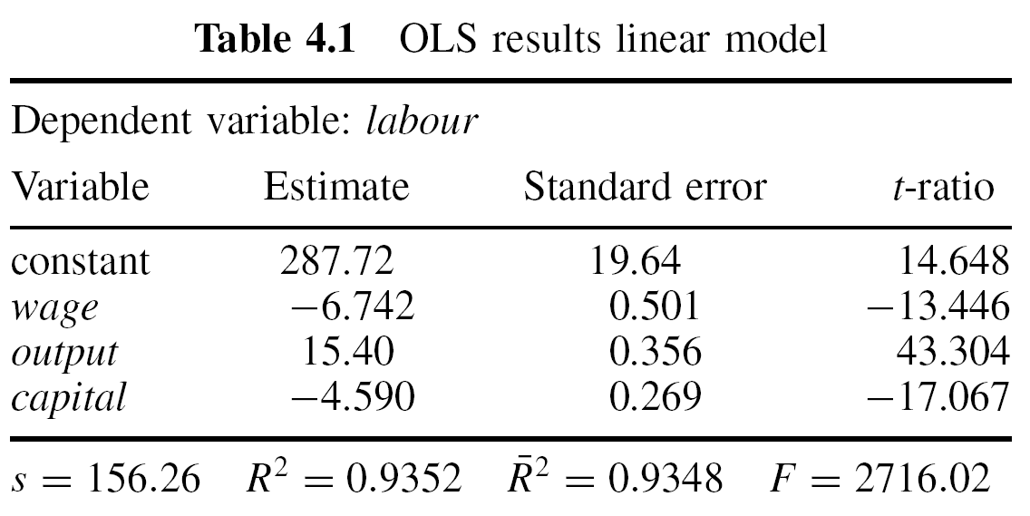
Labor Demand Function
For Belgian companies, 1996; Verbeek’s data set “labour2”
labour = β₁ + β₂*wage + β₃*output + β₄*capital

Slide 26
Labor Demand Function: Residuals vs output

Slide 27
Labor Demand Function, cont’d
Can the error terms be assumed to be homoskedastic?
They may vary depending on the company size, measured by, e.g., size of output or capital
Regression of squared residuals on appropriate regressors will indicate heteroskedasticity

Slide 28
Labor Demand Function, cont’d
Auxiliary regression of squared residuals, Verbeek
Indicates dependence of error terms on output, capital, not on wage

Slide 29
Labor Demand Function, cont’d
With White standard errors: Output from GRETL
Dependent variable : LABOR
Heteroskedastic-robust standard errors, variant HC0,
coefficient std. error t-ratio p-value
-------------------------------------------------------------
const 287,719 64,8770 4,435 1,11e-05 ***
WAGE -6,7419 1,8516 -3,641 0,0003 ***
CAPITAL -4,5905 1,7133 -2,679 0,0076 ***
OUTPUT 15,4005 2,4820 6,205 1,06e-09 ***
Mean dependent var 201,024911 S.D. dependent var 611,9959
Sum squared resid 13795027 S.E. of regression 156,2561
R- squared 0,935155 Adjusted R-squared 0,934811
F(2, 129) 225,5597 P-value (F) 3,49e-96
Log-likelihood 455,9302 Akaike criterion 7367,341
Schwarz criterion -3679,670 Hannan-Quinn 7374,121

Slide 30
Labor Demand Function, cont’d
Estimated function
labour = β₁ + β₂*wage + β₃*output + β₄*capital
OLS estimates and standard errors: without (s.e.) and with White correction (White s.e.) and GLS estimates with w_{i} = 1/(e_{i}²)
The White standard errors are inflated by factors 3.7 (wage), 6.4 (capital), 7.0 (output) with respect to the OLS s.e.
 | β₁ | β₂ | β₃ | β₄
Coeff OLS | 287.19 | -6.742 | 15.400 | -4.590
s.e. | 19.642 | 0.501 | 0.356 | 0.269
White s.e. | 64.877 | 1.852 | 2.482 | 1.713
Coeff GLS | 321.17 | -7.404 | 15.585 | -4.740
s.e. | 20.328 | 0.506 | 0.349 | 0.255

Slide 31
An Alternative Estimator for b
Idea of the estimator
Transform the model so that it satisfies the Gauss-Markov assumptions
Apply OLS to the transformed model
Results in an (at least approximately) BLUE
Transformation often depends upon unknown parameters that characterizing heteroskedasticity: two-step procedure
Estimate the parameters that characterize heteroskedasticity and transform the model
Estimate the transformed model
The procedure results in an approximately BLUE

Slide 32
An Example
Model:
y_{i} = x_{i}’β + ε_{i} with V{ε_{i}} = σ_{i}² = σ²h_{i}²
Division by h_{i} results in
y_{i} /h_{i} = (x_{i} /h_{i})’β + ε_{i} /h_{i}
with a homoskedastic error term
V{ε_{i} /h_{i}} = σ_{i}²/h_{i}² = σ²
OLS applied to the transformed model gives
This estimator is an example of the “generalized least squares” (GLS) or “weighted least squares” (WLS) estimator

Slide 33
Weighted Least Squares Estimator
A GLS or WLS estimator is a least squares estimator where each observation is weighted by a non-negative factor w_{i} > 0:
Weights w_{i} proportional to the inverse of the error term variance σ²h_{i}²: Observations with a higher error term variance have a lower weight; they provide less accurate information on β
  Needs knowledge of the h_{i}
    Is seldom available
    Estimates of h_{i} can be based on assumptions on the form of h_{i}
    E.g., h_{i}² = z_{i}’α or h_{i}² = exp(z_{i}’α) for some variables z_{i}
  Analogous with general weights w_{i}
  White’s HCCME uses w_{i} = e_{i}⁻²

Slide 34
Labor Demand Function, cont’d
Regression of “l_usq1”, i.e., log(e_{i}²), on capital and output
Dependent variable : l_usq1
coefficient std. error t-ratio p-value
-------------------------------------------------------------
const 7,24526 0,0987518 73,37 2,68e-291 ***
CAPITAL −0,0210417 0,00375036 −5,611 3,16e-08 ***
OUTPUT 0,0359122 0,00481392 7,460 3,27e-013 ***
Mean dependent var 7,531559 S.D. dependent var 2,368701
Sum squared resid 2797,660 S.E. of regression 2,223255
R- squared 0,122138 Adjusted R-squared 0,119036
F(2, 129) 39,37427 P-value (F) 9,76e-17
Log-likelihood −1260,487 Akaike criterion 2526,975
Schwarz criterion 2540,006 Hannan-Quinn 2532,060

Slide 35
Labor Demand Function, cont’d
Estimated function
labour = β₁ + β₂*wage + β₃*output + β₄*capital
OLS estimates and standard errors: without (s.e.) and with White correction (White s.e.); and GLS estimates with w_{i} = e_{i}⁻², with fitted values for e_{i} from the regression of log(e_{i}²) on capital and output
 | β₁ | wage | output | capital
OLS coeff | 287.19 | -6.742 | 15.400 | -4.590
s.e. | 19.642 | 0.501 | 0.356 | 0.269
White s.e. | 64.877 | 1.852 | 2.482 | 1.713
FGLS coeff | 321.17 | -7.404 | 15.585 | -4.740
s.e. | 20.328 | 0.506 | 0.349 | 0.255

Slide 36
Contents
Violations of V{ε} = σ² I_{N}: Illustrations and Consequences
Heteroskedasticity
Tests against Heteroskedasticity
GLS Estimation
Autocorrelation

Slide 37
Tests against Heteroskedasticity
Due to unbiasedness of b, residuals are expected to indicate heteroskedasticity
Graphical displays of residuals may give useful hints
Residual-based tests:
Breusch-Pagan test
Koenker test
Goldfeld-Quandt test
White test

Slide 38
Breusch-Pagan Test
For testing whether the error term variance is a function of Z₂, …, Z_{p}
Model for heteroskedasticity
σ_{i}²/σ² = h(z_{i}‘α)
with function h with h(0)=1, p-vectors z_{i} und α, z_{i} containing an intercept and p-1 variables Z₂, …, Z_{p}
Null hypothesis
H₀: α = 0
implies σ_{i}² = σ² for all i, i.e., homoskedasticity

Slide 39
Breusch-Pagan Test, cont‘d
Typical functions h for h(z_{i}‘α)
Linear regression: h(z_{i}‘α) = z_{i}‘α
Exponential function h(z_{i}‘α) = exp{z_{i}‘α}
  Auxiliary regression of the log (e_{i}²) upon z_{i}
  “Multiplicative heteroskedasticity”
  Variances are non-negative
For h(z_{i}‘α) = z_{i}‘α
Auxiliary regression of the “scaled” squared residuals u_{i}² = e_{i}²/s² with s² = e’e/N on z_{i} (and squares of z_{i});
Test statistic BP follows approximately the Chi-squared distribution with p -1 d.f.

Slide 40
Koenker Test
Koenker test: variant of the BP test which is robust against non-normality of the error terms
For testing whether the error term variance is a function of Z₂, …, Z_{p}
Auxiliary regression of the squared OLS residuals e_{i}² on z_{i}
e_{i}² = z_{i}‘α + v_{i}
Test statistic: N*R_{v}² with R_{v}² of the auxiliary regression; follows approximately the Chi-squared distribution with p -1 d.f.
GRETL: The output window of OLS estimation allows the execution of the Breusch-Pagan test with h(z_{i}‘α) = z_{i}‘α
  OLS output => Tests => Heteroskedasticity => Breusch-Pagan
  Koenker test: OLS output => Tests => Heteroskedasticity => Koenker

Slide 41
Labor Demand Function, cont’d
Auxiliary regression of squared residuals, Verbeek
Tests of the null hypothesis of homoskedasticity
Breusch-Pagan: BP = 5931.8, p-value = 0
Koenker: NR² = 569*0.5818 = 331.04, p-value = 2.17E-70

Slide 42
Goldfeld-Quandt Test
For testing whether the error term variance has values σ_{A}² and σ_{B}² for observations from regime A and B, respectively, σ_{A}² ≠ σ_{B}²
Regimes can be urban vs rural area, economic prosperity vs stagnation, etc.
Example (in matrix notation):
  y_{A} = X_{A}β_{A} + ε_{A}, V{ε_{A}} = σ_{A}²I_{NA} (regime A)
  y_{B} = X_{B}β_{B} + ε_{B}, V{ε_{B}} = σ_{B}²I_{NB} (regime B)
Null hypothesis: σ_{A}² = σ_{B}²
Test statistic:
with S_{i}: sum of squared residuals for i-th regime; follows under H₀ exactly or approximately the F-distribution with N_{A}-K and N_{B}-K d.f.

Slide 43
Goldfeld-Quandt Test, cont‘d
Test procedure in three steps:
Sort the observations with respect to the regimes A and B
Separate fittings of the model to the N_{A} and N_{B} observations; sum of squared residuals S_{A} and S_{B}
Calculate the test statistic F

Slide 44
White Test
For testing whether the error term variance is a function of the model regressors, their squares and their cross-products; generalizes the Breusch-Pagan test
Auxiliary regression of the squared OLS residuals upon x_{i}’s, squares of x_{i}’s, and cross-products
Test statistic: NR² with R² of the auxiliary regression; follows the Chi-squared distribution with the number of coefficients in the auxiliary regression as d.f.
The number of coefficients in the auxiliary regression may become large, maybe conflicting with size of N, resulting in low power of the White test

Slide 45
Labor Demand Function, cont’d
White's test for heteroskedasticity
OLS, using observations 1-569
Dependent variable: uhat^2
coefficient std. error t-ratio p-value
--------------------------------------------------------------
const -260,910 18478,5 -0,01412 0,9887
WAGE 554,352 833,028 0,6655 0,5060
CAPITAL 2810,43 663,073 4,238 2,63e-05 ***
OUTPUT -2573,29 512,179 -5,024 6,81e-07 ***
sq_WAGE -10,0719 9,29022 -1,084 0,2788
X2_X3 -48,2457 14,0199 -3,441 0,0006 ***
X2_X4 58,5385 8,11748 7,211 1,81e-012 ***
sq_CAPITAL 14,4176 2,01005 7,173 2,34e-012 ***
X3_X4 -40,0294 3,74634 -10,68 2,24e-024 ***
sq_OUTPUT 27,5945 1,83633 15,03 4,09e-043 ***
Unadjusted R-squared = 0,818136
Test statistic: TR^2 = 465,519295,
with p-value = P(Chi-square(9) > 465,519295) = 0

Slide 46
Contents
Violations of V{ε} = σ² I_{N}: Illustrations and Consequences
Heteroskedasticity
Tests against Heteroskedasticity
GLS Estimation
Autocorrelation

Slide 47
Transformed Model Satisfying Gauss-Markov Assumptions
Model:
y_{i} = x_{i}’β + ε_{i} with V{ε_{i}} = σ_{i}² = σ²h_{i}²
Division by h_{i} results in
y_{i} /h_{i} = (x_{i} /h_{i})’β + ε_{i} /h_{i}
with a homoskedastic error term
V{ε_{i} /h_{i}} = σ_{i}²/h_{i}² = σ²
OLS applied to the transformed model gives
This estimator is an example of the “generalized least squares” (GLS) or “weighted least squares” (WLS) estimator

Slide 48
Properties of GLS Estimators
The GLS estimator
is a least squares estimator; standard properties of OLS estimator apply
The covariance matrix of the GLS estimator is
Unbiased estimator of the error term variance
Under the assumption of normality of errors, t- and F-tests can be used; for large N, these properties hold approximately without normality assumption

Slide 49
Generalized Least Squares Estimator
A GLS or WLS estimator is a least squares estimator where each observation is weighted by a non-negative factor
Example:
y_{i} = x_{i}’β + ε_{i} with V{ε_{i}} = σ_{i}² = σ²h_{i}²
  Division by h_{i} results in a model with homoskedastic error terms
V{ε_{i} /h_{i}} = σ_{i}²/h_{i}² = σ²
  OLS applied to the transformed model results in the weighted least squares (GLS) estimator with w_{i} = h_{i}⁻²:
  Transformation corresponds to the multiplication of each observation with the non-negative factor h_{i}⁻¹
The GLS estimator is a least squares estimator that weights the i-th observation with w_{i} = h_{i}⁻², so that the Gauss-Markov assumptions are satisfied

Slide 50
Feasible GLS Estimator
Is a GLS estimator with estimated weights w_{i} = h_{i}⁻²
Substitution of the weights w_{i} = h_{i}⁻² by estimates ĥ_{i}⁻²
Feasible (or estimated) GLS or FGLS or EGLS estimator
For consistent estimates ĥ_{i}, the FGLS and GLS estimators are asymptotically equivalent
For small values of N, FGLS estimators are in general not BLUE
For consistent estimates ĥ_{i}, the FGLS estimator is consistent and asymptotically efficient with covariance matrix (estimate for σ²: based on FGLS residuals)
Warning: The transformed model is uncentered

Slide 51
Multiplicative Heteroskedasticity
Assume V{ε_{i}} = σ_{i}² = σ²h_{i}² = σ²exp{z_{i}‘α}
The auxiliary regression
log e_{i}² = log σ² + z_{i}‘α + v_{i}
provides a consistent estimator a for α
Transform the model y_{i} = x_{i}’β + ε_{i} with V{ε_{i}} = σ_{i}² = σ²h_{i}² by dividing through ĥ_{i} from ĥ_{i}² = exp{z_{i}‘a}
Error term in this model is (approximately) homoskedastic
Applying OLS to the transformed model gives the FGLS estimator for β

Slide 52
FGLS Estimation
In the following steps (y_{i} = x_{i}’β + ε_{i}):
Calculate the OLS estimates b for β
Compute the OLS residuals e_{i} = y_{i} – x_{i}‘b
Regress log(e_{i}²) on z_{i} and a constant, obtaining estimates a for α
log e_{i}² = log σ² + z_{i}‘α + v_{i}
Compute ĥ_{i}² = exp{z_{i}‘a}, transform all variables and estimate the transformed model to obtain the FGLS estimators:
y_{i} /ĥ_{i} = (x_{i} /ĥ_{i})’β + ε_{i} /ĥ_{i}
The consistent estimate s² for σ², based on the FGLS-residuals, and the consistently estimated covariance matrix
are part of the standard output when regressing the transformed model

Slide 53
FGLS Estimation in GRETL
Preparatory steps:
Calculate the OLS estimates b for β of y_{i} = x_{i}’β + ε_{i}
Under the assumption V{ε_{i}} = σ_{i}² = σ²h_{i}², conduct an auxiliary regression for e_{i}² or log(e_{i}²) that provides estimates ĥ_{i}²
Define wtvar as weight variable with wtvar _{i} = (ĥ_{i}²)⁻¹
FGLS estimation:
Model => Other linear models => Weighted least squares
Use of variable wtvar as “Weight variable”: both the dependent and all independent variables are multiplied with the square roots (wtvar)^{1/2}

Slide 54
Labor Demand Function
For Belgian companies, 1996; Verbeek
Log-transformation is expected to reduce heteroskedasticity

Slide 55
Labor Demand Function, cont’d
Estimated function
log(labour) = β₁ + β₂*log(wage) + β₃*log(output) + β₄*log(capital)
The table shows: OLS estimates and standard errors: without (s.e.) and with White correction (White s.e.); FGLS estimates and standard errors
 | β₁ | wage | output | capital
OLS coeff | 6.177 | -0.928 | 0.990 | -0.0037
s.e. | 0.246 | 0.071 | 0.026 | 0.0188
White s.e. | 0.293 | 0.086 | 0.047 | 0.0377
FGLS coeff | 5.895 | -0.856 | 1.035 | -0.0569
s.e. | 0.248 | 0.072 | 0.027 | 0.0216

Slide 56
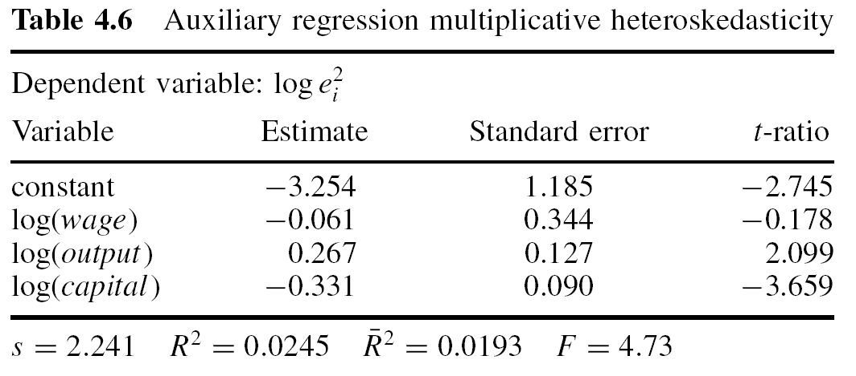
Labor Demand Function, cont’d
For Belgian companies, 1996; Verbeek
Breusch-Pagan test: BP = 66.23, p-value: 1,42E-13

Slide 57
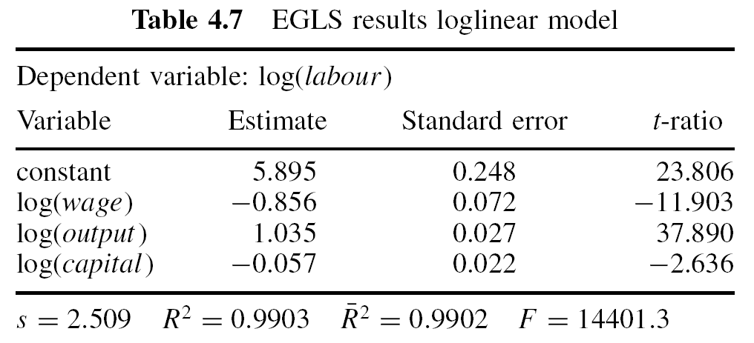
Labor Demand Function, cont’d
For Belgian companies, 1996; Verbeek
Weights estimated assuming multiplicative heteroskedasticity

Slide 58
Labor Demand Function, cont’d
Estimated function
log(labour) = β₁ + β₂*log(wage) + β₃*log(output) + β₄*log(capital)
The table shows: OLS estimates and standard errors: without (s.e.) and with White correction (White s.e.); FGLS estimates and standard errors
 | β₁ | wage | output | capital
OLS coeff | 6.177 | -0.928 | 0.990 | -0.0037
s.e. | 0.246 | 0.071 | 0.026 | 0.0188
White s.e. | 0.293 | 0.086 | 0.047 | 0.0377
FGLS coeff | 5.895 | -0.856 | 1.035 | -0.0569
s.e. | 0.248 | 0.072 | 0.027 | 0.0216

Slide 59
Labor Demand Function, cont’d
Some comments:
Reduction of standard errors in FGLS estimation as compared to heteroskedasticity-robust estimation, efficiency gains
Comparison with OLS estimation not appropriate
FGLS estimates differ slightly from OLS estimates; effect of capital is indicated to be relevant (p-value: 0.0086)
R² of FGLS estimation is misleading
  Model has no intercept, is uncentered
  Comparison with that of OLS estimation not appropriate, explained variables are different

Slide 60
Your Homework
Use the data set “labour2” of Verbeek for the following analyses:
  (i) Estimate (OLS) the model for log(labor) with regressors log(output) and log(wage); (ii) generate a display of the residuals which may indicate heteroskedasticity of the error term.
  Perform (i) the Koenker test with h(z_{i}‘α) = exp{z_{i}‘α} and the White test (ii) without and (iii) with interactions; explain the tests and compare the results; use z_{i} = (log(capital_{i}), log(output_{i}), log(wage_{i}))’.
  For the model of a): Compare (i) the OLS and (ii) the White standard errors with HC₀ of the estimated coefficients.
  Estimate (i) the model of a), using FGLS and weights obtained in the auxiliary regression of the Koenker test in b); (ii) comment on the estimates of the coefficients, the standard errors, and the R² of this model and those of c)(i) and (ii).

Slide 61
Your Homework, cont’d
Transform the variables of the model y_{i} = x_{i}’β + ε_{i} with E{ε_{i}} = 0 and V{ε_{i}} = σ_{i}² = σ²h_{i}² for i = 1, …, N, by dividing each variable through h_{i}: y_{i} -> y_{i} /h_{i} and (x_{i})’ -> (x_{i} /h_{i})’. Show that for the model in transformed variables,
y_{i} /h_{i} = (x_{i} /h_{i})’β + ε_{i} /h_{i}
the Gauss-Markov assumptions A3 and A4 are satisfied.

