Slide 1
0. TRANSPORT ECONOMICS
(MPE_TREN)

Slide 2
Transport economics
Transport Economics explores the efficient use of society’s scarce resources for the movement of people and goods.
Its numerous case studies illustrate the economic principles, discuss testable hypothesis, analyze econometric results, and examine each study’s implications for public policy.

Slide 3
Course
Transport markets
Demand elasticity
Transport demand issues
Costs
Efficiency
Competition
Ownership
Regulation
9. Subsidy
10. Pricing
11. Transport and development
12. Transport appraisal
13. Demand forecasting

Slide 4
Empirical Project
The major task will be to write an empirical project in transport economics.

Slide 5
Course Evaluation
25% - class attendance
25% - class activity
25% - written exam
25% - defense of an empirical project

Slide 6
Contact
Zdeněk Tomeš
tomes@econ.muni.cz

Slide 7
1. TRANSPORT MARKETS

Slide 8
Market analysis
Market demand and supply
State regulation and intervention
Ceteris paribus clause

Slide 9
The law of demand
Law of demand states that, all else being constant, as the price of a product increases (↑), quantity demanded falls (↓)

Slide 10
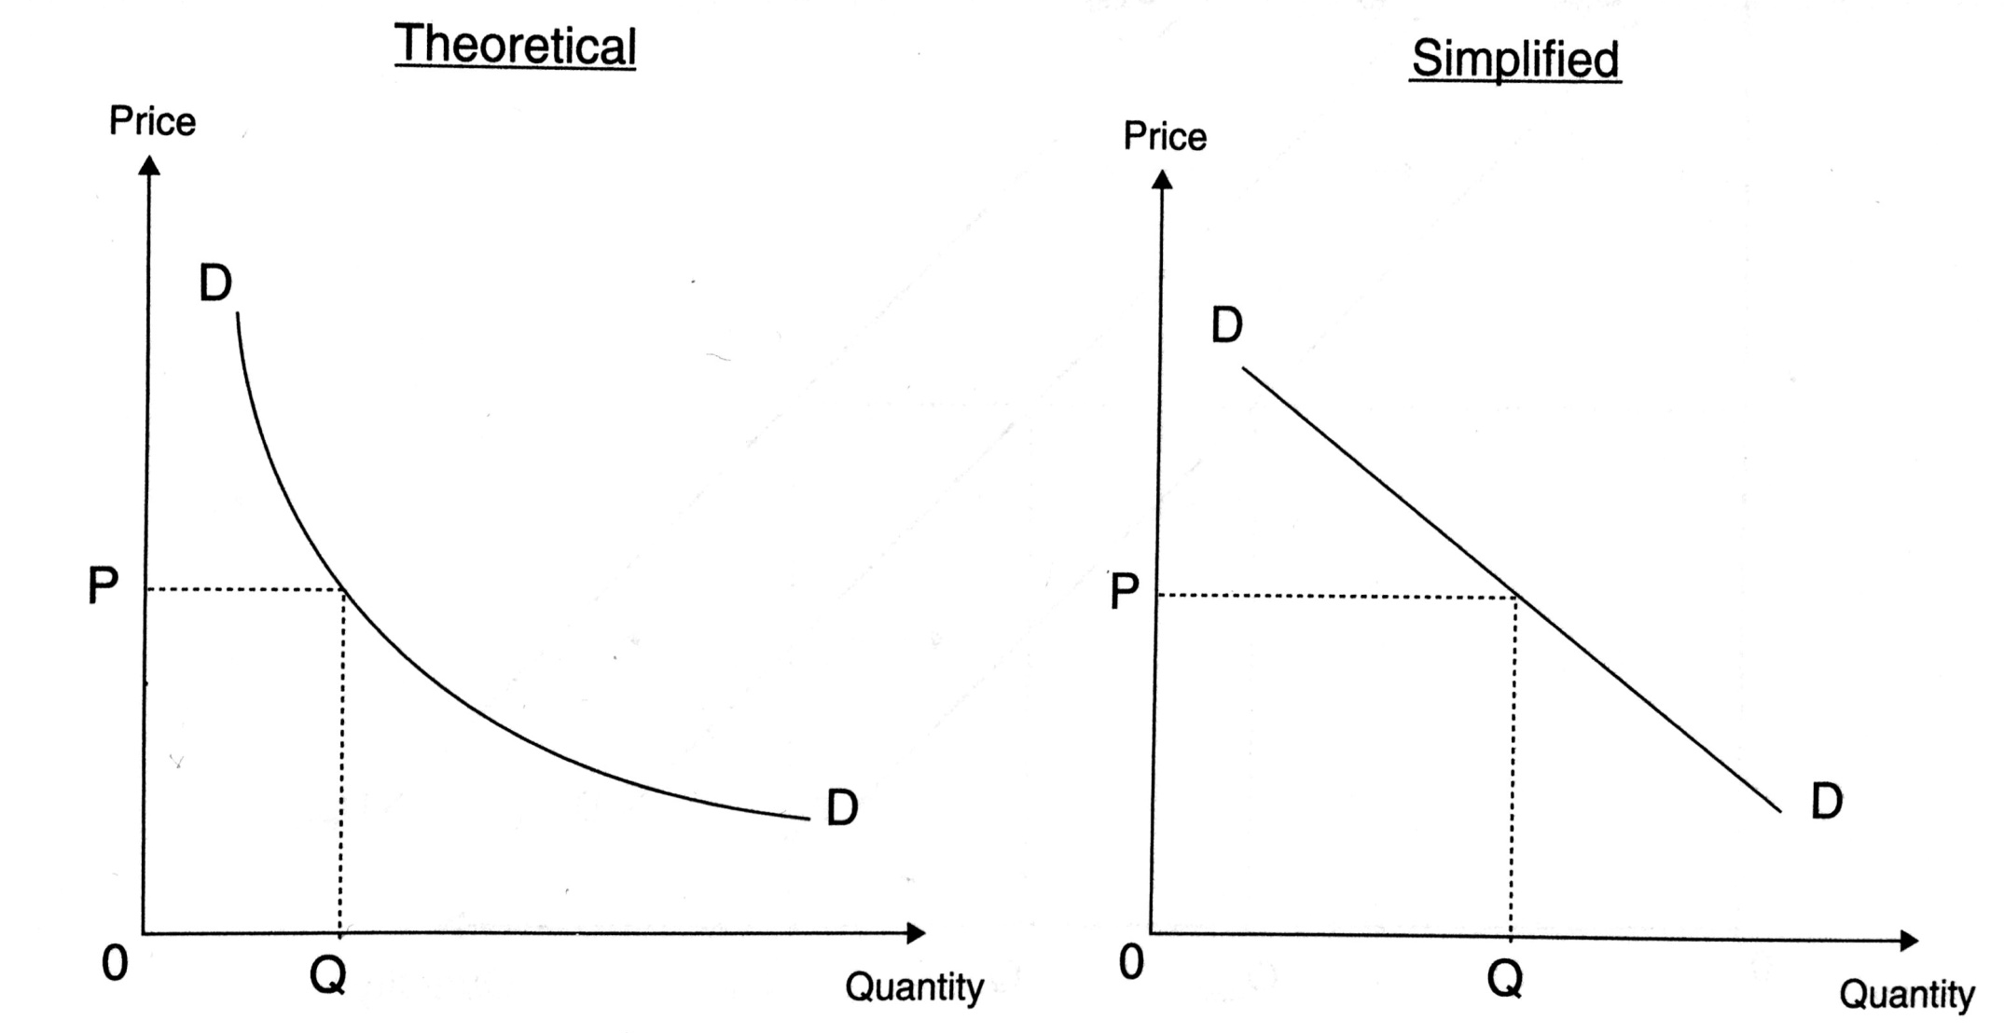
Demand curves
Figure 3.1

Slide 11
Demand determinants
Income ↑
Price of substitutes ↑
Price of complements ↓
Fashion
Expectations

Slide 12
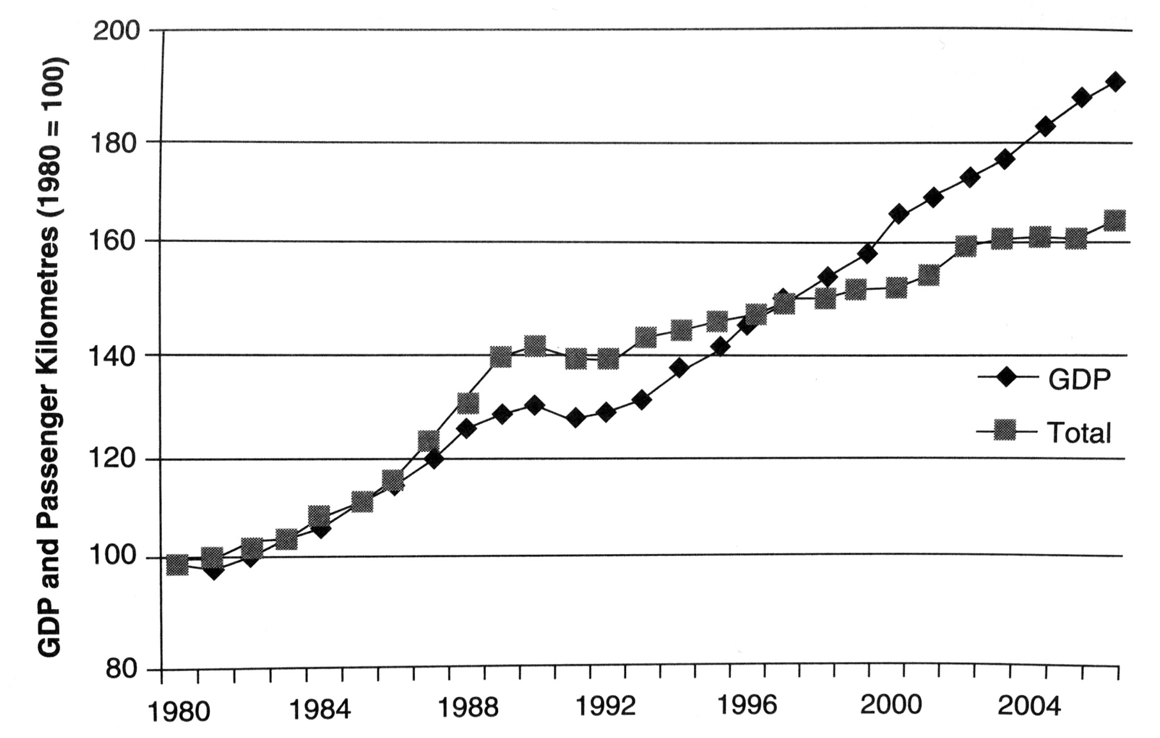
Case 1: Impact of income on demand

Slide 13
Theory of supply
The law of supply is a fundamental principle of economic theory which states that, all else equal, an increase in price results in an increase in quantity supplied

Slide 14
Supply determinants
The cost of production
Government policy
The price of goods in joint supply
Natural shocks
Aims of producer

Slide 15
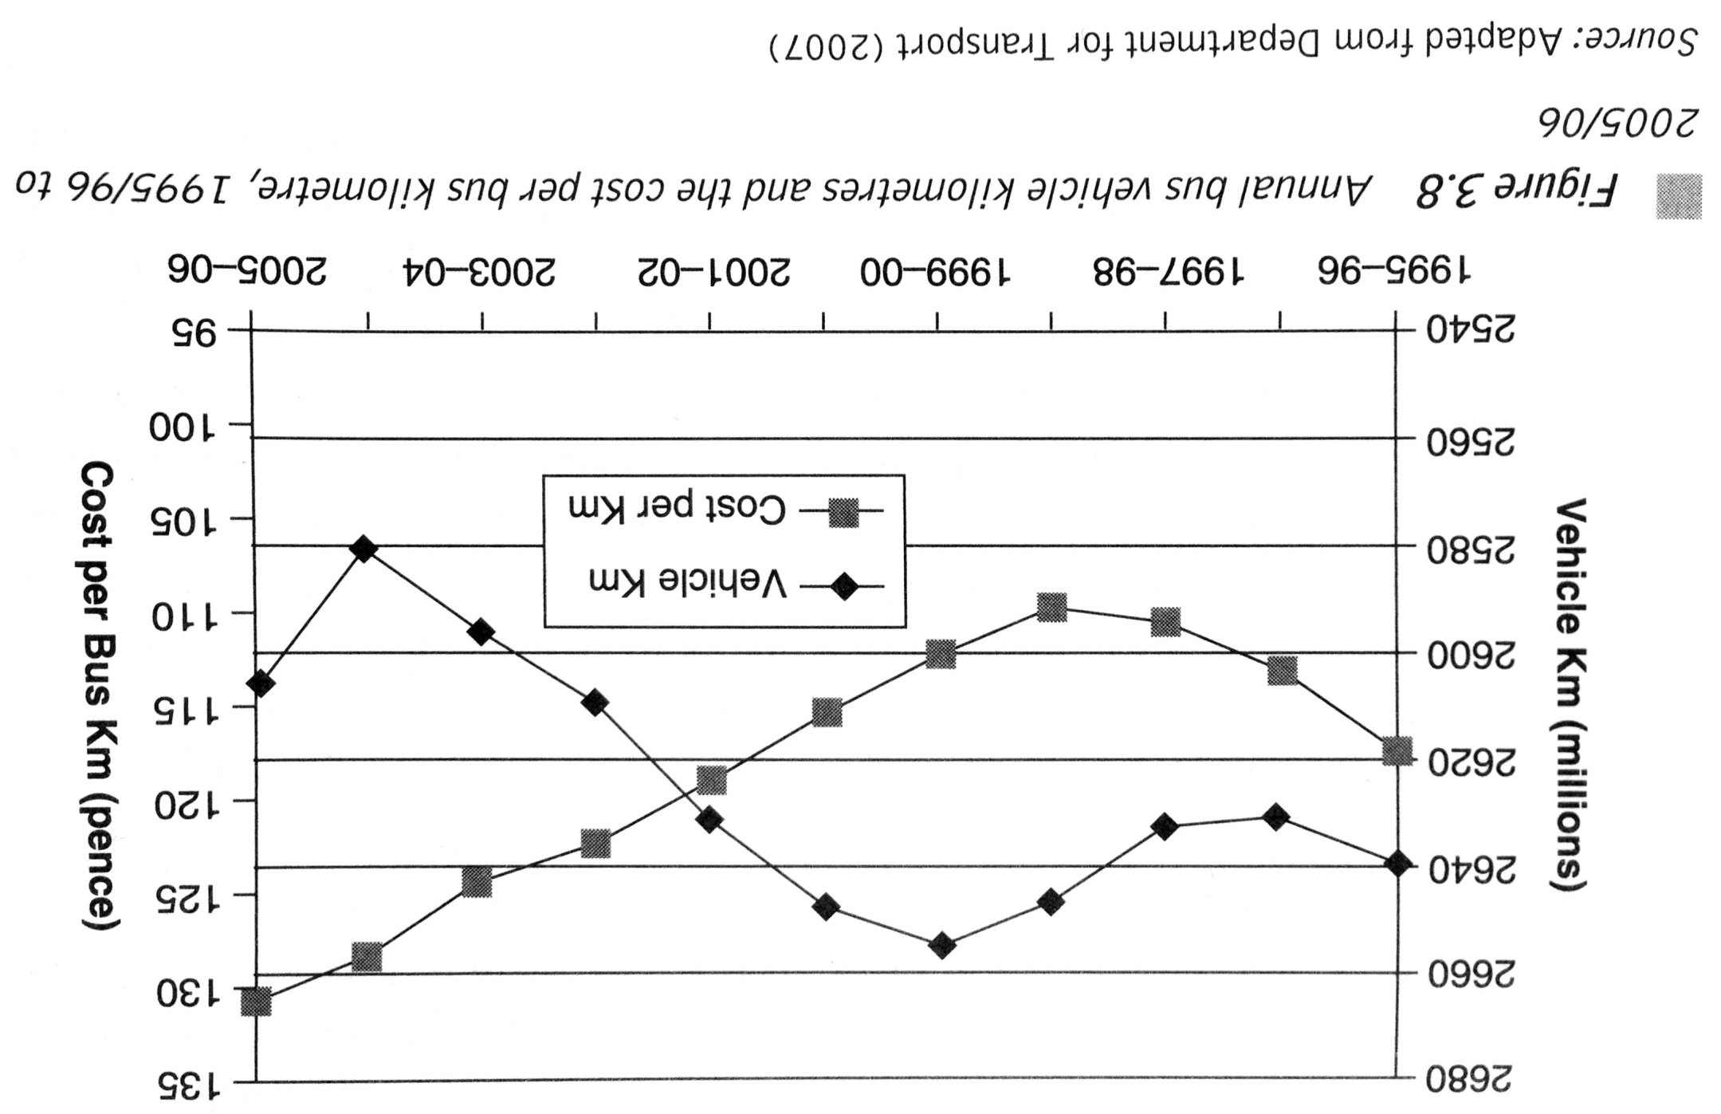
Case 2: British bus industry

Slide 16
Organization of Supply
Integration or Fragmentation?
Monopoly or Competition?
Intervention or Liberalism?

Slide 17
Market workings
Putting together demand and supply
Incorporate market imperfections
Adding government intervention and regulation

Slide 18
Readings for Lecture 2
Paulley, N., Balcombe, R., Mackett, R., Titheridge, H., Preston, J., Wardman, M., ... & White, P. (2006). The demand for public transport: The effects of fares, quality of service, income and car ownership. Transport Policy, 13(4), 295-306.

Slide 19
2. TRANSPORT DEMAND ELASTICITY

Slide 20
Elasticity
Elasticity of demand is the responsiveness of demand to a change in one of its determinants

Slide 21
Price elasticity
Price elasticity of demand = Percentage Change in Quantity Demanded/Percentage Change in Price

Slide 22
Determinants of price elasticity
The number and closeness of alternative modes of travel (subsitutes)
Proportion of disposable income spent on the mode of travel
Time dimension

Slide 23
Price elasticity of demand estimates of passenger transport

Slide 24
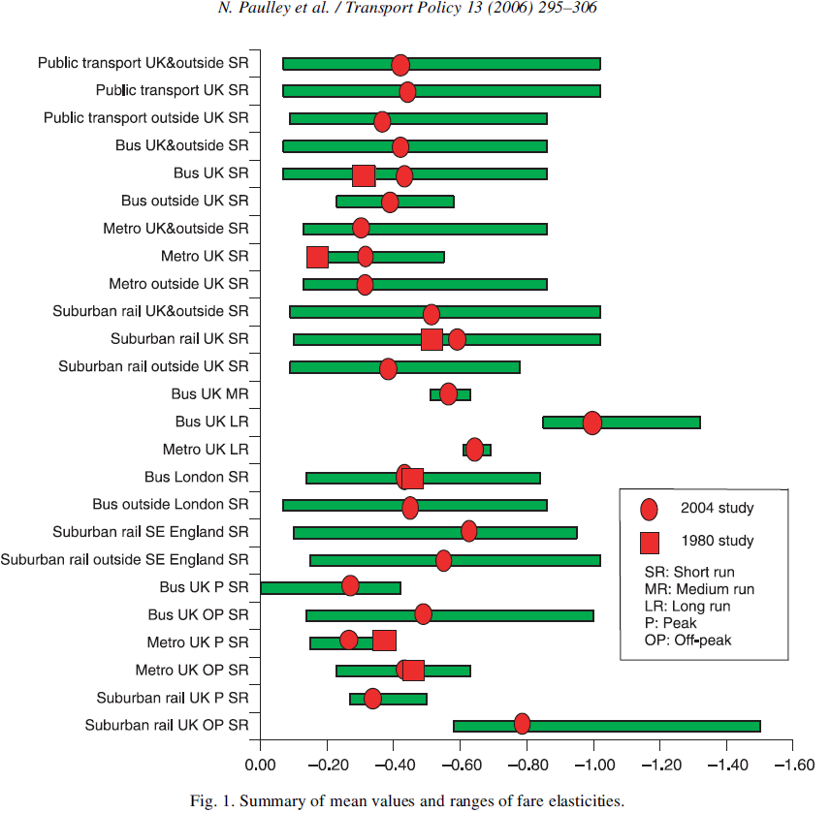
Price elasticities

Slide 25
Cross price elasticity
Cross price elasticity = Percentage change in quantity demanded of service A/Percentage change in price of service B

Slide 26
Cross price elasticities intercity passenger transport demand in Canada, mid range values, Oum and Gillen (1983)

Slide 27
Estimates of cross-elasticities of transport demand

Slide 28
Income elasticity
Income elasticity = Percentage change in quantity demanded/Percentage change in income

Slide 29
South East Britain income rail elasticities (2002)

Slide 30
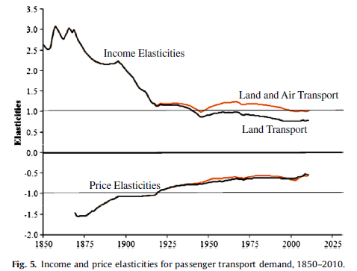
Historical income and price elasticities
Fouquet, R. (2012). Trends in income and price elasticities of transport demand (1850–2010). Energy Policy, 50, 62-71.

Slide 31
Readings for Lecture 3
Buehler, R., & Pucher, J. (2012). Demand for public transport in Germany and the USA: an analysis of rider characteristics. Transport Reviews, 32(5), 541-567.

Slide 32
3. TRANSPORT DEMAND ISSUES

Slide 33
1. The Notion of Need
There are some advocates of the idea that transport services, or at least some of them, should be allocated according to need rather than effective demand.
The idea is that just as everyone in a civilized society is entitled to expect a certain standard of education, medical care, security and so on, so they are also entitled to enjoy a certain minimum standard of transport provision.

Slide 34
The problem of rural demand
The provision of public transport services to satisfy demand in rural areas has always been problematic.
Such services have high costs, but low revenues due to low load factors. They are uneconomic.
However, the demand for these services is very real, as rural populations require them to get to work, to do their shopping, to access schools and medical care and for social reasons.

Slide 35
The problem of rural demand
This problem has worsened in recent times for four main reasons:
  Greater car usage
  Growth of urban conurbations
  Public services co
  ncentrated in urban centres
  Population ageing
Suggested reading: White, P. (2015). Report on public transport provision in rural and depopulated areas in the United Kingdom.

Slide 36
2. Problem of peak
In economics it is usually assumed that demand is constant per unit of time
In transport economics this assumption cannot be made as there are peaks in demand tht occur on a regular basis

Slide 37
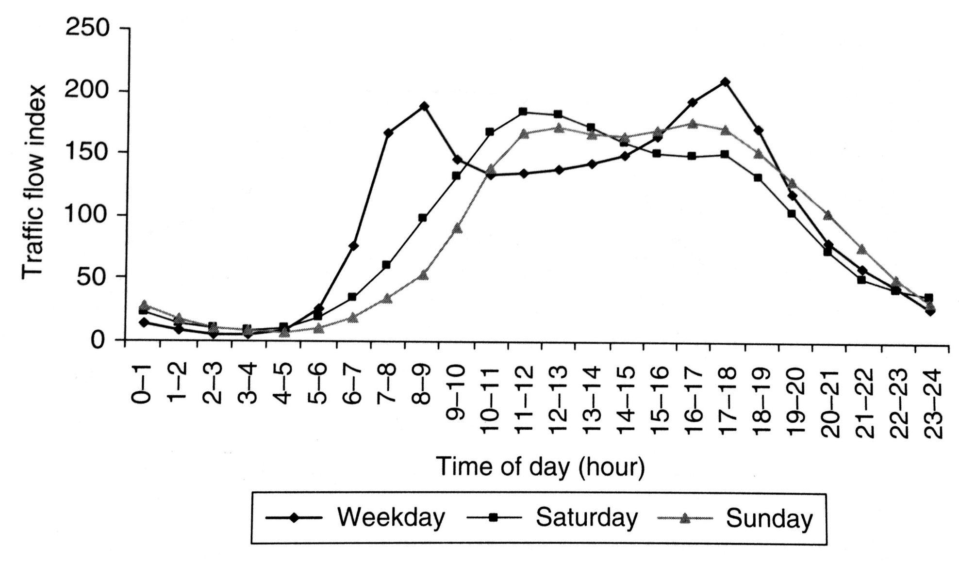
Distribution of traffic by time of the day, UK, 2004: Cars

Slide 38
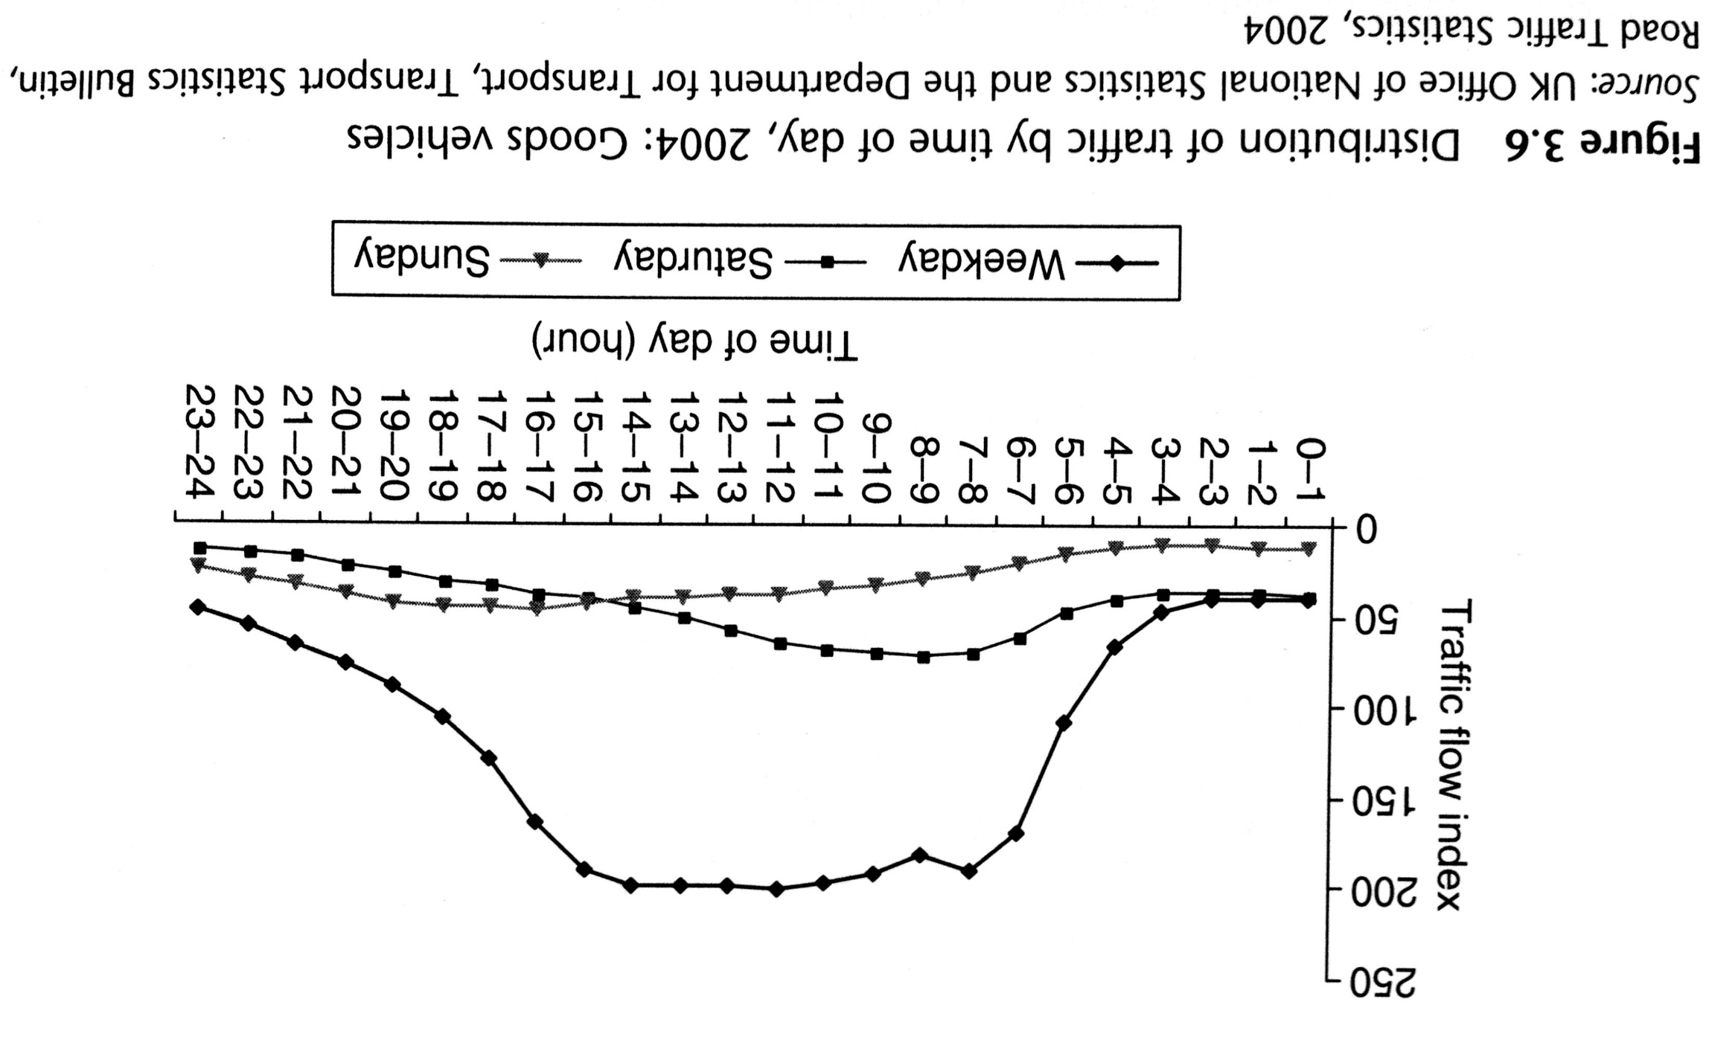
Distribution of traffic by time of the day, UK, 2004: Goods vehicles

Slide 39
3. Valuation of time
The importance of travel time in transport economics should now be apparent.
Transport time savings re normally considered to be a major component of any scheme designed to improve transport efficiency.

Slide 40
Value of time
A value of time can be inferred from logit model by looking at changes in the dependent variable that result from change in either time or costs difference.

Slide 41
Value of time
There differences between values of working times and non-working times.
Also there are differences in the values of walking/waiting times and in-vehile times.
This has important consequences for design fo public transport.
Suggested reading: Small, K. A. (2012). Valuation of travel time. Economics of transportation, 1(1), 2-14.

Slide 42
4. Demand for car
While demand for cars is not a strictly transport matter, the importance of the automobile in travel behaviour, land use patterns and the enviroment makes it a matter of considerable interest to transport economist.
Two approaches to modelling demand for car ownership:
Hedonic approach
Product life cycle

Slide 43
Is demand for car already saturated?
Suggested reading:
Metz, D. (2013). Peak car and beyond: the fourth era of travel. Transport Reviews, 33(3), 255-270.
Buehler, R., Pucher, J., Gerike, R., & Götschi, T. (2017). Reducing car dependence in the heart of Europe: lessons from Germany, Austria, and Switzerland. Transport Reviews, 37(1), 4-28.

Slide 44
Readings for Lecture 4
Glaeser, E. L., & Kohlhase, J. E. (2004). Cities, regions and the decline of transport costs. Papers in regional Science, 83(1), 197-228.

Slide 45
4. TRANSPORT COSTS

Slide 46
Introduction
A major factor affecting supply is the cost of production
Monetary costs + Time costs = Generalised costs of transport
How to maintain downward pressure on public transport costs?

Slide 47
Cost categories
Monetary costs; Time costs
Infrastructure costs; Operators costs
Enviromental costs; Accident costs

Slide 48
Costs classification
Fixed costs (FC) = costs that are the same irrespective of the level of output that is produced
Variable costs (VC) = costs that change as the level of output changes
Semi-variable costs (SVC) = costs that are fixed over a certain range of output, but then change once the upper limit of that range is reached

Slide 49
Case: Mode cost comparison

Slide 50
The importance of cost structure in the business model of low-cost airlines

Slide 51
Short run and long run
Short run = at least one factor of production is fixed
Long run = variations in output can be achieved through variation of all of the inputs

Slide 52
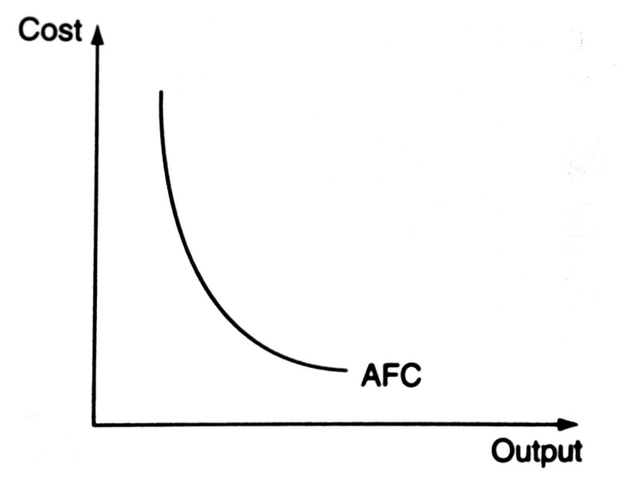
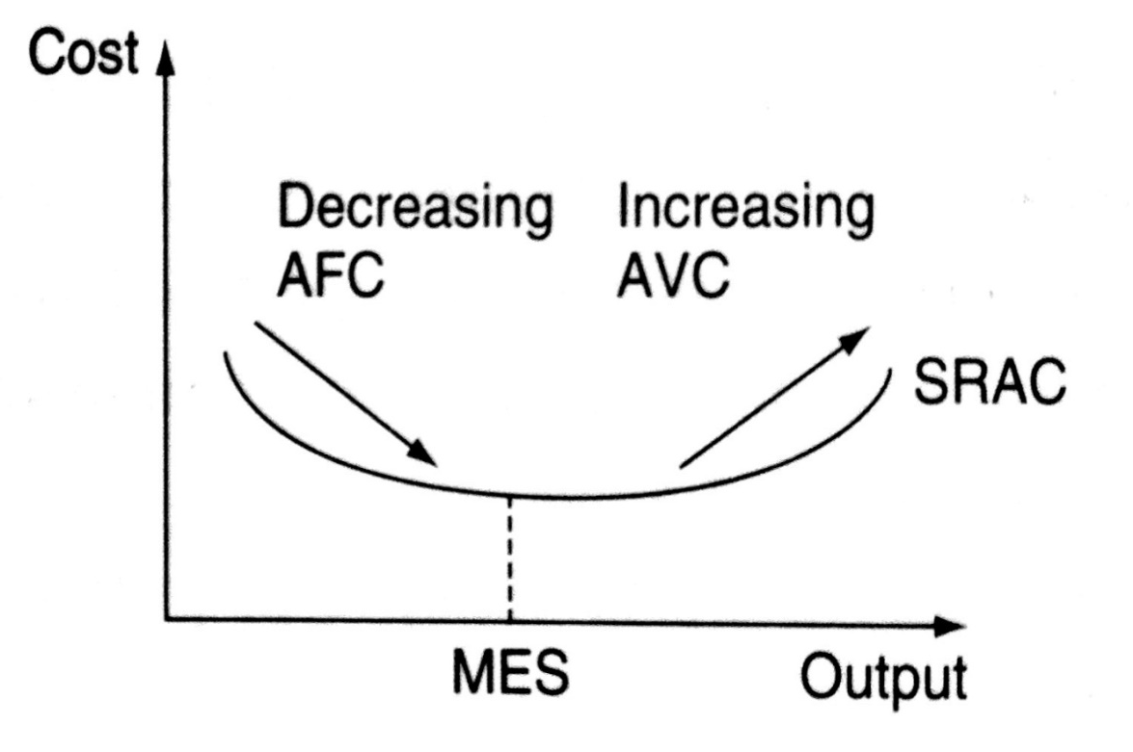
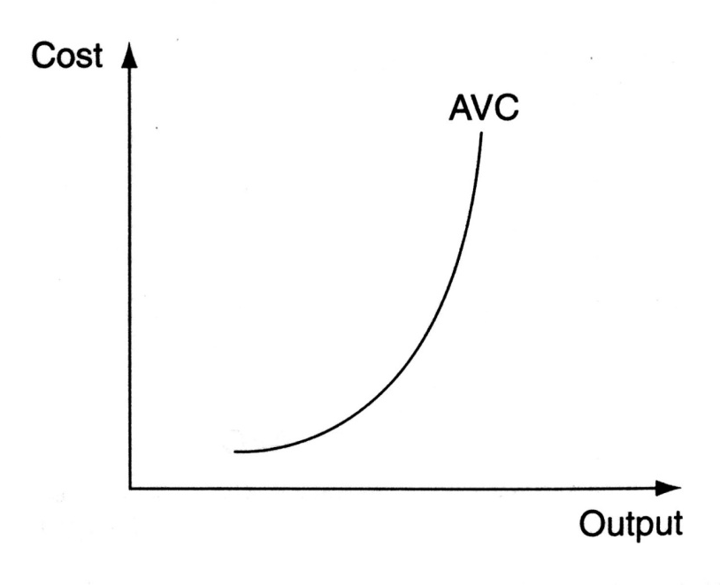
The short run average cost curve

Slide 53
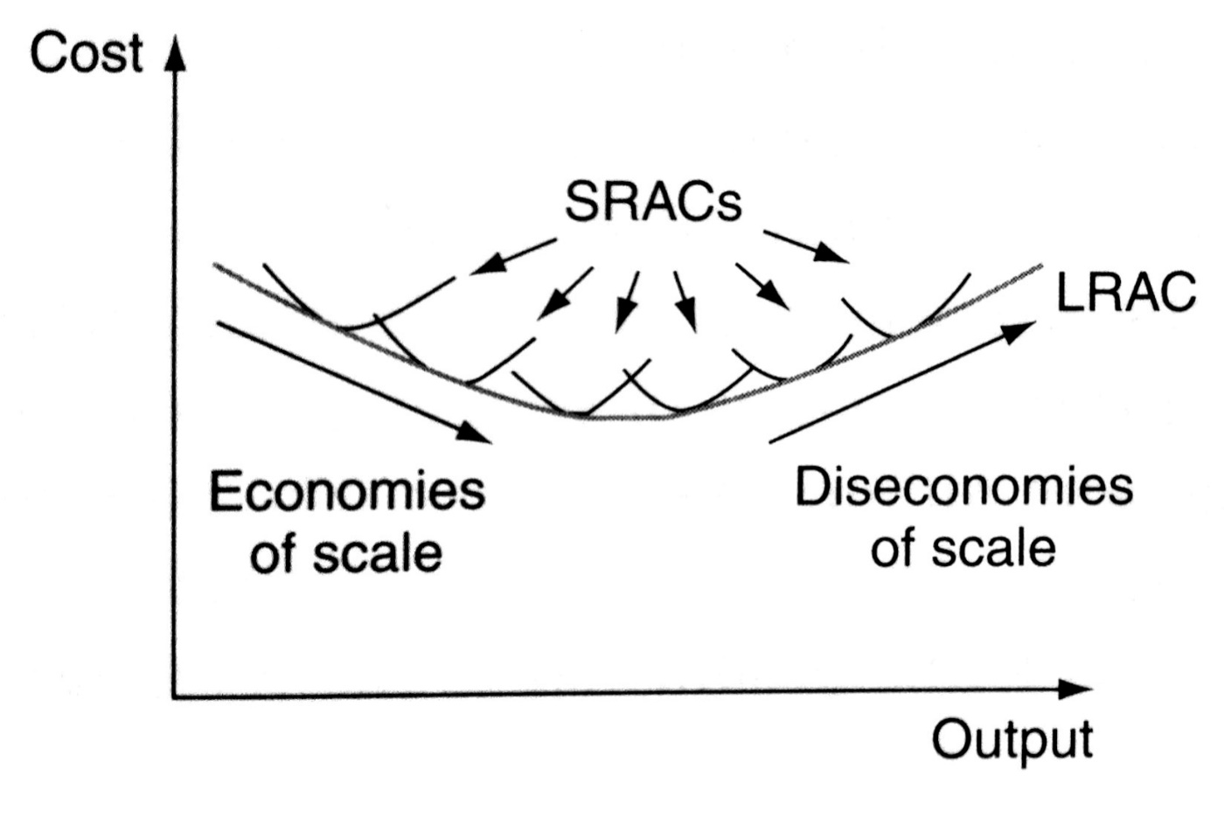
The long run average cost curve

Slide 54
Economies of scale, scope and density
If an equal proportionate increase in all outputs and route kilometers leads to the same proportionate increase in costs → constant returns to scale
If an equal proportionate increase in all outputs holding route kilometers constant leads to the same proportionate increase in costs → constant returns to density
If splitting the production of passenger and freight outputs and of infrastructure leads to increased costs → the railway is said to experience economies of scope
Nash, C. (2011). Competition and regulation in rail transport. Handbook of Transport Economics.

Slide 55
Readings for Lecture 5
Smith, A. S., & Nash, C. (2014). Rail Efficiency: Cost research and its implications for policy.

Slide 56
5. EFFICIENCY

Slide 57
Scarcity, choice and opportunity cost
Any resource is scarce
If individuals cannot have all that they want, then choices need to be made
Opportunity cost is the next best alternative forgone
These three principles can be illustrated on production possibility frontier.

Slide 58
Efficiency
The inputs/outputs ratio is the main base for assessing whether a given operation can be described as efficient or not.

Slide 59
Technical, cost and allocative efficiency
Technical efficiency = minimum level of inputs to produce maximum level of outputs
Cost efficiency = most cost efficient input minimization
Allocative efficiency = cost effcieincy + right quantities

Slide 60
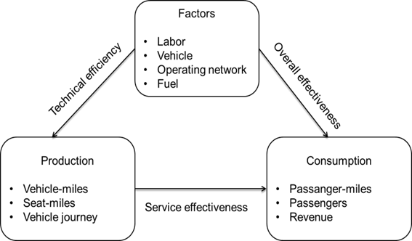
Service efficiency and effectiveness

Slide 61
DEA + Tobit
DEA (data envelopment analysis) = non parametric method for the estimation of production functions. It is used to empirically measure productive efficiency.
Tobit regression = to identify the determinants of DEA efficiency scores

Slide 62
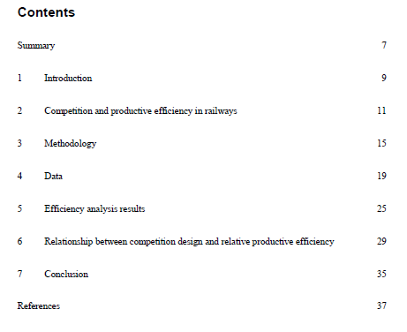
Case study in railways efficiency
Driessen, G., Lijesen, M., & Mulder, M. (2006). The impact of competition on productive efficiency in European railways (No. 71). CPB Netherlands Bureau for Economic Policy Analysis.

Slide 63
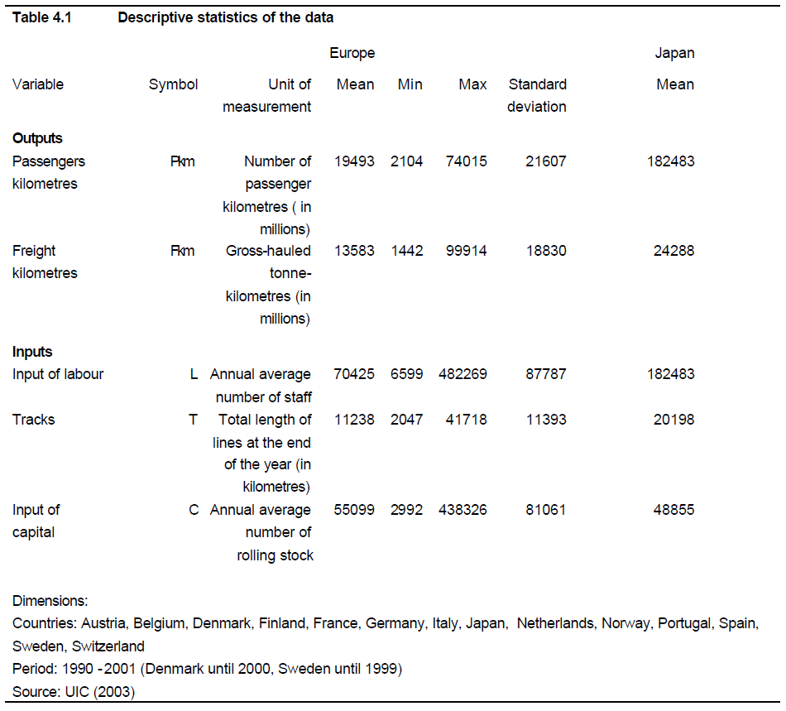
Outputs and inputs
Driessen, G., Lijesen, M., & Mulder, M. (2006). The impact of competition on productive efficiency in European railways (No. 71). CPB Netherlands Bureau for Economic Policy Analysis.

Slide 64
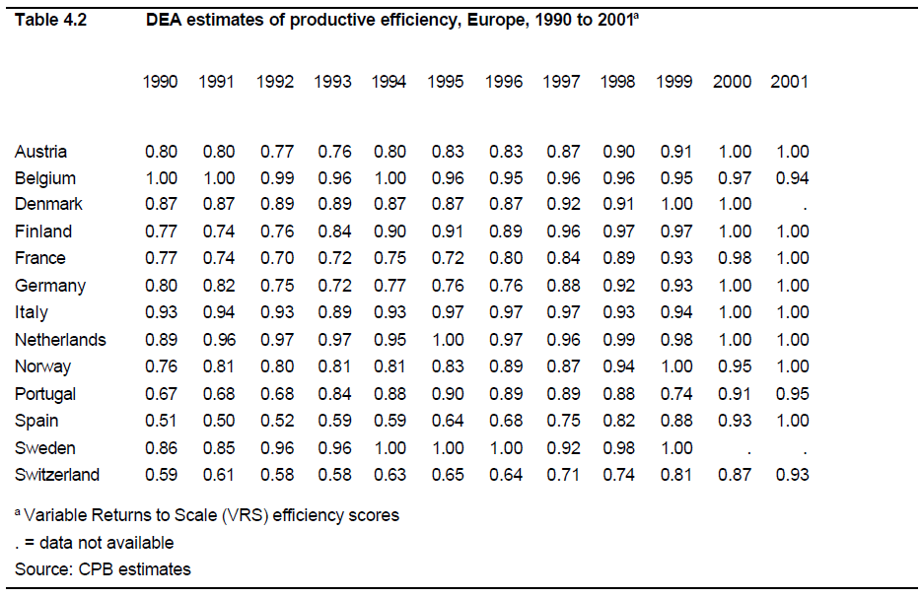
Efficiency scores - DEA
Source: Driessen et al. (2006)

Slide 65
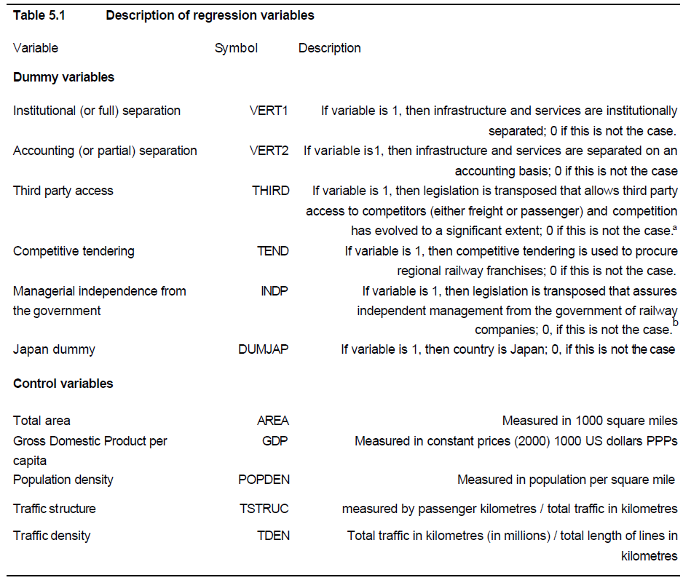
Efficiency determinants
Source: Driessen et al. (2006)

Slide 66
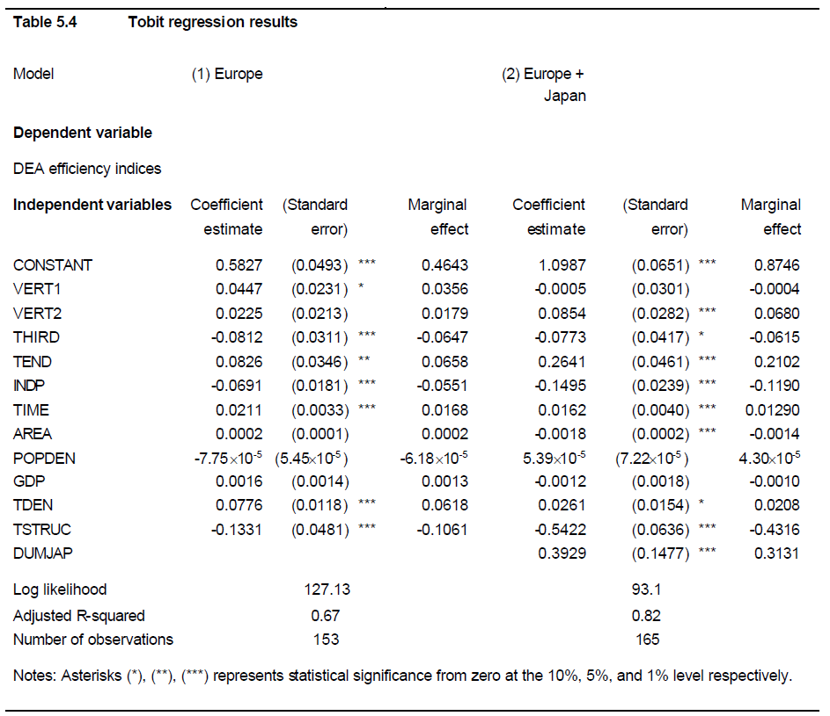
Efficiency determinants – regression
Source: Driessen et al. (2006)

Slide 67
Readings for Lecture 6
Nash, C., Crozet, Y., Nilsson, J. E., & Link, H. (2016). Liberalisation of passenger rail services. CERRE Report.

Slide 68
6. COMPETITION

Slide 69
Perfect competition (assumption)
Many buyers and sellers
No barriers to entry or exit
All firms are profit maximisers
All consumers are utility maximizers
Perfect information
Homogenous product
No economies of scale
Non rivarly in consumption
Absense of externalities
No governemnt intervention

Slide 70
Barriers to entry
Firm size
High sunk costs
Product differentiation
Legal protection
Control of factors of production
Exclusive dealership
Branding

Slide 71
Disadvantages of monopoly
Production inefficiencies
Higher prices charged and lower output produced
Reduction of consumer surplus and is regressive
Net welfare loss
X-efficiency
The market no longer regulates itself

Slide 72
Advantages of monopoly
A higher level of expenditure on R a D
Market size – a natural monopoly
Wasteful competition
Hotellings law

Slide 73
Contestable markets
Baumol (1982) – it is unneccessary for the market to be in perfect competition in order to produce economically efficient results. It is enough to be a contestable market.
Contestable market = entry to the market is free and exit is costless

Slide 74
Case: Contestability in airlines
The sector is becoming more contestable because:
Control over landing slots is lower
The spread of information through Internet
The frequent flyer initiative is on retreat
The growth of LCA

Slide 75
Competition on x for the market
Competition on the market = this occurs where there is no restriction on entry. Operators are competing directly against each other.
Competition for the market = where entry to the network is restricted, it is possible to organize competition for the exclusive right to service individual routes

Slide 76
European rail
Competition on the market:
Praha – Ostrava; Praha – Brno
Wien – Salzburg; Roma – Milano
Stockholm - Goteborg
Competition for the market:
British franchising
Germany regional traffic
Many others
See: Nash, C., Crozet, Y., Nilsson, J. E., & Link, H. (2016). Liberalisation of passenger rail services. CERRE Report.

Slide 77
British bus reform
Local buses in Britain, outside London, were ‘deregulated’ in 1986 (competition on the market)
By contrast, in London, the 1984 London Regional Transport Act introduced a system of comprehensive tendering (competition for the market)
This paper examines the long term impacts of these changes.

Slide 78
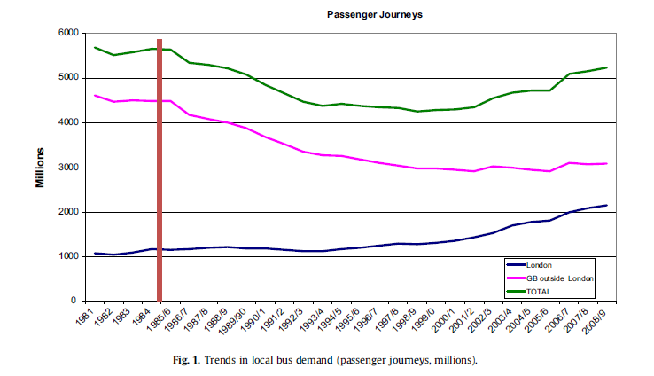
British bus industry - demand

Slide 79
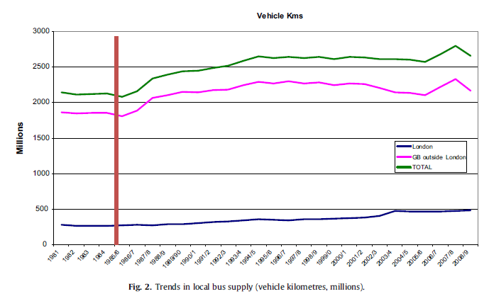
British bus industry - supply

Slide 80
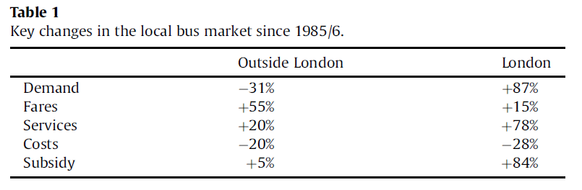
British bus industry – key changes

Slide 81
Readings for Lecture 7
Preston, J., & Robins, D. (2013). Evaluating the long term impacts of transport policy: The case of passenger rail privatisation. Research in Transportation Economics, 39(1), 14-20.

Slide 82
7. OWNERSHIP

Slide 83
Introduction
Due to many market imperfections, transport markets usually cannot be left entirely to market forces to resolve economic transport issues.
In most cases, therefore, they need some form of external intervention in order to correct for market failures

Slide 84
Government control
Government control of transport markets can be achieved through one of two measures:
Regulation - control through direct command; i.e. telling operators what to do
Ownership – the transport authority can own the assets and the means of production. The market is brought into public sector and thus it does not have to operate along market principles

Slide 85
Reasons for public ownership
Eradicate wasteful competition
Military significance
Public goods
Essential to the economy
A large employer
Key industry
High project development costs

Slide 86
Reasons for privatization
Increasing discontent with the model of public ownership
Changing macroeconomic enviroment combined with social change
The desire to introduce competition into the provision of transport services

Slide 87
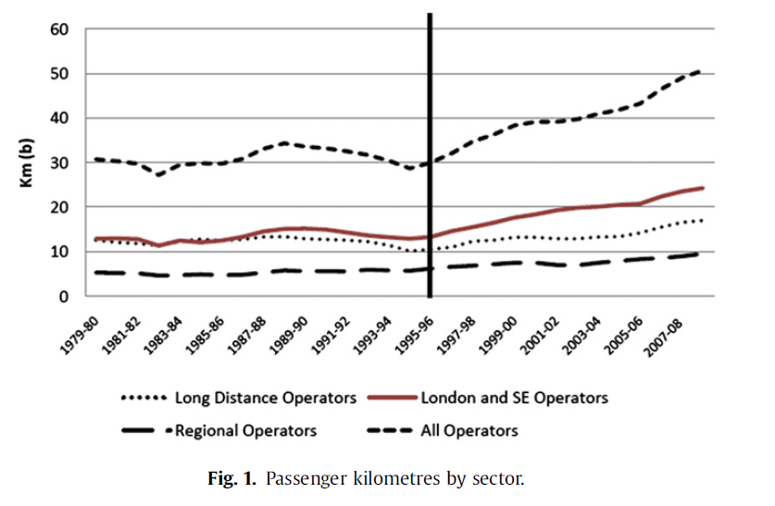
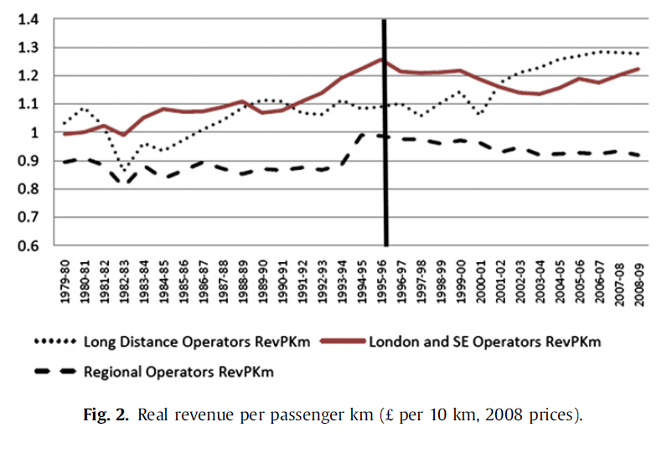
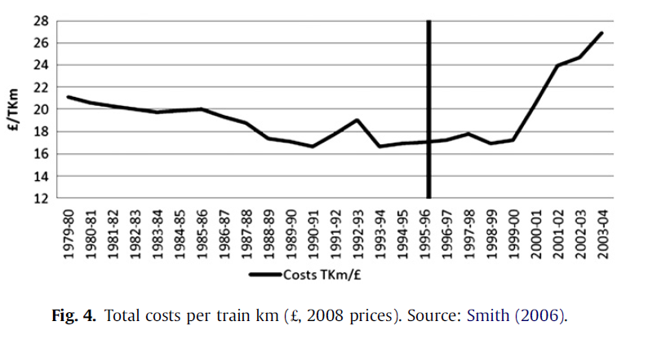
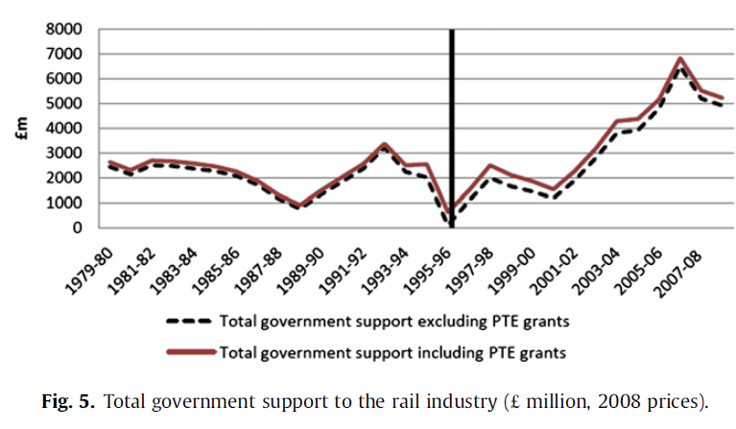
Rail privatization in Britain – success or failure?
Preston, J., & Robins, D. (2013). Evaluating the long term impacts of transport policy: The case of passenger rail privatisation. Research in Transportation Economics, 39(1), 14-20.

Slide 88
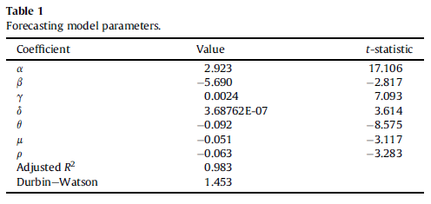
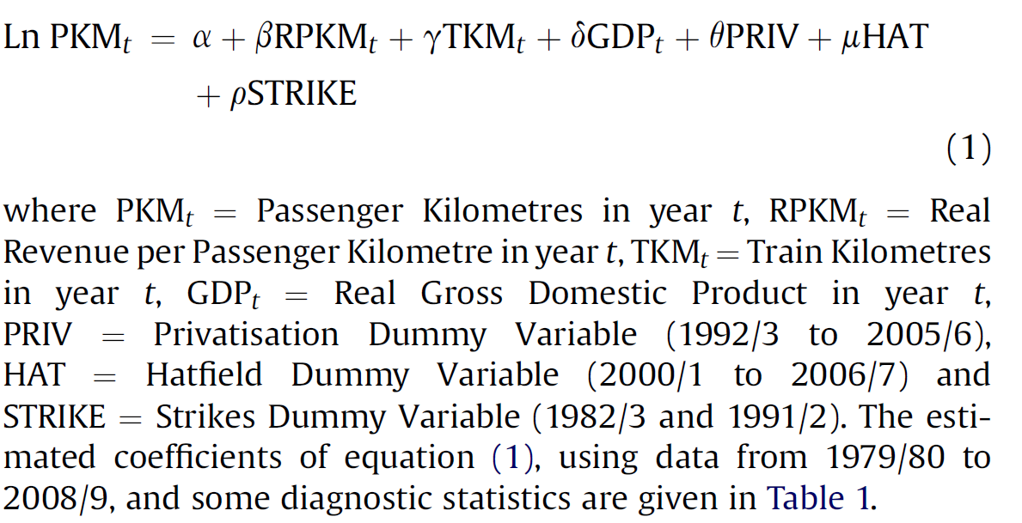
Rail privatization in Britain – success or failure?
Preston, J., & Robins, D. (2013). Evaluating the long term impacts of transport policy: The case of passenger rail privatisation. Research in Transportation Economics, 39(1), 14-20.

Slide 89
Canada (1980): Public ownership does not matter?
The efficiency of public and private firms is usually compared in industries which have heavy regulation and limited competition. In this paper we present a case study in which the effects of property rights can be isolated from the effects of regulation on noncompetitive markets. We compare the postwar (1956 – 1975) productivity performance of the Canadian National (public) and Canadian Pacific Railroads (private). Contrary to the predictions of the property rights literature, we find no evidence of inferior performance by the government-owned railroad. We conclude that any tendency toward inefficiency resulting from public ownership has been overcome by the benefits of competition.
Caves, D. W. – Christensen, L. R. (1980): The Relative Efficiency of Public and Private Firms in a Competitive Enviroment: The Case of Canadian Railroads. Journal of Political Economy

Slide 90
Canada (2013): Ownership does matter?
This article describes and analyzes the privatization of Canadian National Railway (CN), a large railroad privatization (1995). It uses data from 1990 to 2011 to compare CN's post-privatization operating performance with its pre-privatization performance. The overall results demonstrate that CN performed substantially better following privatization, both from an operational perspective and from a broader social welfare perspective. We find statistically significant increases over the long term (16 years following privatization) in sales, capital investment, assets, profit, profitability, productivity, dividends and corporate taxes paid. There was little change in the capital structure of CN and a significant decrease in employment. Using Canadian Pacific Railway as a basis for the counterfactual, we estimate that CN's privatization generated social welfare gains of approximately $25 billion in 2011 Canadian dollars. The Canadian government received almost half of these gains, while CN's shareholders (most of whom were non-Canadian) captured the rest.
Boardman, A. E., Laurin, C., Moore, M. A., & Vining, A. R. (2013). Efficiency, profitability and welfare gains from the Canadian National Railway privatization. Research in Transportation Business & Management, 6, 19-30.

Slide 91
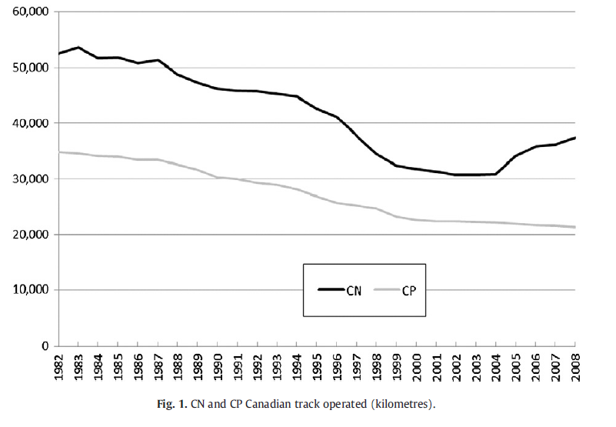
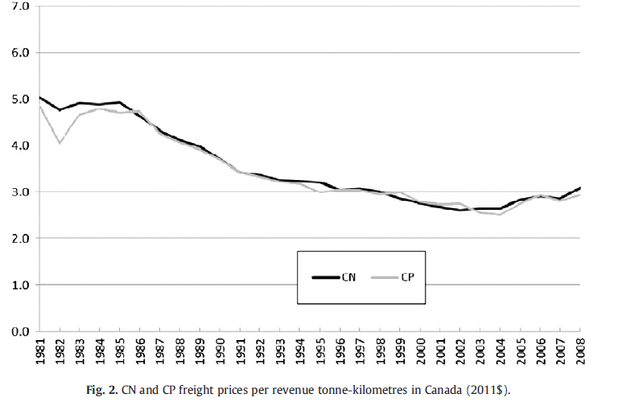
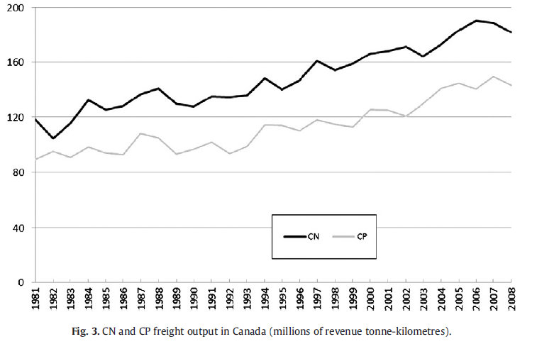
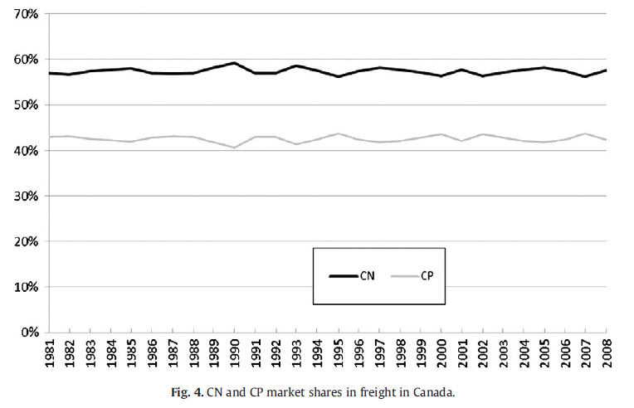
Canada: Output

Slide 92
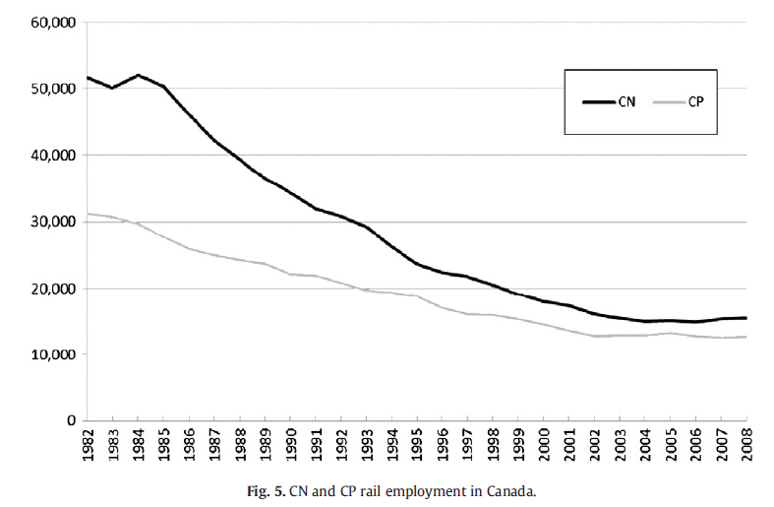
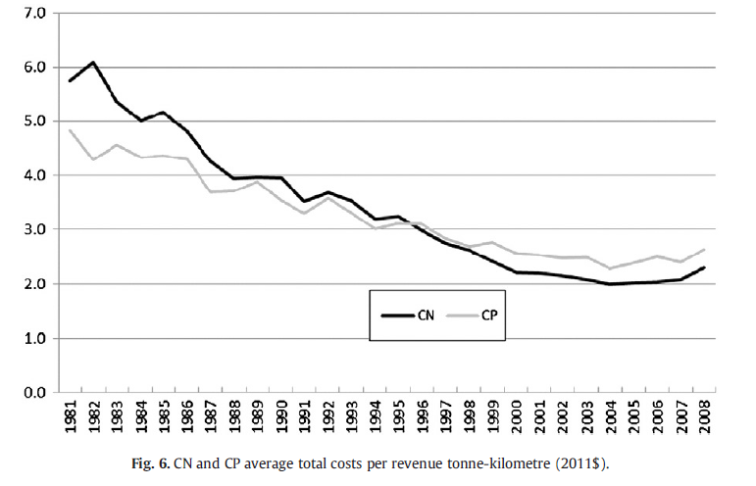
Canada: Employment and costs
Boardman, A. E., Laurin, C., Moore, M. A., & Vining, A. R. (2013). Efficiency, profitability and welfare gains from the Canadian National Railway privatization. Research in Transportation Business & Management, 6, 19-30.

Slide 93
Readings for Lecture 8
Reform of the Railway Sector and its Achievements - Network Industries Quarterly - Vol 18 - No 4 (December 2016)

Slide 94
8. REGULATION

Slide 95
Introduction
This presentation is concerned with control and specifically the control by relevant authorities on the levels and behavour of trasnport users and operators under their control
It concerns all areas of transport, whether that be public, private or freight

Slide 96
Forms of regulation
Specify the price to be charged
Specify the maximum increase in price allowed
Regulate the (final) price through the tax charged on the good or service
Specify the rate of return (profit) to be gained
Through introducing yardstick competition
Specify a minimum frequency
Limit market entry

Slide 97
The rationale for the regulation
To overcome the markt failure or imperfect/assymetric information
The market can no longer regulate itself
To correct for externalities
To ensure the quality of the service provided
To provide a transport service where none exsited before
To improve efficiency within the industry

Slide 98
The drawbacks of economic regulation
Limits free enterprise
Inefficient, second best solution
Assymetry of information
The issue of regulatory capture
Cumbersome regulatory procedures make avoidance of regulatory measures possible

Slide 99
Case: Regulaton of the British railway industry
1945 - 1994 – British Rail. Vertically and horizontally integrated single nationalized operator in the UK.
1994 - 1997 – British railway reform. British Rail divided into 104 separate companies with the main purpose to introduce competition at all levels of railway operation (train operating companies, rolling stock leasing companies, infrastructure maintenance amd renewal companies).
The majority of these companies were privatized

Slide 100
British infrastructure provider
The one exception was the infrastructure provider, where it was considered that the advantages of having a single national network operator significantly outweighed the drawbacks of splitting the network up into separate geographical areas.
This therefore left a monopoly provider of the infrastructure throughout the country
This was organized into a company called Railtrack which was floated on the stock exchange
All infrastructure access charges were to be at full cost
As a result, the firm would return a profit and receive no direct subsidy except to assist the funding of railway investment
The strong regulation was introduced to prevent the abuse of monopoly power

Slide 101
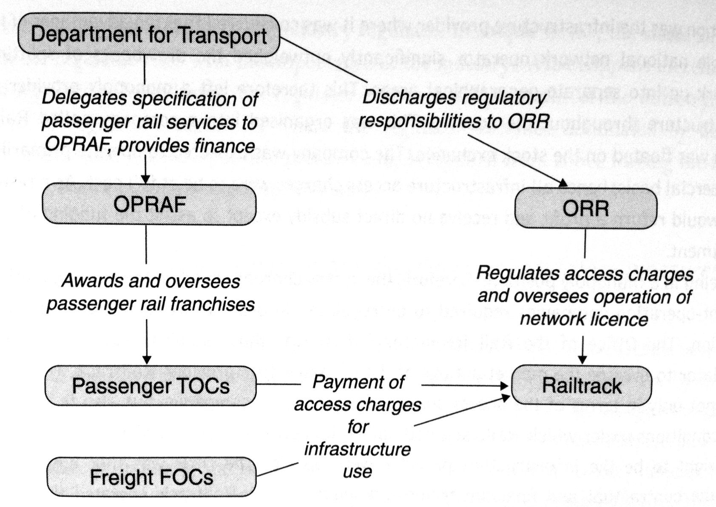
British rail industry regulatory structure 1997 - 2001

Slide 102
What went wrong?
Railtrack investment needs, costs overruns on the major infrastructure projects
Railtrack had effectively very little control over its own costs; loss of engineering expertise
Broken rail at Hatfield (October 2000), resulting in a train derailment and four fatalities. Railtrack panicked and overreacted imposing severe speed limits on the network leading to widespread delays and chaos (2000 – 2001).
Under the terms of track access agreements, Railtrack had to pay more than 500m GBP to train operating companies as a result of the disruption caused.
This combined with major cost overruns led to bankruptcy of Railtrack in October 2001 and it was replaced by non-profit organization Network Rail.

Slide 103
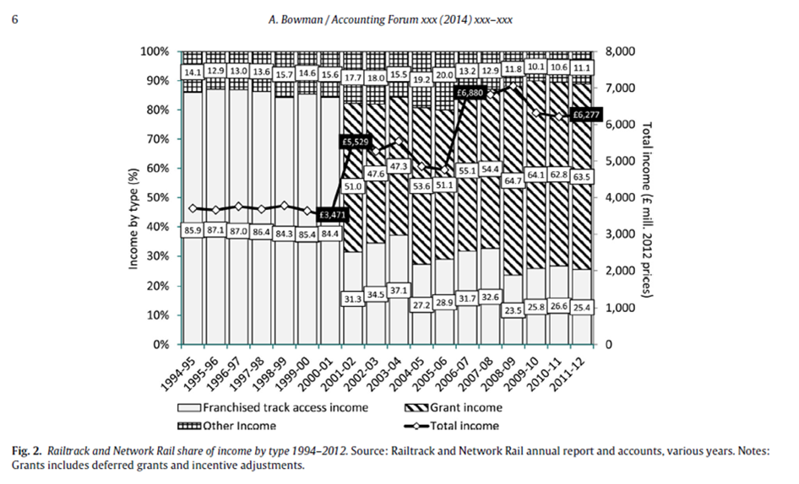
British rail infrastructure provider – results

Slide 104
Readings for Lecture 9
Crössmann, K., & Mause, K. (2015). Rail subsidisation in the European Union: An issue beyond left and right?. Comparative European Politics, 13(4), 471-492.

Slide 105
9. SUBSIDY

Slide 106
Introduction
Subsidy plays a vital role in the operation of transport markets, because they are made up of a combination of market forces and the actions of transport planning authorities, with subsidy playing the pivotal role in reconciling these two forces in the actual market place

Slide 107
Subsidy or payment for public service?
The payment of subsidy is closely related to aspects of regulation
With the general move away from transport provision through traditional forms of public ownership towads far more private sector involment, many argue that there is no longer a subsidy but rather a payment for the performance of a contract for providing a service
The issue is further complicated by the fact, that paying transport subsidies has also a very strong political dimension

Slide 108
The rationale for subsidisation
In support of land use efficient modes of transport
To lessen the impact of enviromentally unfriendly modes of transport
To support economic development or regeneration of an area
To support socially necessary services

Slide 109
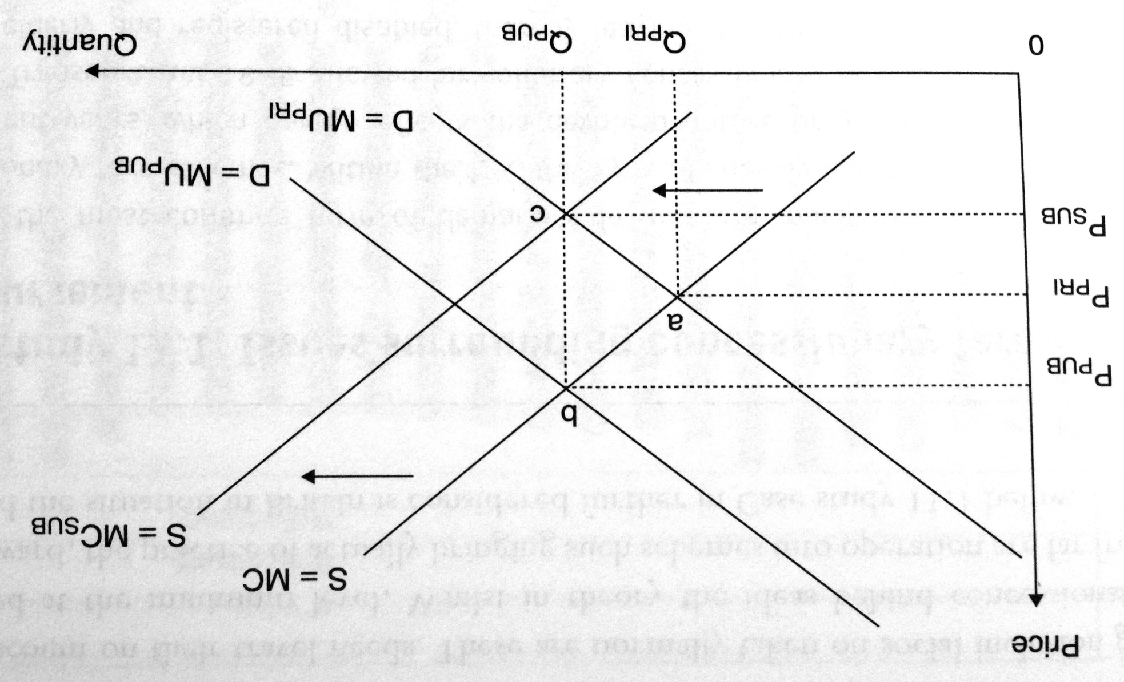
Subsidy to operators to correct for under-consumption (supply side measure)

Slide 110
Demand side measures
Far more straightforward
Used to correct for a demand side market failure
Specific groups and individuals are targeted to receive the subsidy
In effect the individual is given a concession (a reduced fare) to use a service

Slide 111
Drawbacks of paying subsidy
It is always a second best solution
Can lead to inefficient operation
The winners curse syndrom
Subsidise a service that doesnt actually need a subsidy

Slide 112
Cross-subsidization
Cross-subsidization occurs where the profits of one route or service are used to pay for the losses on another route or service.
It has often been used in the past to reduce the level of total subsidy
Drawbacks:
Hides true costs of providing a particual service
Users of profitable routes are penalized
There are better instruments to ensure provision of services

Slide 113
Methods of paying subsidy
Deficit subsidy
Net cost contract
Full cost contract
Design, Built, Operate and Maintain (DBOM)

Slide 114
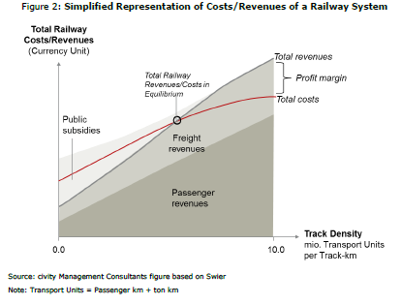
Economies of density and subsidy in railways

Slide 115
Readings for Lecture 10
Alexandersson, G., & Hultén, S. (2006). Predatory bidding in competitive tenders: A Swedish case study. European Journal of Law and Economics, 22(1), 73-94.

Slide 116
10. PRICING

Slide 117
Introduction
Pricing is a vital component in the economics of transport
The price determine who gets and who doesn’t get a particular service, but also determines the distribution of rewards between the provider and the user
The imperfect market structures are characterized by higher rewards for the providers

Slide 118
The principles of pricing
In most cases, transport services are subsidised and/or regulated, however a basic understanding of pricing principles is needed
In order to achieve economic efficiency, the price should equal the marginal cost
In imperfect competition markets, it is possible to observe price discrimination, predatory pricing, price fixing and congestion pricing

Slide 119
Price discrimination
Price discrimination refers to a situation where a company charges particular consumers a higher price than others for the same product for reasons unrelated to cost.
The seller must possess a degree of market power, must be able to divide the market and market segments must have differing elasticities of demand.

Slide 120
Perfect price discrimination
To sell each unit (or ticket) seperately, charging the highest price that each consumer is prepared to pay
If this was achievable, the seller would obtain the entire consumer surplus from the consumer
The seller must know the exact shape of each consumer’s demand and charge each consumer the maximum price they are prepared to pay

Slide 121
Case: Sale of airline tickets
On a typical airline flight there are three classes, namely First, Business and Economy.
Figure on the next slide refers to travel in a particular class and the assumption is made that the marginal cost of one extra passenger is constant up to the point where the aircraft reaches full capacity
At this point the MC curve becomes perfectly inelastic

Slide 122
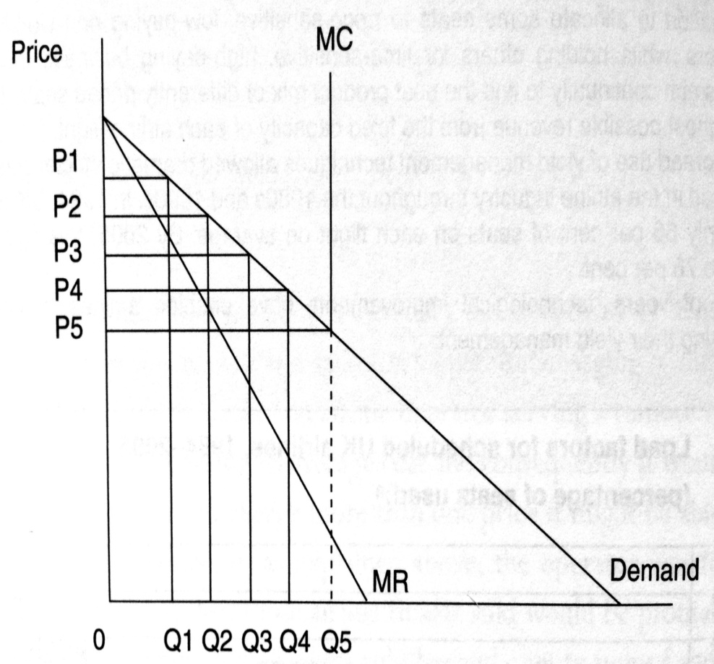
Airline price discrimination

Slide 123
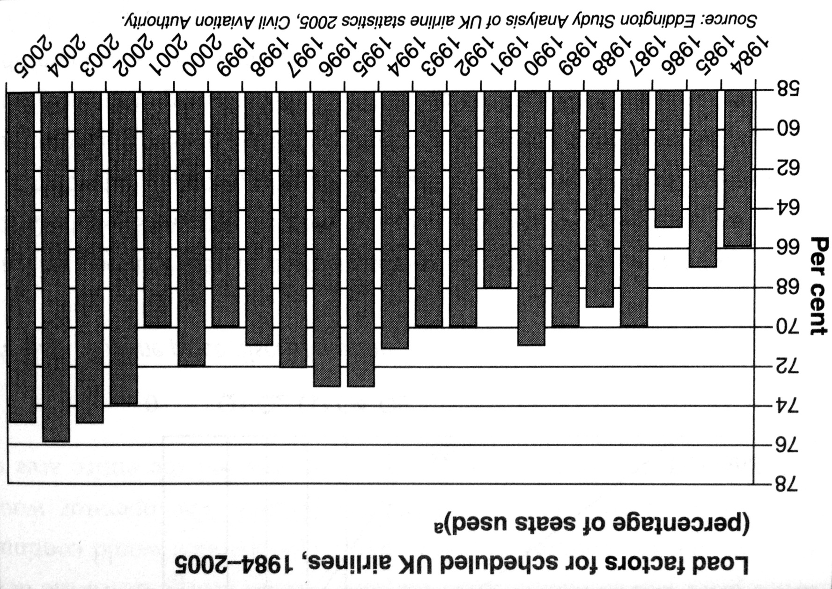
Yield management in the aviation

Slide 124
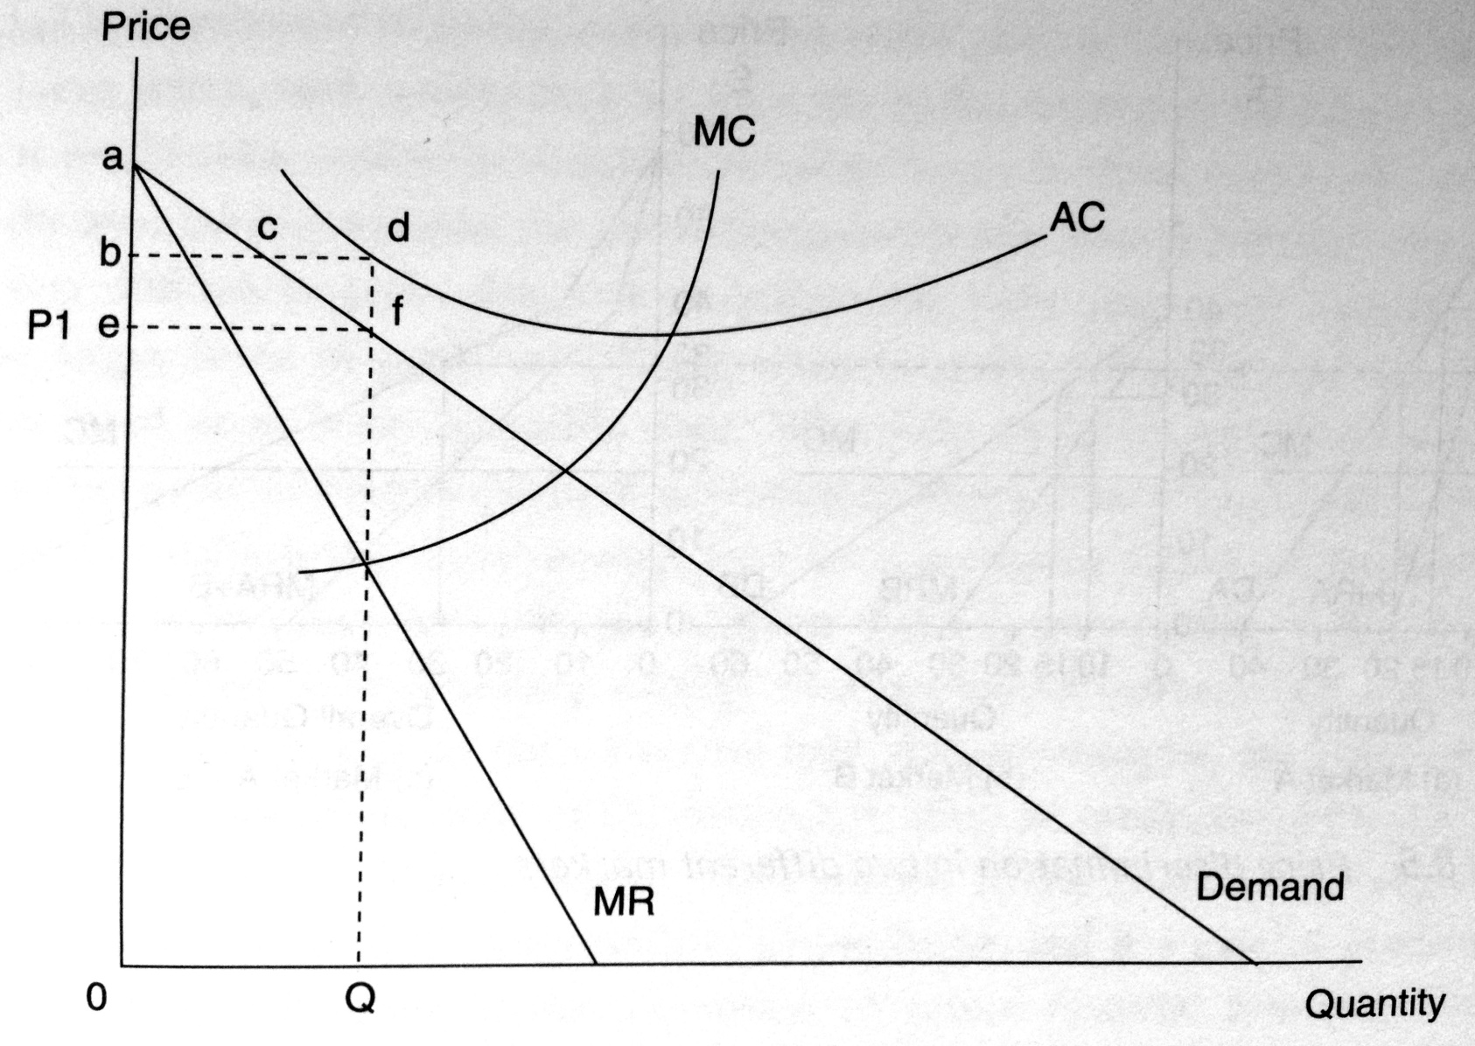
Loss making operator and perfect price discrimination

Slide 125
Predatory pricing
Predatory pricing occurs when a firm with maket power reduces its price below cost in the short run so as to obtain abnormal profit in the long run.
Predatory pricing is aimed at either achieving or maintaining a monopoly situation, with the price set so as to bankrupt competitors, „encourage“ them to merge or in fact collude.

Slide 126
Predatory pricing
The consumer may benefit in the short run from lower prices, due lower competition such activity may not be in the public interest in the long run.
In practise it can be very difficult to prove that such activity has taken place
Predatory pricing is an appealing strategy in a segmented market

Slide 127
Price fixing
Firms in oligopolistic markets such as the airline sector often face a dilemma as to whether to compete with each other or to collude
Price fixing is a situation when oligopoly firms agree on the price they are going to sell their goods or services in order to remov price competitiveness and thus increase their profits

Slide 128
Readings for Lecture 11
Vickerman, R. (2015). High-speed rail and regional development: the case of intermediate stations. Journal of Transport Geography, 42, 157-165.

Slide 129
11. TRANSPORT AND DEVELOPMENT

Slide 130
Learning Outcomes
The link between economic development and transport
Causation: demand led and supply led effects
Impact of transport on economic growth
Transport role in the local economy
The link between transport and wider social development issues

Slide 131
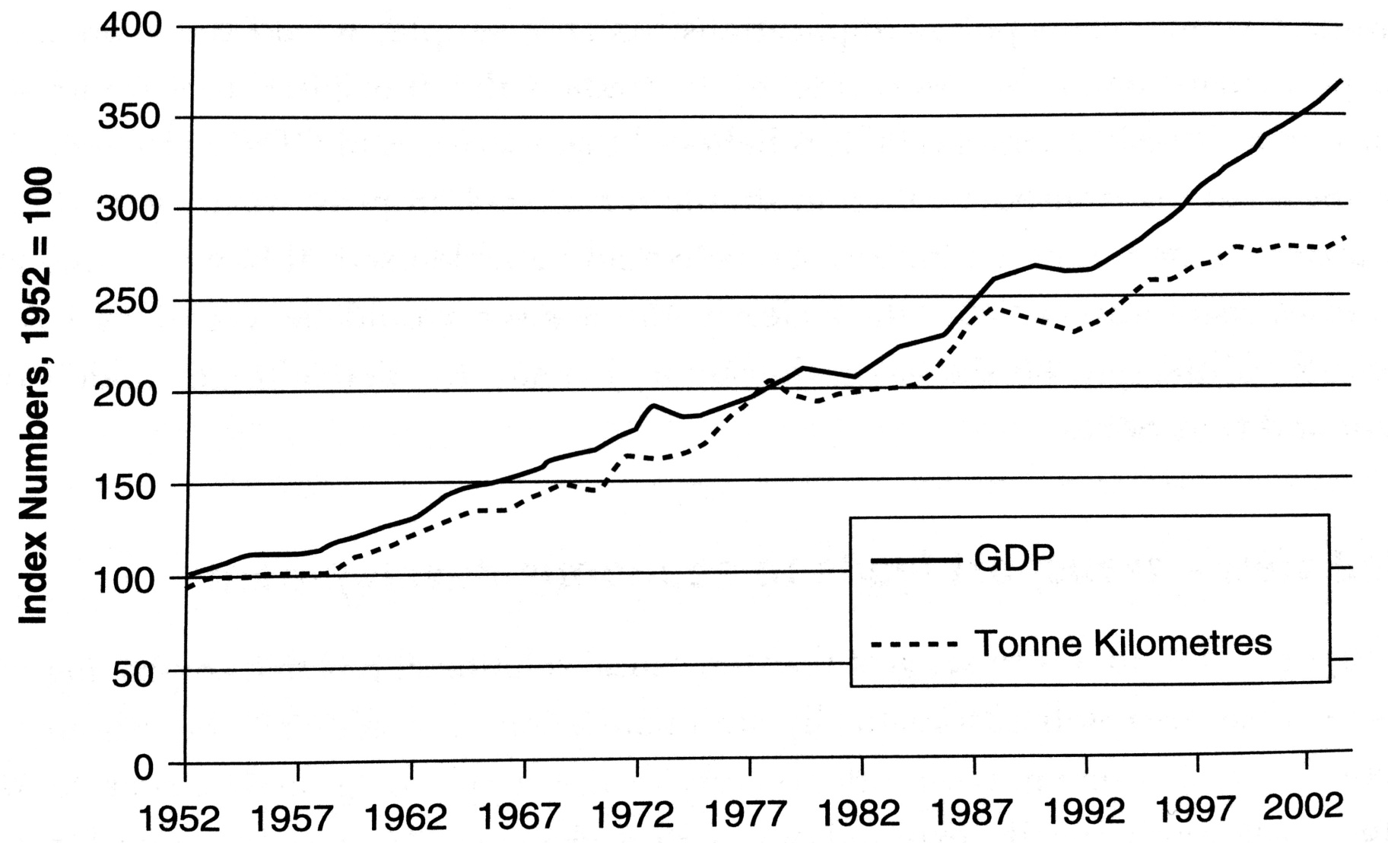
Economic and transport growth
Freight transport and real GDP, Great Britain

Slide 132
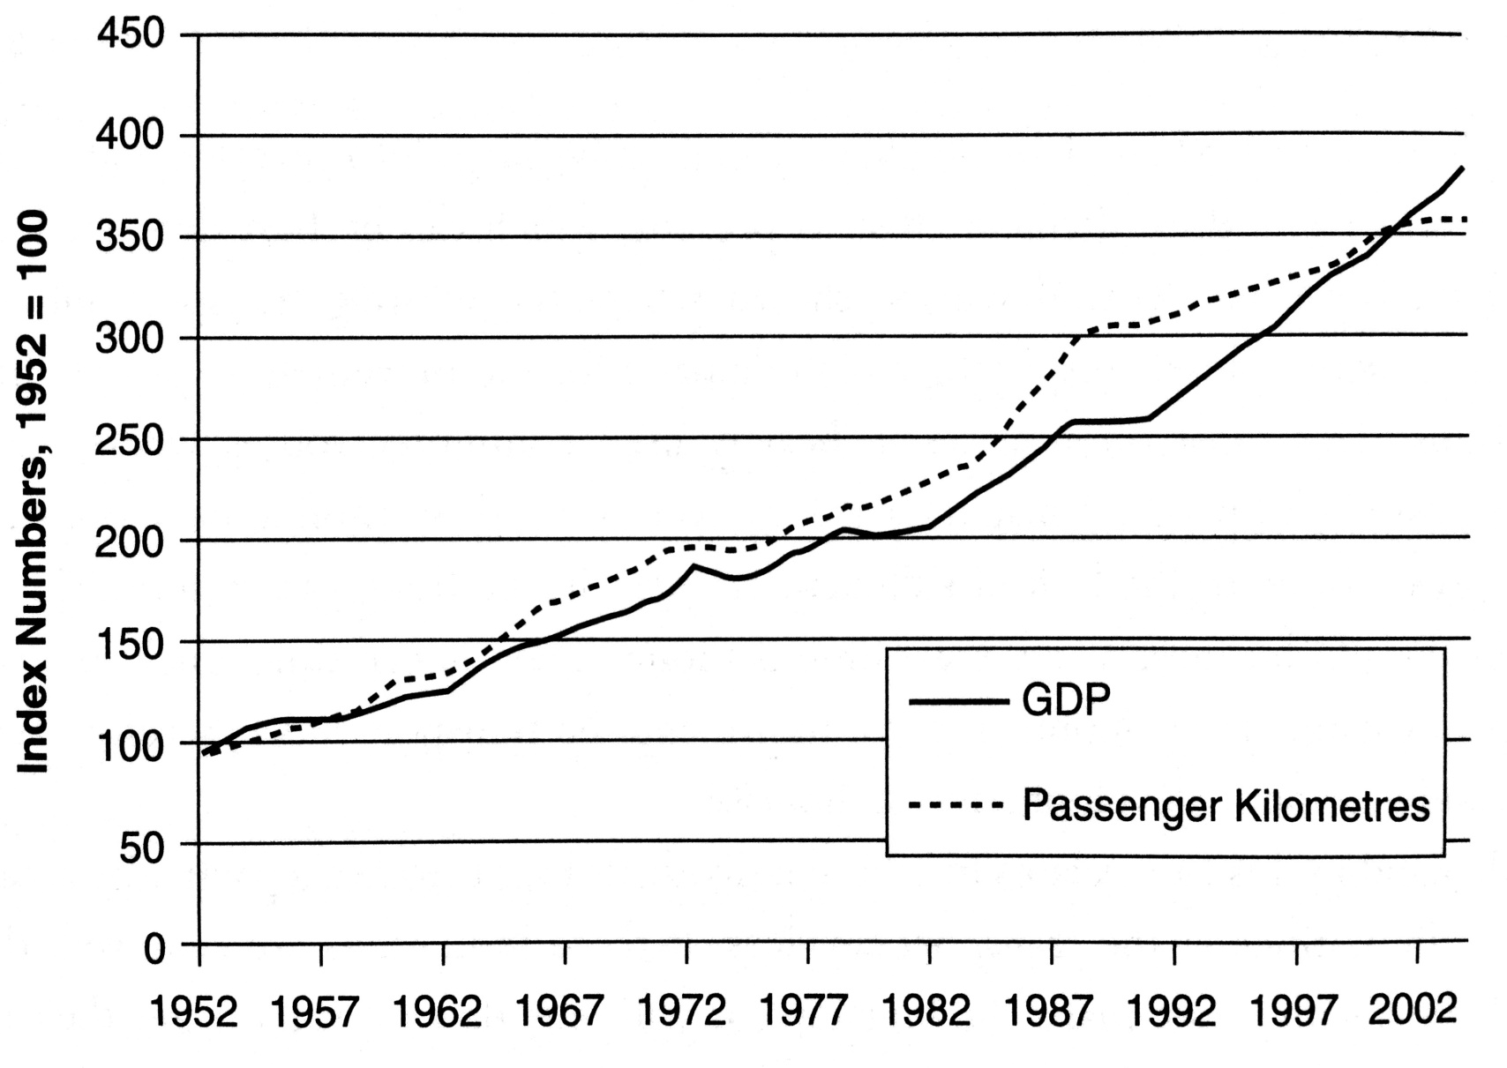
Economic and transport growth
Passengerkilometers travelled and real GDP, Great Britain

Slide 133
Direction of causation?
The association between transport volumes and GDP has long been recognized, there remains real question over the direction of causation
Is it that as income rise, more goods are demanded and transported?
The alterantive hypothesis is that advances in freight transport will result in reduced transport costs an it will lead to more goods produced

Slide 134
Supply led view – transport leads to economic development
To adopt a supply led model is to suggest that the casual relationship is that improving the transport infrastructure of an area will automatically stimulate economic activity. This would occur for a number of reasons:
Widening of markets, increased production and multiplier effects
Indirect effects on employment in construction and operation

Slide 135
Demand led models – economic development drives demand for transport
Contrasting with the supply led view is the alternative idea that transport provision is a invaraibly a response to a basic demand, hence the casual relationship is that economic development leads to a demand for better transport facilities
Without a basic demand for an area’s goods and services, then irrespective of the quality of the transport infrastructure this will never stimulae that demand

Slide 136
Synthesis
There is no clear answer to the direction of causation and the two are closely assosiated
Under a supply led view improving transport services and/or upgrading the infrastructure is a necessary and sufficient condition for imporved trasnport to lead to economic development
Under a demand led view, however, it is a necessary but not sufficient condition, i.e. the only condition required. There has to also be a basic derived demand for transport services in rder for transport developments to then facilitate economic development.

Slide 137
Empirical evidence (examples)
Fogel (1964) – Railroads and economic growth
Purvis (1985) – highway development and economic growth
Aschauer (1989) – elasticity of aggregated output with respect to infrastructure spending
Harmatuck (1997) – return on infrastructure investment will decline as maintanance expenditure goes up
Rodriguez-Pose (2004) – impact of European transport investment on economic development (almost zero)

Slide 138
Decoupling transport from GDP
There is a very close association between freight and passenger traffic and GDP
This has now become a major problem, due to negative impact of transport on the enviroment
Decoupling = GDP can continue to grow without being associated with the growth of traffic
Is decoupling achievable?

Slide 139
Transport and local economy
The role of transport in the local economy → the extent to which the multiplier effect is allowed to function at the local level from any external injection
The better physical links within the local economy → the easier it is for the benefits to have a full impact
Physical separation of production and consumption

Slide 140
Location
Many theorists suggest that firms of similar nature will tend to be located near to each other for various reasons.
Examples: Silicon Valley, Moravian Manchester …..
Improved transport links to create inustrial clusters?
The local economy, transport and housing market

Slide 141
Readings for Lecture 12
Nash, C. (2015). When to invest in high speed rail. Journal of Rail Transport Planning & Management, 5(1), 12-22.

Slide 142
12. TRANSPORT APPRAISAL

Slide 143
Learning Outcomes
Understand why we appraise
Understand main methods of appraisal
Have an appreciation of how these methods vary across Europe
Be able to critique some of the key asumption on whcih appraisal is based

Slide 144
Transport investment
Transport investment involves expenditure on particular project in situation of limited resources.
The task is to choose the project that brings maximum return

Slide 145
Appraisal
Appraisal is a way of predicitng how much utility we as society will derive from the expenditure on one project compared to another, by predicting the utility that will arise from each
It is fundamental to realise that, inherent in appraisal there is some kind of prediction or forecasting required

Slide 146
Cost benefit analysis (CBA)
CBA estimates and totals up the equivalent money value of the benefits and costs to establish whetjer they rae worthwhile.
The result of CBA is a number; this shows the ratio of benefits to costs.
The basis of CBA is that a monetary value needs to be allocated to all benefits and costs

Slide 147
How does CBA work?
Choose options
Choose length of time
Use a predictive model
Calculate time savings
Take away benefits from cost to find out whether benefits exceed costs and, if so, by how much

Slide 148
Key elements of CBA
Project appraisal period
The benefits that are assessed
Forecasting and modelling
Present value
Values of time
Accident valuation
Operating costs
Revenue
Discounting

Slide 149
Criticism and problems with CBA
Valuing time savings
Discount rate and length of time of project appraisal
What does NPV show us?
Equity and distributional effects
Project pricing – optimism and inaccuracy

Slide 150
Costs and benefits of high speed rail
Nash (2015)

Slide 151
CBA of HSR in Spain

Slide 152
CBA of HSR in Britain
Nash (2015)

Slide 153
CBA of proposed HSR in Britain
Nash (2015)

Slide 154
Readings for Lecture 13
Guirao, B., & Campa, J. L. (2014). The construction of a HSR network using a ranking methodology to prioritise corridors. Land Use Policy, 38, 290-299.

Slide 155
13. TRANSPORT FORECASTING

Slide 156
Learning Outcomes (1)
Alternative approaches to generating a forecats of demand for existing, new or improved services
Issues surrounding asking people how they or the public would react to new or improved transport services and the problems taht will occur
Methods for identifying and projecting demand for existing services when no major changes are expected

Slide 157
Learning Outcomes (2)
Methods for identifying and projecting seasonal change
Methods for forecasting demand when significant change is expected in the economic and social envrioment
Methods for forecasting the impact of new or improved services in a competitive enviroment

Slide 158
Aim
In order to assess if the provision of a new or improved transport service makes economic sense we need to have some idea of how public will respond, both immediately and in the far distant future
Forecasting is about collecting information from all relevant sources and analysing it in a consistent structured fashion.

Slide 159
General approaches
There are three approaches to forecasting demand:
  Qualitative: Surveys and Sampling
  Time series analysis
  Econometric techniques

Slide 160
Qualitative Methods
Qualitative Forecasting Methods are based on surveys of either potential customers or experts
The major problem is identyfying who to ask

Slide 161
Time series analysis
In time series analysis we seek to identify the three elements:
The Trend
Seasonal or Cyclical Factors
The unusual (sometimes termed the stochastic factor or noise)

Slide 162
Econometric methods
The modelling process involves 6 stages:
Understanding the Problem
Obtaining the Data
Specifying the Model
Estimating the specified Model
Validating the Model
Simulation/Forecasting

Slide 163
The gravity model
The model that predicts the level of tranport between two locations to be dependent upon their respective population sizes and the distance between them

Slide 164
Econometric demand models
The demand for particular mode (road, rail, air) will be determined by income, price, joureny times, frequency and comparative quality

Slide 165
Modelling choice
It is often the case that we are more concerned with forecasting the share of existing traffic than the growth of that traffic
Logit models

