Slide 1
Management
Organizational Development
and Change in a Global Economy
Mariann Benke & Dr. Roland Schmuck
University of Pécs,
Faculty of Business and Economics

Slide 2
Management
Part 1.
Introduction to
Organization Development and Change
Mariann Benke
University of Pécs, Faculty of Business and Economics
Source: Thomas G. Cummings - Christopher G. Worley

Slide 3
Introduction
Mariann Benke
E-mail: benkem@ktk.pte.hu
  Research fields:
  Change management
  Organizational Development
  Management and Organization
  Organizational Behaviour

Slide 4
Learning Objectives
To provide a definition of Organization Development (OD)
To distinguish OD and planned change from other forms of organization change
To describe the historical development of OD
To understand how leadership is linked to change activities
To describe and compare three major perspectives on changing organizations.
To describe how planned change can be adopted to fit different kinds of conditions
To understand the different elements of a successful change program

Slide 5
Burke’s Definition of OD
OD is a planned process of change in an organization’s culture through the utilization of behavioral science technology, research, and theory.

Slide 6
French’s Definition of OD
OD refers to a long-range effort to improve an organization’s problem-solving capabilities and its ability to cope with changes in its external environment with the help of external or internal behavioral-scientist consultants.

Slide 7
Beckhard’s Definition of OD
OD is an effort
planned,
(2) organization-wide, and
(3) managed from the top, to
(4) increase organization effectiveness and health through
(5) planned interventions in the organization’s “processes,” using behavioral science knowledge.

Slide 8
Beer’s Definition of OD
OD is a system-wide process of data collection, diagnosis, action planning, intervention, and evaluation aimed at:
enhancing congruence between organizational structure, process, strategy, people, and culture;
developing new and creative organizational solutions; and
developing the organization’s self-renewing capacity.
It occurs through collaboration of organizational members working with a change agent using behavioral science theory, research, and technology.

Slide 9
Geert Hofstede
Gerard Hendrik (Geert) Hofstede (born 2 October 1928)
Dutch social psychologist, former IBM employee, and Professor Emeritus of Organizational Anthropology and International Management at Maastricht University in the Netherlands,
well known for his pioneering research on cross-cultural groups and organizations.
Dimensions of national cultures:
Power distance index (PDI)
Individualism vs. collectivism (IDV)
Uncertainty avoidance index (UAI)
Masculinity vs. femininity (MAS)
Long-term orientation vs. short-term orientation (LTO)
Indulgence vs. restraint (IND)

Slide 10
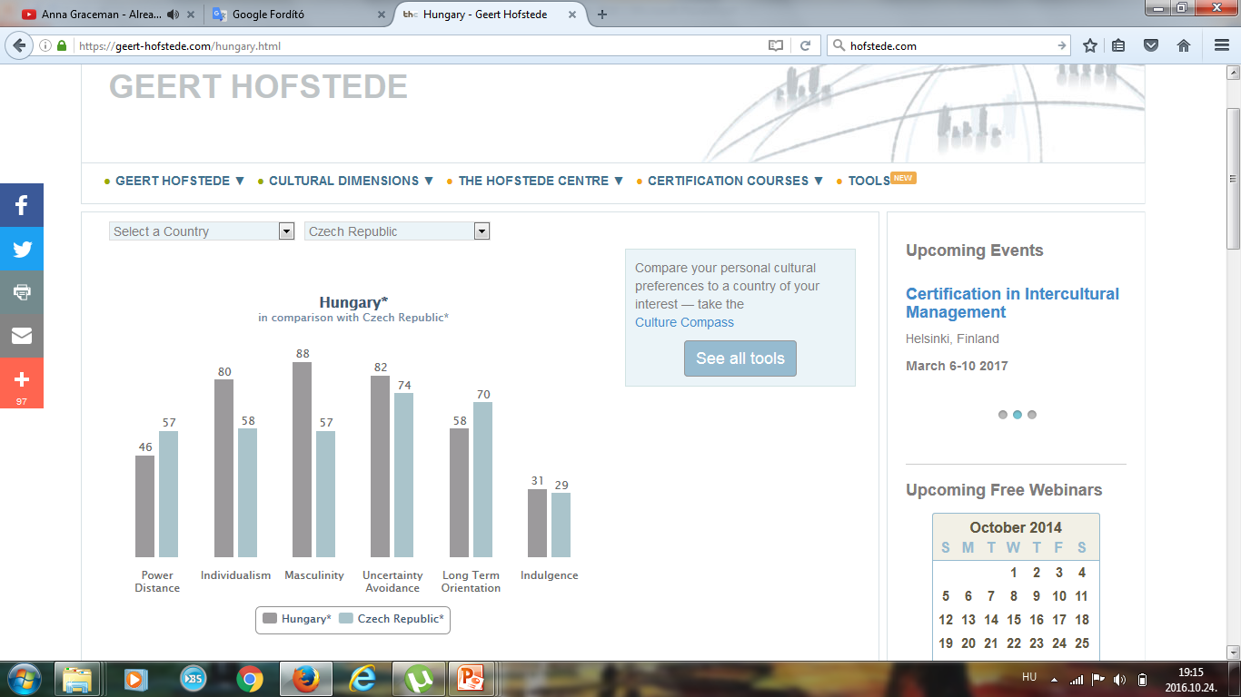
Culture differences by Hofstede

Slide 11
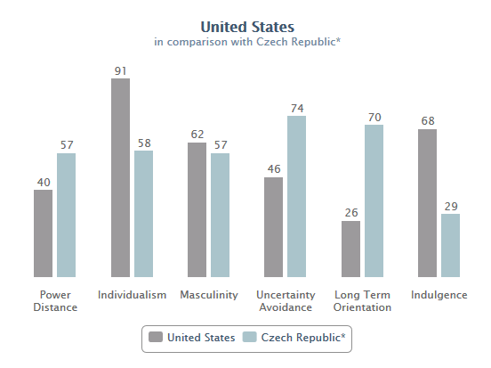
Culture differences by Hofstede

Slide 12
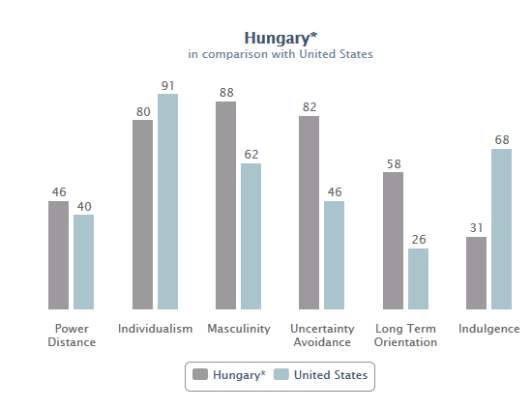
Culture differences by Hofstede

Slide 13
Organization Development is...
a system-wide application and transfer of behavioral science knowledge to the planned development, improvement, and reinforcement of the strategies, structures, and processes that lead to organization effectiveness.

Slide 14
Five Stems of OD Practice
Laboratory Training
Action Research/Survey Feedback
Current Practice
Normative Approaches
Quality of Work Life
Human Capital Approach from Garry S. Becker, Nobel Prise 1962
Strategic Change
1950 1960 1970 1980 1990 2000 Today
Resource-based view 1984

Slide 15
Part I:
The Nature of Planned Change The OD Practitioner
Part II: The Process of Organization Development
Entering & Diagnosing Diagnosing Collecting
Contracting Organizations Groups & Jobs Diagnostic
Information
Feeding Back Designing OD Leading and Evaluating &
Diagnostic Data Interventions Managing Institutionalizing
Change Change

Slide 16
Part III:
Human
Process
Interventions
Individual,
Interpersonal,
& Group
Process
Approaches
Organization
Process
Approaches
Part IV:
Techno-structural
Interventions
Restructuring
Organizations
Employee
Involvement
Work Design
Part V:
Human
Resources
Management
Interventions
Performance
Management
Developing and
Assisting
Members
Part VI:
Strategic
Interventions
Competitive and
Collaborative
Strategies
Organization
Transformation
Part VII: Special Topics in Organization Development
Organization Development OD in Nonindustrial Future Directions
in Global Settings Settings in OD

Slide 17

OD planned change:
M&A activity
Mercedes + Daimler Benz = Benz&Cie → Mercedes-Benz (1926 - …) ☺

Slide 18

OD planned change: M&A activity
BMW + Rover → (1994 – 1998) ☹

Slide 19

OD planned change: M&A activity
Daimler + Chrysler = DaimlerChrysler (1998 – 2005) ☹

Slide 20
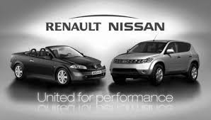

OD planned change: M&A activity
Renault + Nissan → 1999 ☺
Renault + Nissan + Mitsubishi → 2015 ?

Slide 21
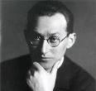
Lewin’s Change Model (1954)
Unfreezing
Movement
Refreezing

Slide 22
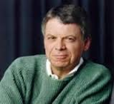
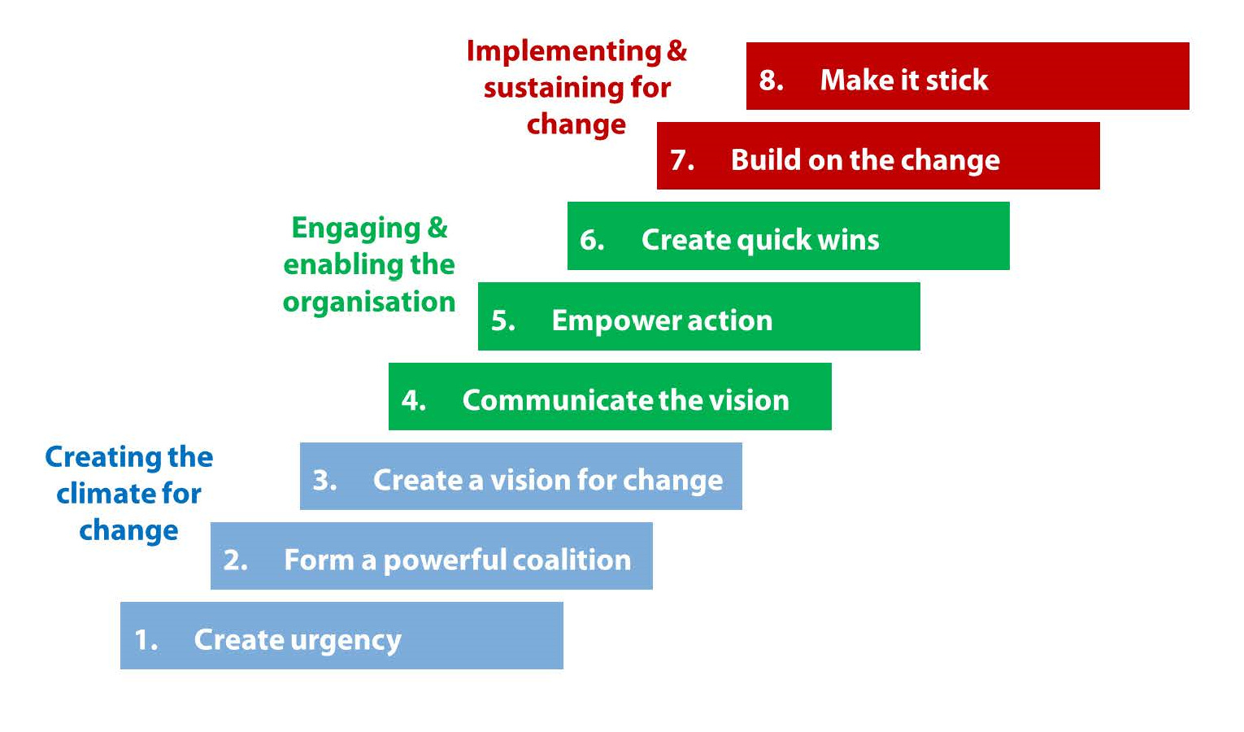
Kotter’s 8-Step Process for Leading Change (1996)

Slide 23
General Model of Planned Change
Planning
and
Implementing
Change
Evaluating
and
Institutionalizing
Change
Entering
and
Contracting
Diagnosing

Slide 24
Different Types of
Planned Change
Magnitude of Change
  Incremental
  Radical
Degree of Organization
  Over-organized
  Under-organized
Domestic vs. International Settings
https://www.youtube.com/watch?v=__IlYNMdV9E

Slide 25
Critique of Planned Change
Conceptualization of Planned Change
  Change is not linear
  Change is not rational
  The relationship between change and performance is unclear
Practice of Planned Change
  Limited consulting skills and focus
  Quick fixes vs. development approaches

Slide 26
Change Management Activities
Motivating Change
Creating Vision
Effective
Change
Management
Developing
Political Support
Managing the Transition
Sustaining Momentum

Slide 27
Motivating Change
Creating Readiness for Change
  Sensitize the organization to pressures for change
  Identify gaps between actual and desired states
  Convey credible positive expectations for change
Overcoming Resistance to Change
  Provide empathy and support
  Communicate
  Involve members in planning and decision making

Slide 28
Creating a Vision
Discover and Describe the Organization’s Core Ideology
  What are the core values that inform members what is important in the organization?
  What is the organization’s core purpose or reason for being?
Construct the Envisioned Future
  What are the valued outcomes?
  What is the desired future state?

Slide 29
Developing Political Support
Assess Change Agent Power
Identify Key Stakeholders
Influence Stakeholders

Slide 30
Sources of Power and
Power Strategies for Change Agents
Individual Sources of Power
Power Strategies
Knowledge
Playing it Straight
Knowledge
Playing it Straight
Others’ Support
Using Social
Networks
Others’ Support
Personality
Going Around the
Formal System
Personality

Slide 31
Examples for human power
Ford 1968:
https://www.youtube.com/watch?v=DZ509hHkHO8
Iron Lady (1979 – 1990):
https://www.youtube.com/watch?v=hZrAKdlX0SA

Slide 32
Managing the Transition
Activity Planning
  What’s the “roadmap” for change?
Commitment Planning
  Who’s support is needed, where do they stand, and how to influence their behavior?
Change-Management Structures
  What’s the appropriate arrangement of people and power to drive the change?

Slide 33
Change as a Transition State
Current
State
Transition
State
Desired
Future
State

Slide 34
Sustaining Momentum
Provide Resources for Change
Build a Support System for Change Agents
Develop New Competencies and Skills
Reinforce New Behaviors
Stay the Course

Slide 35
Restructuring Organizations: Contingencies Influencing
Structural Design
Environment
Organization
Size
Worldwide
Operations
Structural
Design
Organization
Goals
Technology

Slide 36
Structural Design
Functional Organization
The Divisional Organization
The Matrix Organization
The Process-Based Structure
The Network Organization

Slide 37
The Reengineering Process
Prepare the organization
Specify the organization’s strategy and objectives
Fundamentally rethink the way work gets done
  Identify and analyze core business processes
  Define performance objectives
  Design new processes
Restructure the organization around the new business processes.

Slide 38
Management
Part 2.
Global Economic Trends
and Hungarian Facts
Dr. Roland Schmuck
University of Pécs, Faculty of Business and Economics
Main source: Ellis-Williams: International Business Strategy

Slide 39
Introduction
Dr. Roland Schmuck
E-mail: roland@ktk.pte.hu
Research fields:
  Strategic Management
  Change Management
  Quality Management
  Business Consulting

Slide 40
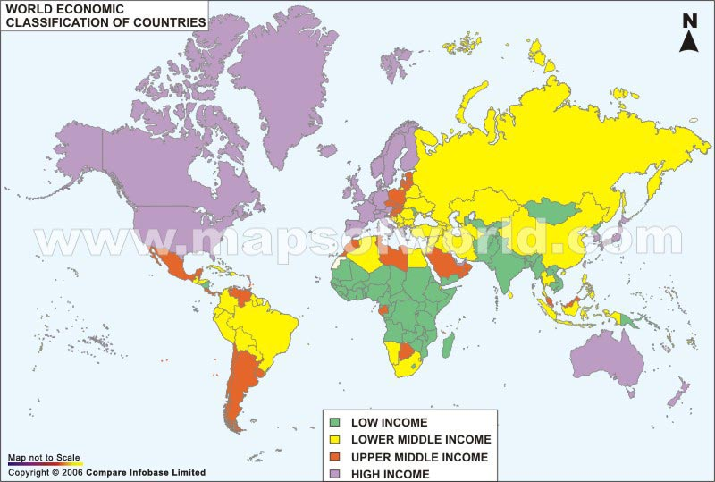

Slide 41
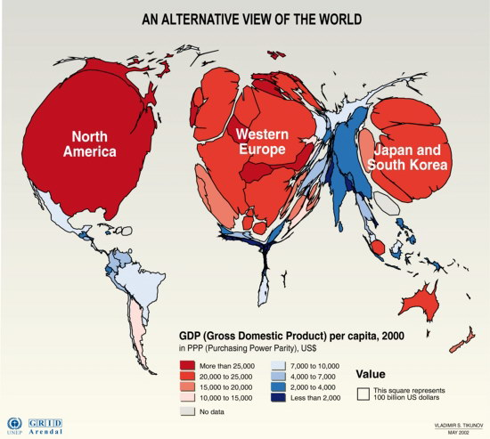

Slide 43
The „Triad”
1/5 of global population, 4/5 of world output (GNP)
More manufacturing/service divisions
Nationality of companies: outdated
National governments can’t stop the process
Raising import penetration: interlinked nature
Percentage growth of international trade is higher than growth of output
Main competitors are becoming the foreign companies

Slide 44
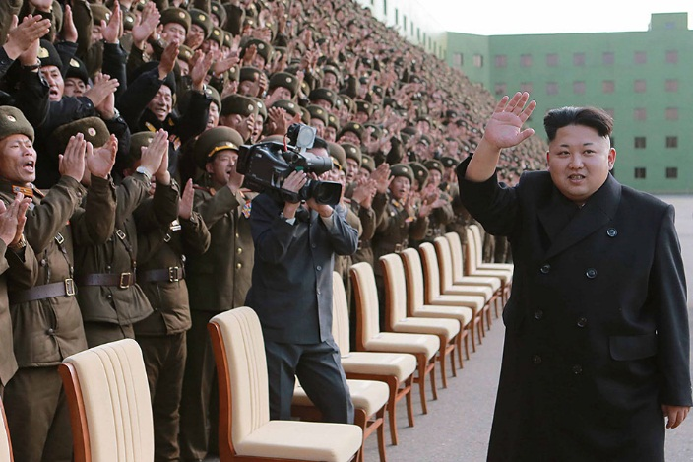
Some are trying to stop the process…

Slide 45
European Union
Population reduction
Slower and unbalanced technology growth influenced heavily by government
Economic policy in constant change, trying to adapt to the different national and regional markets of the Euro-land area
Interest rates and money growth that are compromises for the different needs of different parts of the EU
Government/cartel/regulation driven model in certain key sectors, linked to competition driven model in other parts

Slide 46
USA
Fast growth
Fast technology growth
Economic policy geared to domestic requirements of large single market
Interest rates and money growth to facilitate growth
Free enterprise competition driven model

Slide 47
China
Continued rapid growth in output and per capita incomes
Trade liberalization
Growth of large domestic market for cars, household goods and other manufactured products
China accounts for:
  76% of world exports of leather goods,
  55% of textiles
  32% of radio, TV and communications equipment.
Chinese economy continues to advance in the future

Slide 48
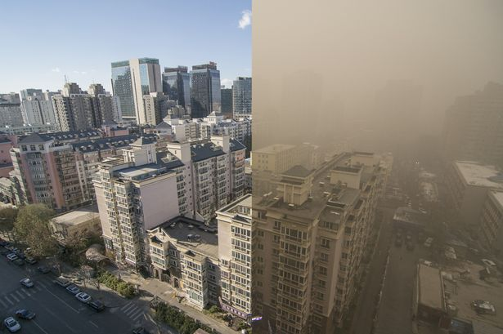
Is it worth?
BEFORE
NOW
BEIJING, CHINA

Slide 49
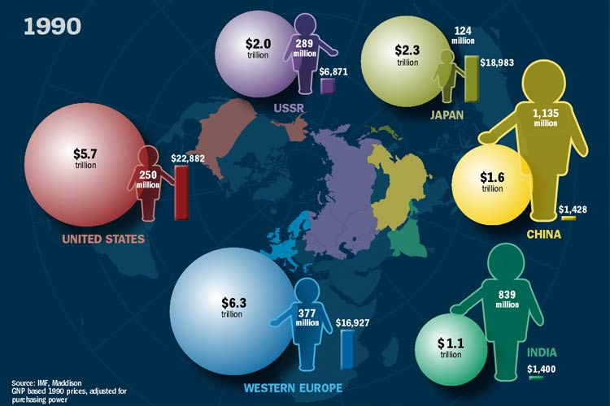

Slide 50
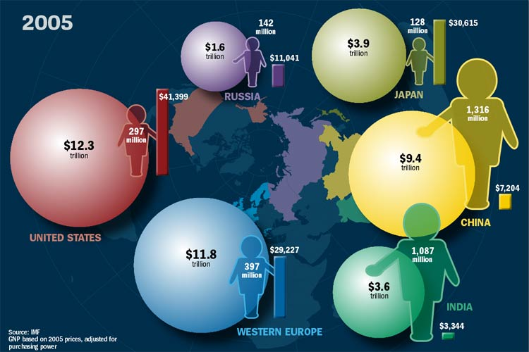

Slide 51
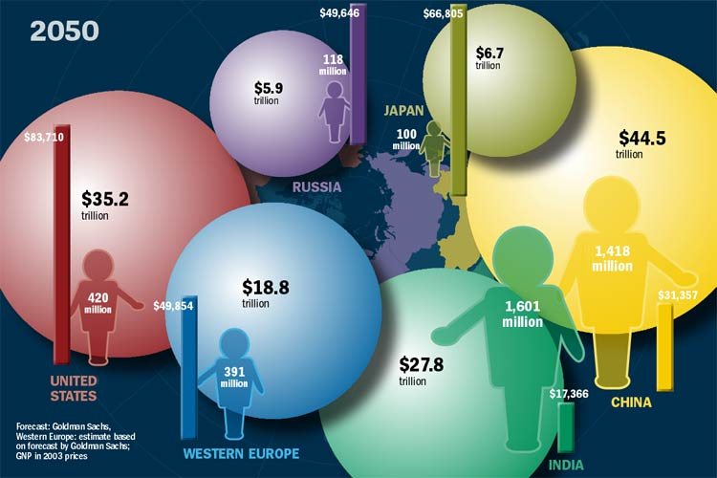

Slide 52
Europe’s declining share of global output
Estimated changes of global output

Slide 53
GDP growth rates
 | China | USA | European Union
1996 | 10.0% | 3.7% | 2.0%
1997 | 9.3% | 4.5% | 2.7%
1998 | 7.8% | 4.2% | 2.9%
1999 | 7.6% | 4.4% | 3.0%
2000 | 8.4% | 3.7% | 3.9%
2001 | 8.3% | 0.8% | 2.1%
2002 | 9.1% | 1.6% | 1.4%
2003 | 10.0% | 2.5% | 1.5%
2004 | 10.1% | 3.6% | 2.7%
2005 | 10.4% | 3.1% | 2.0%
2006 | 11.1% | 2.9% | 3.3%
2007 | 14.2% | 1.8% | 3.1%
2008 | 9.6% | -0.3% | 0.5%
2009 | 9.2% | -2.8% | -4.4%
2010 | 10.6% | 2.5% | 2.1%
2011 | 9.5% | 1.6% | 1.8%
2012 | 7.8% | 2.3% | -0.4%
2013 | 7.7% | 2.2% | 0.2%
2014 | 7.3% | 2.4% | 1.4%
2015 | 6.9% | 2.6% | 2.3%
2016 | 6.7% | 1.6% | 1.9%

Slide 54
Intra-Europe 1214.0 $bn (35,4%)
Europe
174.7 $bn (4.9%)
129.3 $bn (3.7%)
152.7 $bn
(4.4%)
184.8 $bn (5.3%)
America
Asia
153.6 $bn (4.4%)
236.4 $bn (6.7%)
Intra-Americas 270.4 $bn (7.7%)
Intra-Asia 413.5 $bn (11.8%)
Key:
= Exports to
Others: 14.9%
Figure 3.5. Projected merchandise trade in US$ billion and as a percentage of world trade for the year 2005 [GATT Report]

Slide 55
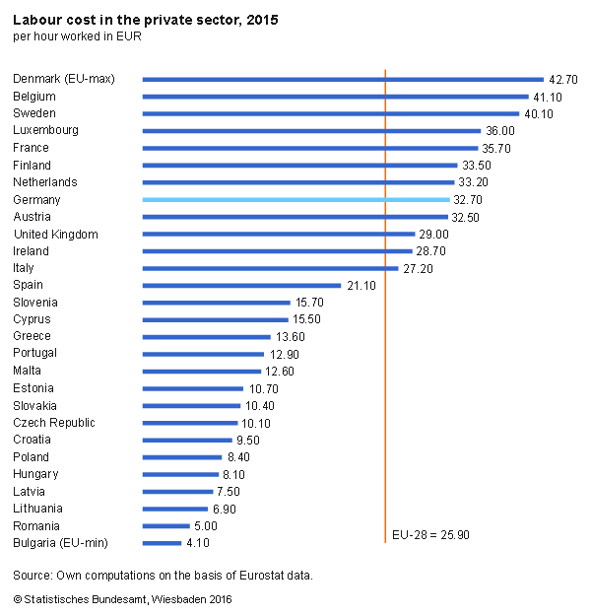

Slide 56
Direct investments
Problem:
  Increasing costs at home country
  Rising exchange rates making exports too expensive
Result:
  Increasing foreign investments:
    Accumulated incoming FDI: Hungary 119.800 millions USD; Czech Republic 147.600 millions USD
…never has an economy passed so quickly as Japan from non-industrialized backwater, through industrial giant, and now towards threatened industrial dinosaur - all in one generation.

Slide 57
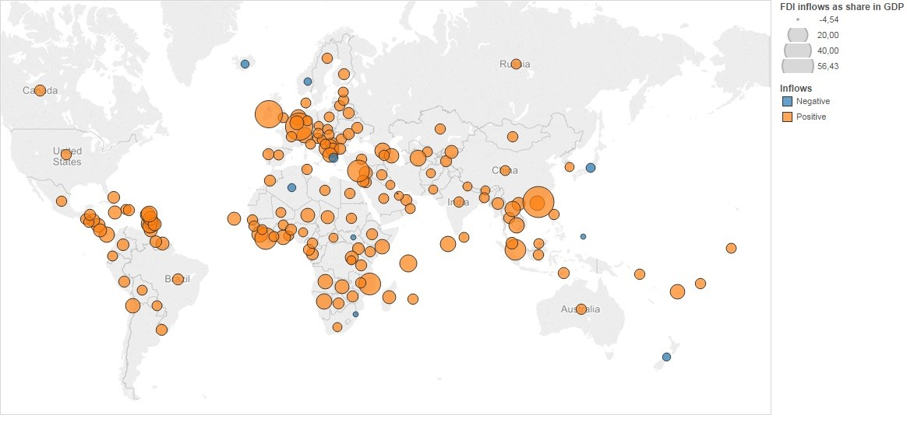
Foreign Direct Investments (2016)

Slide 58
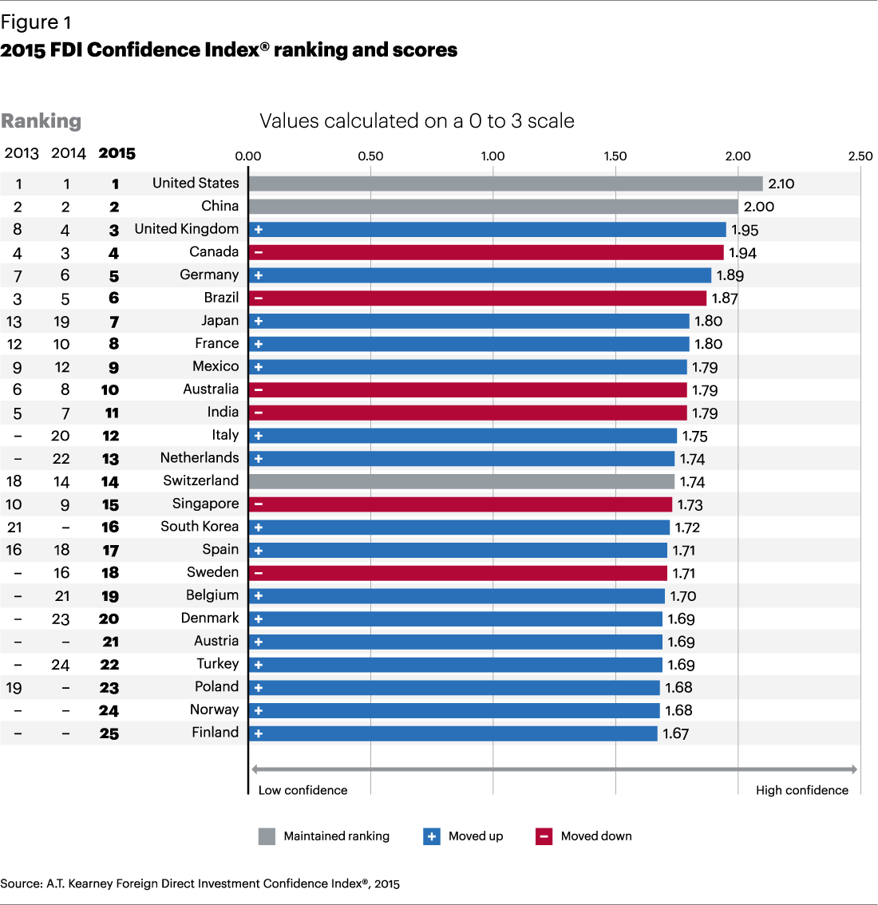

Slide 59
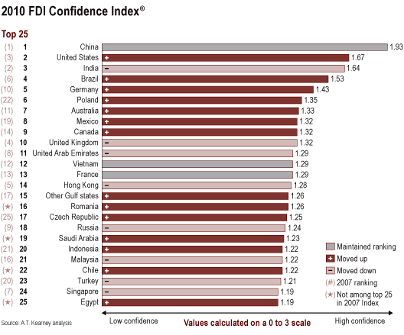

Slide 60
FDI confidence index (2005)

Slide 61
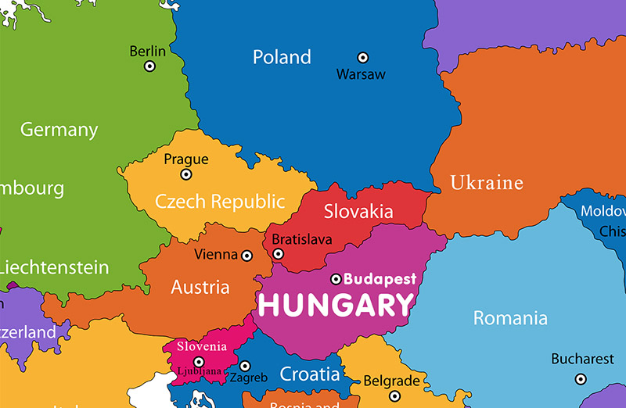

Slide 62
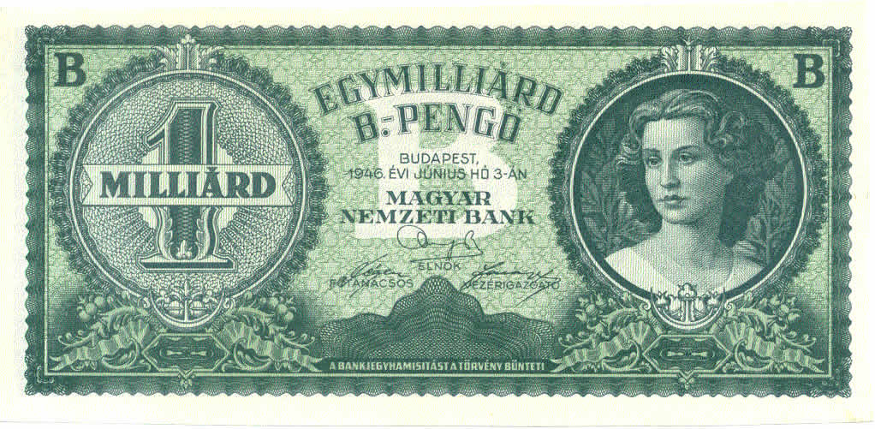
The worst hyper-inflation in the world
1,000,000,000,000,000,000,000 Pengő

Slide 63
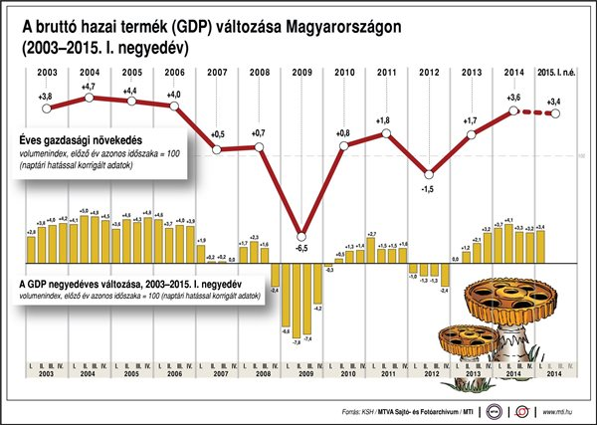
Change of Hungarian GDP (2003-2015)

Slide 64
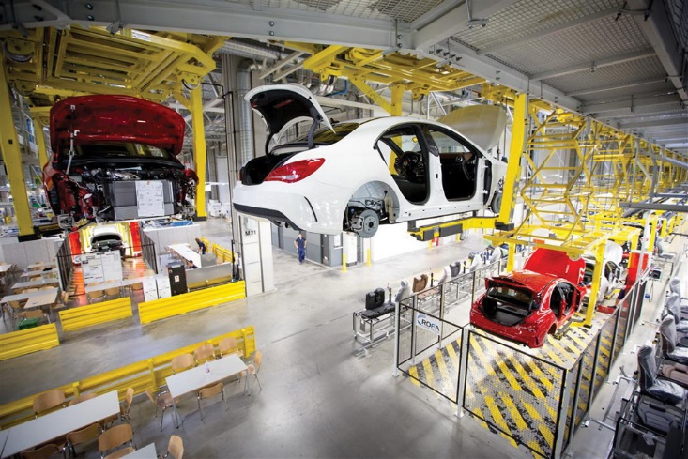

Slide 65
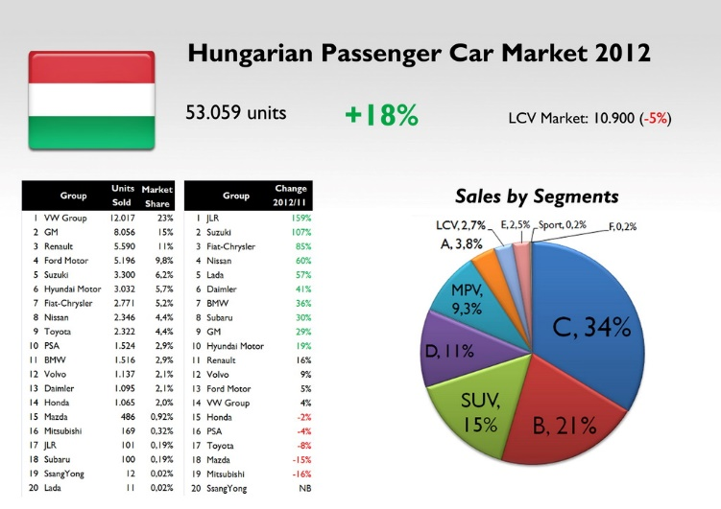

Slide 66
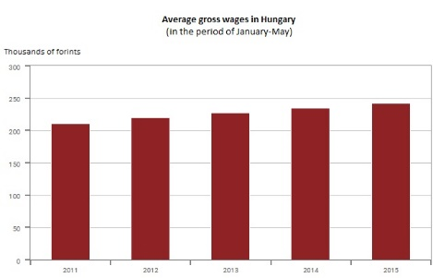
1 CZK = 12 Hungarian Forints
240.000 Forints = 20.000 CZK

Slide 67
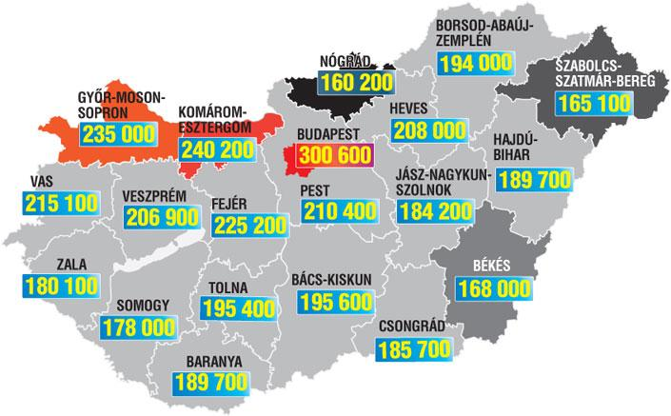
Monthly wages in regions

Slide 68
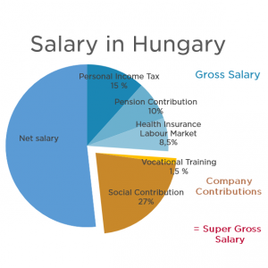

Slide 69
Dynamic adjustment
Successful economy
Richness, better education
Higher wage costs
Appreciated currency
(exporting more expensive)
Home manufacturing becoming
less and less competitive

Slide 70
Dynamic adjustment
Undermines the success of the previously rapidly growing economies
Enables new countries to become preferred production base
Trade protection:
  Temporary solution
  Removes the competitive pressure
  After protection is removed: adjustment is more dramatic

Slide 71
Winners and losers
The dynamics of the world economy create instability and change
Who is the winner and who is the loser?
  „Winning” becomes increasingly expensive as wages and currencies are adjusted upwards.
  Loser economies: unemployed workforce is available at reasonable cost and backed by a week currency, causing economic growth in long-term
The adjustment process is slow, with changes in political, technological and social factors.

Slide 72
Management
Thank you for your attention!
Mariann Benke & Dr. Roland Schmuck
University of Pécs,
Faculty of Business and Economics

