Slide 1
MS Dynamics NAV Intro 1
J.Skorkovský
Department of Corporate Economy
Faculty of Economics and Administration
MASARYK UNIVERSITY
Czech Republic

Slide 2
INTRO 1
Explain the concept of ERP and Microsoft Dynamics NAV 2016W1
ERP = Enterprise Resource Planning System
Resources = financial resources, machines, people, items,…….
Data = transactions having origin in :
  Posted documents (invoices, credit notes, deliveries, stock movement..)
  Hence the type of these transactions- entries
    Customer
    Vendor
    Item (Inventory)
    General Ledger (Accounts)
Linked to : Simple scenario of the first and second ERP Microsoft Dynamics NAV session I.

Slide 3
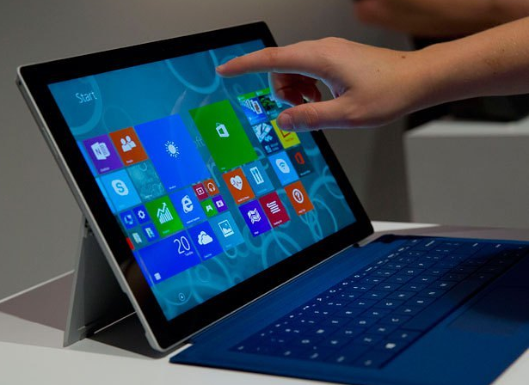
INTRO 2
Customer number | Customer name | Balance | Payment condition | Currency
10000 | SW Kings | 20000 | 1M | USD
20000 | China computers | 432444 | 21D | USD
30000 | Navertica | 9 | 14D | CZK
40000 | Berlin Experts | 20002 | 1W | EUR
Data
How to
see
data
(Window)

Slide 4
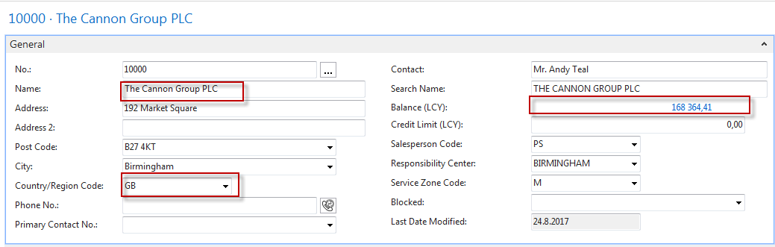
INTRO 3 – Customer card –part of it
Important information having origin in transactions-entries
Fields
Data + Structure = Information

Slide 5
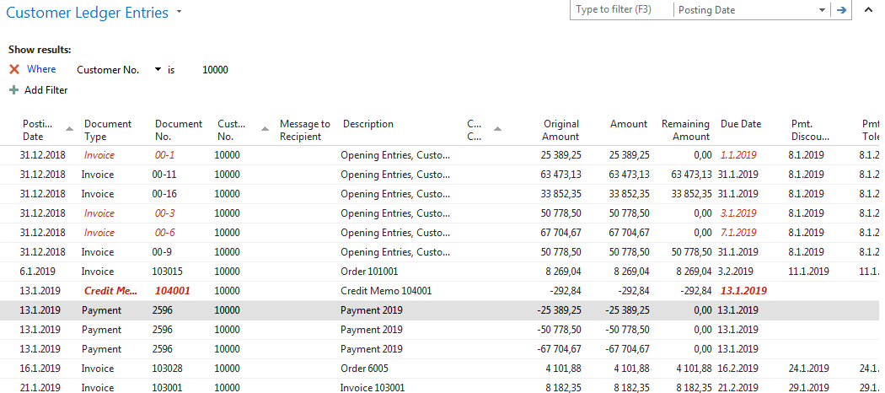
INTRO 4 – Customer entries
What has been posted in the past

Slide 6
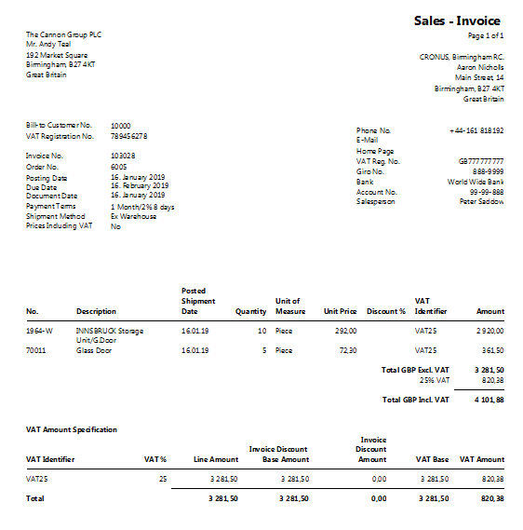
INTRO 5 – Customer document- navigation

Slide 7
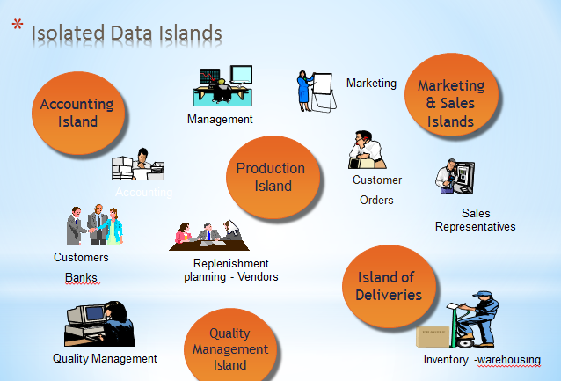
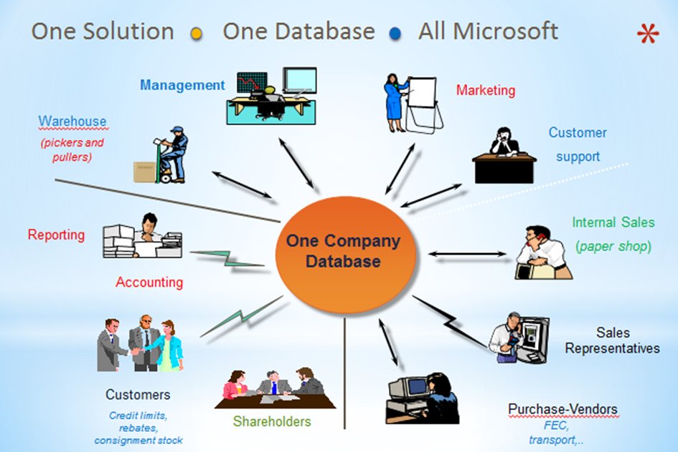
INTRO 6 – What is ERP 1
So our Microsoft Dynamics NAV is an ERP system. But why is it an ERP system? What are the main features of an ERP system and how do we recognize these in Microsoft Dynamics NAV?
Let's have a look at the overview slide. So one of the challenges that some companies might have to address is the one of island systems.

Slide 8
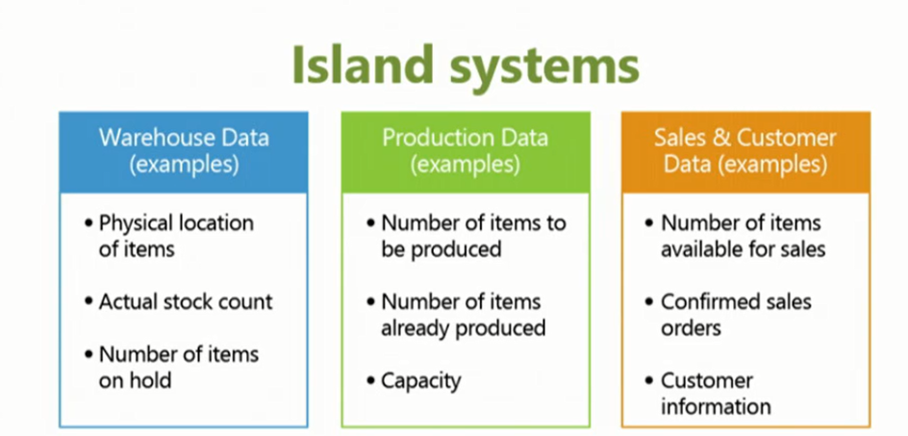
INTRO 7 – What is ERP 2

Slide 9
INTRO 8 – What is ERP 3
So everyone working with the system, for example, the bookkeeper in financial management, the sales representative in sales and marketing, the warehouse worker in the warehouse management, the HR manager in human resources and so on, so they all work with the system in their specific application department but with a common database. And that's very, very important. That's one of the main features of an ERP system.

Slide 10
INTRO 9 – Basics of working space
Card | Worksheet
List | Confirmation dialog
Role Center | List plus
Card part | Navigate page (wizard)
List part | Standard dialog
Document
Will be shown by tutor and examined on demo student databases by them

Slide 11
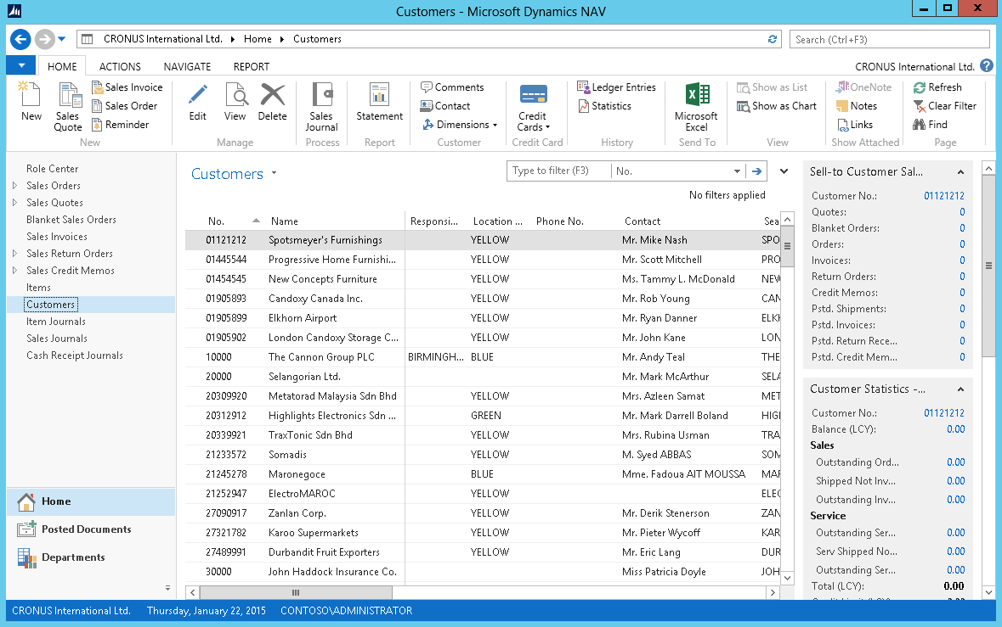
Pages
List Page Windows Client
Ribbon
Filter pane
List
FactBox pane
1
2
4
3
Notes:
After showing this slide and explaining the different components of a list page, go to the application and show some examples of list pages.
Remember to only focus on the interface. Topics such as personalization, filter, search, … are covered in other modules.

Slide 12
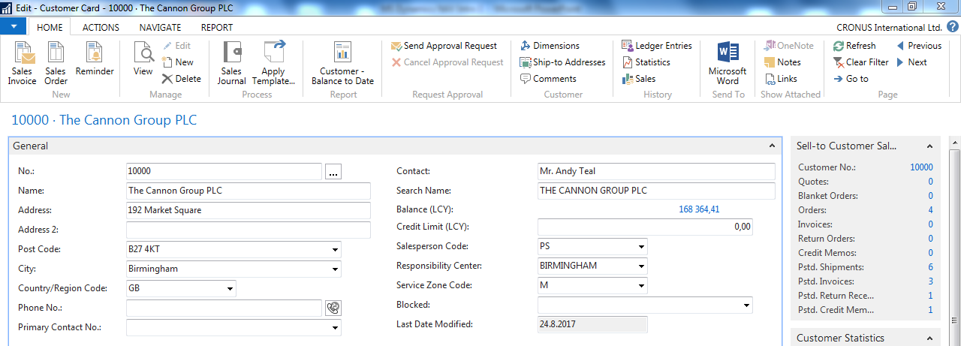
Card page – first tab only

Slide 13
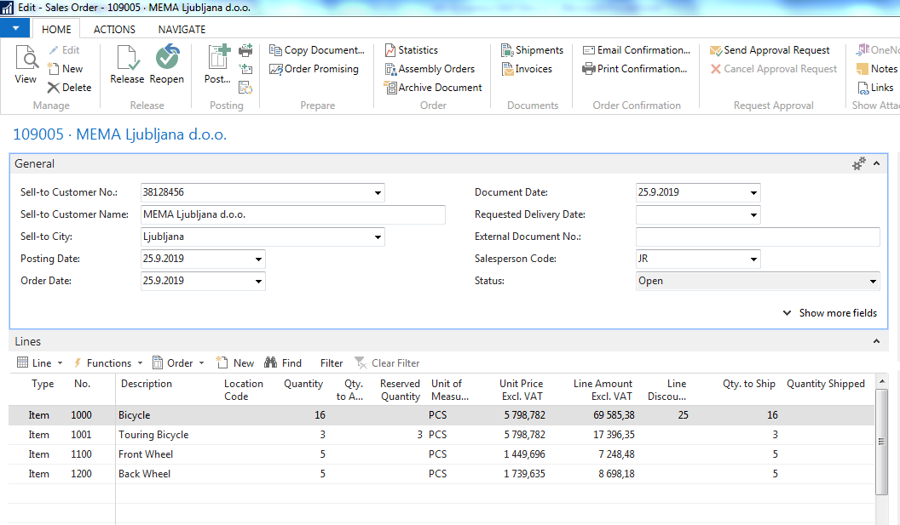
Document page
Header
Lines

Slide 14
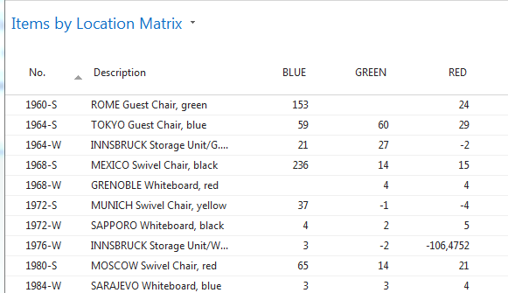
Matrix window (form)
Stock locations

Slide 15
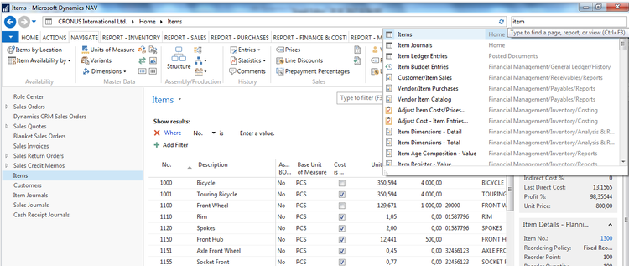
INTRO 10 – Searching window
Will be shown by tutor and examined on demo student databases by them
(Find Vendor, Item, Customer, General Ledger Account, Profile and so on)

Slide 16
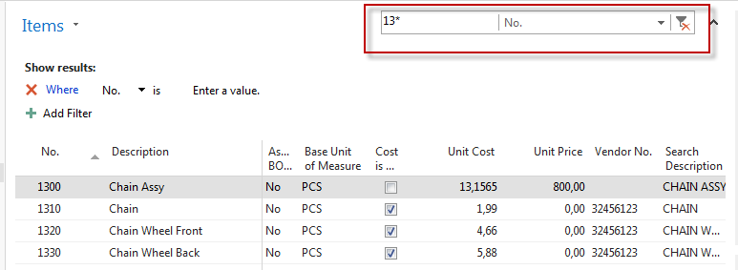
Simple filter

Slide 17
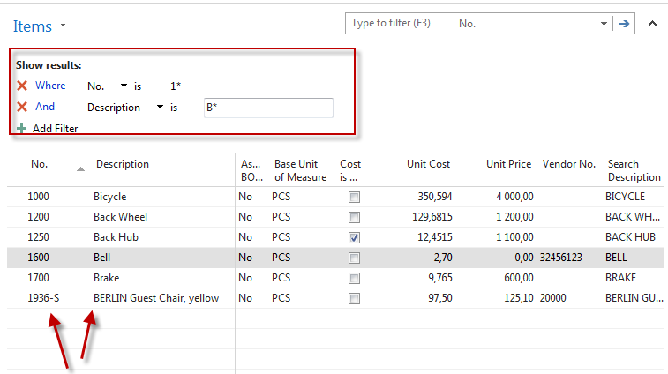
Multiple filter

Slide 18
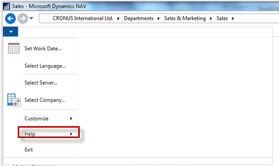
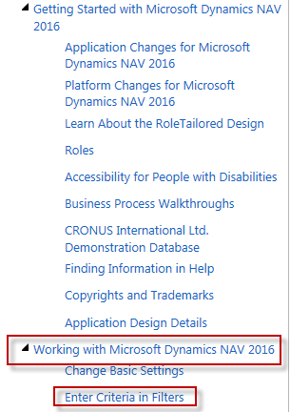
Example of using help _filter criteria)

Slide 19
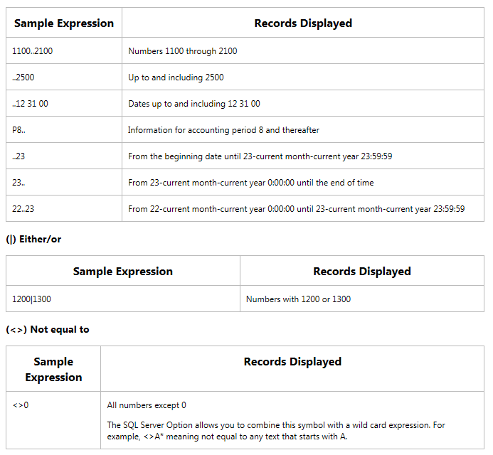
Example of using help _filter criteria)
Only part of it !
Will be presented
by tutor and
experienced by
students ….

Slide 20
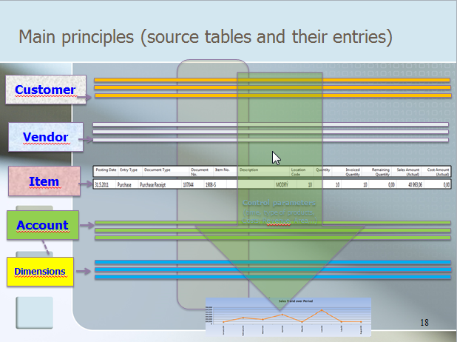
Entries and their use

Slide 21
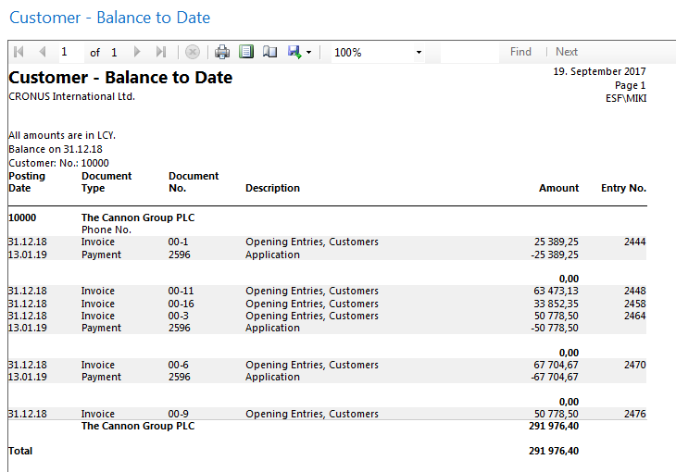
Report – example (data resource - Customer Ledger Entries)

