Slide 1
Government, Advocacy and Civil Society: the Government-Nonprofit Partnership
Alena Kluknavská, CVNS
24. 11. Brno

Slide 2
Content
Roles and responsibilities of NPOs (NGOs)
State – non-profit relations(hip)
NPO, political advocacy and civic participation

Slide 3
Nonprofit organizations purpose
What are the roles of non-profits?
AKA
Why do they exist?
Nonprofits: organizations that are privately incorporated, but serve some public purpose (social responsibility)
Yes?
No?
Why?

Slide 4
Why do NPOs exist?
Economic theories: market failure, government failure, voluntary failure
History, religious roots of charity, altruism
Communitarians: precursors of government and the market, connect people and create communities
Political scientists: providing avenues of civic participation and representation of interests
Civil society approach: the role of nonprofits in generating the social capital that links people to their communities and to others

Slide 5
What are the roles?
Social capital (“the features of social organization, such as networks, norms, and trusts, that facilitate coordination and cooperation for mutual benefit”)
Economic role
Religious role
Service
Policy (e.g. Implementing public policies)
Advocacy (e.g. Building up civic/civil society. Central to prosperous and successful democracies?)
…Significant actors at global level (international perspective)

Slide 6
NPO-gov’t relations I
Vast range and complexity
What’s in a relationship?
  Differences based on: type of org. (large vs. small), field (social services vs. international development), levels of government involved (e.g. federal vs. state vs. county/city; or central, regional, local)
Different aspects:
  funding (grants, fee-for-service contracts, concessionary loans, etc.)
  non-monetary support (facilities, expertise, goods and services in kind)
  mandates (government required to involve nonprofit associations in implementing policy)
  regulations and accountability
Direct government support: direct payments, tax exemption, preferential regulatory treatment, deductibility of donations

Slide 7
NPO-gov’t relations II
Societal problems cannot be solved by governments acting on their own
Need for NPO involvement in governance?
What is appropriate role of government in responding to social and economic needs? (ideological level – mutually excluding cooperation btw gov´t and NPO)
  Limited: NPO as alternative mechanism for responding to social ills, strict separation btw gov´t and voluntary groups (partnership)
  Greater involvement: downplaying importance of NPO, instead need for gov´t action to cope with social and economic problems (separation and conflict)

Slide 8
Where gov´t and NPO interact
Multiple arenas = gov´t and nonprofit may be at odds in one, but cooperate in another (e.g. Planned parenthood)
Arena | Impact on NPO
Government funding for nonprofits | Affecting the need for NPO service (indirect) Determining the resources NPO have available to help meet the resulting needs (direct)
Government tax policy towards NPO | Exempt from taxation, or lower taxes, but may vary
Gov´t regulation of NPO | Gov´t affect which types of org. Are eligible for tax exempt, procedure to gain such status, etc.
Substantive gov´t policy | Involvement of NPO in policy-making Policy advocacy: one of principal functions of NP sector, major contribution to society, Promoting common good Pressuring gov´t to respond to disadvantaged groups Regulatory developoments complicate NPO involvement in the policy arena

Slide 9
Government funding for nonprofits
General trends: retrenchment, shifts in the structure of government funding
  Retrenchement
    Reagan – reversal of government support, „to get gov´t out of the way´, signif decline in the real value of gov´t support to NPO in the early 1980s
    Bush – additional cuts
  Shifts to consumer-side subsidies:
    Discretionary programs – absorbed cuts – previously producer-side subsidies (benefits delivered in the form of grants and contracts to providers of services) – then shift to consumer-side subsidies (benefits delivered in the forms of vouchers directly to the consumers of services, who can then choose providers, something like market) – leads to uncertainity in NPO operations
  Marketization (Pressures to market their services)

Slide 10
Government regulation of NPO
In the US, substantial parts of the business sector deregulated, NPO have confronted an increase in regulation in certain crucial spheres, mostly in:
  Charitable fundraising, advocacy (lobbying) and non-profit management practices (regulation of management)
  Many obstacles in lobbying and advocacy for nonprofit (Lobbying Disclosure Act of 1995)

Slide 11
What is the character of relationship?
Substitute and supplement (Weisbrod, 1988; Douglas, 1987)
Complement (Salamon, 1995, 2002)
Adversary
Nonprofit
Sector
Public
Sector
(Government)
For-Profit
Sector

Slide 12
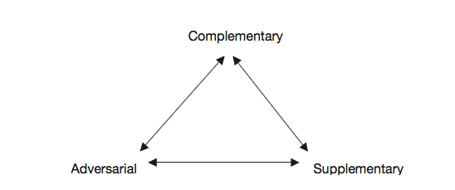
A triangular model
Young (2000)

Slide 13
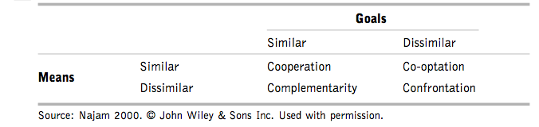
Four Cs model of government–nonprofit relations
^{Najam’s Four Cs model (2000)}

Slide 14
Social movement theory argument
Two sectors are deeply intertwined, conflictual relationship with gov’t
1) first with private concerns, private action (informal, no legal status)
2) As momentum builds, the movement may evolve into formal organizations (become more institutionalized)
3) Ultimately, successful SMOs may influence government policy – by translating private concerns into public issues

Slide 15
SMOs and government
Basically a cycle:
  initial social movement translate public concerns via formal legal entities
  NPO influence government policy
  government responds:
    by directly addressing the issue
    or funds nonprofits
  Nonprofits in turn address these public concerns
  And nonprofits adjust their behavior to reflect public policy and government priorities
  Tries to influence again
Examples of such successful movements?

Slide 16
Civic participation and advocacy
not only important service providers, vehicles for advocacy and civic participation
1) NPOs mediate/facilitate civic participation – by providing structures and networks
2) NPOs engage in public-interest advocacy activities
Aim: to mobilize information to educate and inform the public, both to influence attitudes and to change behaviour
a variety of different forms and approaches

Slide 17
Civic participation
Activities by individuals who attempt to affect governance at a variety of levels (such as voting, but also other forms)
NPOs - direct/indirect activation and facilitation of civic participation
Civic membership groups
Goal: usually to strengthen democracy

Slide 18
Advocacy
a wide range of activities that influence decision makers
encomapasses activities and communications designed to influence public policy
NPO’s crucial civic function
seeks to influence government policy, but not to govern
to “correct imbalanced political representation by ensuring that a broader set of interests are voiced” (Jenkins, 2006)
Goal: To influence government decisions; to shape the policies of private institutions and corporations; or to encourage community and political participation
Why should NPO participate in policies and policy-making?

Slide 19
Reasons to advocate
Focusing public attention on key social problems and solutions
Increasing the base of knowledge on which innovative policy is formed
Policymakers need expertise
Ensuring access for new and unheard voices
Fostering governmental accountability to citizens
Promoting democratic values (freedom of expression, pluralism, ...)
Giving citizens a personal sense of civic skills in the democratic process (can make a difference, can change laws)
increasing citizens‘ sense of attachment to community
helps find real solutions
The views of local nonprofits are important
Lobbying advances your cause and builds public trust

Slide 20
Targets of advocacy activities
Government agencies
Courts
Legislative bodies
Corporations
The media
The public
Other nonprofit groups

Slide 21
What affects advocacy
Declining Civic Engagement
Government regulation
Growing businnes competition
External factor in cooperation: Further work influenced by key people leaving the Government’s Office for Co-operation with CSO’s

Slide 22
Nonprofit responses
have had to become more sophisticated
created more complex organizational structures
take advantage of new technologies – Internet activism fundamentally altered civic participation and advocacy
invested in effective research
increasingly turned to collaborations, including some with business organizations

Slide 23
Forms: How to advocate?
Issue identification, research, and analysis
Education of the public on crucial issues
Lobbying (direct, grassroots, administrative, for/against): reinfluence a specifiers to activities that are intended to a piece of legislation
Voter registration and education
Litigation, legal advocacy in the courts
Media advocacy
Public events and direct action (calls for boycotts and demonstrations)
Judicial advocacy
Coalition building
Expert testimony (testifying before governmental bodies)
Talks with governments
Monitoring of government programs
Drawing up of petition letters, participation in referenda or initiative campaigns
Grassroots organizing and communication with local leaders

Slide 24
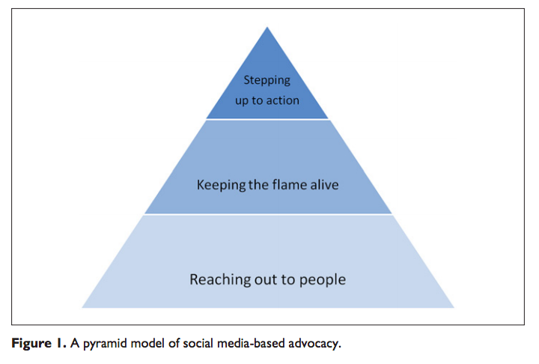
How to advocate? Tweeting social change
Tweeting social change
Facebook campaigns
Guo and Saxton, 2014

Slide 25
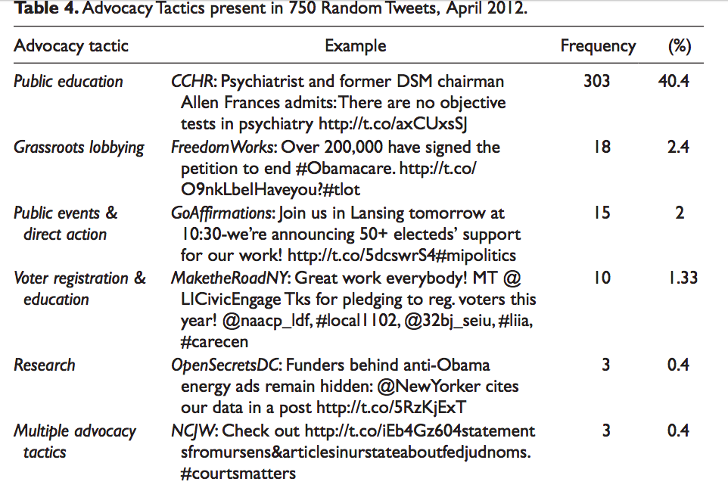
Guo and Saxton, 2014

Slide 26
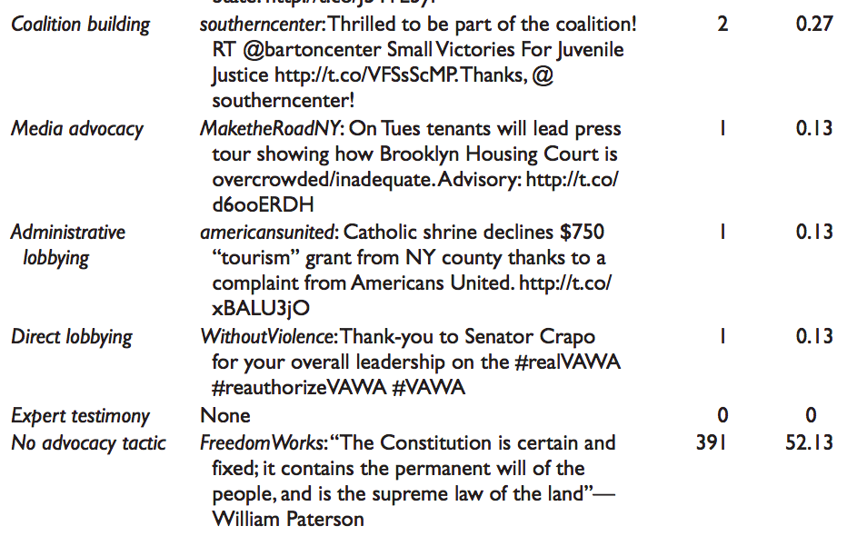

Slide 27
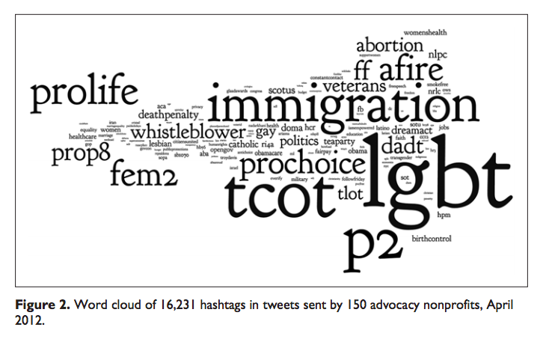
Keeping the flame alive
Guo and Saxton, 2014

Slide 28
Public Funding and Its Impact on Nonprofit Advocacy
relationship between public funding and nonprofit engagement in advocacy (Neumayr at al. 2015)
two main lines of argument:
  resource dependence theory: NPOs that receive public funding will eventually reduce their advocacy activities or even refrain from them altogether for fear of losing their funding
  the nonprofits who receive public funding will increase their engagement in advocacy

Slide 29
So does it affect…?
Empirical studies: mixed results, mostly on US
Austria (Neumayr at al. 2015):
  no significant relationship between advocacy and the receipt of public funding or the proportion of an organization’s total revenue coming from public funding
  the degree to which nonprofits engage in advocacy is influenced by the geographic range of operation and field of activity

Slide 30

Successful advocacy campaigns?
– My sme les (Slovakia, only in Slovak language)
https://www.mysmeles.sk/

Slide 31
Campaigns during migration crisis
E.g. :
Refugees welcome movement
Výzva k ľudskosti (Slovakia)
Global Migration Journey: #sharethejourney

Slide 32
Citizen Lobbying: How Your Skills Can Fix Democracy
By Alberto Alemanno (at TEDxBrussels)
https://www.youtube.com/watch?v=WqNf2OPdu8c

Slide 33
Going the Digital Route
By Marci Harris, a former congressional staffer, founded Popvox, a non-partisan platform to engage digitally with Congress https://www.youtube.com/watch?v=5aKyYR-iWpc

Slide 34
Advocacy Through Social Media: Why Trending Topics Matter
By Karen McAlister (at TEDxUTA)
https://www.youtube.com/watch?v=o4sGLLaLq-Q

Slide 35
Thank you for participation

