Slide 1
Accounting (Basics) - Lecture 4
METHODICAL PARTS OF ACCOUNTING, ACCOUNT AND ACCOUNT SYSTEM, CHART OF ACCOUNTS AND OUTLINE OF ACCOUNTS, ACCOUNTING DOCUMENTS, ACCOUNT BOOKS, BASIC ACCOUNTING CONCEPTS AND PRINCIPLES, ACCOUNTING CONTROL SYSTEM.

Slide 2
Content
Methodical parts of accounting
Account and account system
Chart of accounts and outline of accounts
Accounting documents
Account books
Basic accounting concepts and principles
Accounting control system

Slide 3
Basic concepts
The simplest form of an account has three parts: (1) a title, which is the name of the item recorded in the account and usually also the number of account;
(2) a space for recording increases in the amount of the item, in terms of money; and
(3) a space for recording decreases in the amount of the item, also in monetary terms.
This form of an account, illustrated below, is known as a T account because of its similarity to the letter T.

Slide 4
T-account
Number (usually 3 figures) - Title
Active side Passive side Debit side Credit side

Slide 5
T-accounts
The left side of the account is called the debit side and the right side is called the credit side.
Amounts entered on the left side of an account, regardless of the account title, are called debits to the account, and the account is said to be debited.
Amounts entered on the right side of an account are called credits, and the account is said to be credited.
The concrete marking of accounts results from list of accounts.

Slide 6
Types of accounts
There are three basic types of accounts under double-entry (financial) accounting system.
The balance sheet accounts (assets, liabilities, equity),
Resulting accounts (cost (expense) and revenue accounts)
Closing accounts (profit and loss acount (income summary account), opening balance sheet account, closing balance sheet account)

Slide 7
Types of accounts
The balance sheet accounts are used for charging of assets and equities.
They influence the balance sheet of the company.
Resulting accounts are used for charging of costs (expenses) and revenues.
They influence the profit and loss statement of the company.
Closing accounts are used for opening and closing of the balance sheet and resulting accounts at the beginning and at the end of accounting period.

Slide 8
Double-entry principle
Under double-entry accounting system all economic transactions lead to changes on two different accounts.
All these transactions must be charged on the opposite sides of two different accounts, it means once it is charged on the debit side, and once it must be charged on the credit side of another account.
This principle is called double-entry principle.

Slide 9
Asset, liability and equity accounts
The balance sheet accounts can be divided into another three parts – into asset accounts, liability accounts and into equity accounts.

Slide 10
Asset accounts
The asset accounts are used for charging of the assets and the system of charging on these accounts is as follows:
Bank account
Opening balance
Increase of assets
Decrease of assets
Turnover of debit side
Turnover of credit side
Final balance

Slide 11
Opening balance, turnover, final balance
Opening balance (OB) (or opening stand (OS)) is the amount of assets or equities at the beginning of accounting period.
Turnover of account’s side is the amount of items charged on this side of account during accounting period without the opening balance.

Slide 12
Opening balance, turnover, final balance
Final balance (FB) (or final stand (FS)) is the amount of assets, equities, costs (expenses) or revenues at the end of accounting period.
The final balance is calculated as the opening balance + turnover of the side where the increases are recorded (debit side of asset and cost (expense) accounts, credit side of equity and revenue accounts) – turnover of the side where decreases are recorded (credit side of asset and cost (expense) accounts, debit side of equity accounts and revenue accounts).

Slide 13
Liability and equity accounts
The system of charging on liability and equity accounts is as follows:
Common stock
Opening balance
Decrease of equity
Increase of equity
Turnover of debit side
Turnover of credit side
Final balance

Slide 14
Cost (expense) accounts
Resulting accounts can be also divided into two groups – into cost (expense) accounts and into revenue accounts.
The system of charging on cost accounts can be described like this:
Consumed material
Increase of costs
Decrease of costs
Turnover of debit side
Turnover of credit side
Final balance

Slide 15
Revenue accounts
The system of charging on revenue accounts can be described on this way:
Revenues from sales
Decrease of revenues
Increase of revenues
Turnover of debit side
Turnover of credit side
Final balance

Slide 16
Note
Cost (expense) and revenue accounts have no opening balance.
It is logical, because costs (expenses) and revenues influence the economic result that is always created separately from previous accounting periods.

Slide 17
Opening balance sheet account
The balance sheet accounts are opened at the beginning of accounting period by double-entry records with the help of account Opening balance sheet account.
The system of opening of balance sheet accounts is as follows:

Slide 18
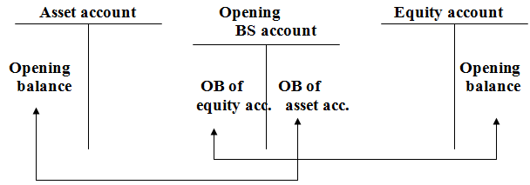
Opening balance sheet account

Slide 19
Closing of the accounts
At the end of accounting period the accounts must be closed with using of accounts Profit and loss account (in case of cost (expense) and revenue accounts) and Final balance sheet account (in case of asset and equity accounts).
The scheme of closing of accounts is as follows:

Slide 20
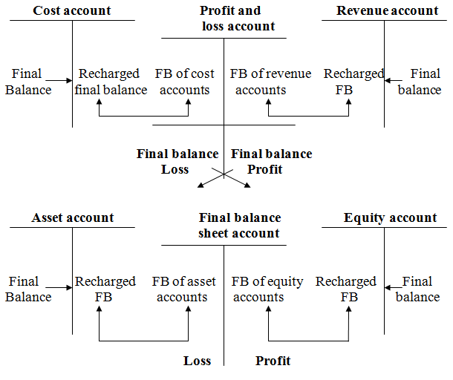
Closing of the accounts

Slide 21
  Accounting books in double-entry accounting
The economic transactions in double-entry accounting system are recorded into three basic accounting books. These books are:
  The journal,
  The ledger,
  The analytic evidence.

Slide 22
  Accounting books in double-entry accounting
The function of the journal is to record all economic transactions realized during an accounting period in chronological sequence.
Then the journal itself is the basic checking accounting book for checking of completeness of the accounting evidence.
The structure of the journal is following:

Slide 23
Journal
The journal has usually 6 basic columns:
Date – the date of realization of the transaction is recorded into this column,
Number – the number of transaction (or number of accounting document) is recorded into this column,
Transaction – the description of the realized transaction is recorded into this column,
DS (debit side) – the number of an account (in according with the list of accounts) on which the transaction will be recorded on the debit side, is recorded into this column,

Slide 24
Journal, Ledger
CS (credit side) - the number of an account (in according with the list of accounts) on which the transaction will be recorded on the credit side, is recorded into this column,
Amount – the amount (in CZK) is recorded into this column.
The function of the ledger is to record all economic transactions realized during an accounting period on synthetic accounts in according with their factual nature. In fact the ledger contains the synthetic accounts (T – accounts).

Slide 25
Analytic evidence
The function of the analytic evidence is to record some economic transactions realized during an accounting period in more detailed evidence than the ledger.
The analytic evidence contains the analytic accounts adding the synthetic accounts and providing more detailed information about assets, liabilities and equity, costs and revenues.
The analytic evidence makes possible to obtain additional information necessary for management of the enterprise.
The journal and the ledger must be kept always.

Slide 26
Basic accounting concepts and principles
The double-entry accounting is based on several basic accounting concepts and principles.
The most important principles and concepts are:
Matching concept – concerns the determination of the economic result (net profit or net loss).
The determination of the periodic economic result is a two-step process in double-entry accounting.
First, revenues are recognized during the accounting period.

Slide 27
Basic accounting concepts and principles
Second, the costs (expenses) of assets consumed in generating the revenues must be matched against the revenues in order to determine the net profit or the net loss.
Revenues are recognized and recorded on the accounts according to various criteria.
The same situation is in case of expired costs.
Adequate disclosure – financial statements and their accompanying footnotes or other explanatory materials should contain all of the pertinent data believed essential to the reader’s understanding of the enterprise’s financial status.

Slide 28
Basic accounting concepts and principles
Criteria for standards of disclosure often must be based on value judgements rather than on objective facts.
Consistency – interested persons should be able to assume that successive financial statements of an enterprise are based consistently on the same generally accepted accounting principles (so-called US GAAP) (in the United States), on the same IAS/IFRS (International accounting standards, International Financial Reporting Standards) (in the European Union) or on the same Czech accounting standards (in the Czech Republic).

Slide 29
Basic accounting concepts and principles
If the principles are not applied consistently, the trends indicated could be the result of changes in the principles used rather than the result of changes in business conditions or managerial effectiveness.
The concept of consistency does not completely prohibit changes in the accounting principles and methods used.
Changes are permissible when it is believed that the use of a different principle or method will more fairly state the economic result and financial position.

Slide 30
Basic accounting concepts and principles
In such cases, the reason for the change and its effects on profit should be disclosed in the financial statements of the period in which the change in principle is made (in the Czech Republic this information should be disclosed in the notes).
Materiality – the accountant must consider the relative importance of any event, accounting procedure, or change in procedure that affects items on the financial statements.
Absolute accuracy in accounting and full disclosure in reporting are not ends in themselves.

Slide 31
Basic accounting concepts and principles
The determination of what is significant and what is not requires the exercise of judgement.
Precise criteria cannot be formulated.
To determine materiality, the size of an item and its nature must be considered in relationship to the size and the nature of other items.
Going concern – generally, a business is not organized with the expectation of operating for only a certain period of time.

Slide 32
Basic accounting concepts and principles
In most cases, it is not possible to determine in advance the length of life of an enterprise, and so an assumption must be made.
The nature of an assumption will affect the manner of recording some of the business transactions, which in turn will affect the data reported in the financial statements. It is customary to assume that a business entity has a reasonable expectation of continuing in business at a profit for an indefinite period of time.

Slide 33
Basic accounting concepts and principles
When there is conclusive evidence that a business entity has a limited life, the accounting procedures should be appropriate to the expected terminal date of the entity.
Changes in the application of normal accounting procedures may be needed for business organizations in receivership or bankruptcy.
In such cases, the financial statements should clearly disclose the limited life of the enterprise and should be prepared from so-called “quitting concern” or liquidation point of view, rather than from “going concern” point of view.

Slide 34
Checking tools
Because of difficulty of financial accounting and a high number of transactions recorded in accounting evidence, it is necessary to have some simple tool for basic checking of accuracy of accounting evidence.
One of the basic tools is so-called trial balance.
The trial balance is used for checking of double-entry principle.
The scheme of trial balance is following:

Slide 35
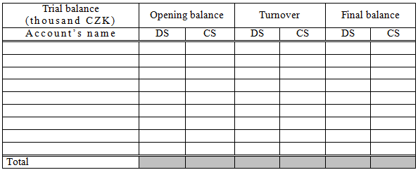
Checking tools

Slide 36
Checking tools
If the double-entry principle is broken, there is inequality in the row total between amounts in columns debit side and credit side in columns opening balance, turnover and final balance.
If this inequality occurs, it is necessary to find out the mistake in the accounting evidence of enterprise.

Slide 37
Checking tools
Remember: The equality in trial balance does not mean automatically the absolute accuracy of accounting evidence.
Summary: The trial balance does not provide complete proof of accuracy of the ledger.
It indicates only that the debits and the credits are equal.
This proof is of value, because errors frequently affect the equality of debits and credits.

Slide 38
Checking tools
If the two totals of a trial balance are not equal, it is probably due to one or more of the following types of errors:
Errors in preparing the trial balance, for example:
  One of the columns of the trial balance was incorrectly added,
  The amount of an account balance was incorrectly recorded on the trial balance,
  A debit balance was recorded on the trial balance as a credit, or vice versa, or a balance was omitted entirely.

Slide 39
Checking tools
Error in determining the account balances, such as:
  A balance was incorrectly computed,
  A balance was entered in the wrong balance column.
Error in recording a transaction in the ledger, such as:
  An erroneous amount was posted to the account,
  A debit entry was posted as a credit, or vice versa,
  A debit or a credit posting was omitted.

Slide 40
Checking tools
Among the types of errors that will be not revealed by the trial balance, because they will not cause an inequality in the trial balance totals, belong the following:
  Failure to record a transaction or to post a transaction,
  Recording the same erroneous amount for both the debit and the credit parts of a transaction,
  Recording the same transaction more than once,
  Posting a part of a transaction correctly as a debit or credit but to the wrong account.

Slide 41
Checking tools
The amount of the difference between the two totals of a trial balance sometimes gives a clue as to the nature of the error or where it occurred.
Usually the difference of 100, 1 000, 10 000, etc. between two totals is frequently the result of an error in addition.
A difference between totals can also be due to the omission of a debit or a credit posting or, if the difference is divisible evenly by 2, to the posting of a debit as a credit, or vice versa.

Slide 42
Checking tools
Two other common types of errors are known as transpositions and slides.
Transposition is an erroneous rearrangement of digits, such as writing 852 as 582.
In a slide, the entire number is erroneously moved one or more spaces to the right or to the left, such as writing 642,00 as 6420,0.
If an error of either type has occurred and there are no other errors, the discrepancy between the two totals will be evenly divisible by 9.

Slide 43
Checking tools
A preliminary examination along the lines suggested by the preceding paragraphs will frequently disclose the error.
If it does not, the general procedure is to retrace the various steps in the accounting process, beginning with the last step and working back to the original entries.
While there are no rigid rules for discovering errors, the errors that have caused the trial balance totals to be unequal will ordinarily be discovered before all of the procedures outlined in the following suggested plan have been completed:

Slide 44
Checking tools
  Verify the accuracy of the trial balance totals by re-adding the columns,
  Compare the listings in the trial balance with the balances shown in the ledger, making certain that no accounts have been omitted,
  Recompute the balance of each account in the ledger,
  Trace the postings in the ledger back to the journal, placing a small check mark by the item in the ledger and also in the journal. If the error is not found, examine each account to see if there is an entry without a check mark. Do the same with entries in the journal,
  Verify the equality of the debits and the credits in the journal.

Slide 45
Checking tools
It is readily apparent that care should be exercised both in recording transactions in the journal and in posting to the accounts.
The desirability of accuracy in determining account balances and reporting them on the trial balance is equally obvious.

