Slide 1
Organization Life Cycle

Slide 2
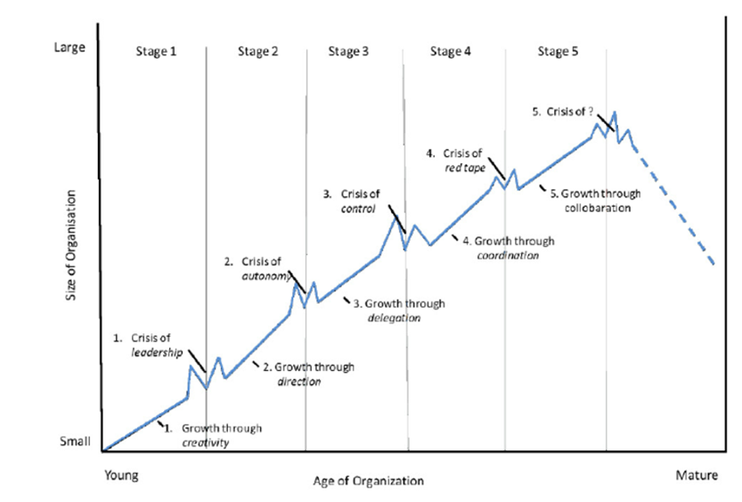

Slide 3
Organisation growth
Greiner´s growth model :
Growth through creativity
  Leadership crisis
Growth through direction
  Autonomy crisis
Growth through delegation
  Control crisis
Growth through coordination
  Red-tape crisis
Growth through collaboration ( cooperation)
  Crisis ?

Slide 4
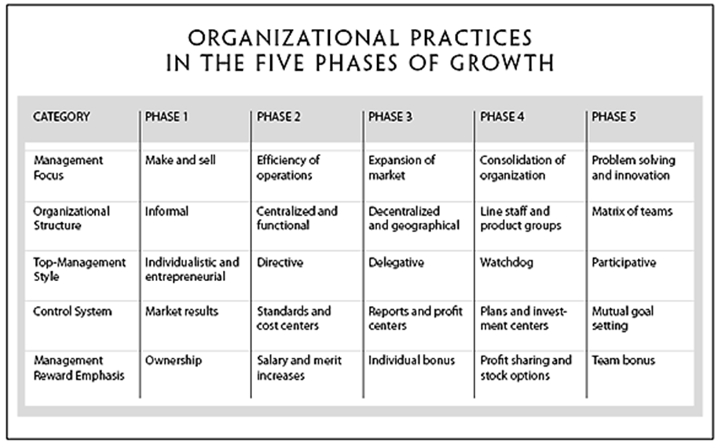

Slide 5
Creativity – crisis of leadership
The founders of the company are usually technically or entrepreneurially oriented, and they generally disdain management activities; their physical and mental energies are absorbed entirely by making and selling a new product.
Communication among employees is frequent and informal.
Long hours of work are rewarded by modest salaries and the promise of ownership benefits.
Decisions and motivation are highly sensitive to marketplace feedback; management acts as customers react.

Slide 6
Direction – crisis of autonomy
A functional organizational structure is introduced to separate manufacturing from marketing activities, and job assignments become increasingly specialized.
Accounting systems for inventory and purchasing are introduced.
Incentives, budgets, and work standards are adopted.
Communication becomes more formal and impersonal as a hierarchy of titles and positions grows.
The new manager and his or her key supervisors assume most of the responsibility for instituting direction; lower-level supervisors are treated more as functional specialists than as autonomous decision-making managers.

Slide 7
Delegation – crisis of control
Much greater responsibility is given to the managers of plants and market territories.
Profit centers and bonuses are used to motivate employees.
Top-level executives at headquarters limit themselves to managing by exception based on periodic reports from the field.
Management often concentrates on acquiring outside enterprises that can be lined up with other decentralized units.
Communication from the top is infrequent and usually occurs by correspondence, telephone, or brief visits to field locations.

Slide 8
Coordination – red tape crisis 1/2
Decentralized units are merged into product groups.
Formal planning procedures are established and intensively reviewed.
Numerous staff members are hired and located at headquarters to initiate companywide programs of control and review for line managers.
Capital expenditures are carefully weighed and parceled out across the organization.

Slide 9
Coordination – red tape crisis 2/2
Each product group is treated as an investment center where return on invested capital is an important criterion used in allocating funds.
Certain technical functions, such as data processing, are centralized at headquarters, while daily operating decisions remain decentralized.
Stock options and companywide profit sharing are used to encourage employees to identify with the organization as a whole.

Slide 10
Collaboration - ? Crisis 1/2
The focus is on solving problems quickly through team action.
Teams are combined across functions to handle specific tasks.
Staff experts at headquarters are reduced in number, reassigned, and combined into interdisciplinary teams that consult with, not direct, field units.
A matrix-type structure is frequently used to assemble the right teams for the appropriate problems.

Slide 11
Collaboration - ? Crisis 2 /2
Formal control systems are simplified and combined into single multipurpose systems.
Conferences of key managers are held frequently to focus on major problems.
Educational programs are used to train managers in behavioral skills for achieving better teamwork and conflict resolution.
Real-time information systems are integrated into daily decision-making processes.
Economic rewards are geared more to team performance than to individual achievement.
Experimenting with new practices is encouraged throughout the organization.

Slide 12
Life cycle of the enterprise
The existence of an enterprise is limited in time by its origin - the beginning of the business and the termination of its business activity.
An enterprise passes four phases of the life cycle
1. Establishment, start up, launch
2. Growth,
3. Maturity
4. Decline .

Slide 13
VW – How big is VW ( Honda)?
https://www.youtube.com/watch?v=ws1o-024es
https://www.youtube.com/watch?v=DNnV3Jb3pkA

Slide 14
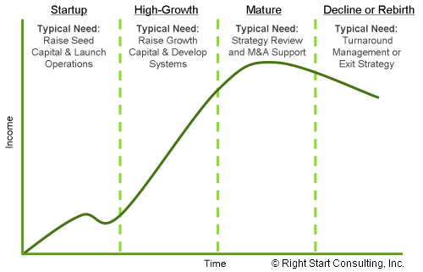
Life cycle of enterprise

Slide 15
Establishment, start up
Birth of the business,
Profit is negative
Business is very vulnerable at this time.
Small businesses, such as a sole trader or partnership, have unlimited liability: when the business owner is personally responsible for all the debts of his or her business.
Detailed planning during this stage can greatly increase the chances of success.
The main challenge at the establishment stage is to get the business on a solid foundation by generating enough sales to create a positive cash flow.

Slide 16
Growth
business is continually gaining regular customers.
Sales are increasing and cash flow is almost always positive.
SME (10 and 15 employees)
need for long term planning.
Advertisement is important
need to make investments in relevant equipment or employees to ensure a good reputation.
Owners must be careful not to expand faster than their business can adapt to the changes.

Slide 17
Growth and expansion can occur either through a merger or acquisition (takeover).
A merger occurs when the owners of two separate businesses agree to combine their resources and form a new organisation

Slide 18
An acquisition (takeover) occurs when one business takes control of another business by purchasing a controlling interest in it.
Vertical integration occurs when a business expands at different but related levels in the production and marketing of a product.

Slide 19
Horizontal integration occurs when a business acquires or merges with another firm that makes and sells similar products.
Diversifi cation (or conglomerate integration) occurs when a business acquires or merges with a business in a completely unrelated industry

Slide 20
Maturity
Sales are increasing in lower rate.
business is thriving with a good customer base and regular cash flow
more formal and detailed approach towards planning
it is important to make quick decisions with a good chance of success
the rate of change has slowed; more detailed long term plans can be made

Slide 21
It may be wise to re-evaluate the businesses mission and vision statements to match when the business is now. There is a good chance they will have changed since establishment; assuming the owner has been flexible to ensure success.
The goal is to maintain profits at pre-existing levels.
Marketing and financial management are center to ensure your position .

Slide 22
Post-Maturity
The final stage consists of three possible outcomes:
Renewal: New areas of growth cause increased sales and profits
Steady State: A continuing state of maturity.
Decline: Profits begin to fall as a result of poor management; often a direct result of a drop in sales or excess expenses.

Slide 23
Renewal
Often a direct result of new markets being tapped to create new areas of growth, expanding the reach of products and services the business provides.

Slide 24
Steady State
To maintain a steady state, focus should be on what existing customers are currently demanding. This requires market research for accurate results. A steady state stops expenditure on research and development required for renewal. Be warned, a steady state cannot be maintained forever and will fall into decline if not forced into renewal.

Slide 25
Decline
Decline is difficult to reverse for the following reasons:
Financial institutions are reluctant to lend money to high risk businesses
Suppliers will restrict credit facilities and may insist on cash payments
Products may have become obsolete
Well qualified employees may begin to leave to seek out better opportunities, without a strong workforce, the rate of decline increases.

Slide 26
Cessation
Voluntary cessation - of own accord
Involuntary cessation – forced by others
The two main causes of business decline (and possible failure) are lack of management expertise or undercapitalisation

Slide 27
Voluntary cessation
A business may cease operations and voluntarily wind up its affairs. Any assets owned by the business are sold. The business stops operating because the owner may wish to retire, wants a change of lifestyle or, in the case of a sole trader, has died
However, most businesses cease to trade due to business failure. With debts increasing and a negative cash fl ow, a business owner will soon realise if their business is underperforming. To prevent this accumulation of debt, the owner will need to cease operating the business of their own accord; that is, undergo voluntary cessation.

Slide 28
Involuntary cessation
Many businesses, however, fi nish involuntarily. The owner is forced to cease trading by the creditors of the business; that is, undergo involuntary cessation. Creditors are those people or businesses who are owed money.
Even though a business appears to be in fi nancial diffi culty, many owners
continue operating in the hope that ‘things will get better’. In many cases they do not. As the business continues its decline, creditors become worried about the money they are owed and force the business owner into winding up the business.

Slide 29
Sole traders and partnerships may voluntarily or involuntarily go into bankruptcy:
a declaration that a business, or person, is unable to pay his or her debts.
A company has two options when facing financial difficulties:
  (a) voluntary administration occurs when an independent administrator is appointed to operate the business in the hope of trading out of the present financial problems.
  (b) voluntary or involuntary liquidation is the process of an appointed liquidator converting the business’s assets into cash

Slide 30
Liquidation normally occurs because the company is insolvent
It is estimated that an average 30 to 40 people are personally affected by one company insolvency.

Slide 31
L.E. Greiner (1998) Harvard Business Review.
Business studies in action ( chapter4)

