Slide 1

Introduction to MS Dynamics Business Central
(NAV in Cloud, SaaS, the future of Dynamics NAV a new name for Dynamics 365 for Finance and Operations )
Ing.J.Skorkovský,CSc.
MASARYK UNIVERSITY BRNO, Czech Republic
Faculty of economics and business administration
Department of corporate economy
Reason for this short PWP presentation : what would we expect in the future

Slide 2
MS Dynamics 365 Business Central
Microsoft Dynamics 365 Business Central is a cloud-based, all-in-one business management solution which enables customers to upgrade from their entry-level accounting software or legacy ERP system to one single, comprehensive solution to manage finances, operations, sales and customer service. Helping organisations streamline their processes, improve customer relations and enable growth through:
Text for home study
Business without silos—connecting businesses and boosting efficiency with automated tasks and workflows, all within the familiar Microsoft interface of applications such as Word, Outlook and Excel.
Actionable insights—achieving more and gaining a complete view of the business with connected data, business analytics and guidance delivered by Microsoft’s leading intelligent technologies.
Solutions built to evolve—get started quickly, growing and adapting in real time with a flexible platform that makes it easy to extend beyond Business Central based on evolving business needs.

Slide 3
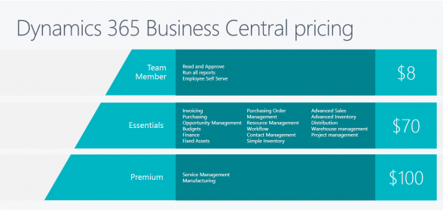
Central Pricing

Slide 4
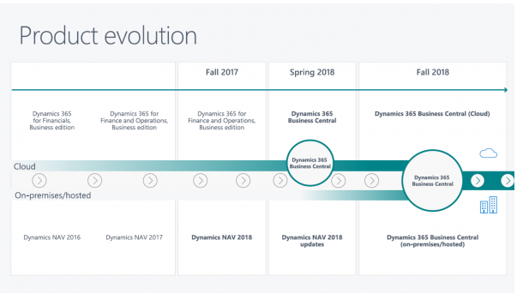
Product Evolution
Today

Slide 5
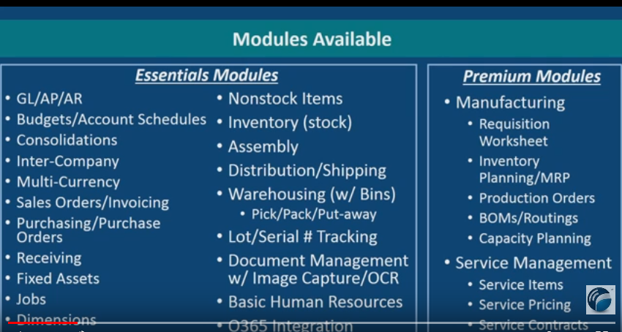
Basic modules
Resource : video : https://www.youtube.com/watch?v=2zFSo_o1AwU

Slide 6
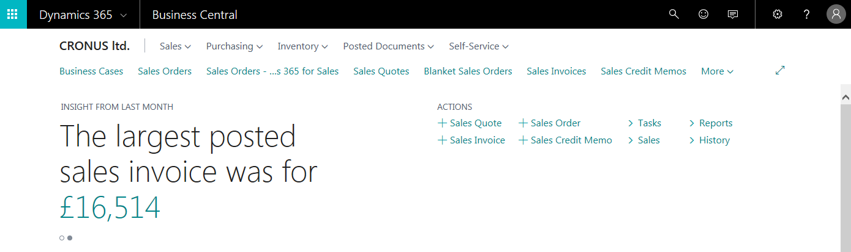
1st part of title screen
(První část titulní obrazovky)

Slide 7
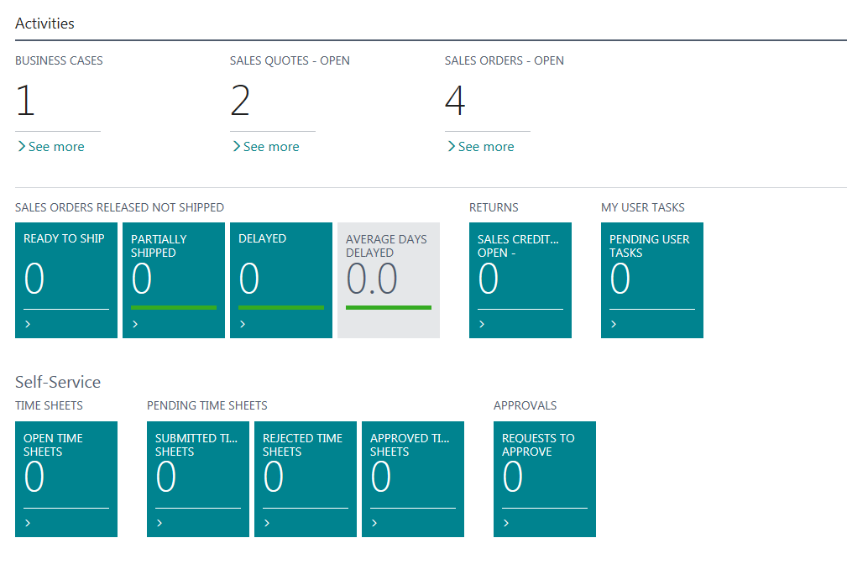
2nd part of title screen
(Druhá část titulní obrazovky)

Slide 8
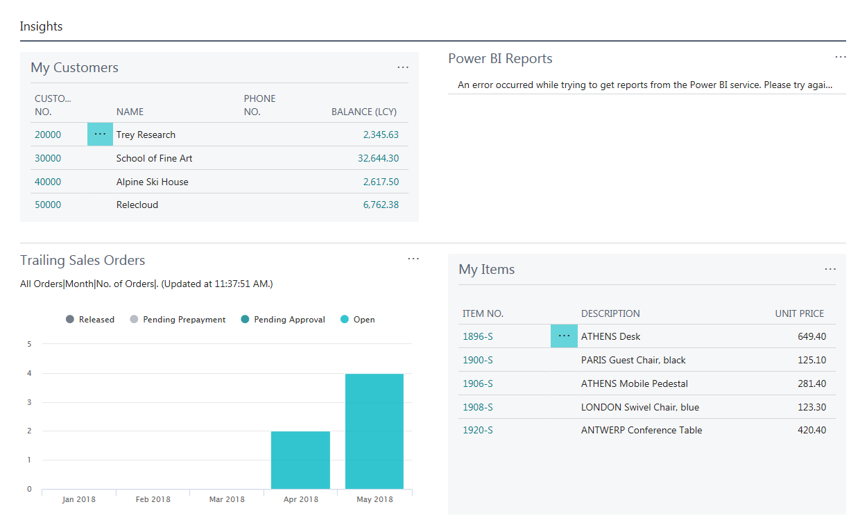
3rdd part of title screen
(Třetí část titulní obrazovky)

Slide 9
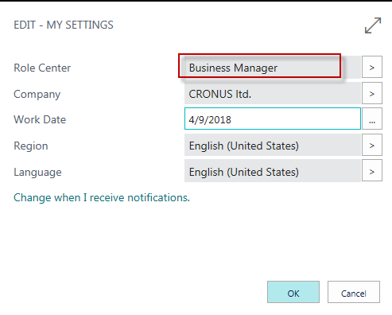
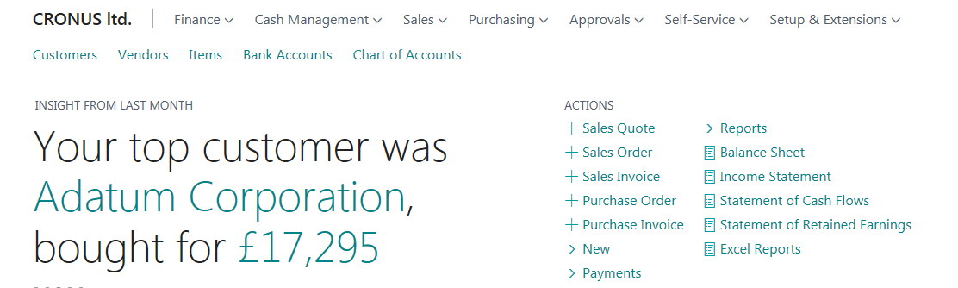
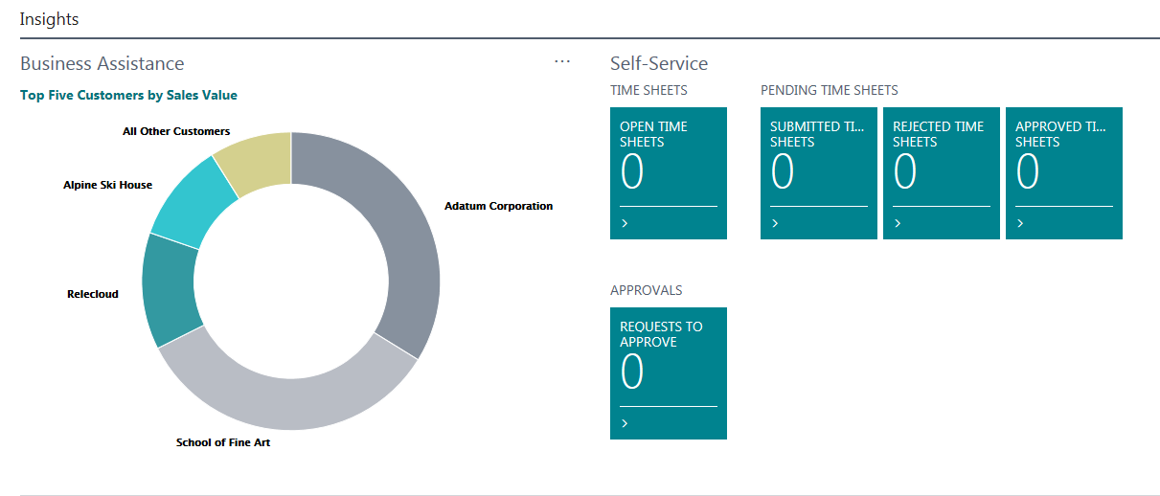
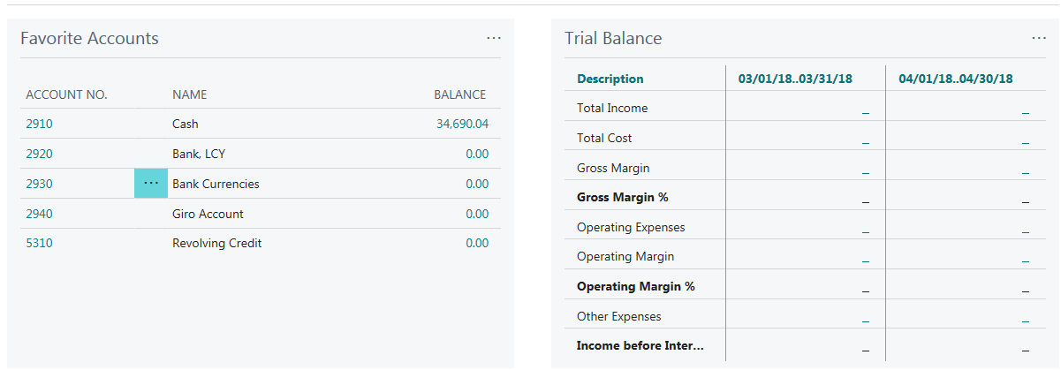
Change setup based on user skills and position

Slide 10
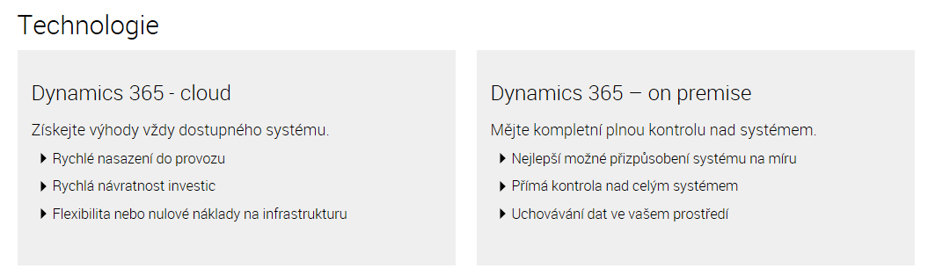
Technologie Dynamics 365

Slide 11
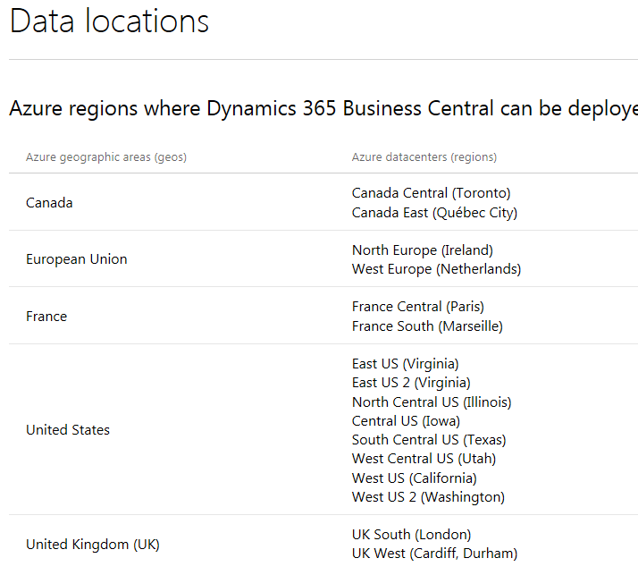
Countries so far available

Slide 12

End of the sections Business Central

