Slide 1
Introduction to MS Dynamics NAV
(ATP_CTP)
Ing.J.Skorkovský,CSc.
MASARYK UNIVERSITY BRNO, Czech Republic
Faculty of economics and business administration
Department of corporate economy

Slide 2
ATP-CTP
Available-to-Promise (Lze slíbit)
Capable-to-Promise (Možné slíbit)
ATP – based on the inventory reservation system – performing the availability check (calculation of the date of delivery )
CTP – based on WHAT IF scenarios. Earliest date in which an item will be available
If no items that can be available, no inbound orders- purchase, transfer , return, production – it calculates Earliest Date, creates Order lines, and reserves the inventory.
Maybe integrated to the production scheduling, transfer and purchase

Slide 3
ATP -CTP
Requested Delivery
Date=RDD
Shipment
Date=SD
Planned Shipment
Date= Plan SD
Planned Delivery
Date=Plan DD
Manually
entered
Output
Warehouse
Handling Time=OWHT
Shipping
Time=ST
Promised Delivery
Date=Prom DD
Calculation
Navision calculates earliest PDD taking into account inventory
availability without customer´s requirements
Navision verifies, if by hand entered RDD is realistic
taking into account inventory availability (backward calculation)
Next

Slide 4






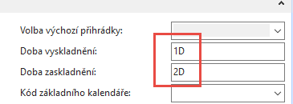
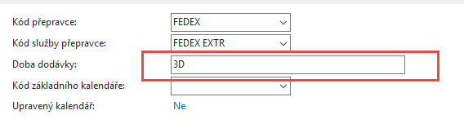
ATP -CTP
Location
BLUE
Output
Warehouse
Handling Time=OWHT=1D
IWHT=2D
Shipping
Time=ST=1D
Customer->Shipping->Shipping Agent Services->
Shipping Time and Calendars
In the text for 2018|2019 course it is 2D and 1D
Customer
In the text for 2018|2019 course it is 2D only (Fedex Standard)

Slide 5
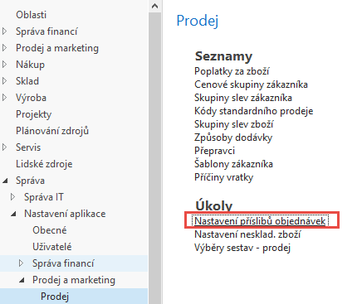
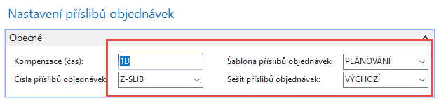
ATP –CTP – Order Promising Setup
In the setup for 2018|2019 course was Plánování,
but better to get Purchase order to change to Pož
(Request)
The field Offset time – Kompenzace(čas) contains the period of time that the program must wait before
it is allowed to issue a new Purchase Order, Production order or Transfer Order.
The period starts with the current date.
The time units of measure that you can use are days, workdays, weeks, months, quarters or years.

Slide 6
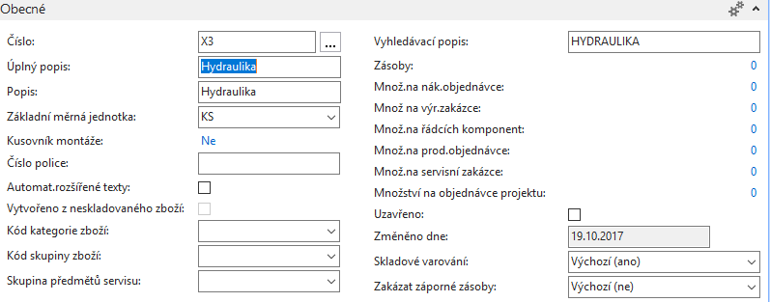
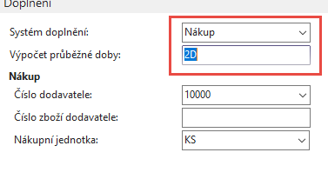
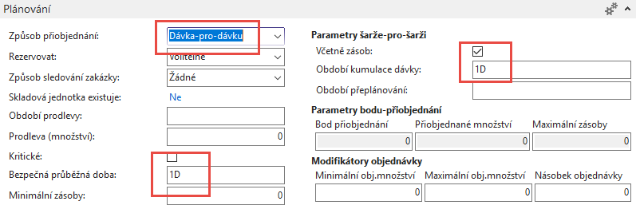
New Item X3
In the setup for 2018|2019 it was 4D
In the setup for 2018|2019 it was 2D

Slide 7
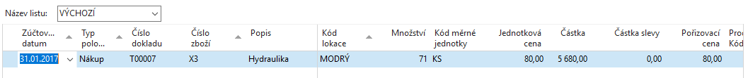
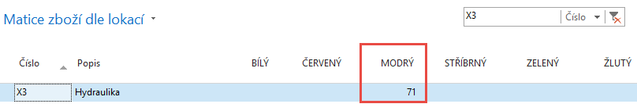
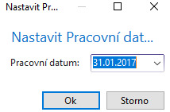
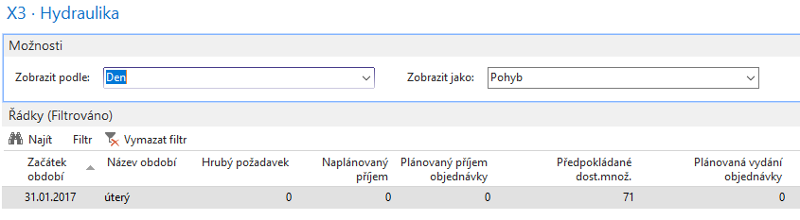
Purchase Item X3 by use of Item journal
Availability by period

Slide 8
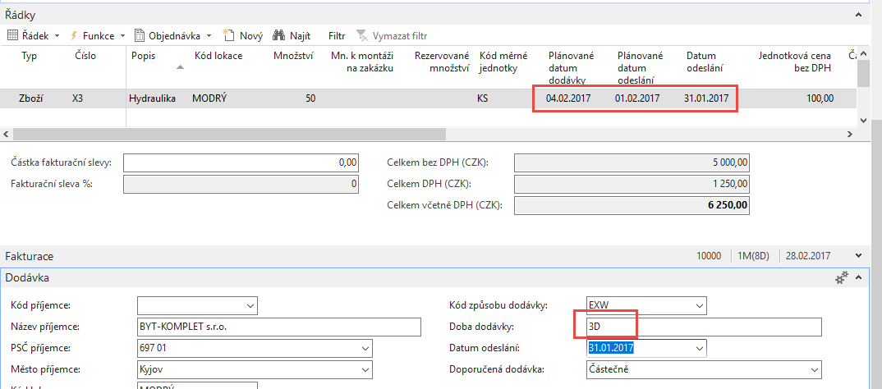
ATP –CTP – simple example
(Sales Order)
Output
Warehouse
Handling Time=OWHT
On the customer Card ST=1D and Shipping agent ST = 3D (Shipping agent setup has a priority over Customer ST=1D). Create new Shipping agent method EXTRA =ESF transport =3D and overwrite again shipment time on Customer card to 1D only

Slide 9
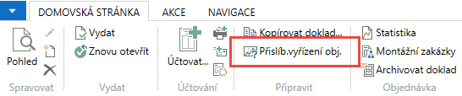

ATP –CTP – simple example
Viz další snímek

Slide 10
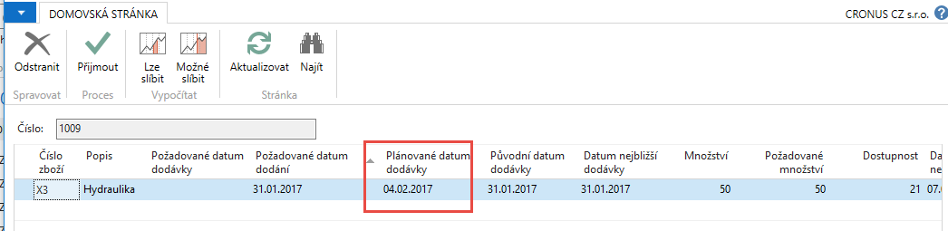
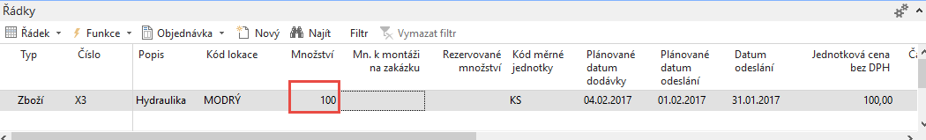
ATP –CTP – simple example
Lze slíbit
Next step- Accept (Přijmout)
Změna požadovaného množství v řádku PO 50->100

Slide 11
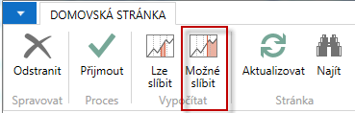
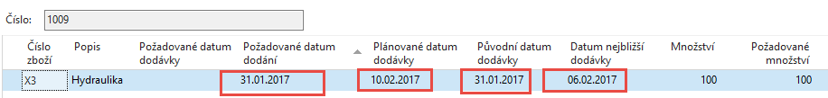
ATP –CTP – simple example ATP
SO line

Slide 12
ATP –CTP – simple example Lze (ATP) with LT=2D
6.2.- 31.1. = 6D = 2D LT + 1D SLT+ 1D IWHT+ 2D OWHT
10.2.-6.2. = 4D = 3 ST + 1D IWHT
IWHT = Inbound Warehouse Handling Time - čas naskladnění
OWHT = Outbound Warehouse Handling Time – čas vyskladnění
LT = Lead Time – průběžný čas
SLT = Safety Lead Time – bezpečný průběžný čas
ST = Shipment Time – čas dopravy

Slide 13
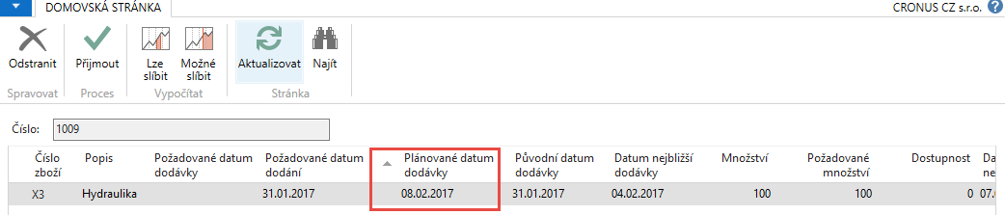
ATP –CTP – simple example
and change of lead time to 7 D on item card X3
4.12-2009 – 31.11.2009 = 4 DAYS = 1D SLT + 2D IWHT +1D OWHT + 7D LT
8.2.-4.2.=4 D = 3 ST + 1D OWHT
IWHT = Inbound Warehouse Handling Time - čas naskladnění
OWHT = Outbound Warehouse Handling Time – čas vyskladnění
LT = Lead Time – průběžný čas
SLT = Safety Lead Time – bezpečný průběžný čas
ST = Shipment Time – čas dopravy
Shipping time of shipping agent>higher
priority than ST on Customer card.

Slide 14
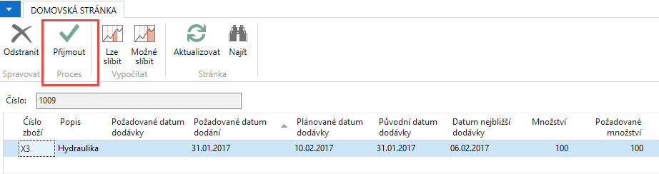
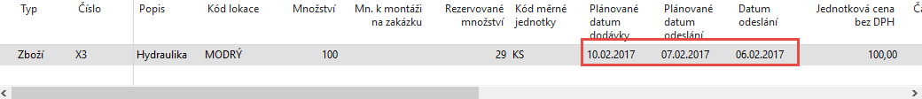
ATP –CTP – simple example
ST=3D
OWHT=1D

Slide 15
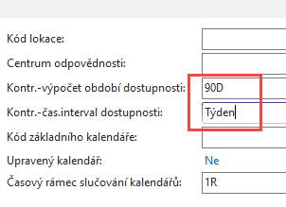
Setting up an Availability
Setup scenario : Application Setup – General -Company Information
90 days
1 week
6D
2W
13W
W=week
Today
90 days

Slide 16
ATP-CTP
See tab SO Shipping->Shipment Date !!!!
SEE XLS FILE ATP_CTP CALCULATIONS PLEASE
(Part of study material)
28.11.2008
12.12.2008
10 ks = Inventory , Lead Time=5D
20 ks = Purchase Order

Slide 17
More in detail
90 days
30.7.-1.5.=90 days

Slide 18

End of section
(ATP-CTP)

