Slide 1



Basics of Budget and its use
Jaromír Skorkovský
November 2017, Brno ,Czech Republic

Slide 2
Basic principles
General Ledger Item Entries (Debit amounts)
Dimensions
ADM
07.11.14
1500
Purchase Order
F9
Sales
100
07.12.2014
Difference = 500=2000-1500
Account 8420
(Entertainmnent and PR)
Account 8420
(Entertainment and PR )
Difference = 1400
(1500-100)
Budget for chosen Year
(Business Plan)
1002
8420
9510
D1
D2
D3
D 4
Direct Posting field
must be ticked !!!
2000
1500

Slide 3
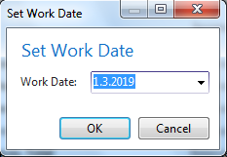
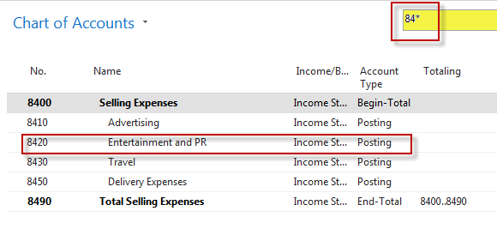
Simple budget example
+ 2 times Purchase Order with two lines
for consultation services (G/L account 8320)
In our example we will show only PO lines

Slide 4
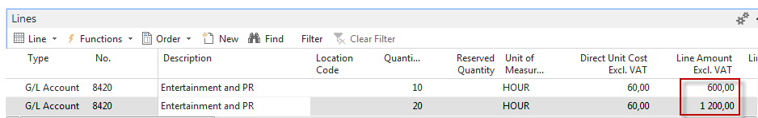
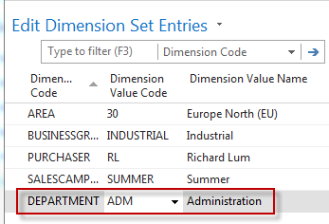
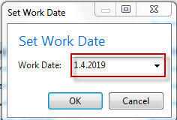
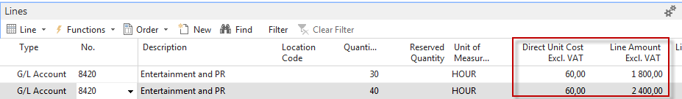
PO lines-generation of G/L Entries
Dimension = ADM
1.3.19, Cost=600=10x60
Dimension = SALES
1.3.19,Cost=1200=20x60
From Icon Line,
Dimensions
Post PO 1 and change of Working date to 1.4.2017
Dimension = ADM
1.4.19, Cost=1800
Dimension = SALES
30.1.19,Cost=2400
Purchase Order Line 2

Slide 5
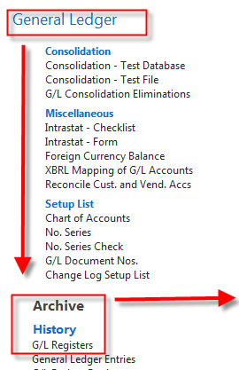
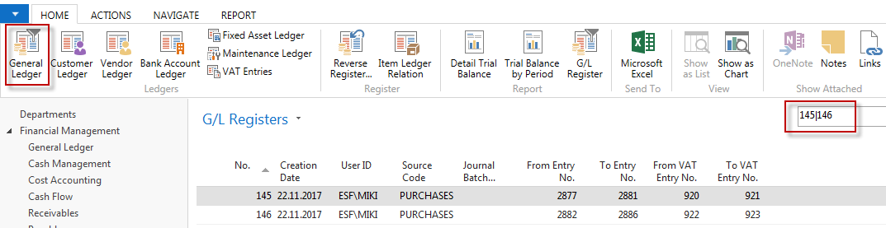
General Ledger Entries (filtered for just created ones)
See next slide to se G/L Entries

Slide 6
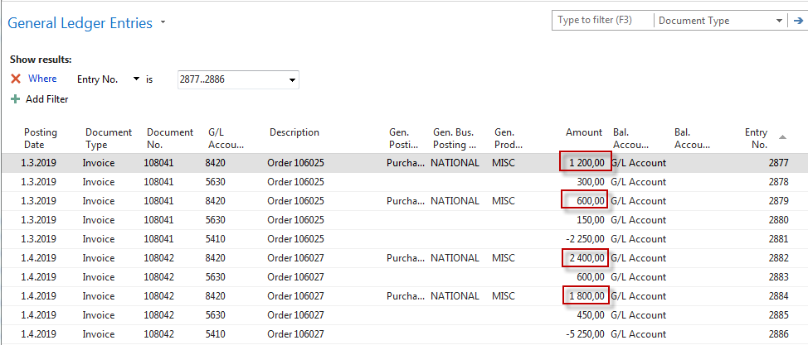
General Ledger Entries – what was posted =impact of two posted purchase orders
PO1
PO2

Slide 7
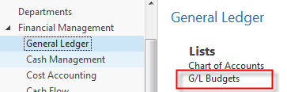
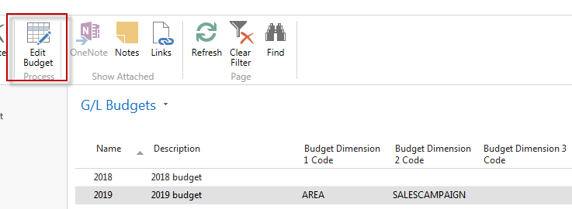

Setup data in Budget matrix
We have to go back in time

Slide 8
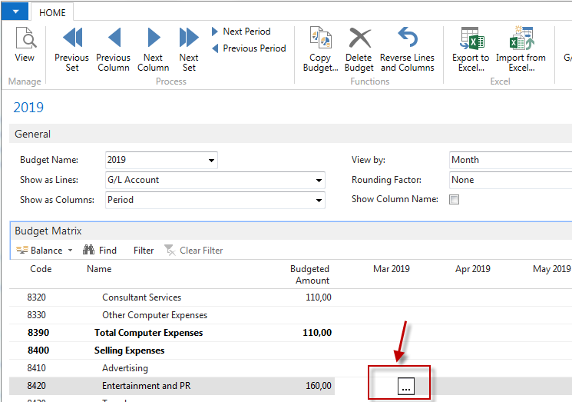
Budget Matrix
Setup of expected (budgeted) values
for chosen dimension

Slide 9
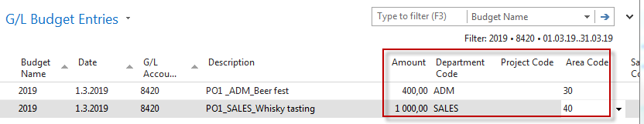


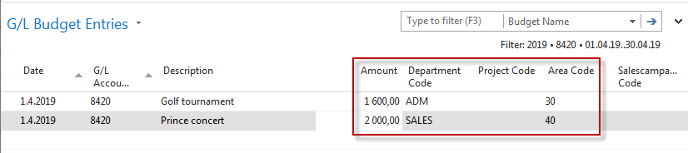


Setup of budget - values-manually entered

Slide 10
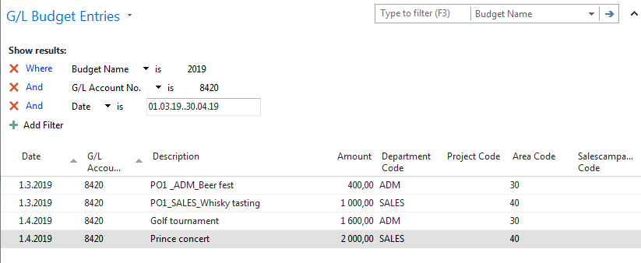
Setup of budget - values-manually entered
To see new setup of budget fro chosen account you must close
and open budget in order to refresh it !!

Slide 11
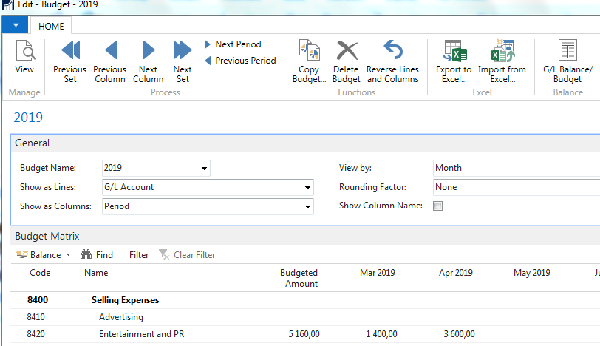
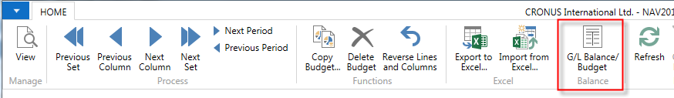
Budget

Slide 12
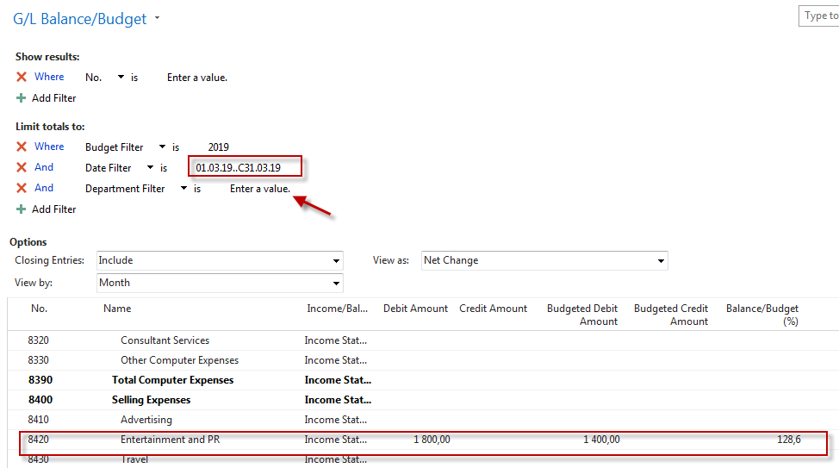
Budget calculation for March

Slide 13
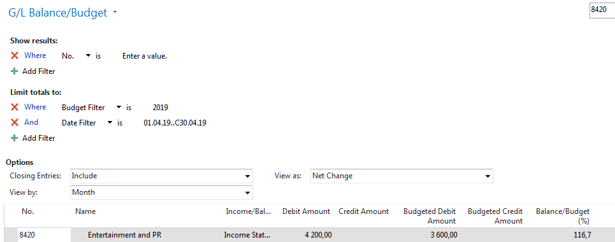
Budget calculation for April

Slide 14
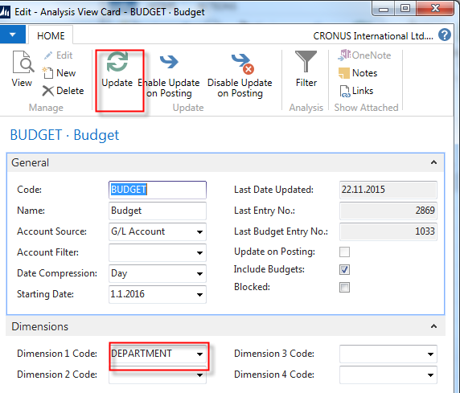
Creation of new Accounting Schedule view - home study
Use recently created Accounting Schedule TEST (see Intro PWP XIV)
It is necessary to update Analysis view in order to use data
created by this method in period which is not so far included

Slide 15
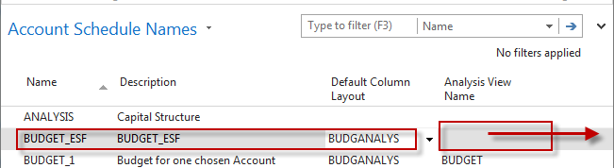
Account Shcedule
Enter data manually

Slide 16
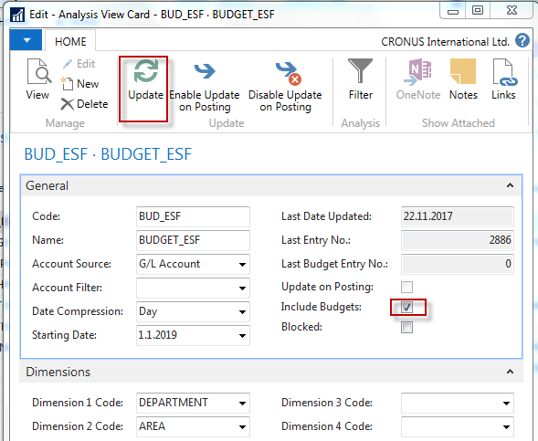
Accounting Schedule
Add Default column from predefined set of columns templates

Slide 17
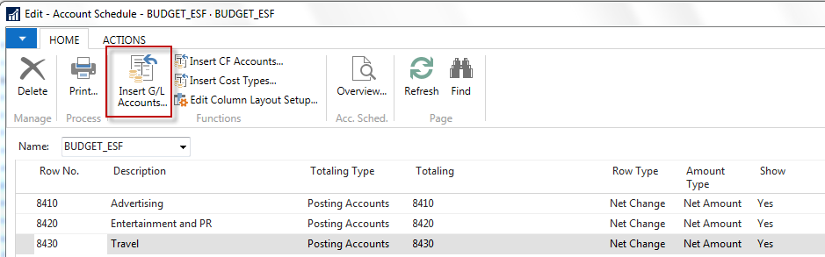
Template of budget Account Schedule (Edit Account Schedule)

Slide 18
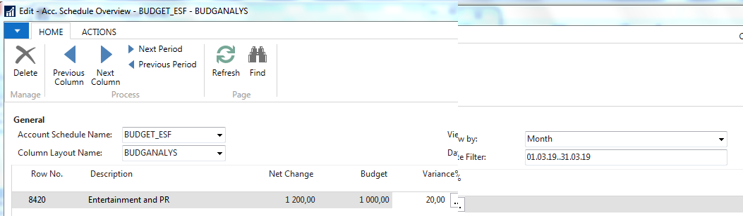

Overview of Accounting Schedule with use of filters ( SALES)
Net change =600 (1st PO line 1) for ADM dimension ->0
Net change =1200(2nd PO line 1) for SALES dimension->1200
Budget is 1000 difference is 20 %

Slide 19
Thanks for Your attention and time

