Slide 1
Introduction to MS Dynamics NAV (Non stock Items-Neskladové zboží)
English version of PWP show (Czech database)
(The key material for CZ students will be created
Ing.J.Skorkovský,CSc.
MASARYK UNIVERSITY BRNO, Czech Republic
Faculty of economics and business administration
Department of corporate economy

Slide 2
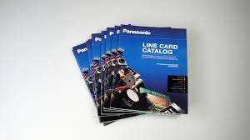
Nonstock Items
It enables to decrease quantity of Items cards
It enables to market many times more Items that you have currently in your stock
Nonstock Items (Catalog)
e.g. 2 000 000 pcs
Stock
e.g. 50 000 pcs

Slide 3
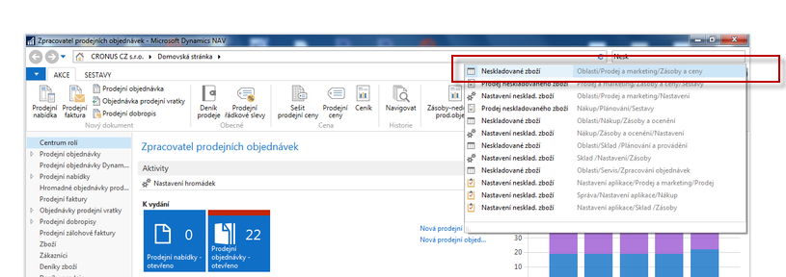
Nonstock Items

Slide 4
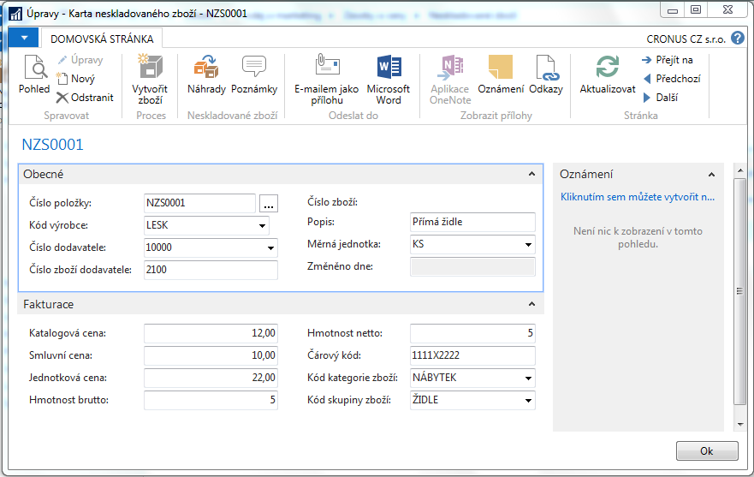
Nonstock Item Card

Slide 5
Vysvětlení některých důležitých polí
Katalogová cena: Toto pole obsahuje publikované náklady nebo ceníkovou cenu dodavatele neskladovaného zboží.
Smluvní cena : Toto pole obsahuje cenu, na které jste se dohodli, že zaplatíte za neskladovou položku.
Program používá obsah tohoto pole k aktualizaci pole Průměrná cena a Pevná cena na kartě zboží, kterou bude v případě potřeby (zájmu zákazníka) generovat

Slide 6
Explanation of sime important fields
Published costs (katalogová cena): Contains the published cost or vendor list price (Ceník) for the nonstock item.
Negotiated cost (smluvní cena): Contains the price you negotiated to pay for the nonstock item.
The program uses the contents of this field to update the
Average Cost field and Standard Cost field on the item card that it generates.

Slide 7
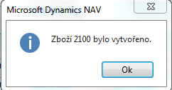
New Item Card from Nonstock Item Card creation (manually)

Slide 8
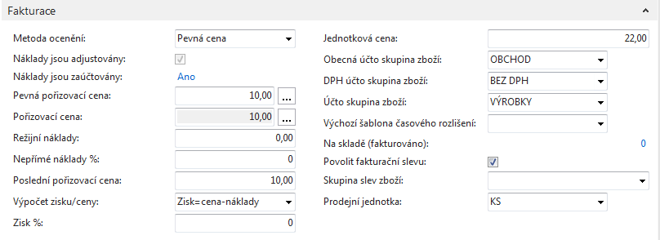
New item card from nonstock item card creation (manually)
Smluvní cena
(Negotiated cost=10, which is lower
than Published cost=12)
Jednotková cena
(Unit Price)

Slide 9
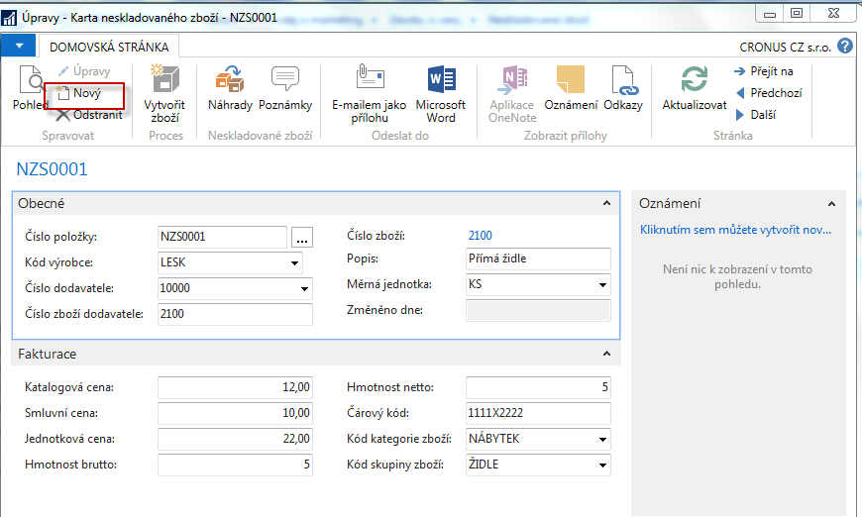
Creation of new nonstock item

Slide 10
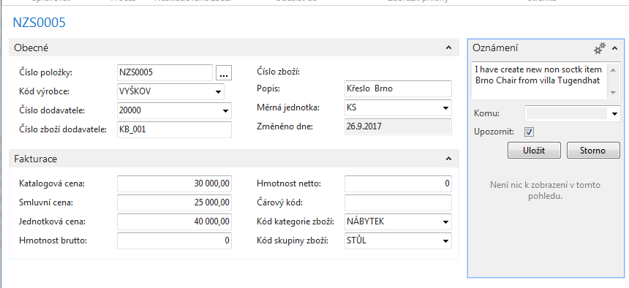
New nonstock item card

Slide 11
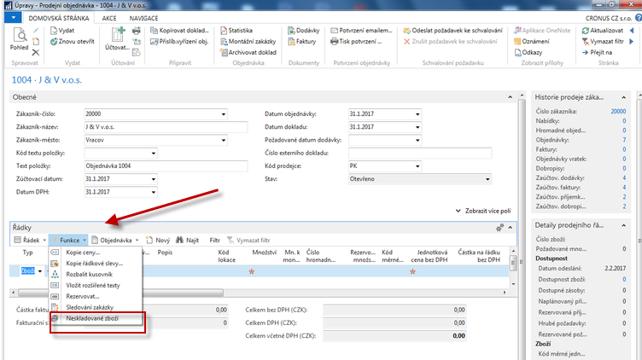
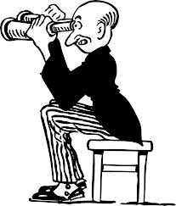
Sales Order
Sales Order

Slide 12
Sales Order – choice of nonstock item from the list

Slide 13
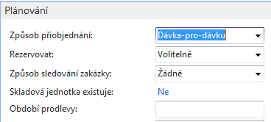
Sales Order Line
New created item card
Modification of tab Planning of this newly created card

Slide 14
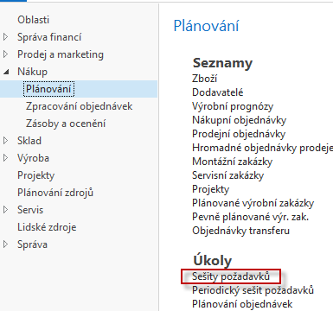
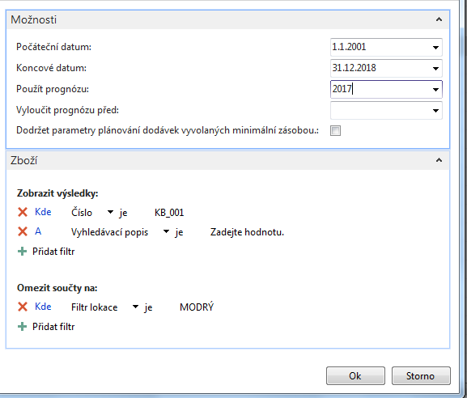
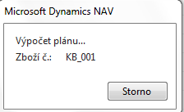
Requisition worksheet (Sešit požadavků)

Slide 15
Requisition worksheet (Sešit požadavků)
Creation of the new Purchase Order
Purchase Order Line

Slide 16
Item tracing
Sales Order Line

Slide 17
Thanks for Your attention and time

