Slide 1
Introduction to MS Dynamics
(Warehouse Management Role Tailored Client version) show for NAV 2016W1 and NAV 2016CZ
Ing.J.Skorkovský,CSc.
MASARYK UNIVERSITY BRNO, Czech Republic
Faculty of economics and business administration
Department of corporate economy

Slide 2
Simplified Warehouse Management (WM)
Use of location White-see setup next slides
WM creates another types of entries than Item Ledger Entries, Reservation Entries or Value Entries – Warehouse Entries
Causes of these entries are another stock operations :
  Receipt
  Put-away
  Pick
  Shipment

Slide 3
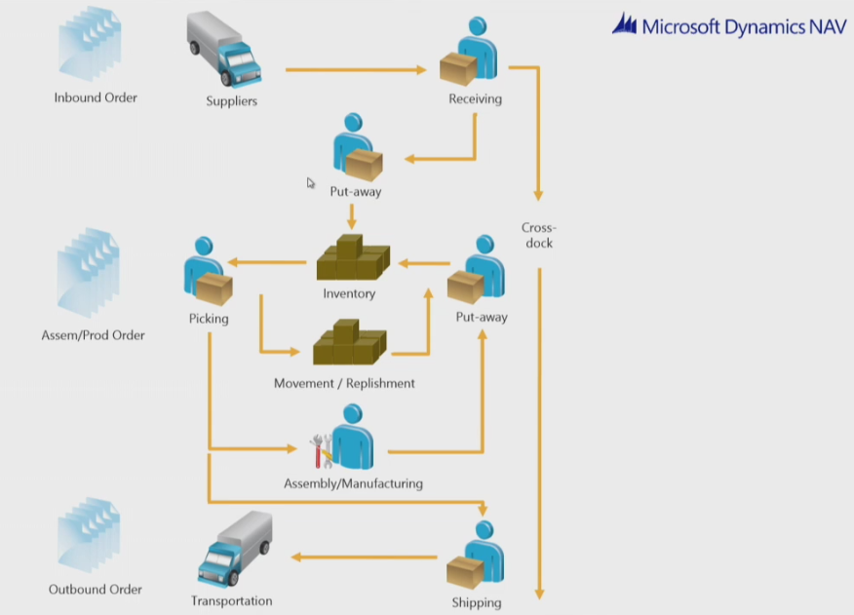
Warehouse workflow

Slide 4
Main WM Outline
Shipping Zone
Receiving Zone
Bin PutPick
PO
WHR
PA
B1
Pick
WHS
S0
B2
Bin W_08_001 (B0)
(Receiving Bin)
Bn
Bin W_09_001 ( E )
(Shipment Bin)
Item
Picking Zone
WHR=Warehouse Receipt; PA=Put-away; PO=Purchase Order; SO=Sales Order

Slide 5
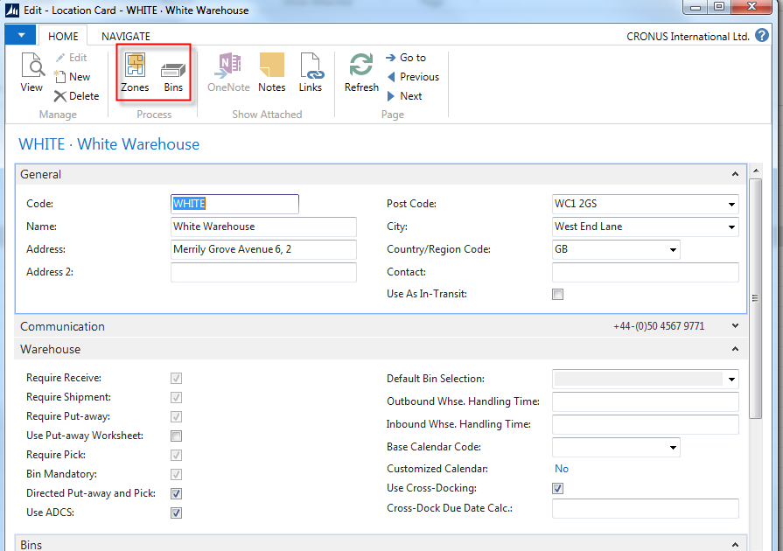
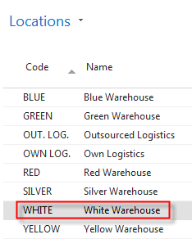
Location setup-White 2016W1

Slide 6
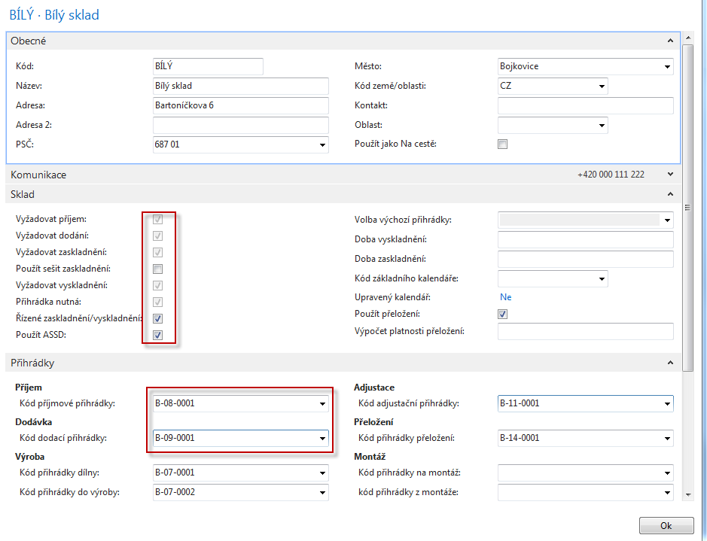
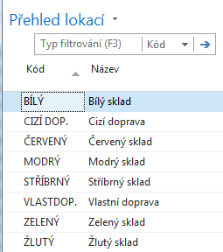
Location setup-White 2016CZ

Slide 7
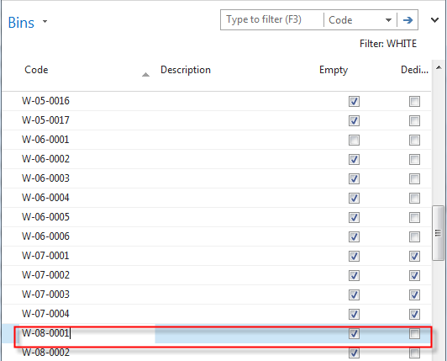
From White Location to Bins 2016W1
Bins can be empty or not, dedicated
or floating and so on. It is described in
related word document (WHM setting)

Slide 8
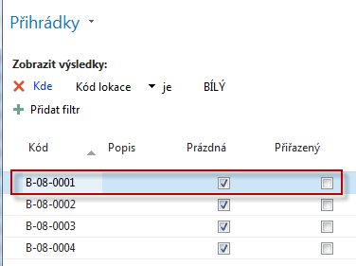
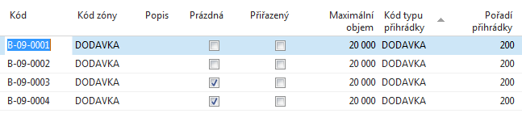
From White Location to Bins 2016CZ
Text for home study !!!
Bin ranking is a method of prioritizing replenishment movements picks and put-aways. Indicating which bin needs to be replenished or needs to have items picked or put away first. And this is done so with a bin ranking. And a bin with a high ranking number has a higher priority than the one with a low number.
Bins can be empty or not, dedicated or floating and so on. It is described in
related word document (WHM setting) – see study material !!

Slide 9
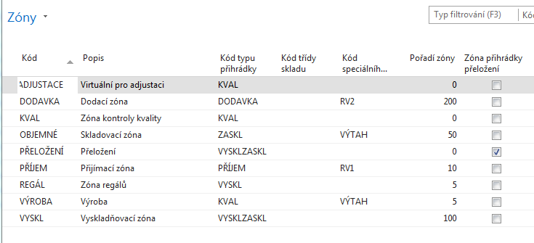
WH Zones 2016 CZ

Slide 10
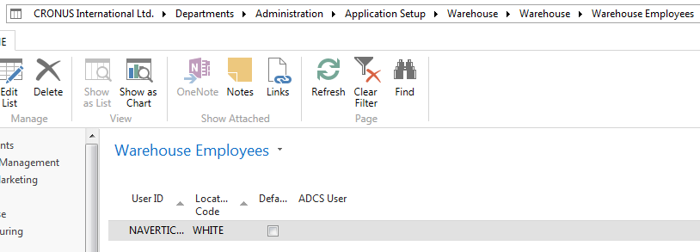
Setup of WH employee (e.g Puller or Picker)-2016W1
ADCS-Automatic Data Capture System
You can use your automatic data capture system (ADCS) to register all movements of items within the warehouse and to register all
journal activities, including quantity adjustments in the warehouse item journal, physical inventories and reclassifications.
To use ADCS, each item stored in the warehouse must be given an item identifier. You must also set up mini-forms, handheld functions, data exchanges and some fields concerning ADCS, all of which you can find in the Warehouse Management Setup window.
Text for home study !!!

Slide 11
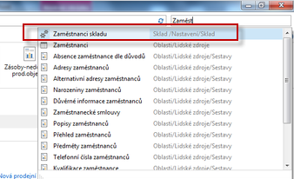
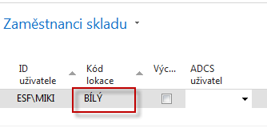
Setup of WH employee (e.g Puller or Picker) 2016CZ
ADCS-Automatic Data Capture System
Text for home study !!!
You can use your automatic data capture system (ADCS) to register all movements of items within the warehouse and to register all
journal activities, including quantity adjustments in the warehouse item journal, physical inventories and reclassifications.
To use ADCS, each item stored in the warehouse must be given an item identifier. You must also set up mini-forms, handheld functions, data exchanges and some fields concerning ADCS, all of which you can find in the Warehouse Management Setup window.

Slide 12
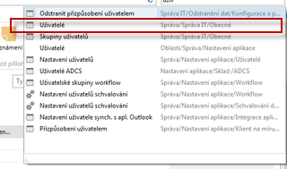
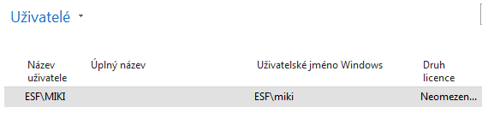
User setup 2016CZ

Slide 13
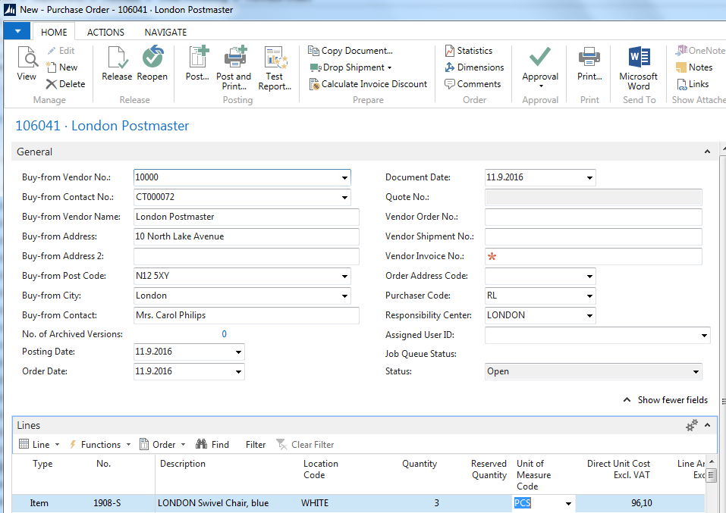
Purchase Order 2016W1

Slide 14
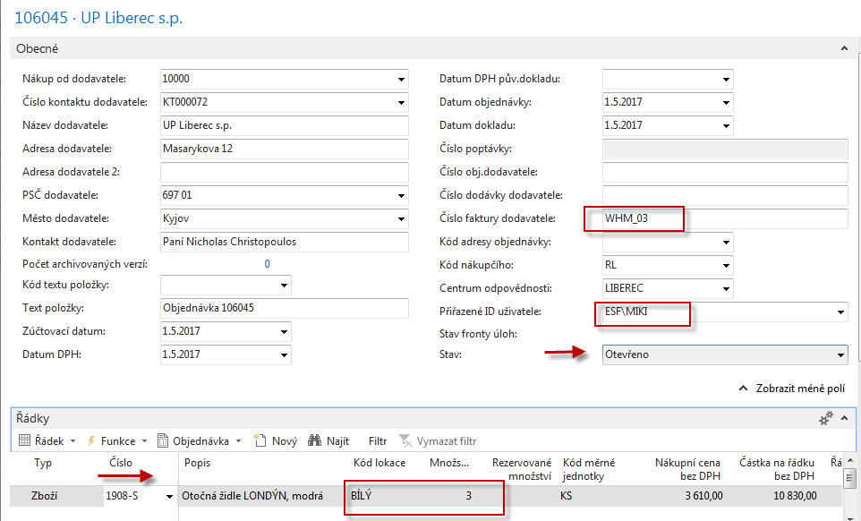
Purchase Order 2016CZ

Slide 15
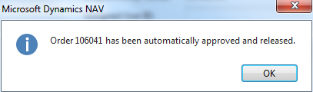


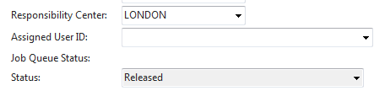
PO have to be firstly Approved ->Released 2016W1 (Approval will be not employed in 2016CZ!! Only Releasing)
Enter by F4 assigned employee (Puller,…)

Slide 16
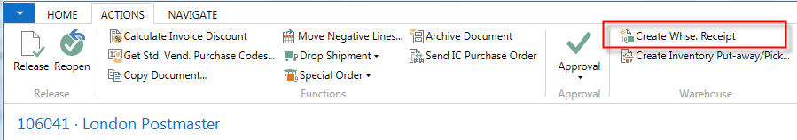
Creation of WH Receipt 2016W1

Slide 17
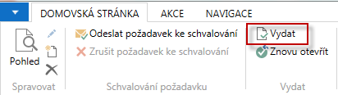
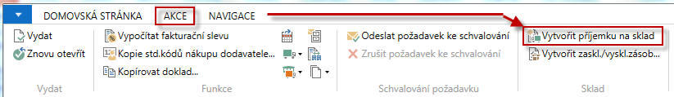
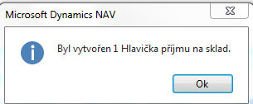
PO have to be firstly released 2016CZ
SEE next slide for NAV 2016CZ

Slide 18
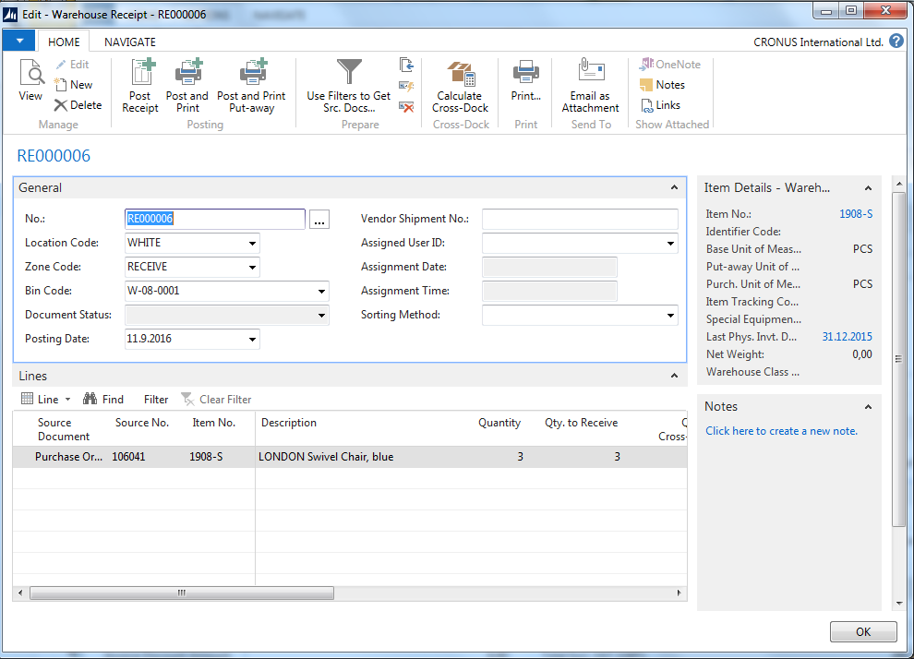
Created WH Receipt 2016W1
You can see Receiving bin (W-08-0001, see white location setup).
Zone : RECEIVE

Slide 19
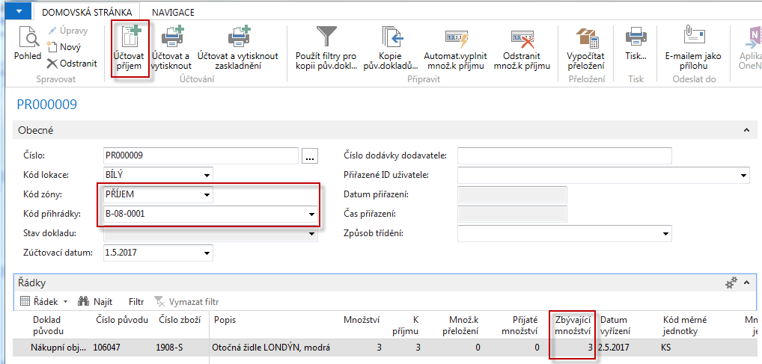
Created WH Receipt 2016CZ
You can see Receiving bin (W-08-0001, see white location setup).
Zone : RECEIVE
SEE next slide for NAV 2016CZ

Slide 20
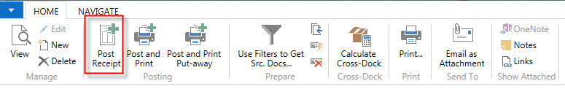
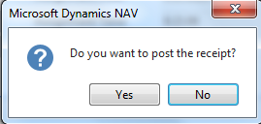
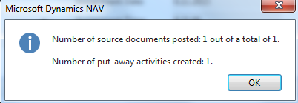
Posting of this document (WHR) 2016W1
Put-away is automatically created after Posting (F9) of Receiving document !!!

Slide 21
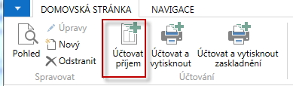
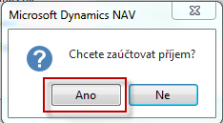
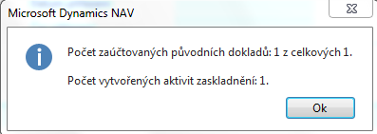
Posting of this document (WHR) 2016CZ
Put-away is automatically created after Posting (F9) of Receiving document !!!

Slide 22

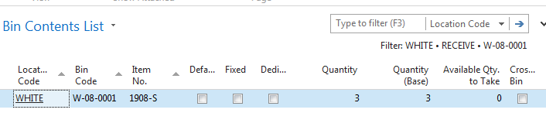
Receive bin is not empty 2016W1

Slide 23
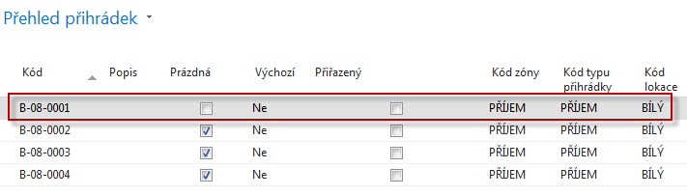
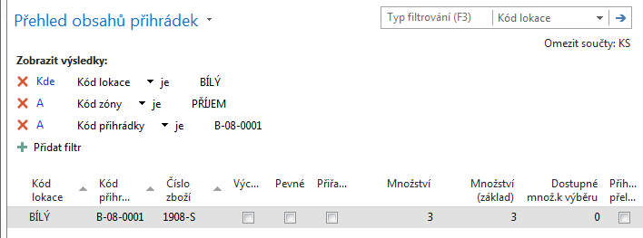
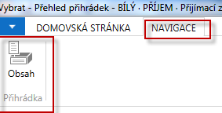
Receive bin is not empty 2016CZ

Slide 24
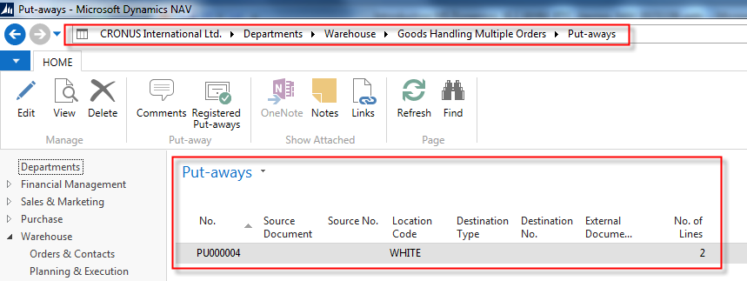
Put-away line 2016W1

Slide 25
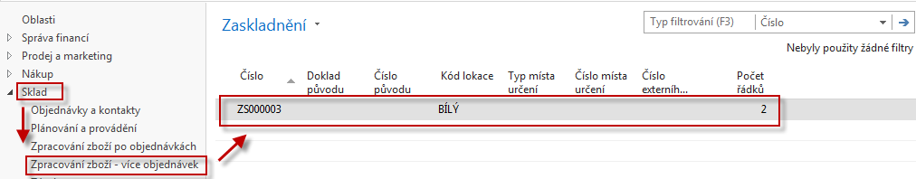
Put-away line 2016CZ

Slide 26
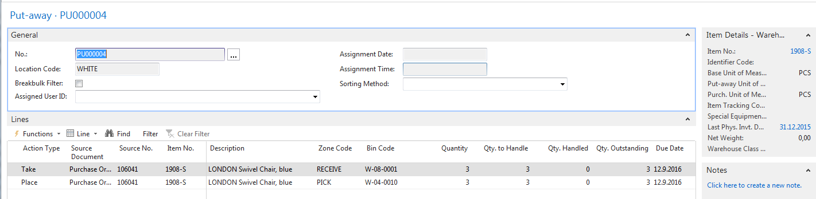
Put-away document 2016W1
Two actions : Take from bin W_08_0001 and Place to suggested W_04010

Slide 27
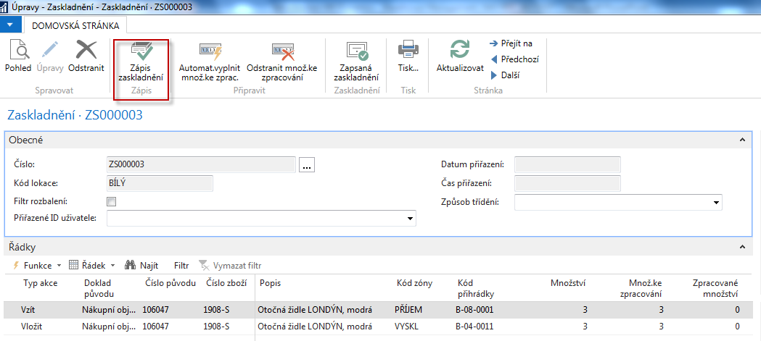
Put-away document 2016CZ
Two actions: Take (Vzít) from bin B_08_0001 and Place (Vložit) to suggested B_04011

Slide 28
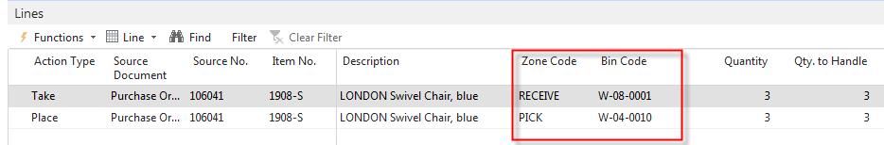
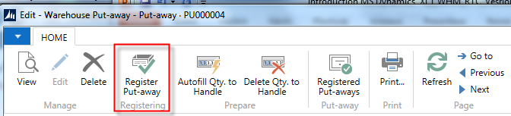
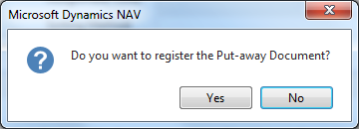
Register Put-Away 2016W1

Slide 29
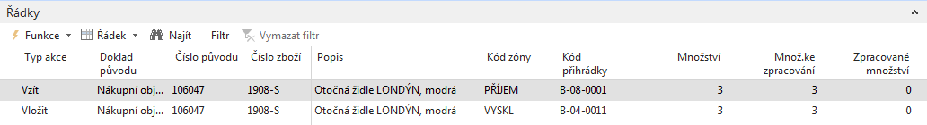
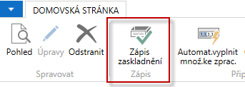
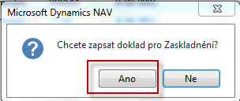
Register Put-Away 2016CZ

Slide 30
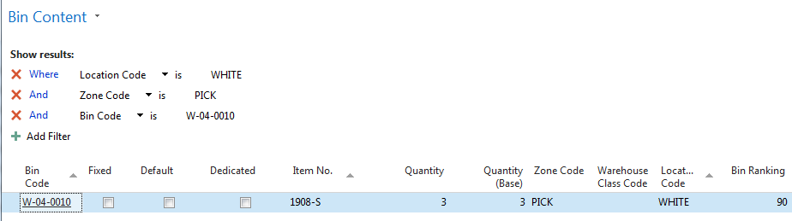
WH entries 2016W1
Report Bin Content

Slide 31

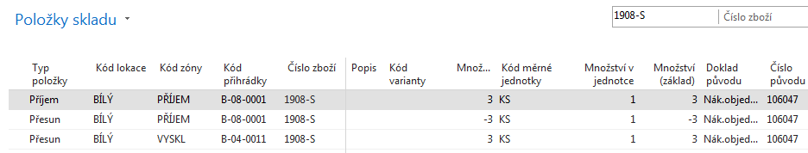
WH entries 2016CZ

Slide 32
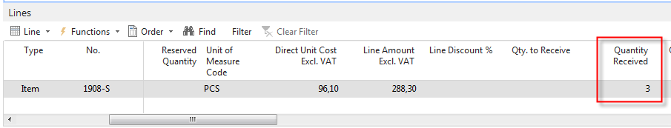
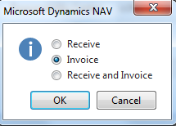
Posting of PO-only Invoice 2016W1!!!

Slide 33
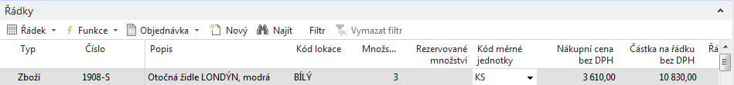
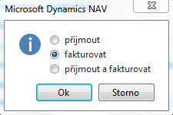
Posting of PO-only Invoice 2016CZ1!!!
Header of PO

Slide 34


Slide 35

Sales order and creation of WHS Shipment 2016W1
(error in picture, marked must be lower one : Create Warehouse-Shipment!!)
Must be released !!

Slide 36


Sales Order (SO)and creation of WHS Shipment 2016CZ
SO must be firstly released (Vydat) !!

Slide 37


Sales Order (SO) WHS Shipment 2016CZ
(vytvoření dodávky ze skladu-picking)
SEE created document

Slide 38


Warehouse Shipment has been created 2016W1

Slide 39
Warehouse Shipment has been created 2016CZ

Slide 40

WH Shipment document 2016W1
From this document you have to Create Pick !!!

Slide 41

WH Shipment document 2016CZ
From this document you have to Create Pick ! (Vytvořit vyskladnění) !!

Slide 42



Parameters necessary to create pick 2016W1

Slide 43


Parameters necessary to create pick 2016CZ1

Slide 44


Pick lines 2016W1

Slide 45


Pick lines 2016CZ

Slide 46


Pick lines 2016CZ
Manually enter quantity to handle (Množství ke zpracování)

Slide 47

Pick document 2016W1
You must enter manually or by BAR code reader Quantity to handle !!

Slide 48


Registering Pick Document 2016W1

Slide 49

Registering Pick Document 2016CZ

Slide 50


Shiping from WH Shipment 2016W1

Slide 51


Shiping from WH Shipment 2016CZ

Slide 52


Ship lines has been posted 2016W1

Slide 53

Ship lines has been posted 2016CZ

Slide 54



Posting of Sales order 2016W1

Slide 55


Posting of Sales order 2016CZ

Slide 56


Item ledger entries ands WH ledger entries 2016CZ

Slide 57
Classic 2009NAV -WHM

Slide 58


Location White I

Slide 59
Location White II

Slide 60


Setup if ID exists and we have to assign warehouse employee

Slide 61

PO and Open->Release

Slide 62


Creation of the Warehouse Receipt

Slide 63



WH Receipt (F11->PA created)

Slide 64




Receipt bin content

Slide 65




PO Lines after WH Receipt was posted
Created Put-aways
You can show a column there Action /Take-Place)

Slide 66



Registering Put-aways (F11)
Warehouse Entries

Slide 67


Warehouse Entries
Posting PO (only Invoice)

Slide 68

Sales Order
10=5+5

Slide 69


Creation of Warehouse Shipment
Before WH S creation change SO status from Open to Released !!

Slide 70



WHS Document and Pick Creation

Slide 71




Created Pick
W-03-0001
W-09-0001
YES

Slide 72

Before Registering …
Enter Quantity to Handle

Slide 73




WH Shipment document
How to get there from SO ???

Slide 74

SO –Post only Invoice
Warehouse Entries
See next slide

Slide 75


Warehouse Entries
Comment : use filter F7=Item No.=1896-S in order to only Item used in our model!!!

Slide 76

End of the section
(Warehouse management)

