Slide 1
“HRM
&
OrgDev”
Introduction
Prof. DI Johannes GÖLLNER, MSc
Masaryk University, Brno, CZ
October, 05th, 2018, 10:00–15:50
Lecture 1

Slide 2
Relevant CONTENT of HRM & OrgDev:
Which problems should have been solved by Human Resource Management in organizations, and in further consequence in economy and society?
Relation between organizational and individual capabilities and skills for strategic and operational organizational development
Relevance of Knowledge Management for Human Capital Leadership?
Models and methods for skill analysis and development (input, output and comparison models and methods with a special focus on assessment centres)
A practical example for the application of the assessment centre method in context of HRM
Relation between HRM, Knowledge Management and Risk Management for organizational development, controlling and leadership

Slide 3
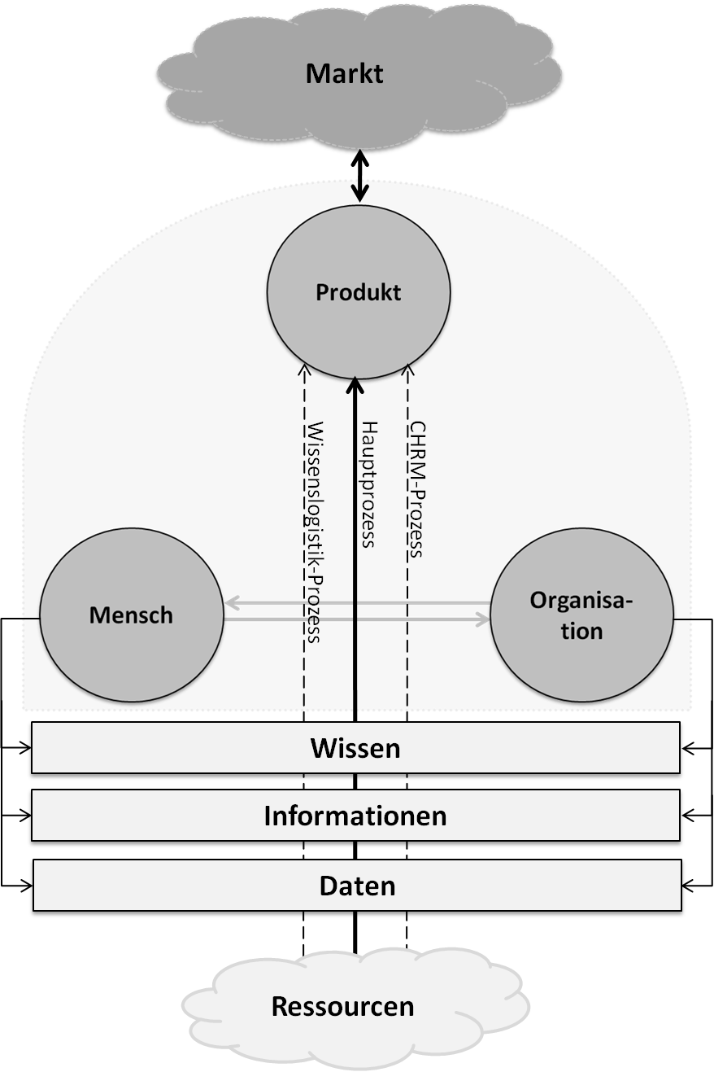
/market
Generic description
of the system ORGANISATION
/product
/human being
/main process
/knowledge
/data
Quelle: Copyright by GÖLLNER,
publiziert iRd MT-Hartinger, Donau Universität Krems, 05/2012, S.71
/resources

Slide 4


Slide 5

Organisation-Development
EVALUATION
(Controlling)
SCENARIO
Knowledge
(FC, SC, HC, RC)
ORGANISATIONAL
OPERATION

Slide 6
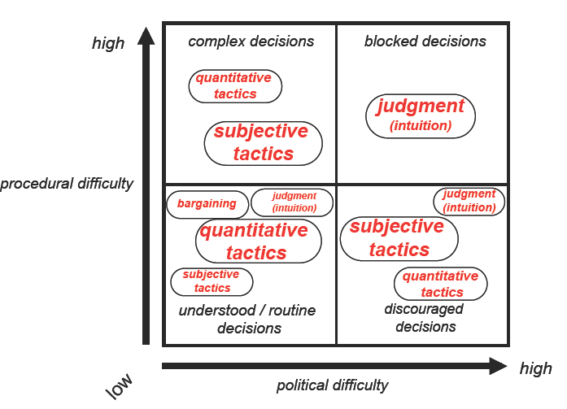
Entscheidungsfindung
30%
4%
49%
17%
Quelle: Paul C. Nutt, 1998
Notes:
References Paul C. Nutt
How Decision Makers Evaluate Alternatives and the Influence of Complexity Management Science 1998 44:1148-1166;

Slide 7

Building
the Knowledge Performance System
with a Model Based
Approach
No engineer, designer or architect works without a
plan / planning / BPM - tool!
Do we have a KM - System, a Knowledge planning/
modelling tool and a KM/Evaluation tool in our
organisation?

Slide 8
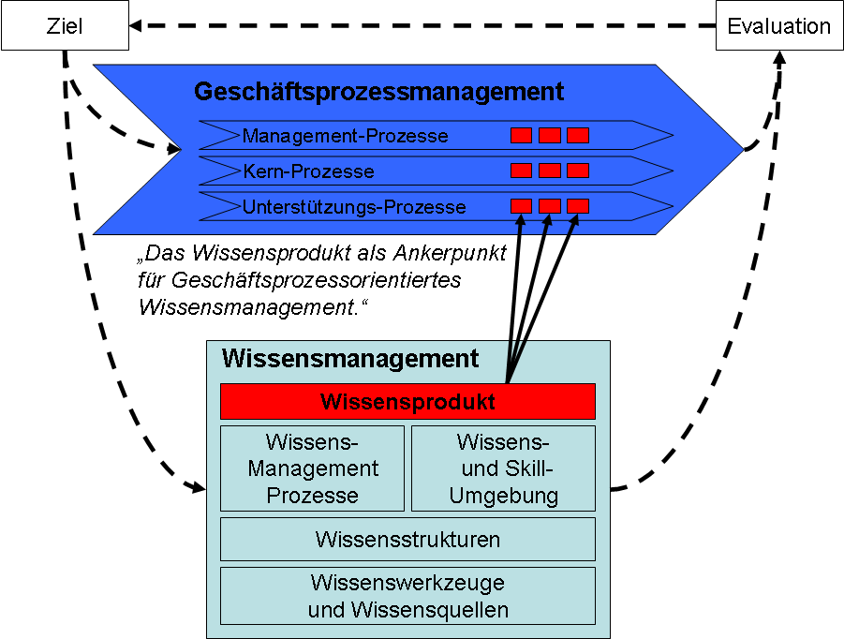
  IF YOU CAN`T MEASURE -
  YOU CAN`T MANAGE IT!
„idea“
Goal/Task
Evaluation
Business-Process
Management-Process
Core-Process
Support-Process
„The Knowledge-Product – anchor point
of business process oriented
Knowledge Management“
Knowledge Management System
Knowledge Management System
Knowledge Product
Use case and product
Knowledge-
Management
Process
Knowledge-
and Skill
Environment
HC relations and skills
Processes and structures
Knowledge Structures
Ressources and support
Knowledge Tools & Knowledge Sources

Slide 9
Relation HC and Risk Management (RM) for organisational development
risk-identification, -analysis, -assessment
Risk Management
design procedures
Shareholder value
guarantees
purchasing price

Slide 10
LEGAL COMPLIANCE
 | Austria | Germany | U.K. | USA
Gesetze | AktG, GmbHG, IRÄG, URÄG, RLÄG | KontTraG, dAktG, dHGB, | - | Sarbanes-Oxley Act (2002)
Corporate Governance Kodizes | Nationaler CGC (2002) | Nationaler CGC (2006) | Combined Code on Corporate Governance (2003) | Final NYSE Corporate Governance Rules (2003)
Standards & Empfehlungen | ONR 49000:2010 ON ISO 31000 ISO 31010 | - | Revised Turnbull Guidance (2005), Orange Book (2004), BS 31100 | COSO I & II
Exemplarely Documentation of different Regulations

Slide 11
All measures designed to ensure the correct conduct of a company, its management and supervisory bodies and its employees.
CORPORATE COMPLIANCE
The main task of the Board / CEO is to ensure that:
- organizational measures, training and controls and
- the correct conduct of the company and its employees
is ensured.
The company should be protected from claims for damages and judicial and administrative authorities penalties.
Source: Copyright by GÖLLNER,
LV Risikomanagement I, BOKU Wien, 2012
Notes:
Text ergänzen aus Folienvortrag RM Vortrag BOKU: HANNES

Slide 12
vs.
HRM
CONTROLLING
Strategic HRM
= Strategic HR-Controlling
Strategic
CONTROLLING
Integrierted CONTROLLING/
Balanced Controlling
Operatively HRM
= Operatively HR-Controlling
Operatively
CONTROLLING
Finance
IKS
Accounting
Notes:
CO OVERVIEW – SUBMODULES / SYSTEM

Slide 13
Process-Chart: Organisation „X“:
Strat.Plg.
Lead.Pr.
Oper.-Plg.
QM
Controlling
RM
WM
Mgmt.-prozesse
Contr.Pr.
Orders
Knowledge Logistics
Core-
processes
PL
Support-processes
Accounting
LOGISTIC
SALES
LAW
PRODUCTION
R & D
HRM
PR
etc.

Slide 14
General Process-Logic of an Organisation
SCENARIO
Development
MONITORING
(Controlling)
KNOWLEDGE/RISK-PRODUCT Relation
(FC, SC, HC, RC)
ORGANISATIONAL
OPERATION
Source: Goellner

Slide 15

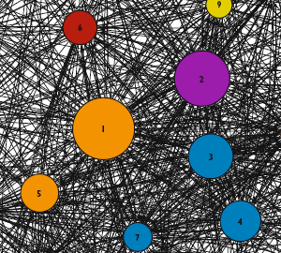
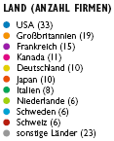
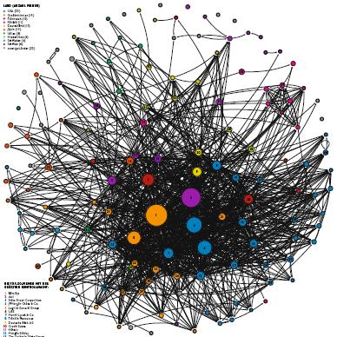
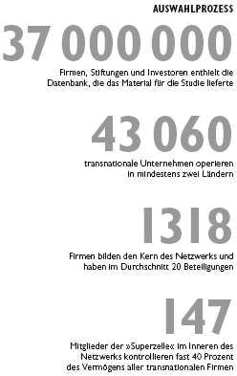
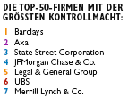

Network Analysis of Banking & Finance Organisations
Source:

Slide 16
Practical example
competence profiling:
  social competences
  personal competences
  professional competences
  technique competences
  Leadership competences

Slide 17
Human Capital - Ideas
for instance:
Prof. Eduard E. Lawler III, USA, Development: Human-Capital-Measurement 1970-1980 as well as political implications for enterprises, shareholder and state,
Prof. David P. Norton, USA, developed Balanced Scorcard under the criteria of measurement of Intangible Assets,
The book: „Humanvermögensrechnung“ von Dr. Herbert Schmidt im Jahr 1974 and
Flamholt´s Buch: Human Resource Accounting, published 1974,
Introduction of Human Resource Accounting (HRA) at Barry Corporation, USA,1972,
HC-Measurements at the enterprise SKANDIA (Skandia Navigator)
HYPO-BANK, Germany, Realisation of the Human-Capital-Measurements via Employee-Value-Index (EVI) 1990,
Buck Consultants of Mellon Financial: Development of a EVi-Expected Value of the individual (EVi represents the value of a individual for the organisation as minimum of the expected partitional contribution to the profit of the organisation)
Intellectual Capital Report (Wissensbilanz) of the Austrian Research Centers ARC (2003)
Intellectual Capital Report-Act (Wissensbilanz) for Austrian Public Universities (2004)

Slide 18
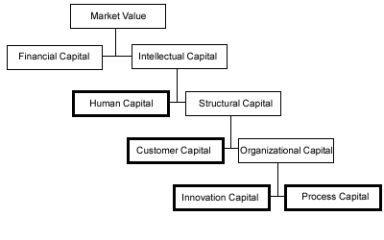
Scandia Navigator:

Slide 19
Human Capital - Models
Input Models: value of the HC = in employee invested sum of money
  Output Models: value of the HC = from employee earned profits
  Comparison Value Models: value of the HC = difference between at the employment market potentially achievable value and the transacted investments
    Indicator Models:
  often only listings of indices
  mostly approximations

Slide 20
scheme of HC-models
Input Models:
  HumanAssetWorth (Mayos 2001)
  Value Added Intellectual Coefficient (Public 1998/2000)
  Output Models:
  Accounting for the Future (Nash 2003)
  Calculated intangible Value (NCI Research, Stewart 1997)
  Human Capital Pricing Model (Bender/Röhling 2001)
  ROI on Human Capital (Fitzenz 200)
  Knowledge Capital Scoreboard (Lev/Bothwell 2001)
  EVi - (expected value of the individual) (Buck Consultants)

Slide 21
scheme of HC-models
  Comparison Value Models:
  Excellence Modell (EFQM) (European Foundation for Quality Management, Brüssel)
  Global Human Resources Survey Report (PriceWaterhouseCooper, 2003)
  TRI*M Index (NFO Infratest)
  Overall Human Capital Index (Watson Wyatt)
  Ranking: Attractive Employer (Hewitt 2001)
  Value Creation Index (Cap Gemini Ernst & Young,
  1997/2000)
  CIPD Framework (Scarborough/Chartered Institute of Personnel& Development 2003)
  Intellectual Capital Ranking (Edvinsson2000)
  Human Capital Value (Human-Capital-Club e.V. Munich, Ge, 2003)
  Intellectual Capital Audit (Brooking 2000)

Slide 22
scheme of HC-models
      Indicator Models:
    Intangible Assets Monitor (Sveiby 1986/87)
    Skandia Navigator (Edvinsson 1991)
    Intellectual Capital Navigator (Stewart 1995)
    Human Resource Scorecard (Becker/Huselid/Ulrich 2001)
    Human Capital Indicator (Mercer 2001)
    Werttreiber-Modell (Wucknitz 2002)
    (value driver-Model)

Slide 23
scheme of HC-models
      Saarbrücker Formel (formula):
Value Basis
Value Loss
Value Compensation
Value Change

Slide 24
Practical example
competence profiling:
  social competences
  personal competences
  professional competences
  technique competences
  Leadership competences

Slide 26
Dr Gerhard Hanggi’s Model

Slide 27
Individual skill profiling
Defining skill profile for position “Production Controller”
Tasks | Skill profile | Description
Task 1-Control production costs | Personal competences | load-bearing capacity,credibility,goal oriented
 | Technique competences | critical thinker,conceptual skills,negoiation skills
 | Professional competences | strategy formulator,decion maker,problem solver
 | Social competences | conflict resolution ability,persuasive
Task 2-Processing customer orders | Personal competences | crediblity, assertiveness,goal oriented
 | Technique competences | negotiation skills, language skills
 | Professional competences | delegation capabilites, problem solver
 | Social competences | social intelligence, conflict resolution
Task 3-Investigate production problems | Personal competences | willingness to change, assertiveness, load bearing capacity
 | Technique competences | negotiator,structured thinking
 | Professional competences | decision maker, problem solver
 | Social competences | conflict resolution, flexibility

Slide 28


Users of Dr Hanggi’s model:

Slide 29
Practical example
Kompetence Radar

Slide 30
Practical example
Assessment Center:
development of arrangements
potential assessment
strengths-weakness-profil
Simulations
(exercises)
observation/
rating system
Profil of qualification
structure of a assessment center

Slide 31
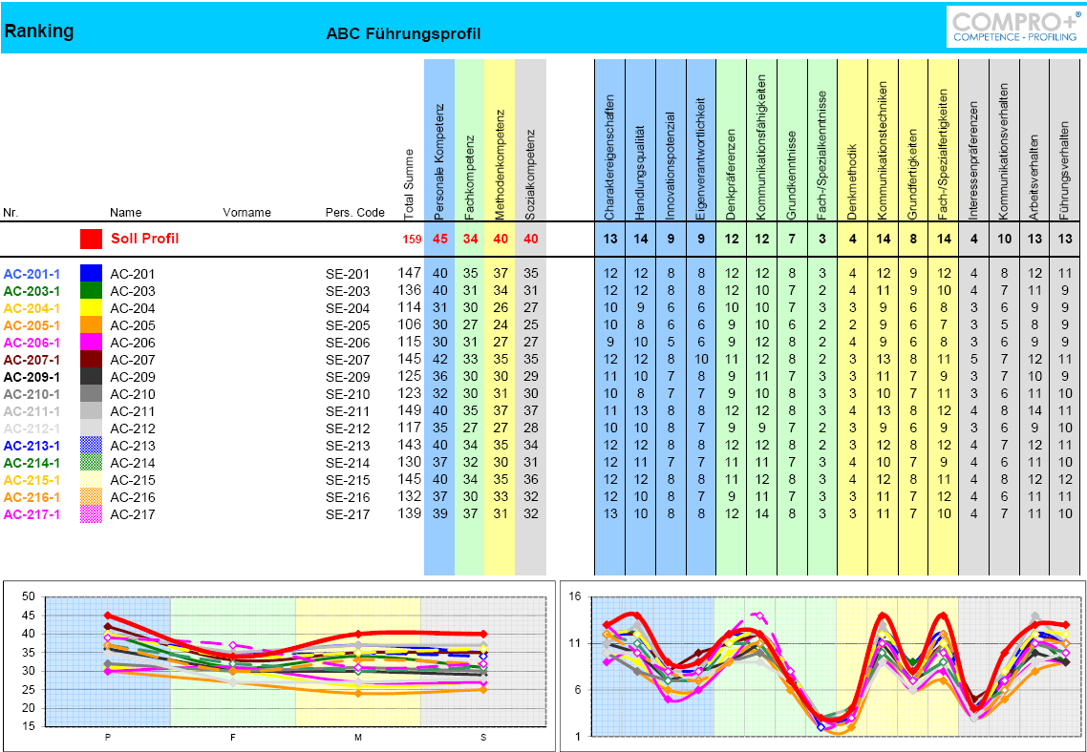

Slide 32
Contact:
Dipl.-Ing. Johannes GOELLNER, MSc email: johannes.goellner@meinesteuerberatung.at
1030 Vienna, Marxergasse 13/10, Austria mobil: +43-(0)650-22529991

Slide 33
Thank you for your attention.
Questions ?

Slide 34
INTRODUCTION
short CV Dipl.-Ing. Johannes GÖLLNER, e.g.:
Visiting Professor for Human Resource Management at the MASARYK University Brno (CZ), 02-06/2015.
Visiting Professor for Organisational Knowledge Development & Knowledge Management at the MASARYK University Brno (CZ), 10/2014.
CEO & Partner of M²D MasterMind Development GmbH (Ltd.), Vienna, Austria
Head of the Section of Knowledge Management at the National Defence Academy of the Austrian Ministry of Defence & Sport, Vienna, (AT), 2011-dato)
Lecturer for Risk – and Crises Management and Organisational Leadership at the University of Natural Resources and Life Science Vienna (AT), 2008-dato.
Core Member of the Standardization/Guideline-Workshop “Supply Chain Risk Management” of the Risk Management Association, e.V., Munich, Germany (2013-dato).
Chairman of the Center of Risk & Crises Management (at the University of Natural Resources and Life Science Vienna); www.zfrk.org
Founder and Chairman of the Standardization Committee for Risk- and Crises Management (ONK 246) at the Austrian Standardization Institute (01/2003-11/2008); (ISO 31000, ISO 22399, CEN “Critical Infrastructure”).
Director of the postgraduate MSc- Study Program “Risk Management” at the Danube University Krems (AT) (2009-2012).
Director of the postgraduate MBA- Study Programm“Environmental Threats & Disaster Management” at the NBC Defence School of AFF (2003-2009).
S3, Ref. Knowledge Management & Head of the Section of Risk Management at the NBC Defence School of the Austrian Ministry of Defence & Sport (since 2003-2010).
Assistant & Visiting Professor, Scientific employee and Lecturer at Austrian Universities and Universities of Applied Science (1992-2010)
Scientific Leader of the EU-FP 7-Project “Foresight Security Scenarios: Mapping Research to a Comprehensive Approach to Exogenous EU Roles” at the Danube University Krems (AT) , www.focusproject.eu ;(2011-2013).

Slide 35
INTRODUCTION
Actuall Research Activities: DI GOELLNER, MSc
actuall research activities in Relation to the National Austrian Security Research Programm, called KIRAS (http:www.kiras.at) are, e.g.:
RSB: Risikanalysis for Simultanious Threats
MDL & QuOIMA
SG²: Smart Grids
Cloud Sicherheit/Security: Guidelines for SME & Authorities
LMK-MUSE: Last Mile im Katastrophenfall-Modellunterstützte Simulation für Entscheidungsfindung-decision making in logistics under VPPP-Supply Private Public Partnership-requirements & conditions
META RISK: Meta-Risiko-Modell für kritische Infrastrukturen (Development of a META RISK MODEL)
RAGOUT Risikoanalyse Güterverkehr – Organisation, Umsetzung und Technologien
GeRiAn Gesamtstaatliche Risiko-Analyse
ABC-DEKO
ABC-VR
SRA-Strategisches Lagezentrum für Ressource-Analysis
BITCRIME: Verfolgung und Prävention organisierter Finanz-
kriminalität mit virtuellen Währungen

