Slide 1
Social Media as Recruitment Tool
Prepared by:
BODAPATLA SRAVANI UCO: 486343
MD SAIFUL ISLAM UCO: 480931
IVO CARAPINA UCO: 480919
LINGLI JING UCO: 486132

Slide 2
Social Media
Social media is where people hang out online to express ideas and interact with each other.
According to GlobalWebIndex, the average internet user has more than 5 social media accounts. People go to these different communities to share what’s on their mind and converse with like-minded people. Like a town center, social media sites have become the focal point for online interaction.
Sites like LinkedIn, Facebook, Twitter and a handful of others offer recruiters a tremendous opportunity to connect with candidates.

Slide 3
Importance of Social Media In Recruitment.

Slide 4
How to Use Social Media as a Recruitment Tool
Take a soft approach and promote your culture: Share content that shows your company is a great place to work so you can organically attract candidates.
Encourage employees to share company achievements: Sharing interesting and impressive information about the business, including successes and thought of leadership content.
Clarify the Available Position and Employment Requirements: add a link to a more detailed job posting on your organization’s website where they will also find an application form and the resume submission process.
Pay Attention to Privacy Matters for Your Organization and for Candidates: Your potential job candidates will appreciate your concern for protecting their confidential information available on resumes, cover letters and applications.

Slide 5
Social Media Sites
Social media sites like LinkedIn, Facebook, Twitter etc are most commonly used platforms by both recruitment team and a job seeker.
According to recruitment statistics of 2018 : Job seekers get to know about the job vacancies available in a company mostly in these pattern.

Slide 6
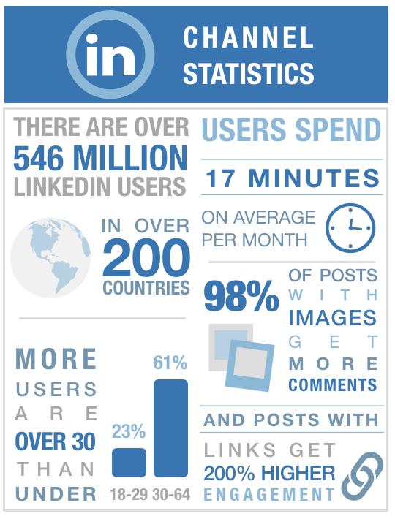
LinkedIn and Facebook
Out of all the social media networks, LinkedIn is of course the best one for recruiting. Nearly everyone with an established career has a profile on the “World’s Largest Professional Network.”
You can use the site to attract
active candidates and connect with
passive ones.
According to LinkedIn stats 2018,
20,000 no of US companies use
LinkedIn to recruit and 11million
active job listings are available.
Deloitte, Ernst & Young, Apple all
have dedicated Face book
recruitment strategies. Face book is
used as a strategy to connect with
passive candidates and build long
term talent pools.

Slide 7
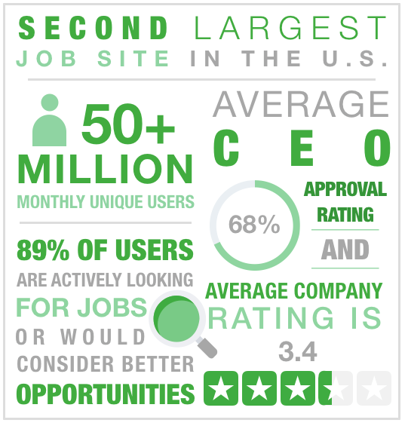
Glassdoor
The largest job site in the U.S., according to Comscore Media Metric, Glassdoor provides a showcase for employers’ brand position and company culture. With reviews, job opportunities and content, job seekers get a thorough look into what it’s like to work at the company.

Slide 8
Pros of using Social Media in recruitment.
Reduces time for employers: A typical recruitment process could be long and tiring for both the employer and potential employee. But social media saves a lot of time to learn about the candidate through Facebook and LinkedIn profiles.
Insight into the informal life of a candidate: Social media is effective in viding such information, where the employers can see how a candidate behaves in a normal day.
Reach the elusive passive candidate: social media possess great potential of targeting passive talents, those whose candidature you do not find easily on the mainstream job portal.
Save money: Unless you promote job openings through paid campaigns, social media recruiting is completely free.

Slide 9
Cons of using Social Media in recruitment.
Invading privacy: Social media screening is invading the privacy of the candidate. The information they share on these platforms are mostly for personal use and are not necessarily meant for professional use.
Compliance issues: Unknowingly, an employer can be biased toward people with good social media presence, as compared to people who are not as active online.
Lack of reliability: Social media is definitely not the most reliable source of information for everything.
Inconsistent information available: Lack of consistent information about the candidates applying for same jobs is a problem that cannot be resolved by social media screening.

Slide 10
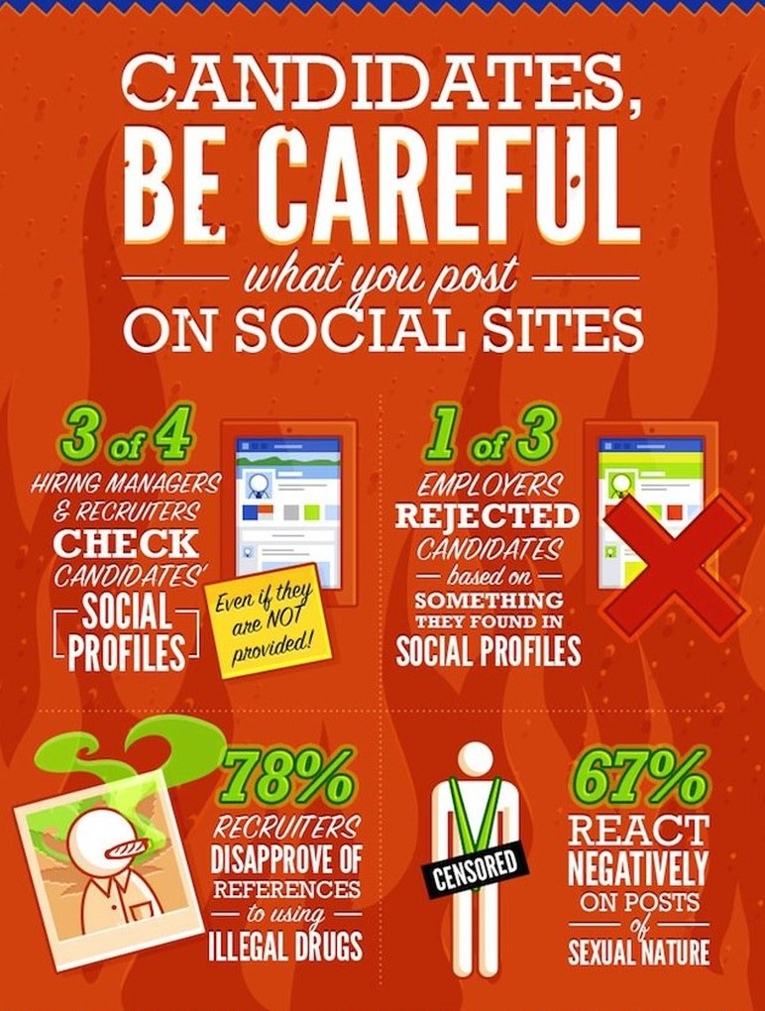

Slide 11
References
https://expandedramblings.com/index.php/linkedin-job-statistics/
https://www.themuse.com/advice/job-seekers-social-media-is-even-more-important-than-you-thought
https://recruiting.jobvite.com/
www.directemployers.org

Slide 12
Thank you
=

