Slide 1
HOLaCRACY

Slide 2
What is holAcracy?
Holacracy is a method of decentralized management and organizational governance, in which authority and decision-making are distributed throughout a holarchy of self-organizing teams rather than being vested in a management hierarchy.
A holarchy is a hierarchy of self-regulating holons that function both as autonomous wholes and as dependent parts.
Holacracy has been adopted by for-profit and non-profit organizations in several countries. Holacracy is designed for organizations and fundamentally differentiates the roles of the organization from the people working in it. It emphasizes on iterative governance, adaptive processes, and self-organization.

Slide 3
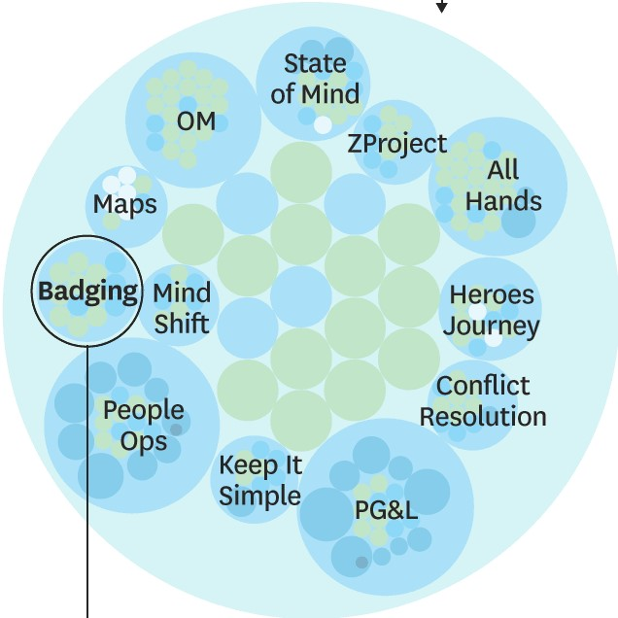
A success story of holacracy
CIRCLE
Zappos: an online shoe and clothing retailer, launched in 1999
Implemented holacracy in 2013 with over 1,500 employees
“I think flexibility and adaptability is what’s actually going to be the competitive advantage. And holacracy allows for faster flexibility and adaptability.” CEO Tony Hsieh
Circles replace the pyramidal hierarchy
Circle structure: „circles“, „subcircles“ and „supercircle“
Circles: “values”, “projects”, “functions”, “segments”
(150 departments evolved into 500 circles.)

Slide 4
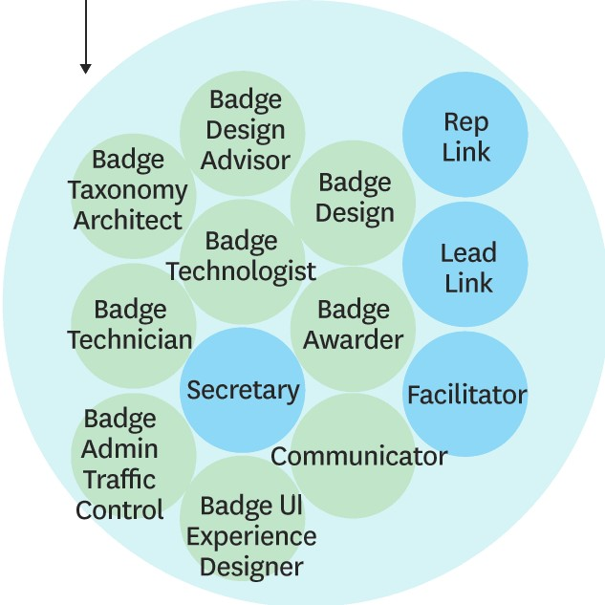
A success story of holacracy (cont’d)
SUBCIRCLE of Badging
Circle (supercircle) could contain subcircles
Subcircles: Particular functions of the company
Ex. marketing, production
Circles and subcircles consist of “Roles”
Roles: Tasks broken down from a traditional job
Ex. social media, advertising, web marketing in a marketing circle
Special roles: Specific type of roles
Ex. Lead Link and Rep. Link, substitute for titles of managers in pre-holacracy
Difference - leadership responsibility belongs to the roles, not the individuals.
Decision making - the majority doesn’t rule
Any circle member can propose changes, and they are adopted unless another member objects on the grounds that they would harm the circle.
In some part of stuff and function, stability is secured. Ex. customer service.

Slide 5
A failure story of Holacracy
A failure story A failure story of Holacracy
of Holacracy
A failure story of Holacracy
A place to read and write big ideas and important stories
Founded in 2012 Implemented holacracy structure in 2013
Reversed the holacracy structure in 2016 due to:
1. Inability to synchronize efforts at scale
2. Difficulty to codify responsibilities while growing fast
3. Difficulties faced in recruitment due to misconceptions

Slide 6
Factors that affect success
No managers.
Increase the efficiency, transparency, innovation, and accountability.
Collaboration and cooperation are key.

Slide 7
Factors that affect failure
New concept and needs more studies.
Losing human factors.
Uncertainty situations like, “What happens when things go badly?”, “Or how do I manage my career?”

Slide 8
conclusion
Holacracy boosts the Organizational DNA with enhanced capacity to consciously have an incremental change and improve over time.
It avoids traditional approaches to achieving order and rather adopts a peer-to-peer self organization. It depicts a broader societal trend and leaves out conventional models.
If organizations want to pursue their purpose and be free from the of top-down planning, Holacracy is a sure path to tow. It makes the impossible pursuit of agreement possible and helps organizations to be fast and more agile.
Though Holacracy can not solve all organizations' tensions and fears, it provides a stable ground to curbing them.

Slide 9
REFERENCES
https://hbr.org/2016/07/beyond-the-holacracy-hype
https://www.businessinsider.com/tony-hsieh-zappos-holacracy-management-experiment-2015-5
https://www.holacracy.org/resource/zappos/
https://medium.com/@rubzie/medium-drops-holacracy-how-we-deal-with-their-problems-after-3-years-12428b373b5f
https://blog.medium.com/management-and-organization-at-medium-2228cc9d93e9
https://nslsfacts.org/2017/09/26/lost-utopia-why-did-holacracy-fail/
https://www.business.com/articles/is-it-time-to-shift-to-the-holacratic-workplace/
https://support.7geese.com/hc/en-us/articles/206287627-Best-Practices-Holacracy-Collaboration-Change-Management-and-Remote-Work
http://fistfuloftalent.com/2014/01/six-problems-holacracy.html

Slide 10
GROUP MEMBERS
NAME UCO
Saeid Mosaferi UCO-486303
Festim Uka UCO-483086
Mariko Ueno UCO-476839
Kanchana Madhumali Kodikara UCO-483090
Adjoa Nyameyie Kuntu-Blankson UCO-482361

