Slide 1
Gartner Magic Quadrant Tool
J.Skorkovský , KPH

Slide 2
Agenda related to MQ Matrix
Positioning Technology Players Within a Specific Market
Giving you a wide-angle view of the relative positions of the market's competitors
Helps to digest how well technology providers are executing against their stated vision

Slide 3
MQ Matrix
Challengers
Leaders
Ability to execute
Niche=mezera na trhu
Niche players (gap in the market)
Visionaries
Completeness of vision

Slide 4
MQ Matrix explanation
Leaders execute well against their current vision and are well positioned for tomorrow (make money now and in the future- TOC statement).
Visionaries understand where the market is going or have a vision for changing market rules, but do not yet execute well.
Niche Players focus successfully on a small segment, or are unfocused and do not out-innovate or outperform others
Challengers execute well today or may dominate a large segment, but do not demonstrate an understanding of market direction.

Slide 5
MQ Matrix „A“ better than „B“ and „B“ Better than“C“
Challengers
Leaders
Ability to execute
A
B
Niche players
C
Visionaries
Completeness of vision

Slide 6
MQ Matrix Using colors in order to show progress (Red =bad, Green = good)
Challengers
Leaders
B
A
Ability to execute
B
A
Niche players
C
Visionaries
Completeness of vision

Slide 7
MQ for BI

Slide 8
MQ for ERP

Slide 9
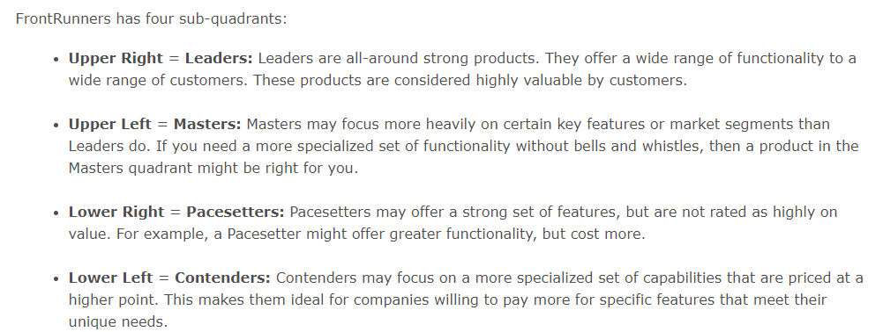
Front runners
Masters
Leaders
Contender- uchazeč, protivník
Pacesetter= tahoun, společnost udávající směr vývoje
Conteders
Pacesetters

Slide 10
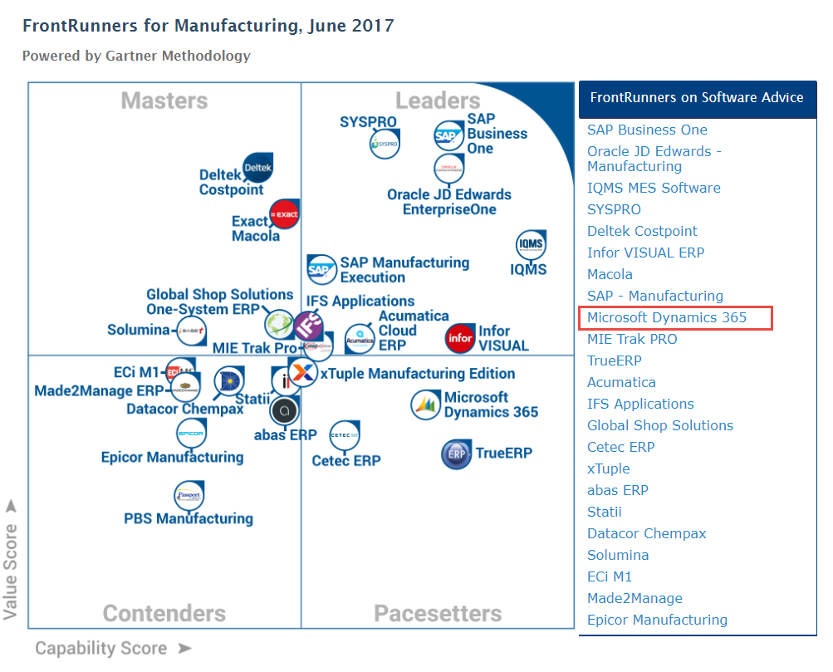
Frontrunners for manufacturing SW
https://www.softwareadvice.com/manufacturing/#top-products

Slide 11
Evaluations and review and templates
EASE –OF – USE
Pros - Once you are comfortable working in NAV it is very easy to navigate
Cons
FUNCTIONALITY
Pros
Cons
PRODUCT QUALITY
Pros
Cons
CUSTOMER SUPPORT
Pros
Cons
VALUE FOR MONEY
Pros
- Cons -Often bad advice is received, where the NAV consultants don't even know how their own system works (Example)

Slide 12
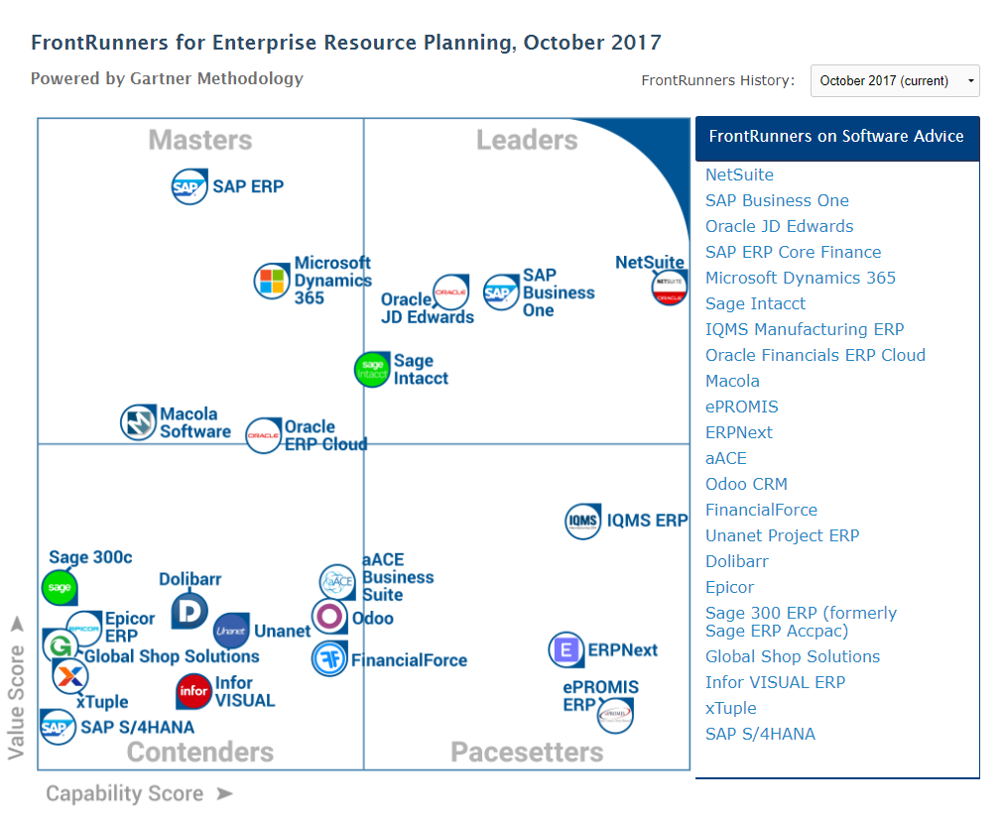
https://www.softwareadvice.com/erp/#top-product

