Slide 1

Operation Management (OM) Prerequisites-first lesson and file
Ing.J.Skorkovský, CSc,
Department of Corporate Economy
FACULTY OF ECONOMICS AND ADMINISTRATION
Masaryk University Brno
Czech Republic

Slide 2
Coordinates (will be part of OM Intro as well)
Lecturer : Ing.Jaromír Skorkovský, CSc.
  Department of Corporate Economy (5th floor)
  miki@econ.muni.cz
  +420 731113517
Study material : will be updated regularly after every lesson (is.muni.cz)
So far there is lot of material there but mind you that nearly every part will be slightly or more heavily modified this year. So the correct material will have at the end of its name specification …2018mmdd e.g. 20180917 if not specified otherwise in advance
Attendance : seminar and lectures are obligatory – see subject specification (is.muni.cz) – first important condition to be admitted to exam)
Excuses : if serious reason emerges- only written from is accepted
Seminar work : will assigned after some theory will be presented. Accepted seminar work is the second condition to be admitted to exam. Assign time :1.11.2018
Tuition plan : at the end of this slide show
Name of the tuition plan file : Tuition plan for both groups AOMA and AOPR_20180808
Locations : AOPR : P104 and VT206, AOMA :VT206 if not specified otherwise

Slide 3
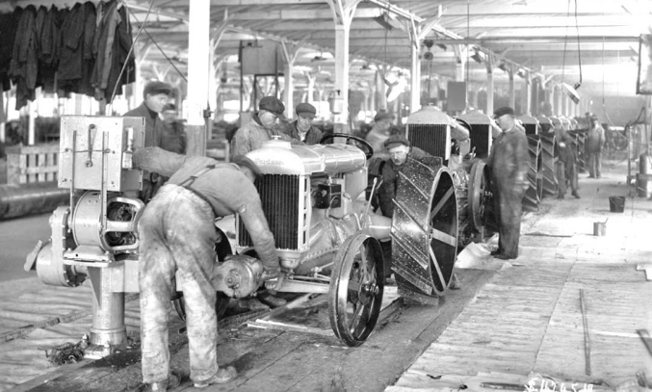

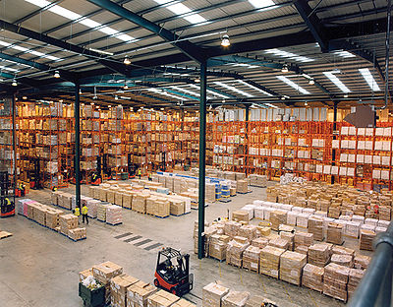
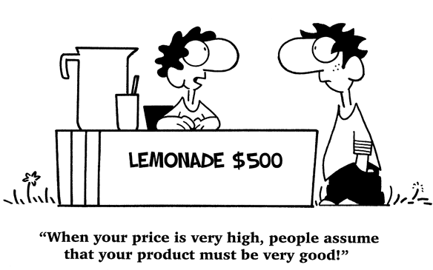
Basic synergy
Shop floor (production)
Accounting department
Data
Warehouse
Selling department

Slide 4

Shop floor (production)
Do we have enough material (items)?
  Connection to inventory
  Connection to Suppliers
  Connection to demand (Customers)
Do we have enough capacity (resources)
  Machines (shifts, capacities, breakdowns,..)
  Workers (loss of working hours, skills,,)
Production planning
  Due dates
  Capacity and material availability
And many, many more

Slide 5
Warehouse management
Locations of item (racks , bins,..)
Receiving
Put-away
Picking
Shipping
Quantity to be ordered
Inventory costing
Transport of item

Slide 6
Sales orders (Sales management)
1 000 0000 USD question : do we realy have profits ?
Selling price construction (discounts,..)
Cost of good sold
Order management
Customer balances
Reminders
…….

Slide 7
Finance management
General Ledger area
Posting invoices
Bank management
Receivables, payables
Taxes
Cost management
…….

Slide 8




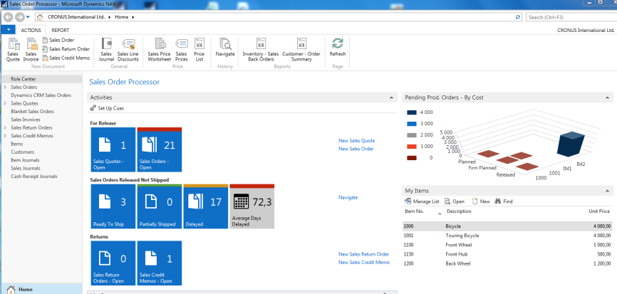

Synergy
Data
Data
Operation management methods

Slide 9
Some OM methods
Theory of Constraints
Balanced Scorecard
Project Management methods (Critical Chain, SCRUM,…)
Material Requirement Planning (MRP) and Just-in-Time
Advanced Planning and Scheduling (APS)
Six Sigma – quality management
Boston, SWOT and Magic Quadrant Matrices
Little´s Law (relations between WIP, Throughput and Cycle time)
Linear programming - optimisation
Yield Management
Kepner-Tregoe (support of decision making)
Decision trees

Slide 10

Thanks for your attention

