Slide 1
Total Quality Management-basics
Ing.J.Skorkovský,CSc.
and various listed resources
Department of Corporate Economy
MASARYK UNIVERZISY Brno
Czech Republic

Slide 2
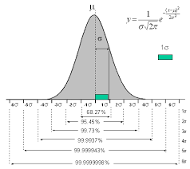


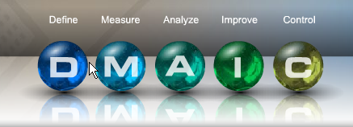
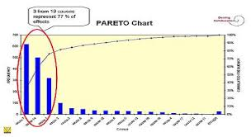
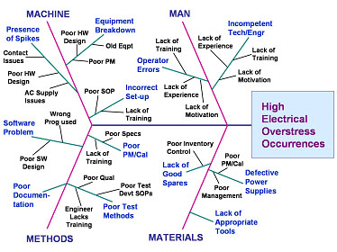
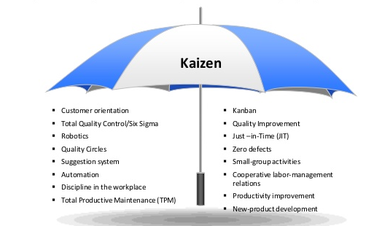
Basic methods
Six sigma
TQM
Inspiration of 6σ method
One of the 6σ method
Pareto
(extra session)
6σ
Kanban & JIT
(extra session)
Ishikawa FBD
(extra session)

Slide 3
Dimensions of Quality
Performance - How well a car handles, gas mileage and so on
Features - Extra item added (stereo CD, GPS, tire checking,..)
Reliability - It should operates without error (DPMO) within expected time frame (done by customer voice)
Conformance - The degree to witch a product meets pre-established standards
Durability - How long the product last(life span or see PLC see later in Boston show)
Serviceability - The ease of getting repairs, the speed of repairs
Esthetics - How a product looks, feels, sounds ,smells or tastes
Safety - Assurance that customer will not suffer injury or harm from the product (automobiles, brakes, accelerators strings,…)
DPMO=Defect per million opportunities

Slide 4
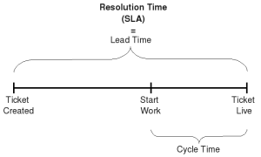
Flow times – lead times (some used units)- will be also used in Little´s law section
Flow Time (FT) is know as a Cycle Time (CT)
Lead Time =LT (length of the process) – time only, supposed to be constant used for planning
Average time from release of the job of the beginning of the routing
until it reaches an inventory point at the end of the routing
or time that part spends as a WIP.

Slide 5
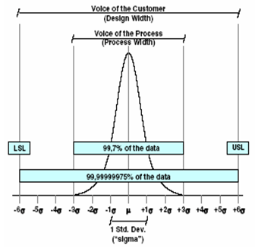
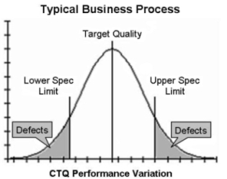
Six sigma
Lead time (expected=voice of customer) = Target Quality (expected value)
production or replenishment constant
LSL
USL
Flow time 1
LSL = Lower specification limit
Flow time 2
USL = Upper specification limit
Flow time 3
Flow time 4
The lenght of flow time represents a variability (voice of process)
= Lead time
FT1
FT2
FT3
= DPMO=3,4
FT4
DPMO=Defect per million opportunities, CTQ=Critical to Quality

Slide 6

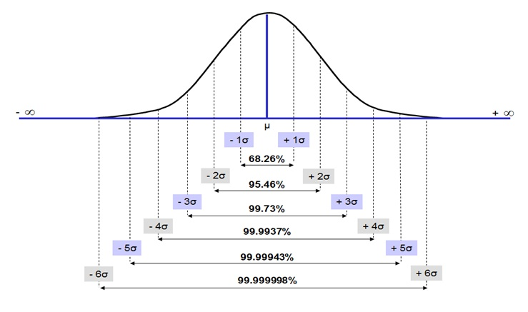



Six sigma
σ =
$$√$$
root
Mean of the xi ->(1,3,8,6,2)->20/5=4

Slide 7
Process Capabilty Ratio (Cp)
(not for MPH_AOPR or MPH_AOMA_2018_2019)
Process Capability Ratio is a statistical measure of process capability: the ability of a process to produce output within specification limits.
The concept of process capability only holds meaning for processes that are in a state of statistical control.
Process capability indices measure how much "natural variation" a process experiences relative to its specification limits and allows different processes to be compared with respect to how well an organization controls them.

Slide 8
Process Capability ratio =Cp
(not for MPH_AOPR or MPH_AOMA_2018_2019)
Cp>=1
Six sigma requires Cp=2
It is no focus on whether process is centred in the specific range
Upper Specification Limit = USL
Lower Specification Limit = LSL
Cp= (USL – LSL )/
6σ
FT4
Cp calculation

Slide 9
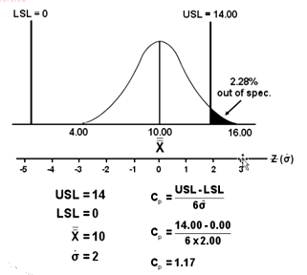
Process capability ratio - (example for home study)
(not for MPH_AOPR or MPH_AOMA_2018_2019)
Standard deviation
It is OK becasue Cp>1

Slide 10
Cpk=Process Capability Index
(not for MPH_AOPR ot MPH_AOMA_2018_2019)
It is a standard index to state capability of one process
The higher value of Cpk a better process
Formula
Cpk=Zmin/3 where Zmin is smallest of these values:
  (USL-Mean)/σ and (Mean-LSL)/σ
  Mean is an average of the part
  Sigma represents process variation
  Cpk = 1,0 is equivalent to yield 99,73%
  Cpk = 1,2 is equivalent to yield 99,97%

Slide 11

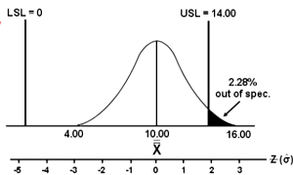

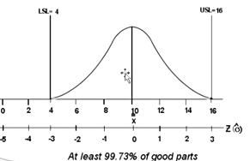
Cpk=Process Capability Index
(not for MPH_AOPR or MPH_AOMA_2018_2019)
Zusl =(USL-Mean)/ σ = (14-10)/2=2 and Zlsl=(Mean-LSL)=(10-0)/2=5
so Cpk=2/3=0,67. Mind you, that Mean = X is our example !!!
This process is better
Zusl =(USL-Mean)/ σ = (16-10)/2=3 and Zlsl=(Mean-LSL)=(10-4)/2=3
so Cpk=3/3=1,0. Mind you, that Mean = X is our example !!!

Slide 12

Six sigma
Six Sigma projects follow two project methodologies inspired by Deming's Plan-Do-Check-Act Cycle. These methodologies, composed of five phases each, bear the acronyms DMAIC and DMADV
DMAIC is used for projects aimed at improving an existing business process
DMADV is used for projects aimed at creating new product or process designs

Slide 13
Six sigma
Define the system, the voice of the customer and their requirements, and the project goals, specifically.
Measure key aspects of the current process and collect relevant data; calculate the 'as-is' Process Capability.
Analyze the data to investigate and verify cause-and-effect relationships. Determine what the relationships are, and attempt to ensure that all factors have been considered. Seek out root cause of the defect under investigation.
Improve or optimize the current process based upon data analysis using techniques such as poka yoke (see next slide) .
Control the future state process to ensure that any deviations from the target are corrected before they result in defects. Implement control systems such as statistical process control, production boards, visual workplaces, and continuously monitor the process.

Slide 14
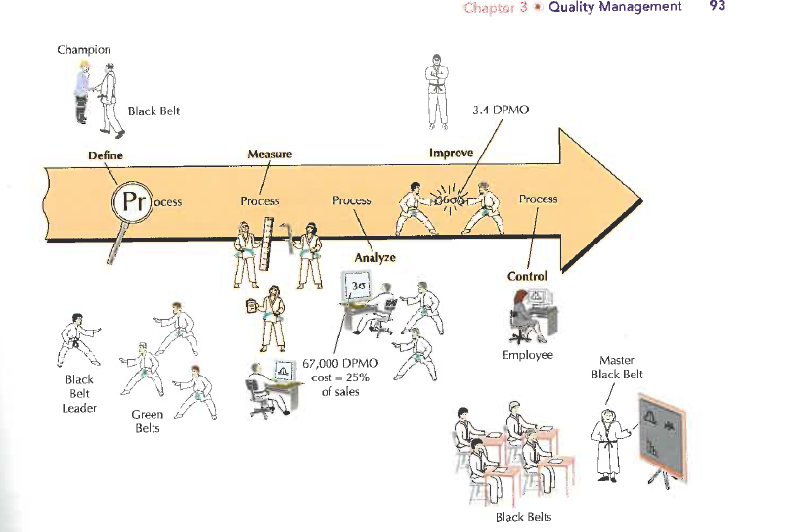
Six Sigma basics

Slide 15
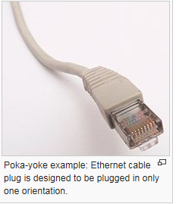
Poka yoke
Poka yoke is a Japanese term that means "mistake-proofing„ that helps an equipment operator avoid (yokeru) mistakes (poka). Its purpose is to eliminate product defects by preventing, correcting, or drawing attention to human errors as they occur

Slide 16

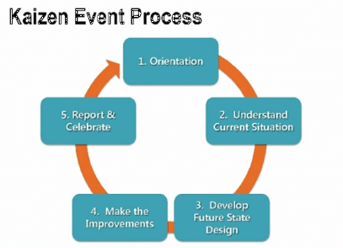
Kaizen
Kaizen (Continuous Improvement) is a strategy where employees at all levels of a company work together proactively to achieve regular, incremental improvements to the manufacturing process. In a sense, it combines the collective talents within a company to create a powerful engine for improvement.

Slide 17
Kaizen events (P-D-C-A)
Set goals and provide any necessary background.
Review the current state and develop a plan for improvements.
Implement improvements.
Review and fix what doesn’t work.
Report results and determine any follow-up items.

Slide 18
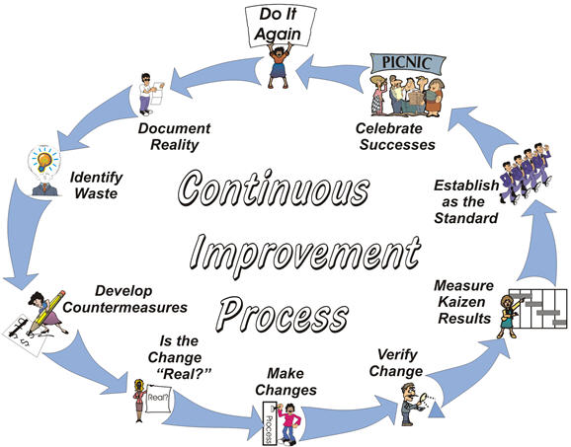

Kaizen – improvement steps

Slide 19

End of section

