Slide 1
Introduction to MS Dynamics NAV (Basic of payments)
Ing.J.Skorkovský,CSc.
MASARYK UNIVERSITY BRNO, Czech Republic
Faculty of economics and business administration
Department of corporate economy

Slide 2
General Journals and its use in G/L
It enables to post and apply payment to „open“ invoices
It enables to post an amount from one account to another
Recurring operations (periodic posting of similar transactions) are much more easier

Slide 3
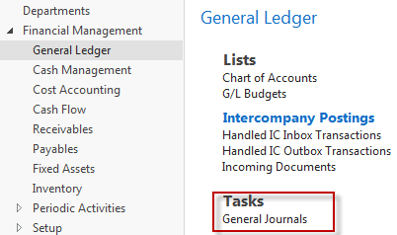
General Journals and its use in G/L
You use the General Journal window to post transactions to G/L, bank, customer, vendor and fixed assets accounts. In a General Journal (GJ), you enter the relevant information for the planned transaction, such as the posting date, amount and the accounts you want to post to. The information you enter in a Journal is temporary and can be changed as long as it is in the Journal.
If you often use the General Journal to post the same or similar journal lines, for example, in connection with payroll expenses you can you periodic one call Recurring Journals.
How to access GJ

Slide 4
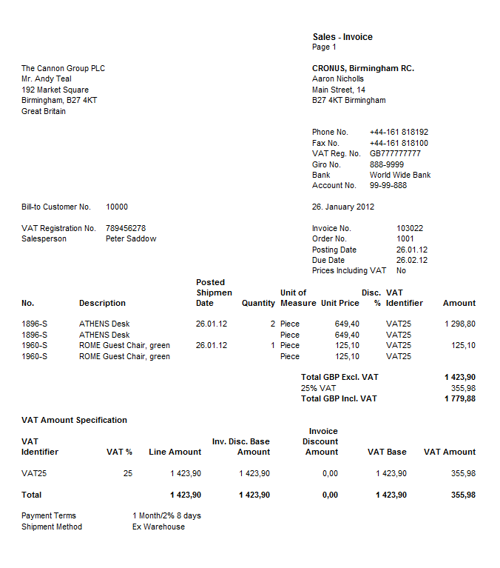

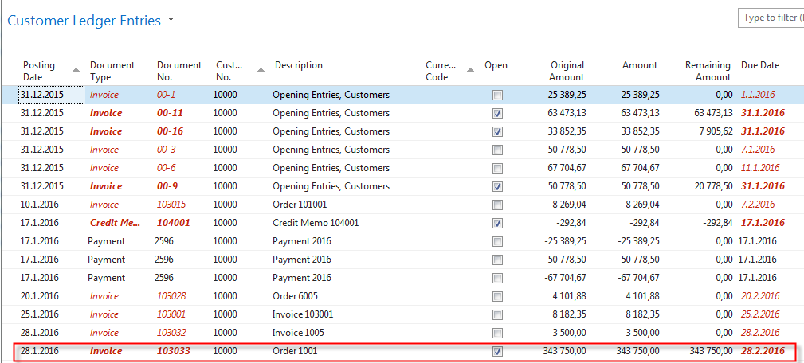
Applying principles
Invoice
Apply
From customer 10000 by Ctrl-F7

Slide 5
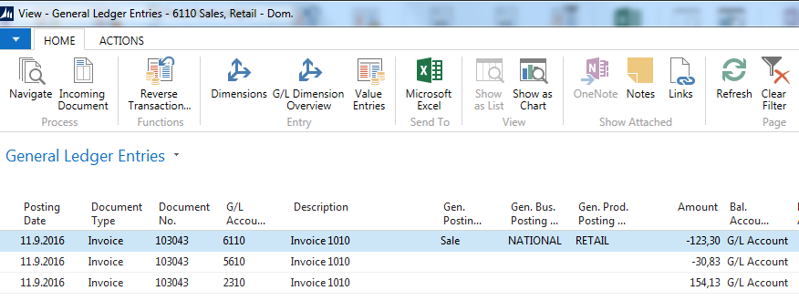
Impacts to G/L (General Ledger Entries)
5610 Sales VAT 25%
2920 Bank Account
2310 Customer Domestic
30,83
6110 Sales Retail Domestic
154,13
154,13
154,13
123,30
Applied payment

Slide 6
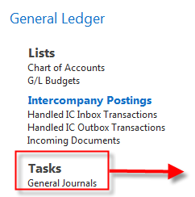
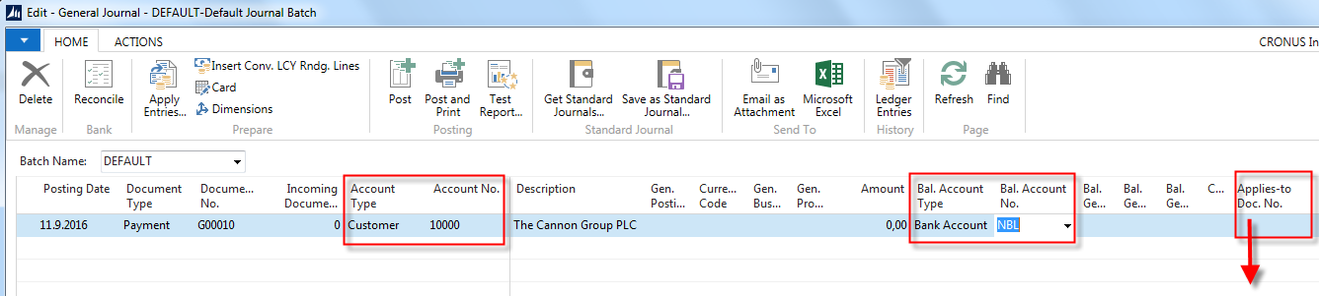
General Journal Structure
GJ structure
Code NBL represents through Bank Account Posting Group G/L Account 2920
Code 10000 represents through Customer Posting Group G/L Account 2310
F4 to access list of open documents (Invoices and Credit Memos)
See list of open documents on the next slide

Slide 7
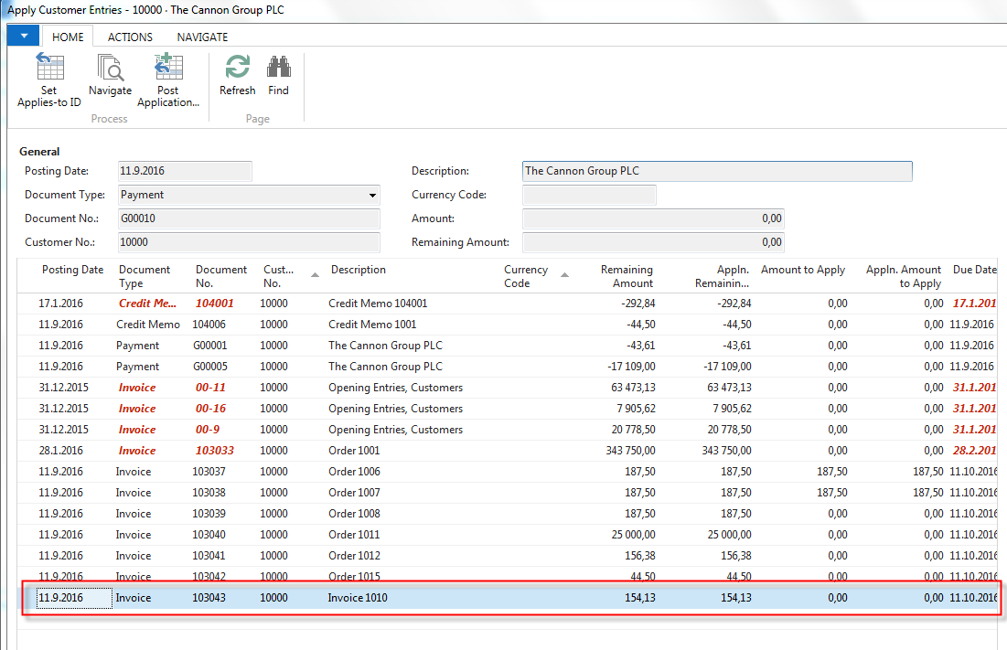
Posted Entries of different types( Customer Entries, Payment Entries, Credit Memo Entries,…..)
Posted Customer Ledger Entries
Select document and click on the OK button to see it (or use Navigate icon)

Slide 8
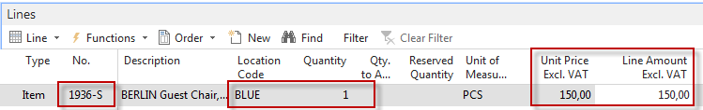
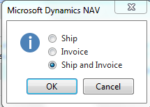
Create new Sale Order
Preparing data for simple example
Customer 10000
Change manually Unit price to 150 in order to get more simple data later !!!
F9

Slide 9
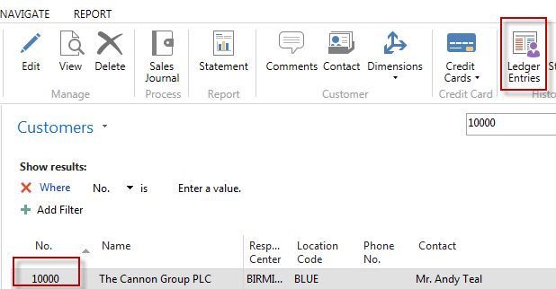
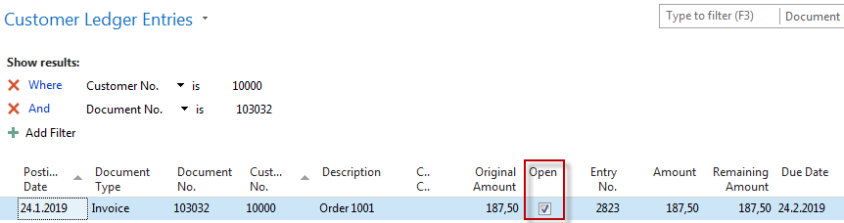
Customer Ledger Entries (CLE) – see our PWP show about SO
Customer Ledger Entries
Author modified columns of CLE to se fields
Open and Entry number as well !!!!
Checked Open field means, that this invoice was
not paid yet (applied by payment)

Slide 10
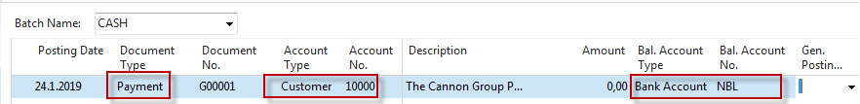
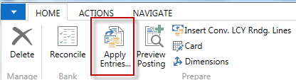
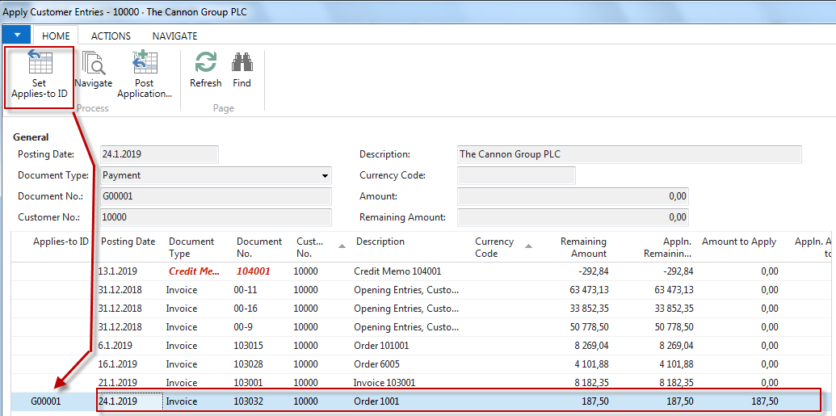
G/L Journal is prepared to be posted
G/L Journal prepared to be posted

Slide 11
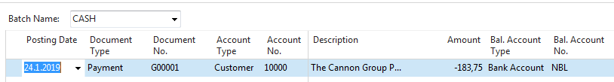
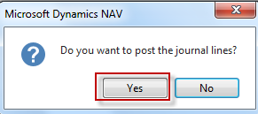
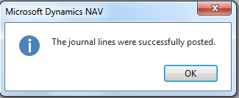
GJ after application entry for setup payment
GJ after application entry
F9

Slide 12
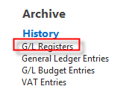
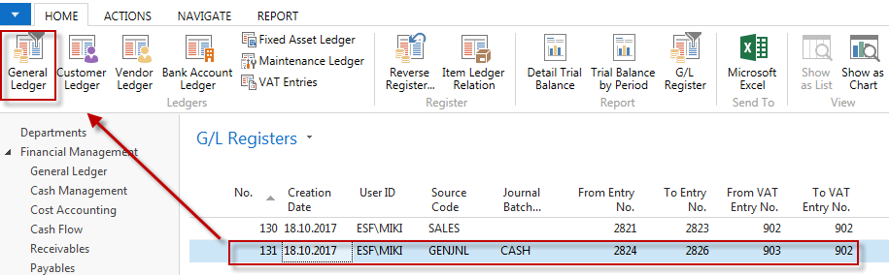
How to find out what we have done so far

Slide 13
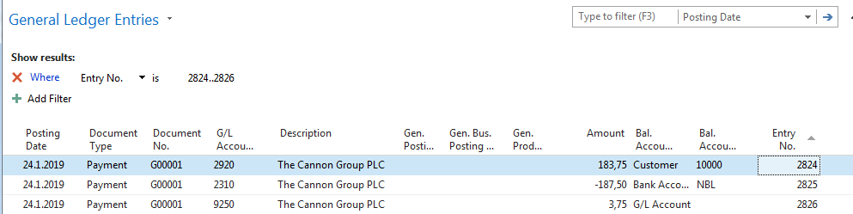
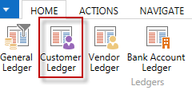
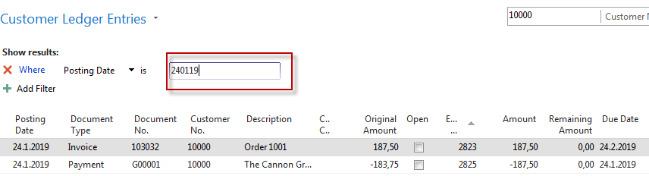
How to find out what we have done so far
(Debit side = plus and Credit side=minus- syntax rule) !!!!!!

Slide 14
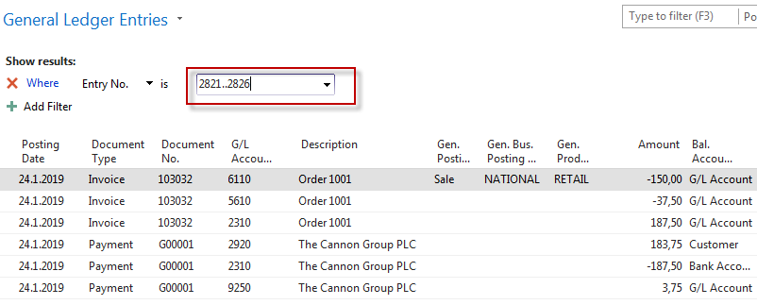
9250 Payment discount granted
5610 Sales VAT 25%
2920 Bank Account
3,75
2310 Customer Domestic
37,50
6110 Sales Retail Domestic
183,75
187,50
187,50
150,00
Applied payment

Slide 15
Additional tasks
Prepare Purchase order and post it (F9)
Enter data to General Journal (Vendor, bank account and so on)
Post GJ
See Vendor entries
Use icon Applied entries to see applied pair !!
Can we do Unapply entries for Customer (Vendor) entry window ?

Slide 16

End of the section
(Basic of payments)

