Slide 1
Introduction to MS Dynamics NAV (Transfers Orders)
Ing.J.Skorkovský,CSc.
MASARYK UNIVERSITY BRNO, Czech Republic
Faculty of economics and business administration
Department of corporate economy

Slide 2
Transfers and locations
Benefits
Direct control of transfers : where (stock locations )do we have what (items) at any moment..
Responsibility of workers in warehouse (Pickers and Pullers)
Responsibility of drivers
Setup enables item tracking (batches, lots)
Better calculation of transport times due to specification of inbound and outbound handling times as well as time of delivery depending on setup of shipping agent services

Slide 3
How to get Location setup

Slide 4
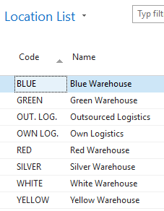
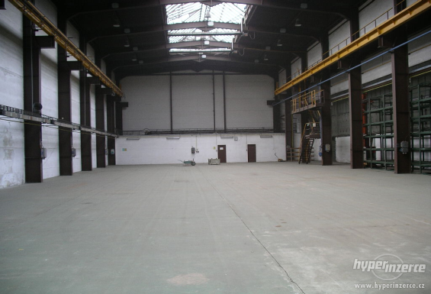
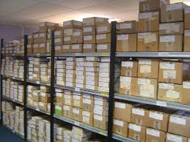
Locations and bins
Storage hall (Location)
Double clicks
Storage zone
See bins on
the next slide
Bin

Slide 5
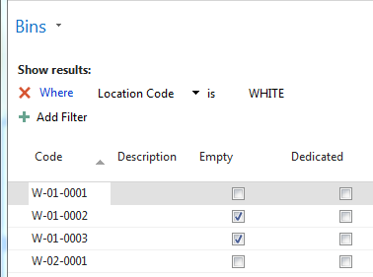
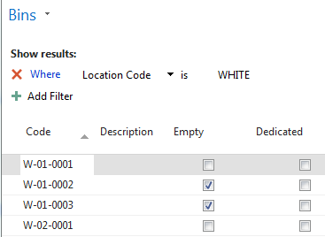
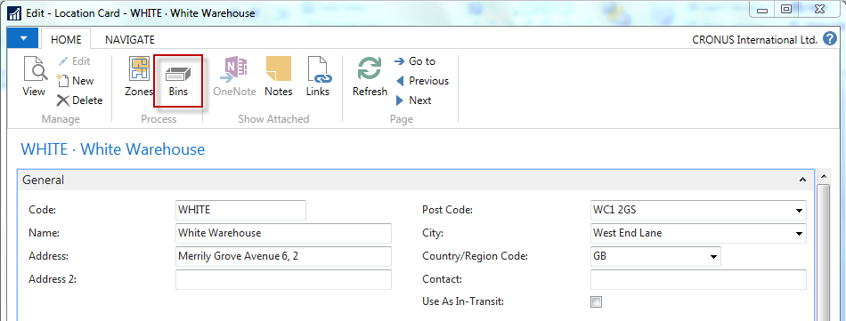
Location White and its bins

Slide 6
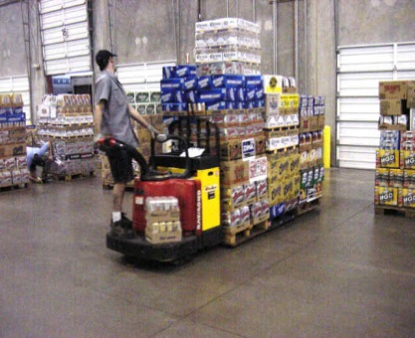
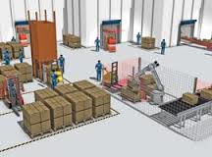
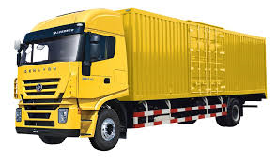
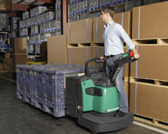
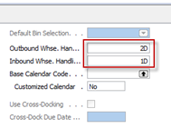
Basic warehouse movements
Put-away
Shipment
Receiving Zone
Inbound (e.g. 1D)
Picking
Outbound (e.g. 2D)
1D=1 day
2D=1 days

Slide 7
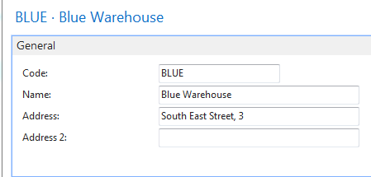
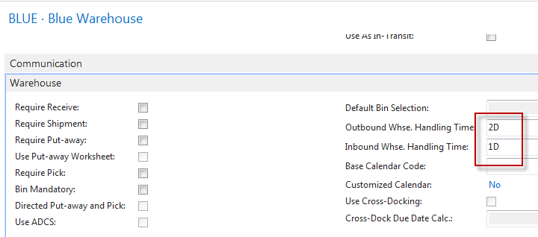
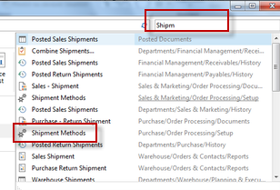
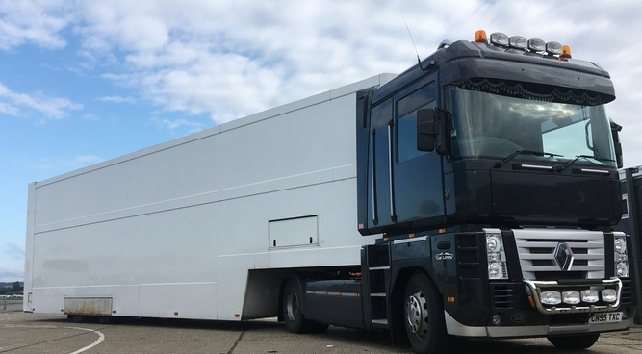
Locations and basic setup shipment
Shipping time = 1D
Blue
Red
Outbound WHS handling time =2D
Inbound WHS handling time =1D

Slide 8
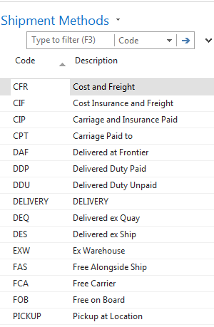
Setup shipment (access from searching window- see previous slide)

Slide 9
Setup shipment –Shipping agent and services (access from Customer Card, Tab=Shipping)
Shipment agents

Slide 10
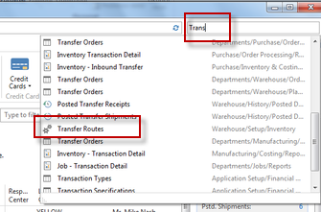
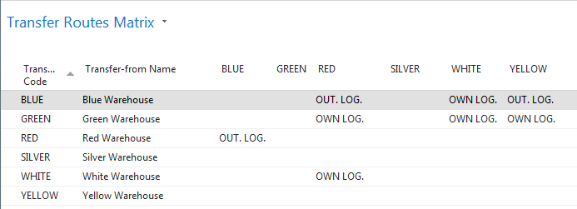
Agent services and Transfer routes
Agent services
Access : searching window
Transfer Routes
Own logistic or Outsourced logictic

Slide 11
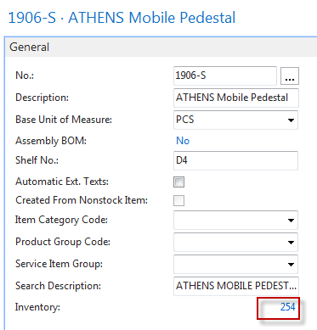
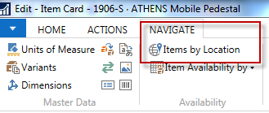
Transfer order
Red Location
Blue Location

Slide 12
Item by Location (from button Item)

Slide 13
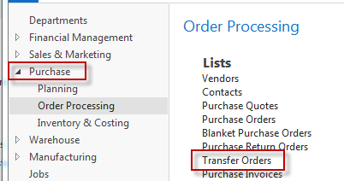
Transfer Order creation

Slide 14
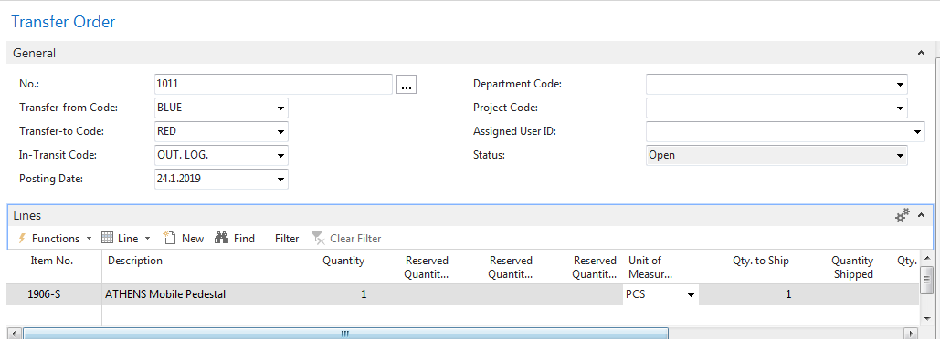
Transfer Order creation – header and lines

Slide 15
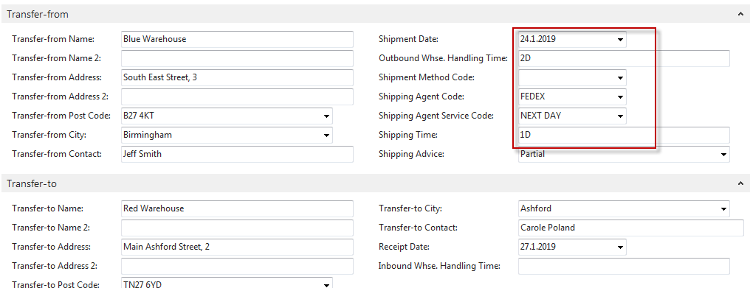
Transfer Order creation – tabs transfers
Next day (1D+Outbound Whse.Handling Time(Blue) (2D) =-1D+2D=3D->24.11.19+3D=27.1.19

Slide 16
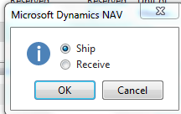
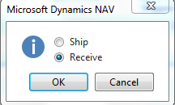
Posting TO (2 times F9)
Item Ledger Entries
Part of the TO line
Item Ledger Entriesc
The posting date is same instead of having two dates 24.1.19 and 27.1.19. The reason
is as follows : both movement were posted at same date !!

Slide 17
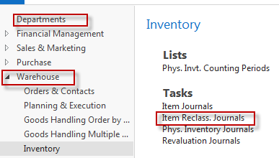
Transfer by use of Item Reclassification Journal

Slide 18
Transfer by use of Item Reclassification Journal
F9
Item Ledger Entries

Slide 19
End of the section (Transfer Orders)

