Slide 1
Introduction to MS Dynamics NAV
(Filtering Searching and Basic orientation in MS Dynamics workspace)
Ing.J.Skorkovský,CSc.
MASARYK UNIVERSITY BRNO, Czech Republic
Faculty of economics and business administration
Department of corporate economy

Slide 2
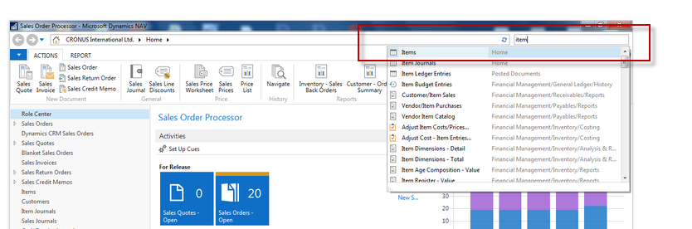
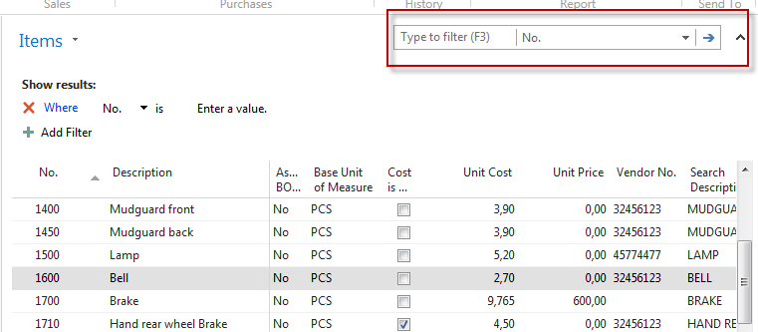
Simple filter
Searching window->Item
You have just accessed Item list window

Slide 3

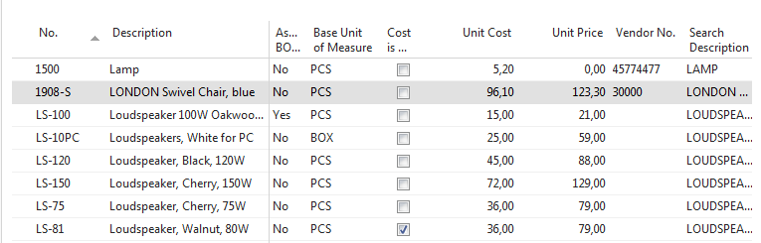
Simple filter

Slide 4

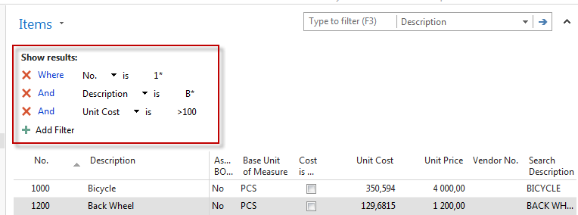
Multiple filter

Slide 5
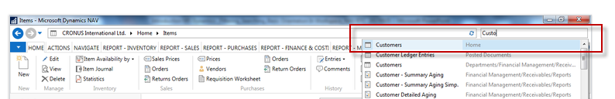
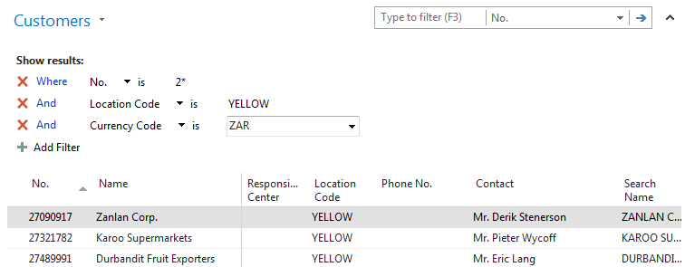
Multiple filter

Slide 6
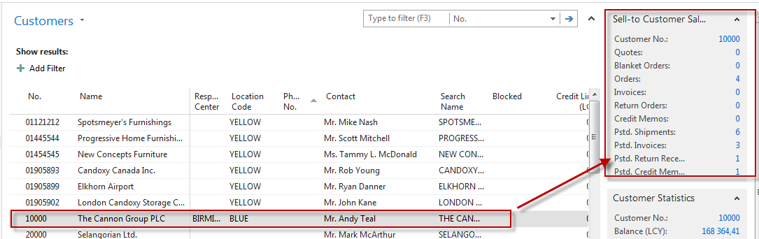
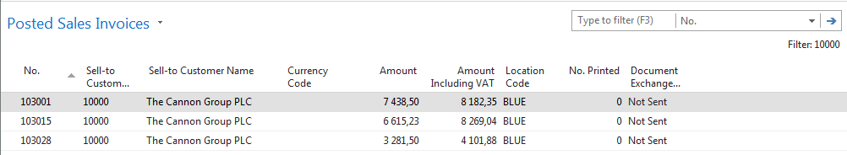
Factbox information

Slide 7
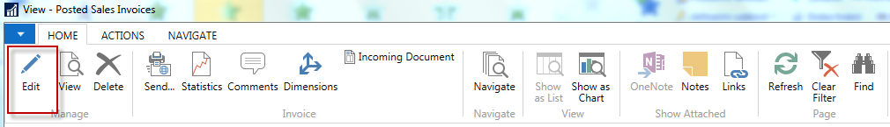
Factbox information- continuation
Customer
Posted invoice composed of header and lines

Slide 8
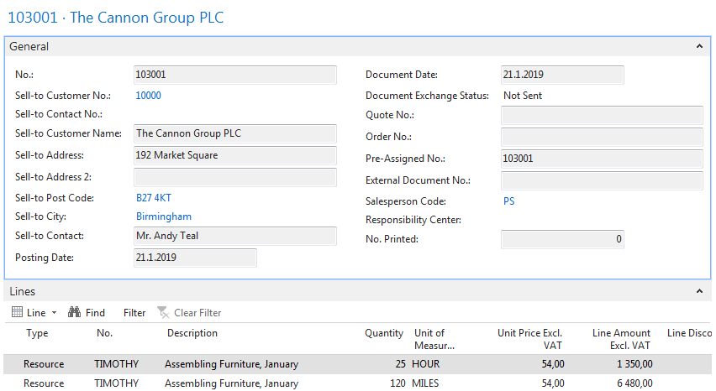
Posted document

Slide 9
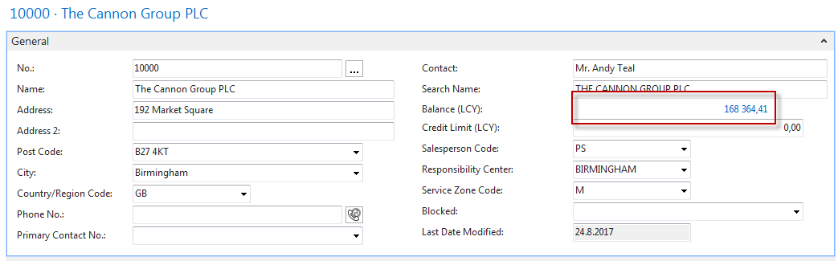
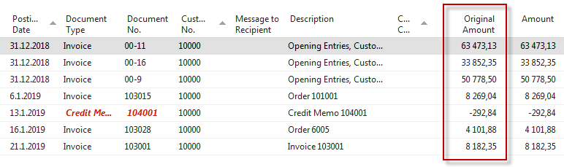
Flow field (Calculation field)
Customer
Ctrl-F7
168 364=63473+33852+….+8182

Slide 10
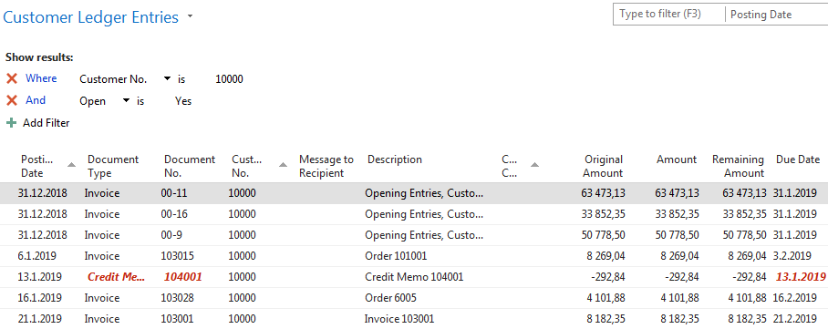
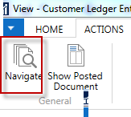
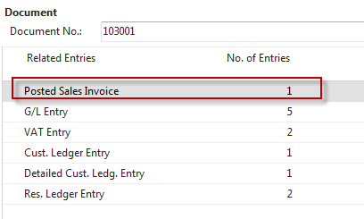
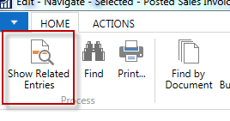
Navigation

Slide 11
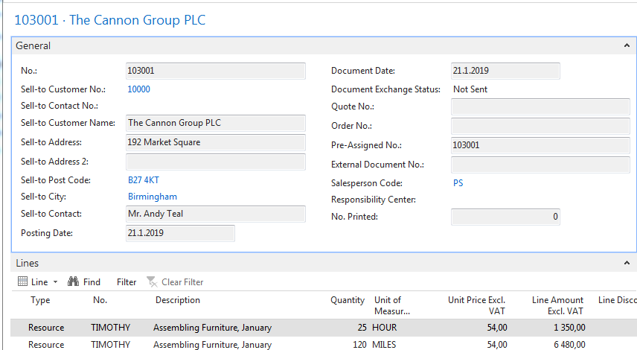
Document after being found by NAVIGATION tool

Slide 12
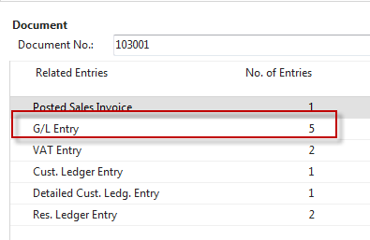
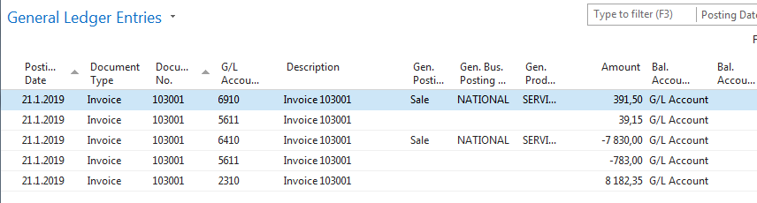
G/L Entries (transactions) after being found by NAVIGATION tool
SYNTAX : If amount i positive (>0) it was posted to debit side, if negative (<0) it was posted to credit side

Slide 13
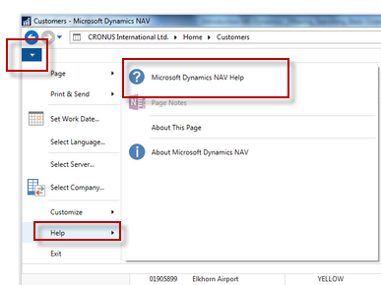
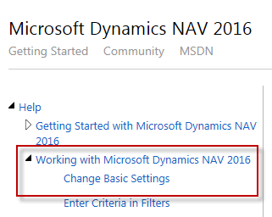
Entering dates and periods
12.2.2017 -> 120217
7 days =7D = 1W
1 month = 1M ….and so on

Slide 14
Basic keyboard shortcuts
New – icon New or Ctrl-N
Delete – icon od Ctrl-Del
Lookup- F4
Post document – F9
Statistics –F7
Entries – Ctrl-F7
F1- Help
F2 Edit

Slide 15
Orientation between forms (windows)
ESC
ESC
Customer
Sales Oder (SO) composed by header and lines
To confirm transfer of Customer and Item data into SO structure you have to confirm by Enter key
Item

Slide 16

End of the section
(Filtering Searching and Basic orientation in MS Dynamics workspace)

