Slide 1
Little´s law basics
Ing. J.Skorkovský,CSc.
KPH-ESF-MU BRNO

Slide 2
Different times used in Little´s law
Lead time (LT)
Flow time (FT)
Cycle time (CT)
It is essential to define precisely above mentioned times in order to better understand principles of Little´s law
WIP=TH x CT

Slide 3
Other two variables of Little´s law
WIP= Work in Process (Work in Progress)
TH=Throughput=Throughput Rate = average output of production process (machine, workstations) per unit time

Slide 4
Definitions
CT=average time from when the job is released into the station (machine or line) to when it exits
LT=management constant indicating the time allotted for production of a part on a given routing
CT =FT (in different publications they use FT instead of CT), where FT stands for=Flow Time
CT=Throughput Time (in different publications they use Throughput Time instead of CT)

Slide 5
Example to be solved
30 customers/hour – (max capacity of the facility). The Facility may be a hairdresser, fast food, bank counter, airport checking…
8 customers waiting in the queue (buffer) – see next slide
5 minutes take service of one customer
You need to remove all times that do not add value to the process
1 serving point = 12 customers per hour -> (60 minutes/5 = 12),
so for 30 customers/hour the needed 2.5 = 30/12 of serving points
8 customers
waiting in the queue
5 minutes/service of 1 customer
at one serving point

Slide 6
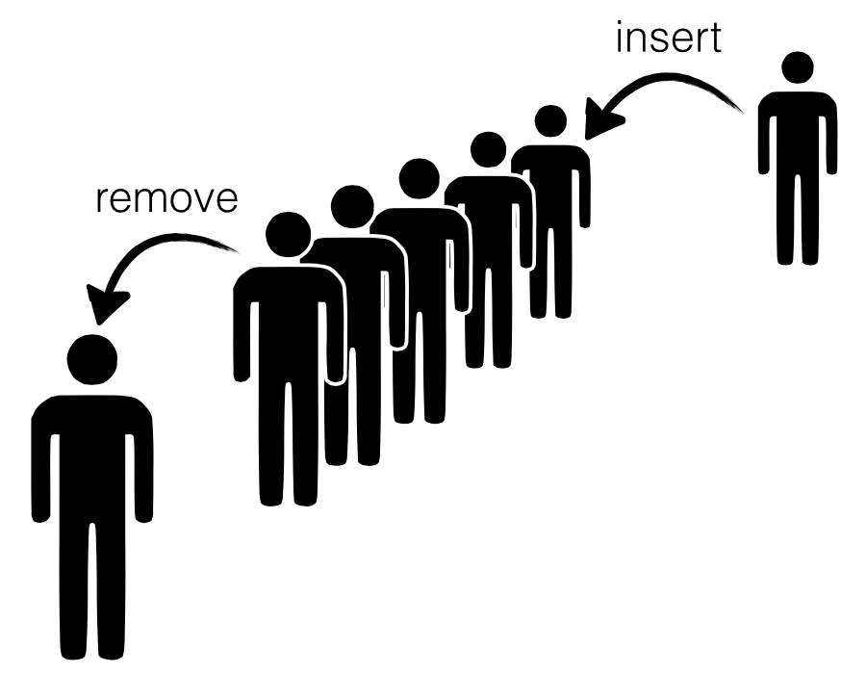
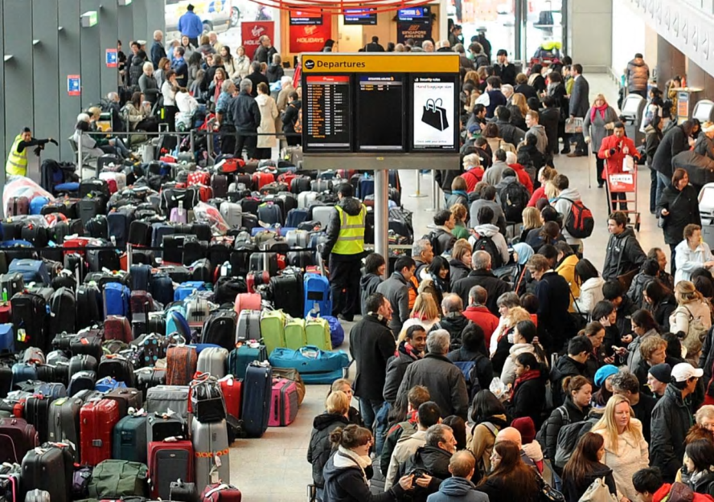
Buffering
A buffer is used to temporarily keep data while it is being moved from one place to another. A buffer often adjusts timing by implementing a queue or FIFO algorithm in memory, simultaneously writing data into the queue at one rate and reading it at another rate.

Slide 7
Questions
- How long does the customer wait in the queue? - How many people on an average can be served at once? - How many customers are in the facility just in time (both pending and those served by facility staff)? - What is the average time of the "flow" of the customer by the facility (wait and service)
Simplifying conditions :
"Input flow" (average) = "Output flow" (average)- steady flow (see video at the end of this PWP) We do not consider fluctuation due to averaging (see flip a coin situation)

Slide 8
Key metrics and variables (completion of definitions)
CT =Cycle Time (how long takes the whole process) = 5 minutes také the service of on customer
Work In Process = WIP (how many units are in process at any moment = Work In Process)
Throughput =TH (how many customers/time unit ) – e.g.. 30/hour in our case = 30/60
These metrics are tied together by Little´s law WIP=TH x CT
Our example : TH=30 customers/hour , service of one takes 5 minutes, WIP=(30/60) *(5/1)=(1/2)*5 =2,5
minutes
WIP
Cycle Time

Slide 9
Solution (home study, C=Customer)
Proces | WIP | TH (Cust/hour) | CT
Buffer | 8 | 30
Service |  | 30 | 5
Total |  | 30
Proces | WIP | TH (Cust/hour) | CT (min/Cust) | Time
Buffer | 8 | 30 | 5
Service |  | 30 | 5 | 5
Total |  | 30 | 5
WIP =TH x CT
CT= WIP /TH (third column is only se see the units)
Proces | WIP | TH (C/h) | CT(min/C) | Time
Buffer | 8 | 30 | 5
Service | 2,5 | 30 | 5 | 5
Total | 10,5 | 30 | 5
Proces | WIP | TH(C/h) | CT (/min/C) | Time
Buffer | 8 | 30 | 5 | 16
Service | 2,5 | 30 | 5 | 5
Total | 10,5 | 30 | 5 | 21
Input (from previous slides) 30 customers/hour - (max Capacity of the facility) = Throughput = TH 8 customers are waiting in the queue = WIP = buffer 5 minutes per customer service = CT WIP = THxCT = ((30/60) * 5) = (3 * 5) / 6 = 2,5, so how many customers can be served at the same time 10.5 = 8.0 (queue) + 2.5 and then: CT = WIP / TH = 8 / (3/6) = (8 * 6) / 3 = 48/3 = 16 (as long as the customer waits in the queue) and finally for control CT = 5 = (2.5 / (3/6)) = 2.5 * 6/3 = 15/3 is the service time (already entered)

Slide 10
Questions
How long does the customer wait in the queue? ->16 minutes - How many average people can be served at once? ->2,5 customers - How many customers are in the facility just in time (both pending and those just serve by facility staff)? 10,5 customers - What is the average time of the "flow" of the customer by the facility (wait and service) -> 21 minutes

Slide 11
Little´s law-2nd part
Skorkovský ,KPH,ESF.MU
Based on resource : Factory Physics (Hopp and Spearman)

Slide 12
Little´s law - definition (formula)
Fundamental relationships among :
WIP (Work In Process)
Cycle Time (CT)
Throughput (T or sometimes TH)
Formula
Can be applied to :
Single machine station
Complex production line
Entire plant
WIP=TH x CT
Relationships among these variables will serve to se clearly precise (quantitative) description of behaviour of the single production line . It helps user to use a given scale to benchmark actual production systems

Slide 13
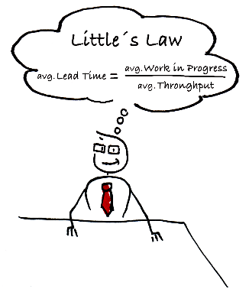
I finally figured it out !!!!
Avg.Lead Time =Cycle Time !!

Slide 14
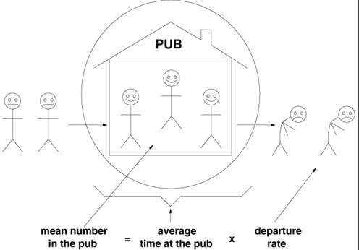
Daily application of the law….

Slide 15
Definition of basic parameters (supplements)
Throughput (Throughput rate, TH) : production per unit time that is sold (see TOC definition)
If TH is measured in cost dollars rather than in prices, it is typically called :
Cost of good sold (COGS)
The upper limit of TH in the production process is the capacity
If you release more raw material above the capacity of the line (machine), the system becomes unstable –> WIP goes up !! See later …

Slide 16
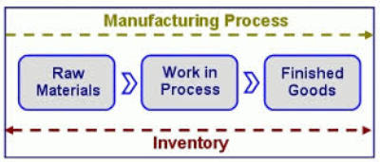
Definition of basic parameters (supplements)
WIP (Work In Process) : inventory between start and end points of the product routing
WIP can be used as one parameter to calculate (measure) an efficiency
Efficiency can be defined as Turnover Ratio = TH/FGI for warehouses or TH/(FGI+WIP) for production plants where FGI=Finished goods inventory
WIP : inventory still in line
FGI : inventory waiting for dispatch (shipping)

Slide 17
Definition of basic parameters (supplements-already mentioned)
CT (Cycle Time) or so called Throughput Rate) : average time from release of the job of the beginning of the routing until it reaches an inventory point at the end of the routing or time that part spends as a WIP.
LT (Lead Time) : managerial constant used for planning of production
Service Level (especially for M-T-O lines, where plant has to satisfy orders with specific due dates) :
Service level P{Cycle time=<Lead Time}

Slide 18
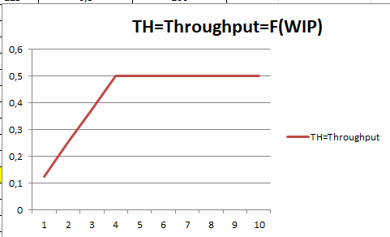
Best case performance

Slide 19
Resources
WIP=TH * CT
Source : Factory Physiscs, Wallace J Hopp and Mark L. Spearman ; ISBN 13: 978-1-57766-739-1 or ISBN 10 :1-57766-739-5
http://www.factoryphysics.com/principle/littleslaw.htm

Slide 20
Example 1
(home study !!!)
Estimating Waiting Times: If are in a grocery queue behind 10 persons and estimate that the clerk is taking around 5 minutes/per customer, we can calculate that it will take us 50 minutes (10 persons x 5 minutes/person) to start service.
This is essentially Little's law. We take the number of persons in the queue (10) as the "inventory".
The inverse of the average time per customer (1/5 customers/minute) provides us the rate of service or the Throughput.
Finally, we obtain the waiting time as equal to number of persons in the queue divided by the processing rate 10/(1/5) = 50 minutes).

Slide 21
Example 2
(home study)
Planned Inventory Time: Suppose a product is scheduled so that we expect it to wait for 2 days in finished goods inventory before shipping to the customer. This two days is called planned inventory time and is sometimes used as protection against system variability to ensure high delivery service. Using Little's law the total amount of inventory in finished goods can be computed as :
FGI = throughput × planned inventory time

Slide 22
Youtube examples (6 minutes)
http://www.youtube.com/watch?v=VU8TUSnQ-vw
http://www.youtube.com/watch?v=rtGihR-bm-U

