Slide 1
Tasks, problems and real South African project
Masaryk University
Faculty of Economics and Administration,
Department of Corporate Economy
Ing.J.Skorkovský,CSc.

Slide 2
Methods (not sorted so far – was already presented in OM Introduction show)
Theory of Constraints
Critical Chain (DBR)
Ishikawa Fishbone Diagram (Total Quality Management)
Pareto Analysis , ABC, EOQ, Six Sigma and Ishikawa
OLAP (On-Line Analytic Processing)
Kepner –Tregoe methodology
MaxMax and MaxMin (Hurwitz)
SWOT, BOSTON and Gartner Magic matrices
ERP Statistics and Reporting
Little´s law
Yield Management
Forward Exchange Contracts
Balanced Scorecard
Production algorithms (MRP,MRP-II, JIT,APS)
Warehouse Management advanced methods –see slide 20
And many, many more…..
Methods marked
by red colour
were used

Slide 3
BS and OM – slide from Balanced Scorecard show (will be presented again in BS context)
Finances – how should we look to our shareholders ?
Processes – at which business processes must we excel ?
Customers – how should we look to our customer ?
Learning and Growing – how will we sustain our ability to change and improve ?
Project management
Theory of constraints
Production
Linear programming
Total quality
management
Product postitioning
Business Intelligence
Workflow
Critical chain
Drum –buffer-rope
MRP-MRP-II,JIT,APS
Cutting, blending
Pareto, ishikawa
Boston Matrix
Gartner QM
Decision
making
CONWIP
Logistics
Yield management
Kepner-Tregoe
EOQ, ABC
Hurviwtz
Little´s law
Prospect theory
Notes:
To show methods, area of use and grouping of these methods

Slide 4
Simplified diagram of ERP usage
DB
ERP
Transaction = Entries
Partners
ERP
Information
Information
(trends)
Enterprise
Reports
Forms
Decision
Knowledge of methods for process management and used metrics
Key decision
Key knowledge

Slide 5
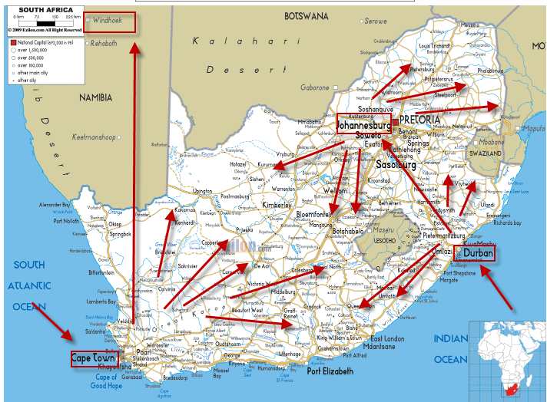
Wholesale-paper-warehouse management-ERP

Slide 6
Basic business specification
100 000 Tones per Year
Carbonless papers
Cast coated papers and Board
Coated papers
House brands
Office papers
5000 locations in HQ and 40 000 M2 warehousing space
50000 customers
90 vehicles
FEC trading (Forward Exchange Contracts)
Hundreds of employees
Heterogeneous IT system with every day synchronization of data in HQ and subsidiaries
High volume-low margin type of business
Products

Slide 7
Basic requirement
One database only (MS SQL) for HQ and 3 subsidiaries
Modern IT technology ensuring :
Fast access to data providing on-line information any time
Easy upgrades
Mobile technologies (BAR code readers,..)
Quick response to business partner requirements
Multidimensional analytic tool->reporting to support decision making process
Efficient warehousing (inbound and outbound operations)
On-line reporting (warehouse status, accounting, cost control,…..)

Slide 8
Isolated Data Islands
Marketing
& Sales
Islands
Accounting
Island
Marketing
Management
Production
Island
Customer
Orders
Accounting
Sales Representatives
Customers
Banks
Replenishment planning - Vendors
Island of
Deliveries
Quality
Management
Island
Quality Management
Inventory -warehousing
8

Slide 9
One Solution One Database All Microsoft
Management
Marketing
Warehouse
(pickers and pullers)
Customer
support
Internal Sales
(paper shop)
Reporting
One Company
Database
Accounting
Sales Representatives
Customers
Credit limits, rebates, consignment stock
FEC, transport,..
Purchase-Vendors
Shareholders
Planning

Slide 10
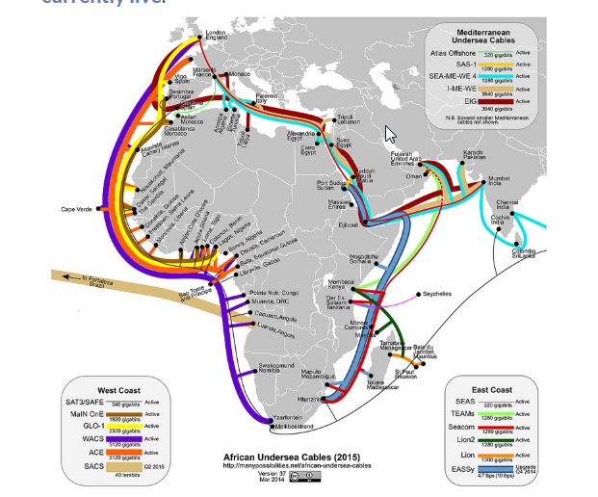
Communications limits (band width, stable connection…)

Slide 11
Efficient warehousing –(only a few examples)
Receipt bins (area where lorries are unloaded)
Put-away to bins (racks) based on zones definition
Capacities of the bins (racks) – (weight, size)
Cross docking (from inbound are directly to outbound area)
Transfer between location (HQ and subsidiaries)
Picking slips (from rack to shipment area)
Shipments area (bins, cages)
Transport planning
Credit limits and overdue payment check
Invoices, Credit memos,….
Claim management

Slide 12
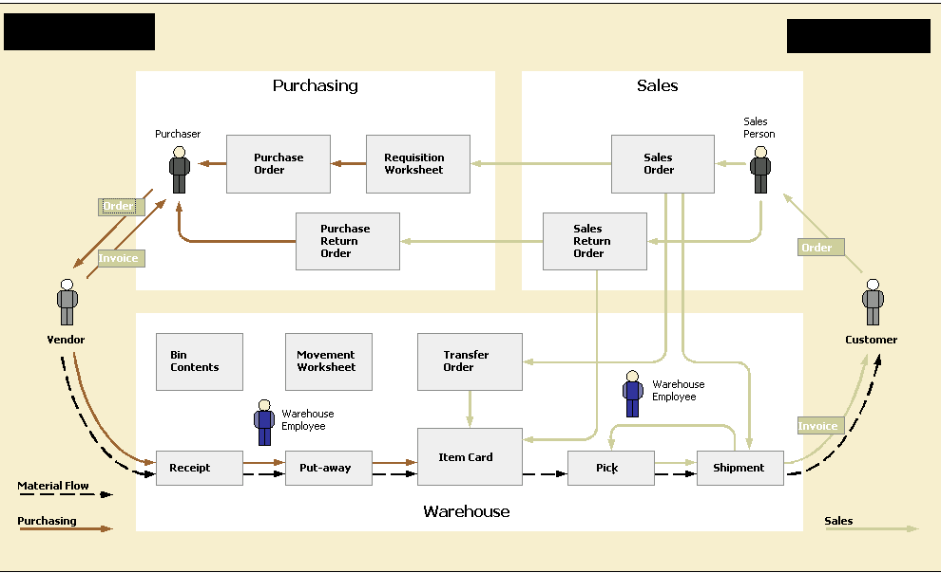
Warehousing

Slide 13
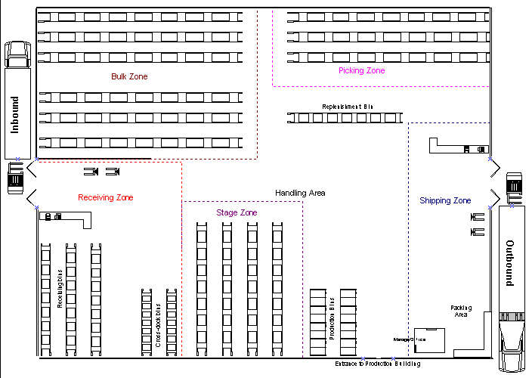
Warehousing

Slide 14
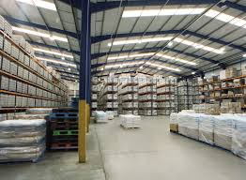

Slide 15
Project management
Budget <->Quote and contract
Planning of resources and task control
Planning tools – see following slides
Reporting (time-capacity usage, costs,…)
Change management
Project Risks
Consignment stock
CPM,PERT,CCPM – will be mentioned later

Slide 16
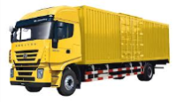
Consignment stock (benefits)
= palette
Requests
Customer
Wholesaler
Transfer
Remaining
stock
Partial invoice after 1 month
(one palette)
Wholesaler
Partial invoice after 2 months
(one palette)
Final invoice after 3 months

Slide 17
Forward Exchange Contract (home study only) A special type of foreign currency transaction. Forward contracts are agreements between two parties to exchange two designated currencies at a specific time in the future. These contracts always take place on a date after the date that the spot contract settles, and are used to protect the buyer from fluctuations in currency prices.
Opened from Purchase order (MS Dynamics NAV 2013)

Slide 18
Staff training
Study materials
Key users – roles, processes
Training :planning
Examination
Change management

Slide 19
Project Management I.
Budget (financial and resource capacities)
Data transfers (old sysetm- >new system)
Setup of the ERP system (MS Dynamics NAV)
Tests
Evaluation od customized solution
Change management
Sharp start
Closing project –evaluation

Slide 20
Steps in the model based problems solving process
Formulate problem
Define goal
Create model
Experiments
Real system
Use
knowledge
Evaluate model
Gain
knowledge
Verification of validity
Model application
Formulate cognition (knowledge)
* Source : Nyhuis,Wiendahl, Fundamentals of Production Logistics na Warehouse management

Slide 21
Implementation
Data transfer
Setup of the system
Role Tailored Clients- profiles, Approvals
Tests
Evaluation
Change management
Sharp start (Namibia and SA)
Closing project
Next stages

