Slide 1
Nonprofit-government relations: The public policy and advocacy perspectives
Alena Kluknavská, CVNS, Masaryk University
19. 11. 2018

Slide 2
Embeddedness of NPOs
Multi-functional organizations
  Social capital
  Economic role
  Religious role
  Service
  Policy
  Advocacy
  Global importance
= interactions – very different environments simultaneously, different stakeholders, very complex, dynamic shifts

Slide 3
NNO-government relations
Legal perspective
Public policy perspective
Advocacy perspective

Slide 4
Public policy perspective
Embeddednes in welfare state arrangements
To what extent governments and public administration cooperate with NPOs
Models of nonprofit-government relations

Slide 5
Najam (2000): Four-C model
based on institutional interests and preferences for policy ends and means
2 hypotheses: a) NPOs constitute a distinct institutional sector with particular motivations and structural preferences, b) NPOs have an abiding interest in public policy

Slide 6
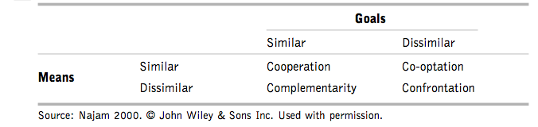
Four-C model

Slide 7
Young (2000)
Refers specifically to economic theories of nonprofit organizations
Based on the underlying assumption that output improvement (particularly of social service delivery) constitutes the core rationale for government-nonprofit sector relations
Refers to NPOs as service providers

Slide 8
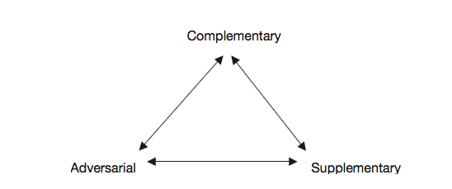
Young: A triangular model
Young (2000)

Slide 9
Salamon and Anheier: Social Origins
explains why the embeddedness of NPOs in welfare state arrangements differs from country to country
relates to the concept of organizational embeddedness focusing explicitly on broader social and political relationships
differences of size and composition are explained by different social origins of the sector
2 dimensions:
  a) the extent of government social welfare spending
  b) the scale of the nonprofit sector

Slide 10
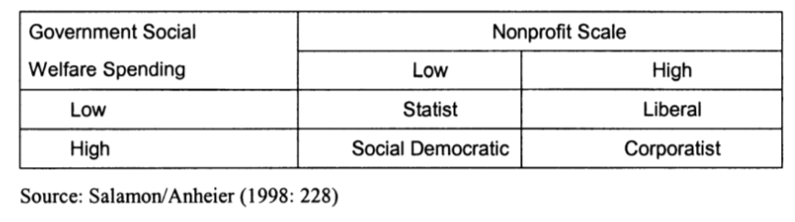
Social origins model

Slide 11
Advocacy perspective
How and to what extent citizens make use of the public sphere by engaging in civic activities
Investigating whether and how civil society organizations give citizens a voice for political participation and provide avenues for societal integration
NPOs mediate/facilitate civic participation – by providing structures and networks
NPOs engage in public-interest advocacy activities

Slide 12
Social movement theory argument
Two sectors are deeply intertwined, but conflictual relationship with government
A relationship cycle:
  SMO translates private into public concerns
  SMO gives impetus for the creation of NPO
  Succesful NPO influences government policy
  Government responds:
    by directly addressing the issue
    or funds nonprofits
  Nonprofit in turn addresses public concerns
  Tries to influence again
Examples of such successful movements?

Slide 13
Public interest advocacy
NPO’s crucial civic function
Goal: To influence government decisions; to influence government policy (not to govern); or to encourage political participation
Voicing a broader set of public interests
Ideal vs. Reality
Why should NPO participate in policies and policy-making? Reasons to advocate?
Targets of advocacy activities?

Slide 14
What affects advocacy
Declining civic engagement
Government regulation
Growing businnes competition
External factors in cooperation?

Slide 15
Nonprofit responses
have had to become more sophisticated
created more complex organizational structures
take advantage of new technologies – Internet activism fundamentally altered civic participation and advocacy
invested in effective research
increasingly turned to collaborations, including some with business organizations

Slide 16
Forms: How to advocate?
Issue identification, research, and analysis
Education of the public on crucial issues
Lobbying (direct, grassroots, administrative, for/against): reinfluence a specifiers to activities that are intended to a piece of legislation
Voter registration and education
Litigation, legal advocacy in the courts
Media advocacy
Public events and direct action (calls for boycotts and demonstrations)
Judicial advocacy
Coalition building
Expert testimony (testifying before governmental bodies)
Talks with governments
Monitoring of government programs
Drawing up of petition letters, participation in referenda or initiative campaigns
Grassroots organizing and communication with local leaders
SOCIAL MEDIA: „Tweeting social change“

Slide 17
Public funding and its impact on nonprofit advocacy
relationship between public funding and nonprofit engagement in advocacy (Neumayr at al. 2015)
two main lines of argument:
  resource dependence theory: NPOs that receive public funding will eventually reduce their advocacy activities or even refrain from them altogether for fear of losing their funding
  the nonprofits who receive public funding will increase their engagement in advocacy

Slide 18
So does it affect…?
Empirical studies: mixed results, mostly on US
Austria (Neumayr at al. 2015):
  no significant relationship between advocacy and the receipt of public funding or the proportion of an organization’s total revenue coming from public funding
  the degree to which nonprofits engage in advocacy is influenced by the geographic range of operation and field of activity

Slide 19
Citizen Lobbying: How Your Skills Can Fix Democracy
By Alberto Alemanno (at TEDxBrussels)
https://www.youtube.com/watch?v=WqNf2OPdu8c

Slide 20
Going the Digital Route
By Marci Harris, a former congressional staffer, founded Popvox, a non-partisan platform to engage digitally with Congress https://www.youtube.com/watch?v=5aKyYR-iWpc

Slide 21
Advocacy Through Social Media: Why Trending Topics Matter
By Karen McAlister (at TEDxUTA)
https://www.youtube.com/watch?v=o4sGLLaLq-Q

Slide 22
Thank you for participation

