Slide 1
Introduction to MS Dynamics NAV
(ATP_CTP)
Ing.J.Skorkovský,CSc.
MASARYK UNIVERSITY BRNO, Czech Republic
Faculty of economics and business administration
Department of corporate economy

Slide 2
Text z helpu systému I - ENG
A company must be able to inform their customers of order delivery dates. The Order Promising Lines window enables you to do this from a sales order line.
Based on an item’s known and expected availability dates, Dynamics NAV instantly calculates shipment and delivery dates, which can then be promised to the customer.
If you specify a requested delivery date on a sales order line, then that date is used as the starting point for the following calculations:
Requested delivery date - Shipping time = Planned shipment date
Planned shipment date - Outbound warehouse handling time = Shipment date
Plánované datum dodávky (expedice)
Doba na cestě
Požadované datum doručení
Doba vyskladnění
Datum dodávky
Plánované datum dodávky (expedice)

Slide 3
Text z helpu systému II - ENG
If the items are available to pick on the shipment date, then the sales process can continue. If the items are not available to be picked on the shipment date, then a stock-out warning is displayed.
If you do not specify a requested delivery date on a sales order line, or if the requested delivery date cannot be met, then the earliest date on which that the items are available is calculated. That date is then entered in the Shipment Date field on the line, and the date on which you plan to ship the items as well as the date on which they will be delivered to the customer are calculated using the following calculations:
Shipment date + Outbound warehouse handling time = Planned shipment date
Planned shipment date + Shipping time = Planned delivery date

Slide 4
ATP-CTP
Available-to-Promise (Lze slíbit)
Capable-to-Promise (Možné slíbit)
ATP – based on the inventory reservation system – performing the availability check (calculation of the date of delivery )
CTP – based on WHAT IF scenarios. Earliest date in which an item will be available
If no items that can be available, no inbound orders- purchase, transfer , return, production – it calculates Earliest Date, creates Order lines, and reserves the inventory.
Maybe integrated to the production scheduling, transfer and purchase

Slide 5
ATP -CTP
Requested Delivery
Date=RDD
Shipment
Date=SD
Planned Shipment
Date= Plan SD
Planned Delivery
Date=Plan DD
Manually
entered
Output
Warehouse
Handling Time=OWHT
Shipping
Time=ST
Promised Delivery
Date=Prom DD
Calculation
Navision calculates earliest PDD taking into account inventory
availability without customer´s requirements
Navision verifies, if by hand entered RDD is realistic
taking into account inventory availability (backward calculation)
Next

Slide 6






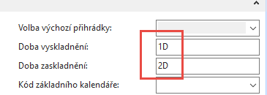
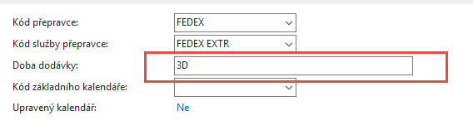
ATP -CTP
Location
BLUE
Output
Warehouse
Handling Time=OWHT=1D
IWHT=2D
Shipping
Time=ST=1D
Customer->Shipping->Shipping Agent Services->
Shipping Time and Calendars
In the text for 2018|2019 course it is 2D and 1D
Customer
In the text for 2018|2019 course it is 2D only (Fedex Standard)

Slide 7
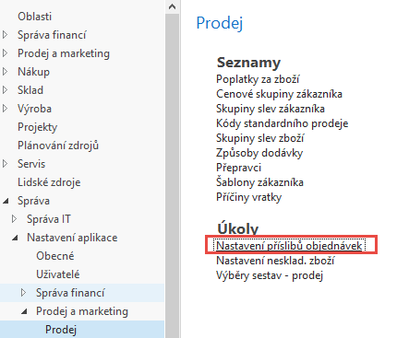
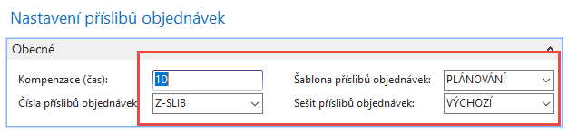
ATP –CTP – Order Promising Setup
In the setup for 2018|2019 course was Plánování,
but better to get Purchase order to change to Požadavek
(Request)
The field Offset time – Kompenzace(čas) contains the period of time that the program must wait before it is allowed to issue a new Purchase Order, Production order or Transfer Order.
The period starts with the current date.
The time units of measure that you can use are days, workdays, weeks, months, quarters or years.

Slide 8
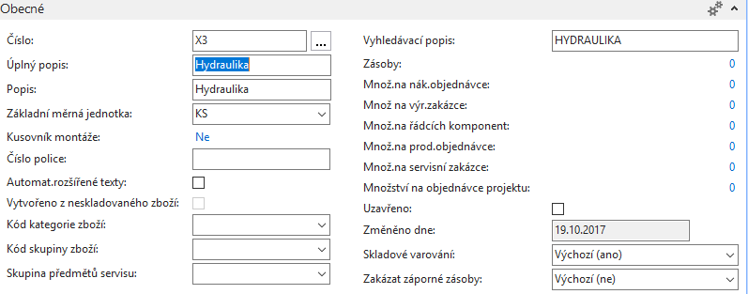
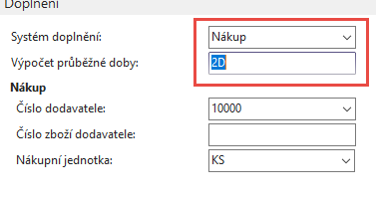
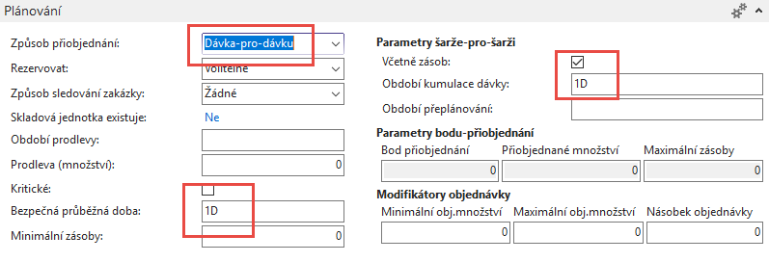
New Item X3
In the setup for 2018|2019 it was 4D
In the setup for 2018|2019 it was 2D

Slide 9
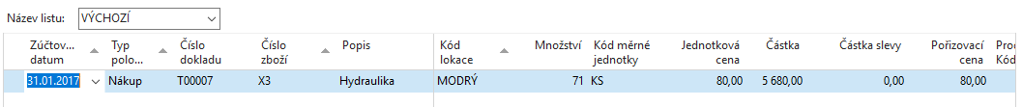
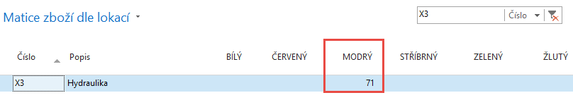
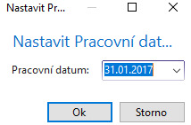
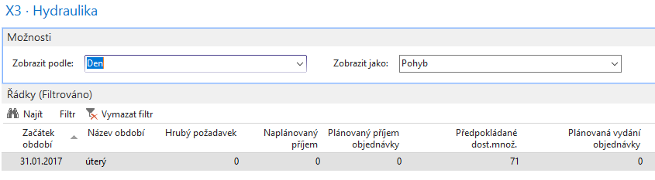
Purchase Item X3 by use of Item journal
Availability by period

Slide 10
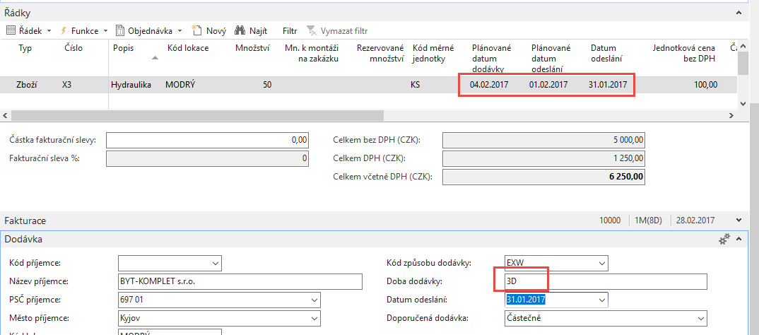
ATP –CTP – simple example
(Sales Order)
Output
Warehouse
Handling Time=OWHT
On the customer Card ST=1D and Shipping agent ST = 3D (Shipping agent setup has a priority over Customer ST=1D). Create new Shipping agent method EXTRA =ESF transport =3D and overwrite again shipment time on Customer card to 1D only

Slide 11
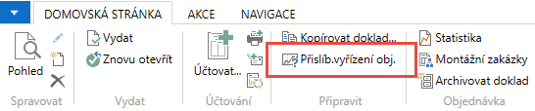

ATP –CTP – simple example
Viz další snímek

Slide 12
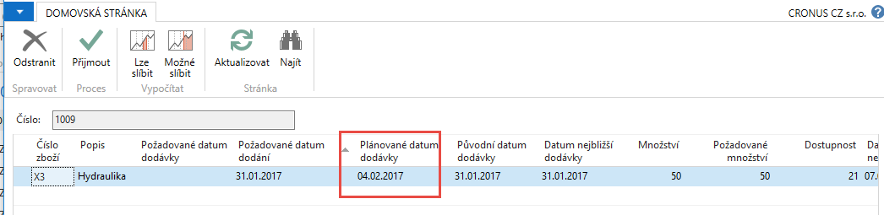
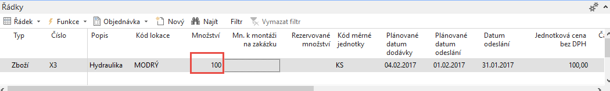
ATP –CTP – simple example
Lze slíbit
Next step- Accept (Přijmout)
Změna požadovaného množství v řádku PO 50->100

Slide 13
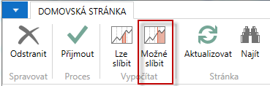
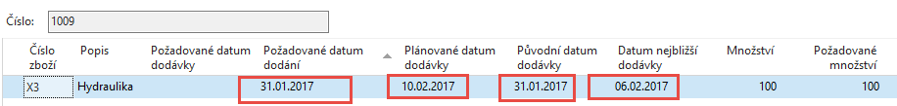
ATP –CTP – simple example CTP
SO line

Slide 14
ATP –CTP – simple example Lze (ATP) with LT=2D
6.2.- 31.1. = 6D = 2D LT + 1D SLT+ 1D IWHT+ 2D IWHT - Nákup
10.2.-6.2. = 4D = 3 ST + 1D OWHT - dodávka (prodej)
IWHT = Inbound Warehouse Handling Time - čas naskladnění
OWHT = Outbound Warehouse Handling Time – čas vyskladnění
LT = Lead Time – průběžný čas
SLT = Safety Lead Time – bezpečný průběžný čas
ST = Shipment Time – čas dopravy

Slide 15
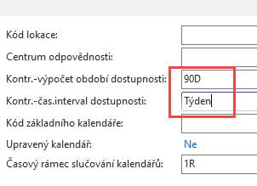
Setting up an Availability
Setup scenario : Application Setup – General -Company Information
90 days
1 week
6D
2W
13W
W=week
Today
90 days

Slide 16
ATP-CTP
See tab SO Shipping->Shipment Date !!!!
SEE XLS FILE ATP_CTP CALCULATIONS PLEASE
(Part of study material)
28.11.2008
12.12.2008
10 ks = Inventory , Lead Time=5D
20 ks = Purchase Order

Slide 17
More in detail
90 days
30.7.-1.5.=90 days

Slide 18
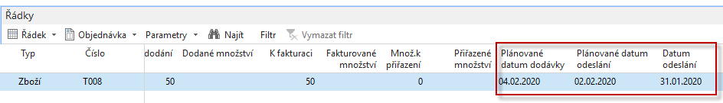
Nový příklad
Pracovní datum =31.1.2020, parametry viz tabulka, nakoupeno 71 ks T008c
31.1.2010+2D vyskladnění =02.02.2020
02.02.2020+2D Doba dopravy=04.02.2020
Když změníme požadovaný počet na 100 pak po výpočtu CTP (Možné slíbit) dostaneme
31.1.2020+ zaskladnění (1D)+průběžné doby (2D+1D) =04.02.2020
04.02.2020 + vyskladnění (2) a doba dopravy (1D) = 07.02.2020

Slide 19

End of section
(ATP-CTP)

