Slide 1
Lecture 1
DHX_MET1 Methodology 1
Stanislav Ježek
Faculty of Social Studies MU

Slide 2
Overview
Course introduction
Research with people
The process of research

Slide 3
Course introduction
Textbook
Consultations – Wednesdays afternoon, Fridays after econometrics
Final assignment – project proposal, due January 31, 2020
Final exam – 1st week in January, based on textbook, , or Friday 13 Decemeber

Slide 4
This course
Is an introduction to social-science research
Research of people‘s behavior, emotions, beliefs…
Research of something else using data about people
Assuming no previous knowledge, just some exposure to research
Assuming you have a broad dissertation topic but not a particular focus yet
Assuming research with people may not be a significant part of your dissertation

Slide 5
Follow-up elective course DHX_MET2
Workshop

Slide 6
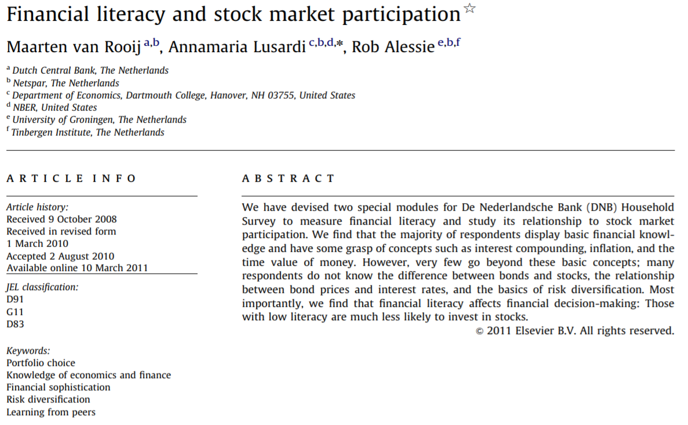
An example to start.

Slide 7
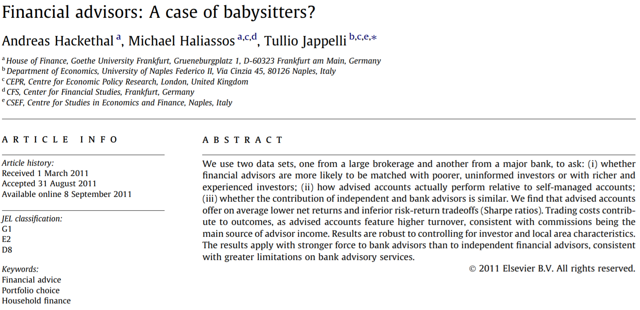

Slide 8
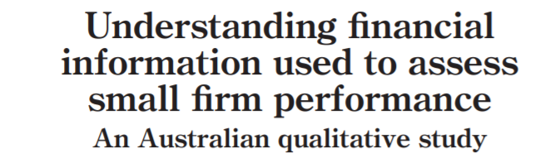
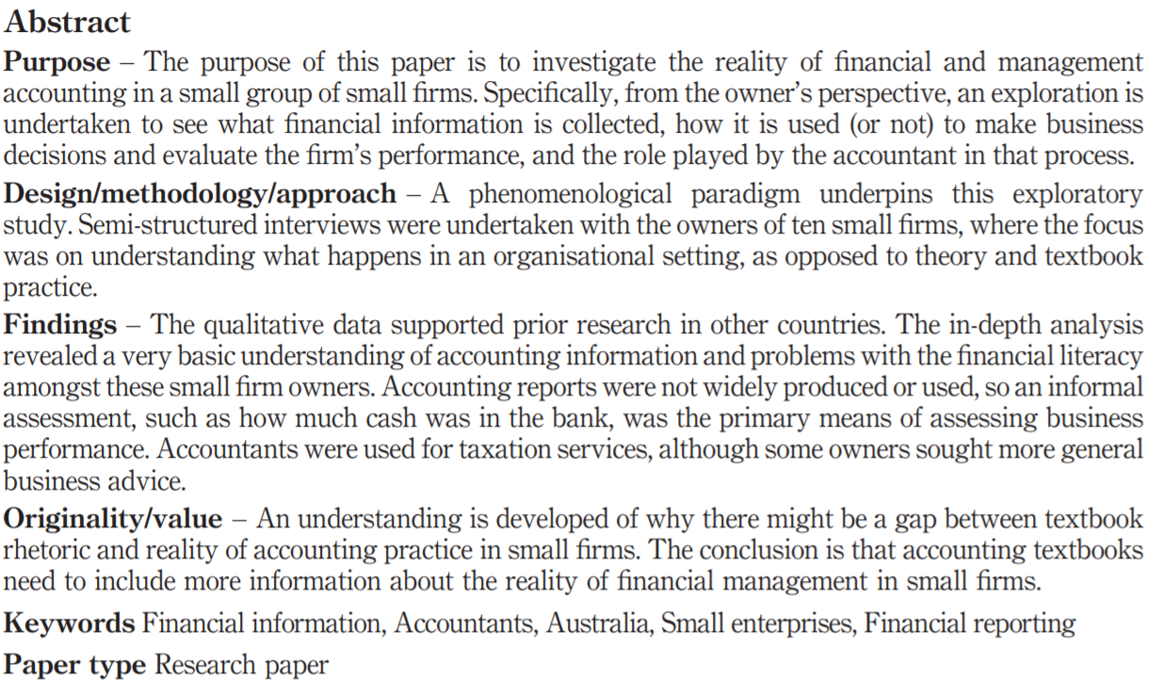

Slide 9
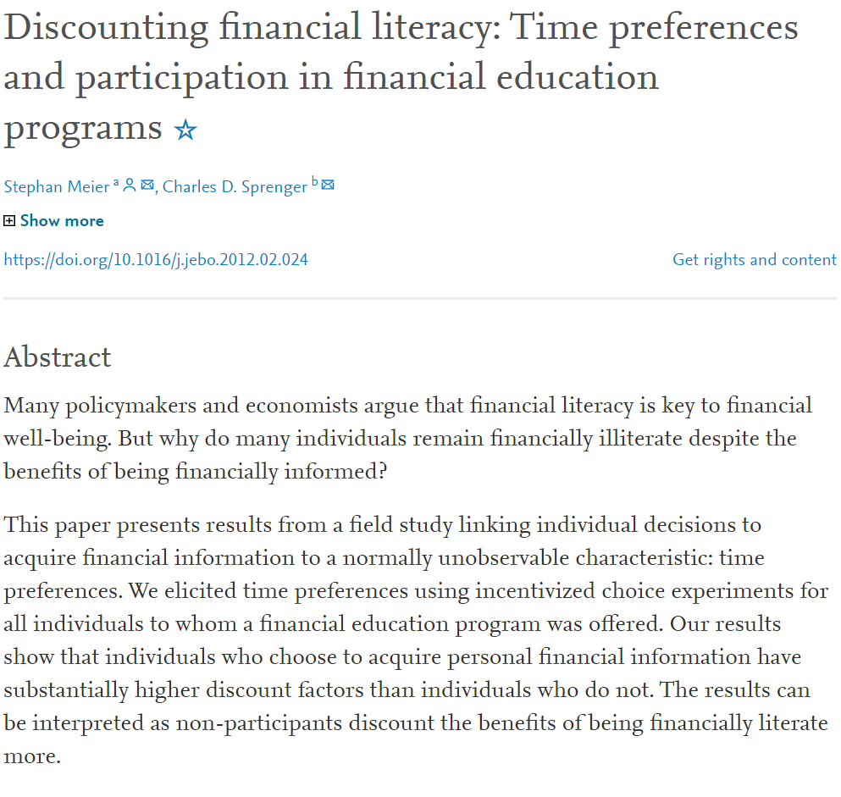

Slide 10
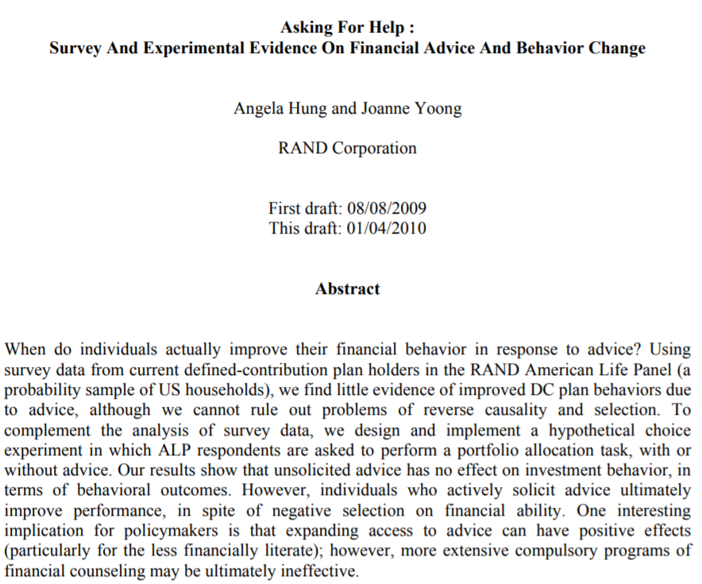

Slide 11
Research with/about people
…just like any other science,
systematic, data-based, critical investigation into a problem
except…
People study people
People react to being studied
People react to findings
There are other people besides the researcher and the participants who have other interests…
… it is difficult to achieve as much control as we would wish for.

Slide 12
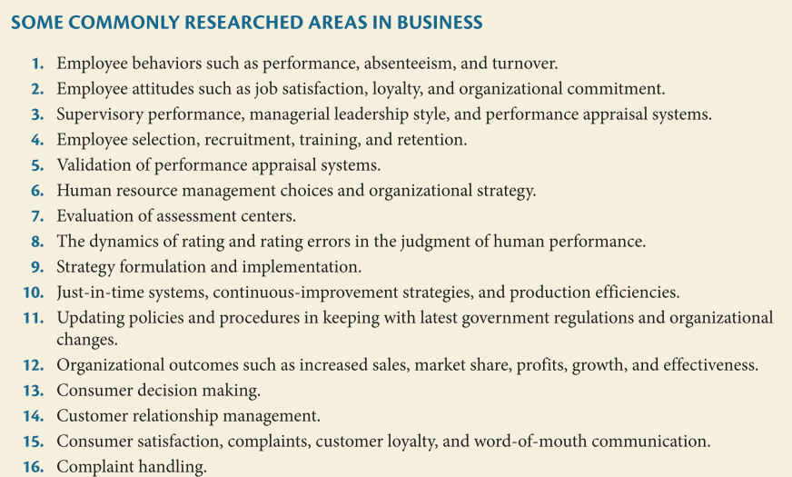
Notes:
Sekaran, Bougie p. 4

Slide 13
Management – employees, leaders…
Marketing - customers
Finance – professionals, customers
Accounting ?
Social science x Business research
General answers valid for populations x answers valid for business (segment)
Basic & aplied x mostly applied

Slide 14
What do we need?
Observe & measure people
Make use of people‘s observations of themselves –Interview them
Use the products of people‘s activity to learn about them
Achieve enough control over people to be able to experiment with them without limiting their rights
Select the right people as sources of information and Persuade them to participate
Make sense of all the data through analysis while humbly taking into account all the things that have or might have gone wrong

Slide 15
Why? What for?
To be able to plan & carry out research successfully.
To be a critical consumer of research
To be a manager knowing when to get a consulting firm to do research and recognize if they do a good job
To be a social scientist or a psychologist in an economic field

Slide 17
What is research?
Activity producing new KNOWLEDGE by
Posing a question to which the knowledge would be an answer
Gathering information from which we could rationally infer the answer
Producing the answer and estimating uncertainties

Slide 18
What is (scientific) research?
Activity producing new KNOWLEDGE
KNOWLEDGE is a BELIEF about the world that is TRUE based on some argument
The type of ARGUMENTATION gives different meanings of TRUTH

Slide 19
A little epistemological detour
Truth as Correspondence and Coherence
Truth based on Corespondence
A belief (a proposition) about the world is true when it is consistent with the actual state of the world
  But we must believe that there is some actual world and that we are able to get to know its state – epistemological realism (objectivism)
  It is intuitively easy to believe in but complicated by language
Truth based on Coherence
A belief about a world is true when it is consistent with other beliefs about the world within a domain of discourse
  The world is what we believe it is, it is made of our beliefs – epistemological idealism (subjectivism)
  While it is serious philosophy to try to defend this position for the natural world, it is easy to believe this about the social world and people‘s minds

Slide 20
A little epistemological detour
The Pragmatic position
Truth considered in the context (of inquiry) not absolutely
Truth as the correspondence with the limit of infinite scientiufic investigation – Peirce, Dewey
True are beliefs that work (have effect) when aplied in practice – William James

Slide 21
A little epistemological detour
Epistemology
What does it mean to know?
What is knowable?
How can we get to know what is knowable?
Answers come in packages „-isms“
  Empiricism, positivism, realism – sensing the real world
  Constructivism – creating a meaningful intersubjective world
  Pragmatism – relaxed, contextuial empiricism, if it works…
  Critical realism – Roy Bhaskar – empiricism-constructivism hybrid – social phenomena are construed and become part of the real world. This increases uncertainty but doesnt make empirical social science meaningless.

Slide 22
What does it mean to KNOW something?
How do we know we have LEARNED something?
How do we know whether our belief is TRUE?
Refuse to doubt and stick to TRADITION
Delegate the decision to AUTHORITY
Cast away authority (and data) and A PRIORI rationally argue the (obvious) truth
Do SCIENCE by combining data (facts) with previous beliefs
19th century Charles Peirce
Notes:
Peirce – methods of fixating beliefs
We are still doing all of this and in life it is good to know which method to use when.

Slide 23
The Process of Science
Hypothetico-deductive method
Identify a broad problem area. Define the problem statement or research question.
Identify relevant theory
3. Develop hypotheses from theory.
4. Determine measures, procedures to create data
5. Collect data
6. Analyze data and compare findings with expectations
7. Evaluate conclusions and update theory (in writing).

Slide 24
THE EMPIRICAL CYCLE
INDUCTION, ABDUCTION
ANALYSIS
PHENOMENA
DATA,
OBSERVATIONS
DATA
DATA
TEORIE
THEORY
HYPOTHESES
SAMPLE
MEASURES
DESIGN
DEDUCTION
Notes:
Abduction, abductive inference - starts with observations and seeks to find the simplest and most likely explanation for the observations. It is like a deduction but in an opposite direction – considering several possible beliefs, we chose the one which is most likely to have produced the observations. One very specific form of abduction is maximum likelihood estimation in statistics.
Like with induction teh conclusions are not certain.

Slide 25
The inductive method
Developing theory from individual observations
No „pure“ induction – there is always some preexisting theory (beliefs)
Starting from „pre-conceptual“ theory – so far we have no concepts/variables allowing us to describe the phenomenon
Either
  starting from existing rich data
  or creating rich data free from (most) preconceptions

Slide 26
Values of scientific research i.e. ways to make the argument for truth more convincing and open to improvement
Purposiveness - focus
Rigor – unbroken „chain of evidence“ from theory to data and conlusions
Testability of hypotheses
Replicability – even great rigor does not mean certainty
Precision & confidence – knowledge thereof
Objectivity – intersubjectivity & transparency of the chain of reasoning
Generalizability – knowledge thereof
Parsimony – sufficient simplicity

Slide 27
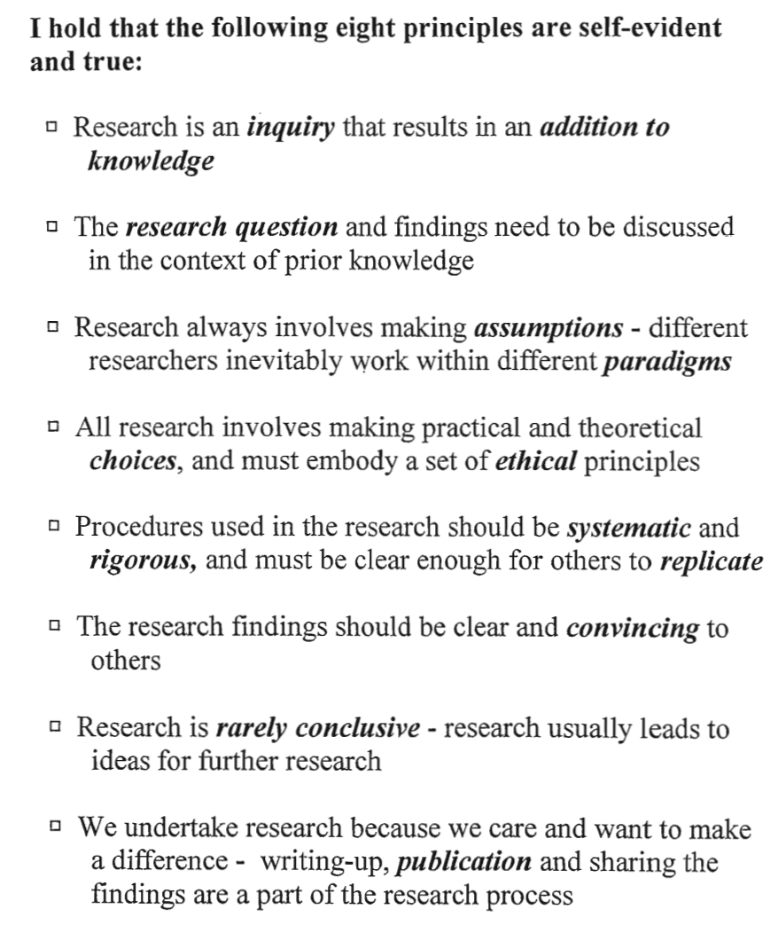
Notes:
David Hiles, lectures at Masaryk University 2001

Slide 29
Types of research by purpose
Descriptive
  what phenomena are there and how frequent they are
  Classifications as a way to understand the variability
Predictive
  How is the probability of one phenomenon related to the probability of other phenomena
  How well can we predict
Causal
  Can we show how one phenomenon affects another?
  How things work – prediction and explanation in one
Understanding
  How people understand situations, how they experience them and what language they use to communicate about this
  What are relevant classes of phenomena, variables

Slide 30
Types of research by design
Surveys
Observation studies
Experiments lab or field, quasiexperiments
Qualitative studies
Ex-post-facto, post-hoc studies
Case studies

Slide 31
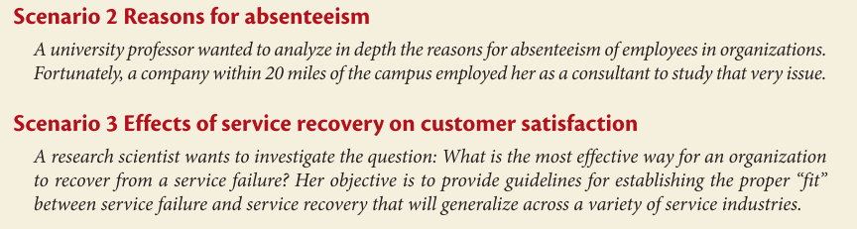

Slide 32
Summary
Research is for making knowledge of various levels of generality – personal, local, company, country, mankind…
Methodological knowledge is good for doing research, consuming it, and contracting it
Many research questions in economic fields are about people – either directly (object of interest) or indirectly (sources of data)
Research of people (social world) is complicated by its unstable nature, reactivity and variability of people, ethical requirements etc.
The process of scientific research with people is only partially the same as in natural sciences and the level of uncertainty is much higher.
While there are other ways of justifying beliefs, scientific research is the one most careful and transparent in the argument WHY something is true.

Slide 33
What next?
For efficiency we need to make best use of what we already know. We know a lot, maybe too much in the way of quantity and too little in the way of quality.
Next we will identify available theory and use it to develop a sound research question.

