Slide 1
Lecture 2 DHX_MET1 Methodology 1
Stanislav Ježek
Faculty of Social Studies MU

Slide 2
PURPOSE
OBJECTIVES
CONCEPTUAL
FRAMEWORK (PARADIGM)
RESEARCH QUESTION
HYPOTHESIS
METHOD
(DESIGN, MEASURES, SAMPLE
VALIDITY
Maxwell, Loomis, 2003:246

Slide 3
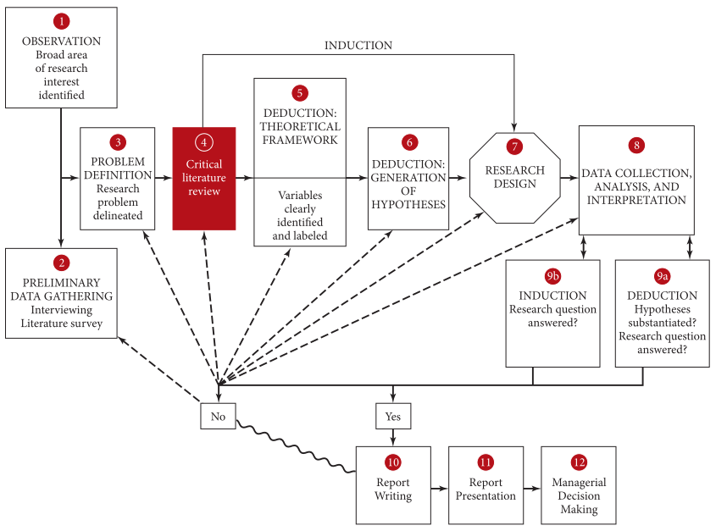

Slide 4
From a topic to hypothesis

Slide 5
Identification of a problem - topic
From previous research
From real life (e.g. business)
„Big Questions“ – novel, creative questions starting a research program
In school – looking for a research problem
Emerges from research or mimicking research

Slide 6
Preliminary research
Get a better understanding of the problem to be able to narrow it into a researchable topic
Identify what is there to be known about the phenomenon of interest
Learn about the context in which you want to study the phenomenon
Asking WHY as a way to identify what social-science theory is needed.

Slide 7
Problem statement
…unambiguous, specific, and focused, and addressed from a specific academic perspective.
Research purpose - motivation
Research objectives - goals
Research questions – information needed to meet the goals

Slide 8
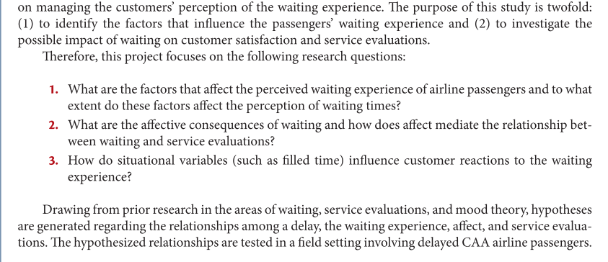

Slide 10
Qualities of a problem statement
Relevance
Nothing known
Fragmented knowledge in need of integration
Contradictory findings
Findings differ or do not hold in different settings
Feasibility
Interest(ingness)
Worth knowing not only for you

Slide 11
RESEARCH QUESTION
HANDLE OF YOUR STUDY
Provides focus
Invites hypothese
Justifies the costs
An answer must be believed to be found
It really must be a question
Is as narrow as necessary for feasibility
intersubjectively meaningful

Slide 13
Types of research questions
Exploratory
Descriptive
Correlational
Causal

Slide 14
Research proposal
1. A working title.
2. Background of the study.
3. The problem statement:
a. The purpose of the study
b. Research questions.
4. The scope of the study.
5. The relevance of the study.
6. The research design, offering details on:
a. Type of study – exploratory and descriptive
b. Data collection methods
c. The sampling design
d. Data analysis.
7. Time frame of the study, including information on when the written report will be handed over to the sponsors.
8. The budget, detailing the costs with reference to specific items of expenditure.
9. References

Slide 15
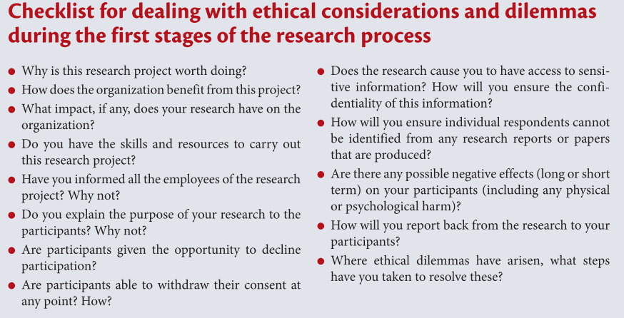

Slide 17
Critical literature review
Purposes
Build on knowledge you will contribute to
Improve your thinking about the problem
Avoid “reinventing the wheel”
Conceptual framework: relevant terminology, concepts & their relationships
Knowledge of the research methods
The research effort can be contextualized in a wider academic debate. In other words, it allows you to relate your findings to the findings of others.
Ultimate purpose: propose plausible and testable hypotheses within the conceptual framework

Slide 18
Data sources
Textbooks
Journals – which are the main ones?
Theses
Conference proceedings
Unpublished manuscripts
Reports
Newspapers
The Internet
DATABASES

Slide 19
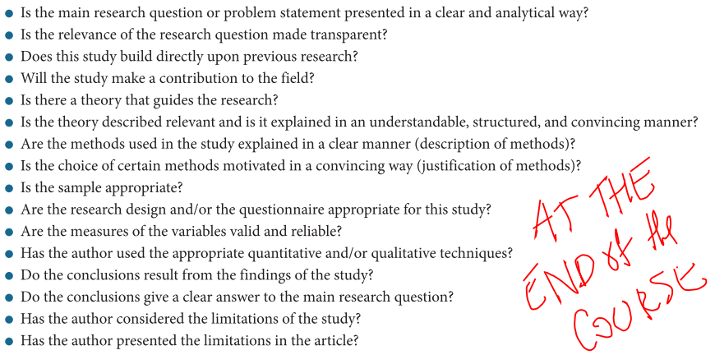
Evaluating the literature
The purpose of abstract is to assess relevance, nothing else.
Social-science journal articles tend to have narrative-review-study-like introductions
Number of citations is just a hint (correlated with age)

Slide 20
The critical literature review needs to be written
As a part of the argumentation for the purpose of your study in a proposal
As a part of the introductory section of any form of report of your findings
Academic writing and citing…

Slide 22
Theoretical framework – concepts & relationships between them
Concepts - generalisations of particular characteristics of the phenomena of interest allowing us to think about them without drowning in their endlessly varying instances
Variables as measured, observed concepts
Competing definitions
Theory of the phenomenon
Conceps/variables used to describe the phenomenon
Ideas about how the concepts/variables are related (description) and why (explanation).
IVs, DVs, moderators & mediators
A very condensed summary of what we know allowing us to propose hypotheses

Slide 23
Hypotheses
Expected answers to our research question inferred from theory.
Expectations about what will be observed (what will be found in our data)
Statements about the world that we provisionally believe in.

Slide 25
Checklist questions – ask yourself
What exactly do I want to find out?
Can it be found by any means other than research?
What kind of an answer will satisfy me? What can I use the answer for? And others?
For what set of phenomena will the answer apply? And for how long?
Why me? Who else wants to know?
Can I imagine how to get the answer? Will I be able to manage it (by myself)?

Slide 26
What next?
Now we have a good idea about what the research questions are and what answers we expect.
Next we need to think about how to get the answers.
Since there is a huge number of possibilities we generally start our thinking from prototypical templates – research designs.

