Slide 1
Lecture 3 - Design
DHX_MET1 Methodology 1
Stanislav Ježek
Faculty of Social Studies MU

Slide 2
Econometrics
4. 10. 10:00--16:00 S307,
11. 10. 10:00--16:00 S307,
25. 10. 10:00--16:00 S307,
1. 11. 10:00--16:00 S307,
8. 11. 10:00--16:00 S307,
15. 11. 10:00--16:00 S307
Additional office hours during the above days – 14 to 15:00 @ FSS MU room 2.47

Slide 3
Exam
Friday December 13
Friday January 10
Short open-ended items + multiple choice
Sekaran & Bougie 7th ed.

Slide 4
So far we have…
decided for a research question
developed a theoretical framework and specified hypotheses

Slide 5
RESEARCH DESIGN?
Research question → Research Project
Design - a strategy, plan of…
  How will I find answer to my RQ?
    How will I test my H?
  How will I know the answer is TRUE? → VALIDITY

Slide 6
RESEARCH DESIGN
What are my variables (phenomena)?
What data represent my variables?
  How do I get the data?
    Find?
    How to create data?
  What will be the limitations of the data?
    Representativeness
      people, places, time, phenomena…
    Validity – certainty about the variables affecting the data (intended, unintended)

Slide 7
BASIC ELEMENTS OF RESEARCH DESIGNS - CHOICES
Gather existing data …. create data?
Precisely measure a few variables … gather rich, contextual data (many variables)?
Low interference (lurking) … high interference?
Field … laboratory?
Focus on one time …. follow the processes?
High control …. natural occurrence

Slide 8
So, what is it that we want to know about designs?
Chose a design based on our RQ and resources
Specify the design so that it can produce high quality data
Execute the design
… Analyze the data

Slide 9
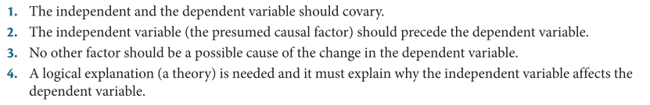
Types of research questions
Exploratory – we are not sure about variables
  Little established theory, uncertainty about relevant variables, concepts
  Focus on understanding the phenomenon in its context, on its meaning
  Proposals of concepts/variables and their values (categorizations) or even theory of their relationships
Descriptive – we have questions about variables
  What are variants of phenomena that occur and how frequently they occur
  Correlational – are there any associations among the occurrences?
Causal – does one phenomenon give rise to another?

Slide 10
Designs - templates for research – by discourse
Experimental design
  experimental, quasi-experimental, single-case/small-N experimenting, ex-post-facto
Survey research
Observations
Case studies
Content/thematic analysis, Grounded theory
Action research, Evaluation research
Notes:
Sekaran & Bougie think about experimental design as longitudinal. While it may appear OK, it is not. Longitudinal reserach is mostly (but not exclusively) non-experimental and basic experiments have just one measurement.

Slide 11
Designs - templates for research – by the underlying logic
Experimental design
  experimental, quasi-experimental, small-N experimenting
Non-experimental design
  correlational, surveys, (longitudinal), ex-post-facto
Qualitative designs
  Case studies
  Qualitative content/thematic analysis study
  Grounded theory
  Ethnography
Notes:
Sekaran & Bougie think about experimental design as longitudinal. While it may appear OK, it is not. Longitudinal reserach is mostly (but not exclusively) non-experimental and basic experiments have just one measurement.

Slide 12
Ethnography
Very general theory - anthropology, sociology, psychology...
RQs how are things done around here. How are the most basic goals achieved here.
Descriptions with Focus on the meaning of behaviors.
Participant observation as the main method of data generation
Takes a long time, even years
Interference should be low due to habituation
Mostly an inspiration for flexible designs with shorter time-frames

Slide 13
Case study
First, look at this case, then we will decide what to do next.
exploration, description
Broadest possible range of methods to gather and create a lot of data
A lot of theory is used
Robert Yin textbooks are the best intro
Difficult generalizations
Case: person, group, organization, program, economy…
N is often >1

Slide 14
Case study – practical features
Hard to hold on to your RQ
interactivity, flexibility
Potential for rich data, triangulation
Need to select case very thoughtfully
Keeping balance between observing and intervening
Beware of „success stories“!
Generalization by theory and replication.

Slide 15
Content/thematic analysis
Grounded theory
Theory generation - proposal
A number of cases that we compare to see what is common and what is different
Actually an analytical approach with so much theory that it becomes a design, still may be used as analytical tool within other designs
Focuses on texts and interview transcripts – less time in the field
Produces content units – topics – that may be the basis for the definition of concepts / variables and their values
GT goes on to formulate a theory of a phenomenon – what gives rize to it, what are the contextual variables that affect it and what are the consequences

Slide 16
Observations
What is the curent state of a phenomenon?
Do various phenomena associate (co-occur)?
Observing the natural occurrence of variable values (phenomena) and their frequencies
May be naturalistic/unstructured …. highly structured
Minimal interference with the observed processes
You know exactly what you want to observe but it may be difficult to get access and time
Limited number of variables – good planning necessary
Descriptive RQs, correlational RQ, longitudinal RQs
Observation is used as a data generation method in other designs
Good sampling is key to representative data

Slide 17
Surveys
What is the curent state of a phenomenon?
Do various phenomena associate (co-occur)?
Serves the same purposes as observational research but instead of observing we ask for the observations of others
We may ask about much more than we may observe – the price is we are using untrained observers who are asked about past events – high level of uncertainty
  Surprisingly high amount of expertise and theory needed to create good data
Wide range of structuring options
Huge range – we may ask about anything

Slide 18
Surveys – practical properties
Survey itself may be an intervention
Self-report validity
  people know less than we think
  the correlation between saying and doing is small
Usually a lot of variables must be measured (to achieve meaningfulness)
Useful to step back and think about existing data
We can use sophisticated statistical models to assess the fit between hypothesized associations among variables and observed data – econometrics…

Slide 19
Experimenting – for causal RQs
If I do this, will happen what I think would happen?
What happens, will it be only beause I did this?
manipulation with an independent variable
measurement of dependent variable, outcome
control of intervening variables

Slide 20
Experimenting– features
Causal inference
  causality generalises better than association (coincidence)
Ex is interactive, w/ strong emphasis on context
  potential for further exploration, case study, qualitative work.
  Ex demanding in terms of control, interference
Ex ca be small, flexible
Ex achieves representativeness more flexibly than eg. survey
  theoretical generalization and replication
Ex is demanding in terms of current knowledge

Slide 21
Specific applied designs
Applied, limited in generalizability, high usability
Evaluation
Action research

Slide 22
EXPERIMENTATION IN DETAIL
We need enough theory and focus that we can identify:
Dependent variable (DV)
  one or very few
  measured as precisely as possible
Independent variables (IV)
  one of few
  manipulated so that it can create as a large effect so that we can detect it, or estimate it with sufficient precision
  manipulation check – when it is not obvious we were successful in manipulating the IV
Intervening, extraneous, confounding, nuisance variables
  variables associated with both DV and IV
  observed(measured)
  controlled – by design, statistically

Slide 23
If the hypothesis is true and everything is executed properly…
the IV will differ among perticipannt solely due to our manipulation,
IV will correlate with DV
the effects of all other variables on DV are controlled for
Thus, if there is a reasonable theory of IV having a causal effect on DV, we can consider the correlation between IV and DV as support fora causal effect.

Slide 24
What is control?
Making sure the intervening variable does not bias our estimate of the effect of IV on the DV
We are trying to prevent the intervening variables to correlate with IVs, DV or both
Fixing the intervening v. – make it a constant so that it cannot correlate
Randomize the IV so that it cannot correlate with the intervening variables
  The intervening will still correlate with the DV but their effect will not affect the effect we want to estimate
  Pairing, matching, balancing is a non random way of achieving this when IV is categorical
Measure and control statisticaly – partial/part correlation

Slide 25
Internal validity – the concept of success
A correlation between IV and DV is considered an internally valid evidence for the causal effect of IV on DV when we can argue tha all known and unknown intervening variables have been controlled.
Then the experiment is said to be internally valid.
Can we say that the differences in DV attributed to IV are really solely due to the differences in IV?
Difficult, therefore it has the form of an argument open to discussion.
Low to high (not „is“ „is not“).

Slide 26
Examples of experimental designs
Pretest – posttest single(experimental) group
  DV is measured before and after experimental manipulation is done
  IV has as many values (levels) as many there are different manipulations
  Within-subject design
Two or more group posttest only design
  DV is measured after experimental manipulation has been done in each group diffrently
  Experimental and control groups terminology
  Each level of IV is assigned to different participants – between-subject design
Two-group pretest-posttest design
  1 + 2 – add a pretest in each group of 2 – mixed design
Four-group Solomon
  2 + 3 – Two groups without pretest, two with pretest

Slide 27
Generic threats to internal validity
History – anything that happened between pretest and posttest could have made/biased the effect
Maturation - …even the naturally running processes in our bodies, getting older, hungry, tired
Testing - …the act of pretest measurement itself could have affected the posttest or even reaction to the experiental manipulation
Selection – unbalanced groups – any known/unknown differences between the groups could have made/biased teh effect
Mortality – what if the reasons for subjects‘ leaving the study correlate with the DV?
Regression to the mean - when the groups are made according to the level of DV (or related variable). Extremes have higher probability of change towards mean.

Slide 28
Not all experiments are true experiments
True experiments
  We have full control (down to each individual) over the manipulation of the IV
Quasi-experiments
  Manipulation is slightly limited by the fact that experimental groups have been formed prior to experiment. We still decide what level of IV will be assigned to each group
  Informally – any experiments with obvious design weaknesses (1, 2)
Ex post facto (post hoc) studies, natural experiments
  Technically not experiments but correlational studies
  The IV has occurred naturally, by itself, by someone else‘s choice – we just observe it
  We use the terminology and statistics of experiments (and ideály dreamof an upgrade)

Slide 29
Field-experimenting
Issues
Randomisation
Manipulation
Ethics
Limited control
Perks
Ecological validity, generalizability
Less reactivity
Availability of people

Slide 30
External validity - generalizability
To different participants, populations
To different settings
  In teh context of lab vs. field – ecological validity.
To different times

Slide 31
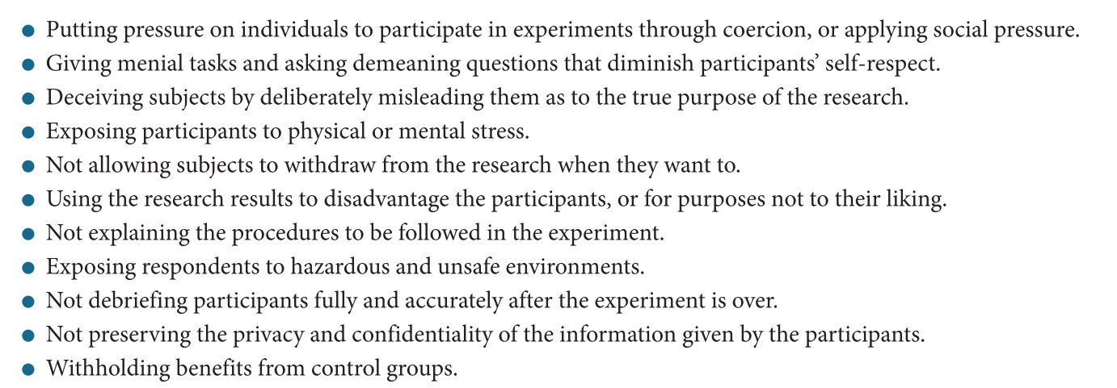
Ethics
The need for control can lead us astray

Slide 32
SUMMARY
Designs are templates for research
Most developed designs are for studies requiring most control
For exploration with little theory – qualitative designs
For descriptive and correlational purposes – observations, surveys, ex-post-facto
For causality inference we need experiments

