Slide 1
Lecture 8
Qualitative Data Analysis
DHX_MET1 Methodology 1
Stanislav Ježek
Faculty of Social Studies MU

Slide 2
OVERVIEW
Remembering the RQ
Reflecting on what we have learned just by doing the interviews (observations).
Reading & re-reading transcriptions
  Transcribing
Coding – themes and concepts
  The more descriptive part of analysis
Theory building
Critical reflection
Writing

Slide 3
0. REMEMBERING THE RESEARCH QUESTION & RESEARCH PURPOSE/OBJECTIVES
Open, wide RQ in QUAL research.
  Descriptive questions
    What are relevant factors in peoples‘ experience of…
    What is the range of ways of understanding/experiencing/doing….
  Explanatory/Understanding questions
    How people make sense of…
    How do social/psychological phenomena come to be, what are their antecedents, consequences, necessary conditions…
In qualitative research the RQ can change (not necessarily).
  The richness of data and wide-open possibilities can result in a feeling the original RQ does not serve the research purpose
  Specification
  Conceptual/focus shifts

Slide 4
1. REFLECTIONS FROM INTERVIEWS
(RESEARCHER IS AN INFORMANT, TOO)
Preliminary understanding of the informants‘ experience
  Initial concepts and their properties
  Extending theoretical sensitivity
Field notes on what parts of interviews were difficult, emotional (informant, researcher) and how the difficulties resolved
Own data collection provides advantages; secondary data analysis still possible

Slide 5
1½ INTERVIEW TRANSCRIPTION
Interviews MUST be transcribed
Time consuming, expensive process.
  https://ocean.sagepub.com/blog/whos-disrupting-transcription-in-academia
  Speech recognition is promising but…
    still pricey as a professional service, e.g. www.happyscribe.co €12 per hour
    without special notation for paralinguistic features
  Software assisting with the process, e.g. https://www.audiotranskription.de
Notation – we want more than just words
  pauses, intonation, stresses, interjections (uh-huh) , and more
  the level of detail depends on the goals and topic

Slide 6
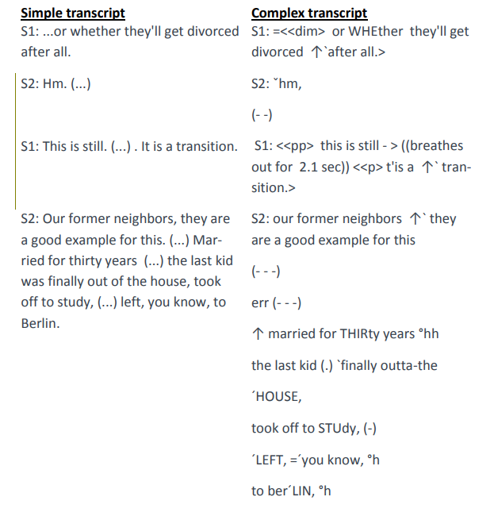
https://www.audiotranskription.de/download/manual_on_transcription.pdf, p. 25

Slide 7
2. READING AND RE-READING
Repeated reading provides further understanding
Especially important when analyzing texts produced by someone else

Slide 8
3. CODING – THE CORE PROCESS
Identification of meaning units in the text
  Theoretical sensitivity, previous readings & research questions indicate what a meaning unit is
  Meaning unit usually describes(mentions) one incidence of a relevant phenomenon
Assigning labels to meaning units – CODES
  Codes are descriptive labels – handles - for phenomena that allow us to quickly refer to them
  The words for codes come from theory, by association, from informants (=in vivo codes)
Codes are initially quite specific (i.e. not general) – represent a narrowly defined phenomena
  With each next meaning unit I ask whether it is another instance of previously used code-phenomenon, or whether a new code is in order
Coding table – meaning unit + code + explanations/notes

Slide 9
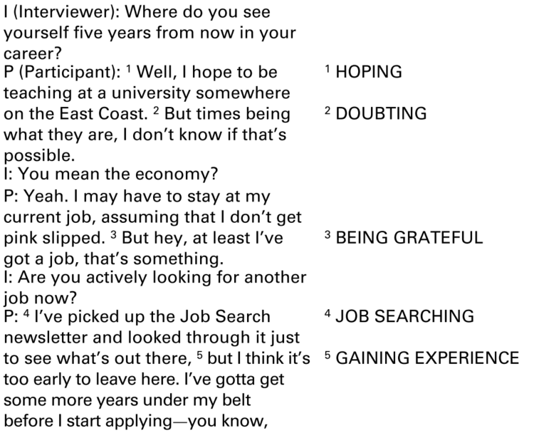
from Saldaña (2011)

Slide 10
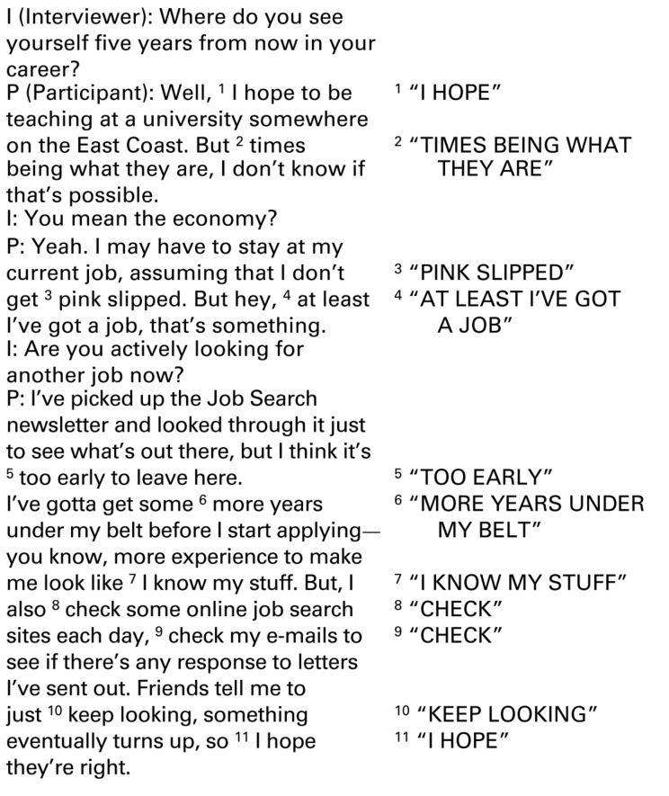
in vivo codes
from Saldaña (2011)

Slide 11
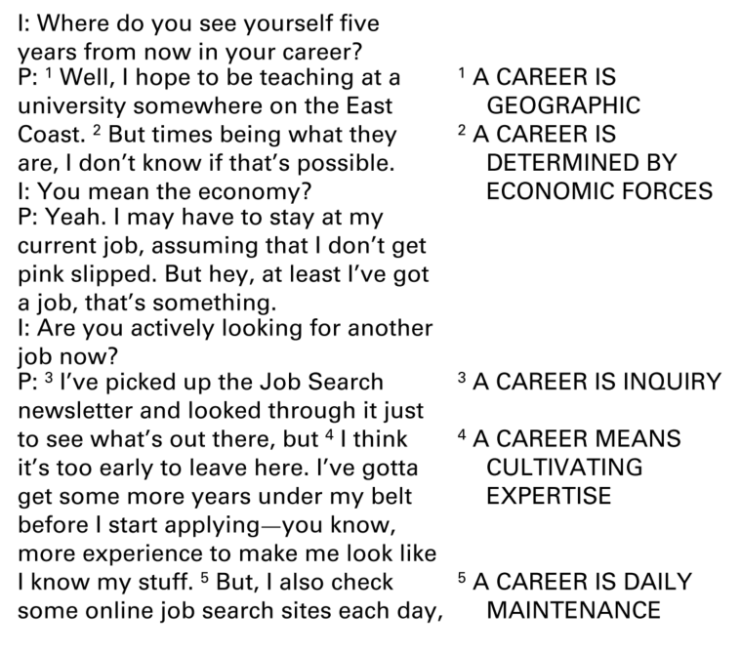
themes
from Saldaña (2011)

Slide 12
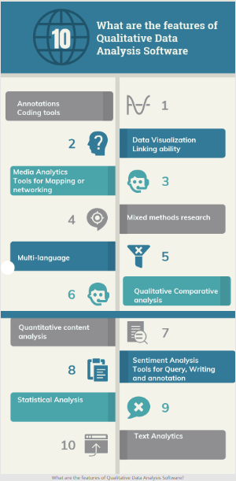
3¼. CODING - Software
Paper&Pen&Highlighter
Office software – Word+Excel
  https://www.youtube.com/watch?v=o4qa7Zb8twM
Specialised software
  Atlas.ti, NVivo …
  free: google free QDA software
https://www.predictiveanalyticstoday.com/top-qualitative-data-analysis-software/

Slide 13
3½. CODING –
EMERGING DEFINITIONS AND HIERARCHIES
The common features of meaning units with the same code indicate the definition behind the code – CONCEPT
  With each coding we decide whether a meaning unit fits the partially implicit/explicit definition.
  With each coding the definition may slightly change to accommodate meaning unit
  This is how concepts gradually EMERGE (as opposed to having them defined from theory before coding)
Close CODES/CONCEPTS may inspire to define a superordinate category/code/concept – a HIERARCHY emerges
More general (higher) categories are sometimes called THEMES
Sekaran & Bougie call this categorization

Slide 14
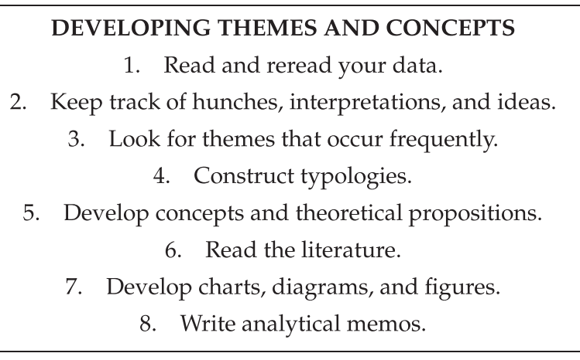
from Taylor (2016)

Slide 15
Analytic Memos
Topics for Reflection during coding
how you personally relate to the participants and/or the phenomenon
relevance to your study’s research questions
your code choices and their operational definitions
the emergent patterns, categories, themes, and concepts
the possible networks (links, connections, overlaps, flows) among the codes, patterns, categories, themes, and concepts
an emergent or related existent theory
any problems with the study
any personal or ethical dilemmas with the study
future directions for the study (Saldaña, 2009 , p. 40)

Slide 16
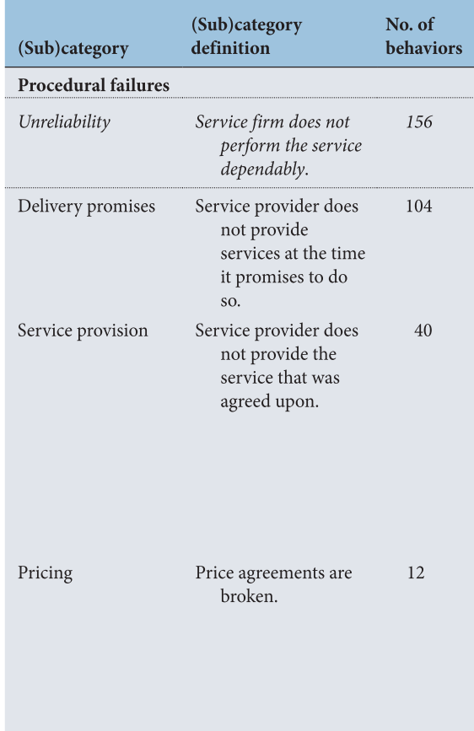
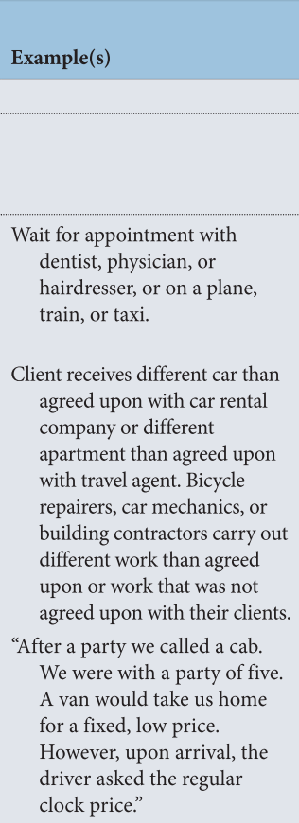

Slide 17
3¾. CODING – DESCRIPTION OF DATA
The above coding procedure is considered DESCRIPTIVE
  despite a lot of subjectivity and considerable theory used
The informants‘ experiences with respect to the RQ may be efficiently summarized by describing the concepts (their definitions)
Open coding (within Grounded Theory)
Thematic Analysis, Content Analysis
Often the analysis ends here
  Categories/Concepts/Themes reported in tables
  …narratives
  …graphical schemes
Content analysis may represent different techniques!
  Quantitative CA = categories heavily dependent on theory, focus on frequencies (=should be reflected by sampling strategy)
  Qualitative CA = emergent categories, focus on their qualities, counting does not carry much weight, often missing

Slide 18
4. THEORY BUILDING
Theory of the phenomenon of interest
Depends on the researcher‘s theoretical background and existing theory of the phenomenon
  Grounded Theory (Glaser, Strauss, Charmaz)
  Narrative Analysis (Bruner, Polkinghorne)
  Discourse Analysis (Potter, Edwards, Wetherell)

Slide 19
4¼. THEORY BUILDING IN GT
Decide about the Central Category (phenomenon, concept)
  The phenomenon of which the theory would be
  Sometimes trivial decision sometimes not
What composes GT theory?
  Properties, dimensions of the central (and other) category
  Antecendents of the central category, possible causes
  Consequences of central category
  Context, intervening conditions
Analytic Induction a.k.a. the Constant-Comparison method
+
Theoretical Sampling - the deductive component.

Slide 20
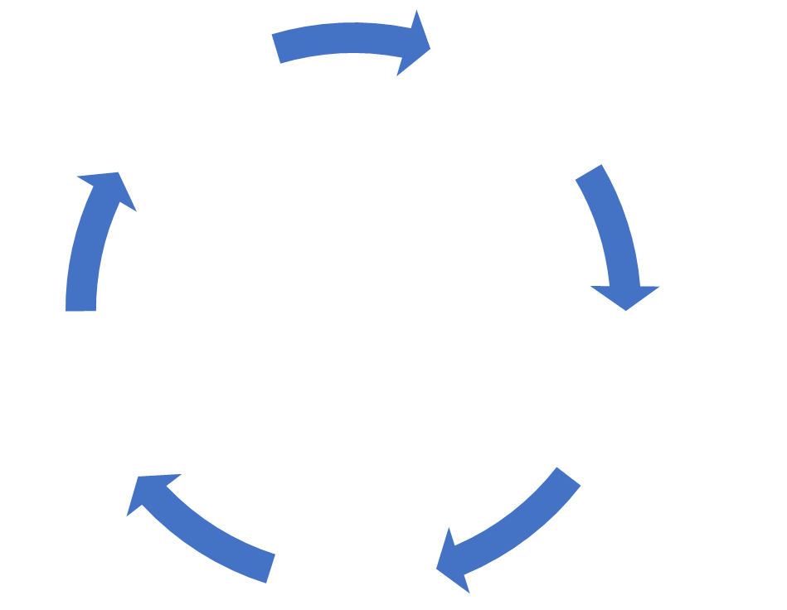
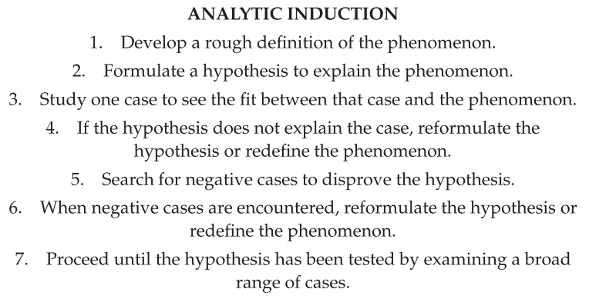
from Taylor (2016)

Slide 21
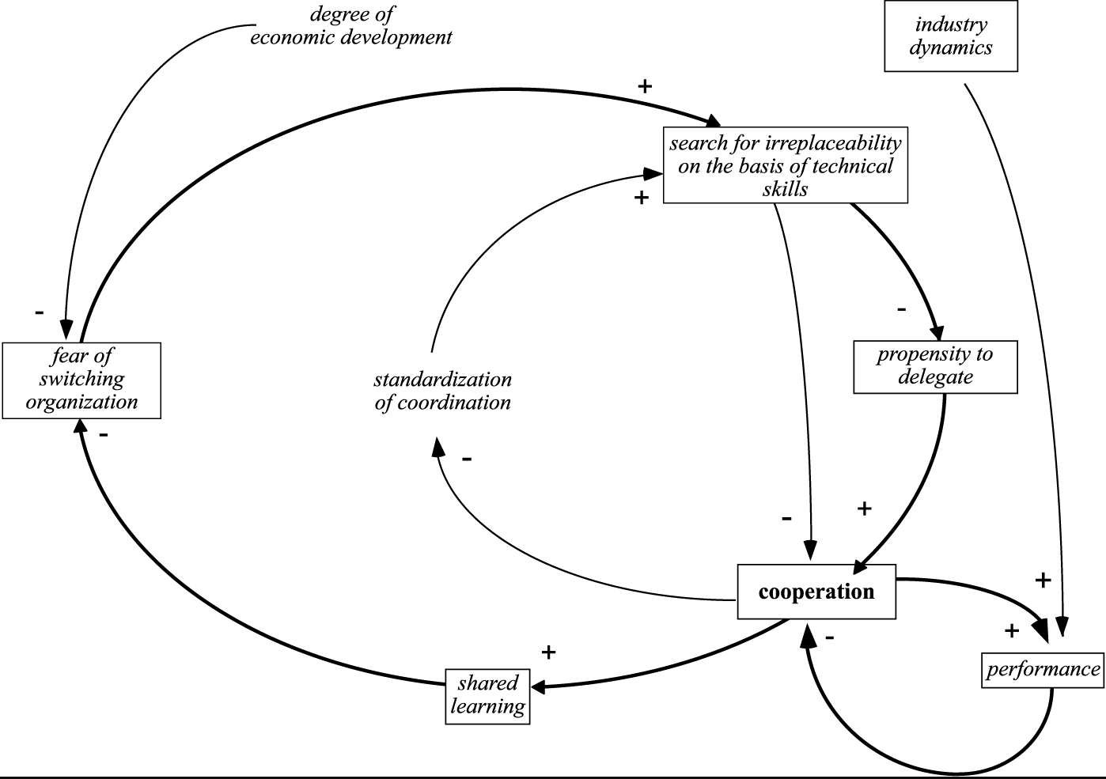
Macrì, D., Tagliaventi, M. and Bertolotti, F. (2002). A grounded theory for resistance to change in a small organization, Journal of Organizational Change Management, 15 (3), 292-310.

Slide 22
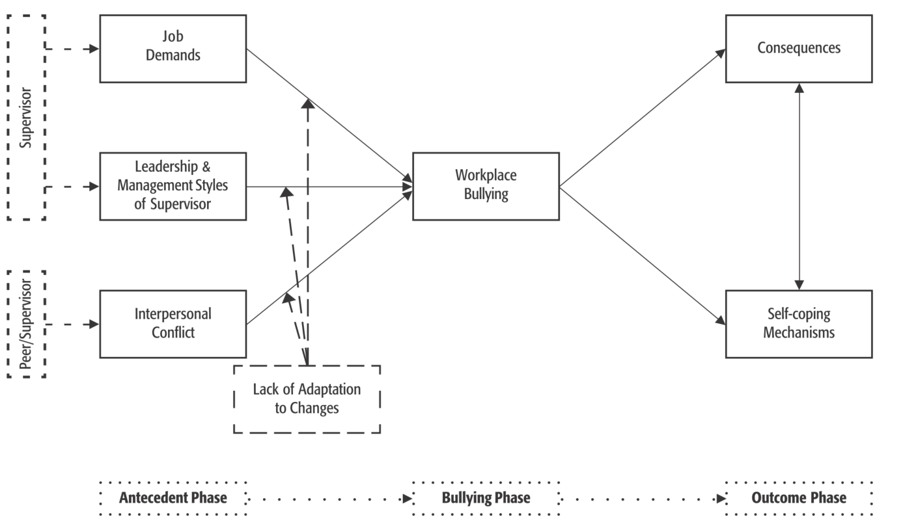
Lillemor R-M. Hallberg & Margaretha K. Strandmark (2006) Health consequences of workplace bullying: experiences from the perspective of employees in the public service sector, International Journal of Qualitative Studies on Health and Well-being, 1:2, 109-119, DOI: 10.1080/17482620600555664

Slide 23
5. THINKING CRITICALLY ABOUT THE FINDINGS – VALIDITY&RELIABILITY
Validity & reliability are seldom used as terms
Instead: Autheniticity, Dependability, Consistency, Applicability…
Data should be persuasively described (represented) by presented categories, concepts, themes … theory
The reader wants to see how the concepts/theory emerged from data and what is derived form theory
The reader wants to see effors to
  become aware of the role/influence of the researcher
  identify weaknesses in the support of concepts/theories
All is reported in a study → length of QUAL studies

Slide 24
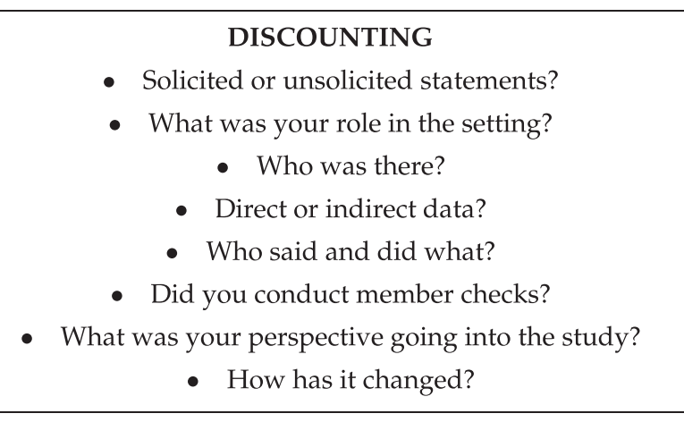
TECHNIQUES FOR INCREASING VALIDITY
Transparency in all parts of analysis
Overt discounting, critical evaluation, explicit falsification attempts
Thick description, verbatim quotes
Triangulation – methods, sources, analytics
Member checking
…

Slide 25
REPORTING
CONCEPTS/THEMES/CATEGORIES
  Their definitions, examples of data from which they emerged
STRUCTURE - Hierarchy or theory
  Narratively described, explained
  Depicted
VALIDITY SUPPORTING INFORMATION
  Explicit steps taken
  Limitations

Slide 26
SUMMARY
QUAL analysis revolves around indentification of meaningful elements of data(text) and inductive generalizations of these elements
Substantial general knowledge of the researcher is necessary
The process is FLEXIBLE → must be well described to be trusted
The process is REPETITIVE, ITERATIVE → meaning

Slide 27
REFERENCES
Taylor, Bogdan, DeVault, Introduction to qualitative research methods: a guidebook and resource, 4th ed. Wiley, 2016.
Saldaña, J. Fundamentals of qualitative research: Understanding qualitative research. OUP, 2011.

