Slide 1
Lecture 9
Report Writing
DHX_MET1 Methodology 1
Stanislav Ježek
Faculty of Social Studies MU

Slide 2
The purpose of research is met by publishing it
in the form of research report to those who commisioned the research
in the form of published journal article
+
oral presentations, posters
+
research proposals, grant applications

Slide 3
PUBLICATION BIAS
A bias in our perception of teh existence or size of an effect due to systematic selective publication of findings
  A file-drawer bias
Preregistration & Registered Reports

Slide 4
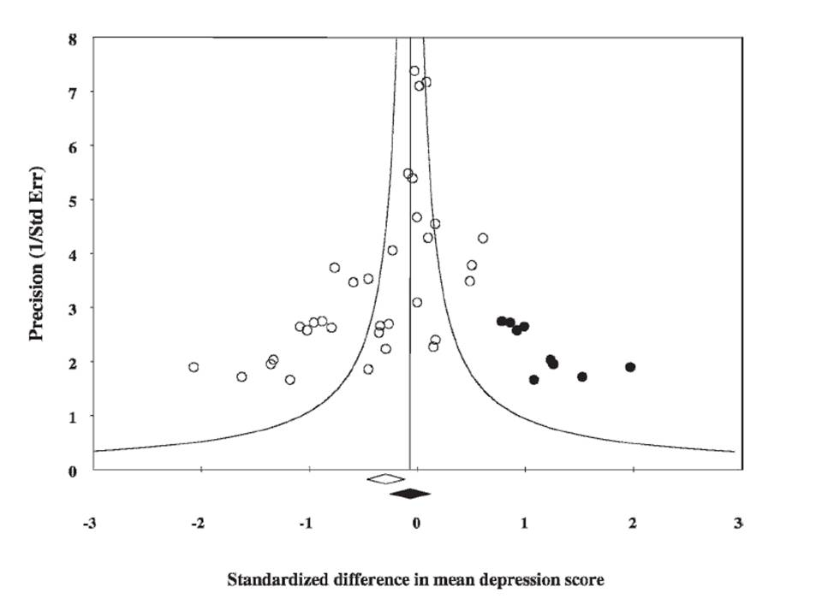
Funnel plot: Effect size by S.E.(~N)
Notes:
Zdroj: http://chrismasterjohnphd.com/2011/01/09/great-unknown-using-statistics-to/
Efekt některých omega-3 kyselin na depresivitu.
Černé jsou hypotetizované nepublikované studie, kde dyperesivita signifikantně narostla.

Slide 5
Writing standards
Field dependent
In psychology and many related fields the standard is set by the Publication manual of the APA
  currently awaiting its 7th edition
  https://apastyle.apa.org/products/publication-manual-7th-edition/?tab=1
  Preview: Appelbaum et al. (2018). Journal article reporting standards for quantitative research in psychology: The APA Publications and Communications Board task force report. American Psychologist, 73(1), 3–25. https://doi.org/10.1037/amp0000191
Standardizes mainly
  Structure of research reports
  Content – reporting results of a range of analyses
  Language and tone
  Citations
  Format

Slide 6
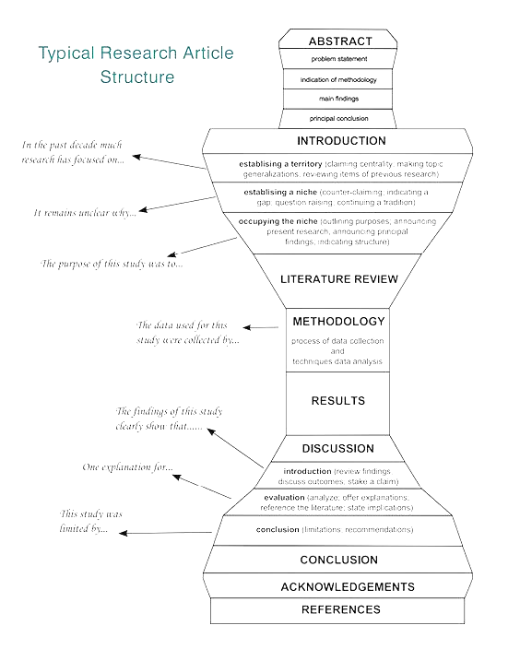
Writing up - IMRaD
INTRODUCTION
  Topic – literature review – RQs/Hs
METHODS
  Sample – Measures – Design - Analyses
RESULTS
  Data description – Models – Tests of Hypotheses – Exploratory analyses
DISCUSSION
  Findings – Implications – Limitations – Further research

Slide 7
INTRODUCTION
From the topic to RQ/H
The topic – what is the problem area and why it is important
The problem – what is the problem and and what are solutions in literature → what is unknown, uncertain, missing, controversial….
My contribution – what my research should bring – RQs/Hs that logically follow from the previous paragraphs

Slide 8
METHOD
How do I (plan to ) achieve the aims of my research.
In detail allowing the reader to assess
  feasibility
  validity – interenal and external – and threats to it
  researcher competence
Design
Sample (participants)
Methods (measures, protocol)
Analyses
Order of the first three varies.
In lab experiments the placement of detailed description of the experimental procedure varies.

Slide 9
In method, notice what is stated and what is NOT stated.
“We report how we determined our sample size, all data exclusions (if any), all manipulations, and all measures in the study.”
Simmons, Nelson, Simonshn: 21-word solution https://papers.ssrn.com/sol3/papers.cfm?abstract_id=2160588

Slide 10
METHOD - DESIGN
The overall strategy of creating new knowledge
Identification of standard type of design + details, deviations
  Observational, Survey, Longitudinal, panel, (Quasi-)Experimental, Case study, Evaluation, Ethnography, GT, Simulation ….

Slide 11
METHOD - METHODS
Measures (to be) used
Experimental procedures.
Short descriptions with arguments for sufficient validity and reliability
In QUAL studies often merged with Design.
  Procedures ensuring validity are explicitely proposed as a part od method
  What choices will be made during the study and how wil the be made?

Slide 12
METHOD - SAMPLE
Description of sampling procedure
Argument for sample size
Description of sample (not in a proposal)
Ethics statement (unless in a special section)

Slide 13
METHOD - ANALYSIS
Plan (or description) of the analysis
  Data processing & diagnostics
  Analytical approach
Tools used (software)
Relevant level of detail – often short unless the analysis is unusual or complex

Slide 14
RESULTS
Final (effective) sample
Missing data and arguments for missingness mechanism, methods applied to address missing data
Descriptive statistics
Inferential statistics
Models
Assumption checking

Slide 15
DISCUSSION
Statements of the support (or absence thereof) found for hypotheses.
Similarities and differences between reported results and work of others.
Interpretation of the results, taking into account
  Sources of potential bias and threats to internal and statistical validity
  Imprecision of measurement protocols
  Overall number of tests or overlap among tests
  Adequacy of sample sizes and sampling validity
Generalizability (external validity) of the findings, taking into account
  Target population (sampling validity)
  Other contextual issues (setting, measurement, time; ecological validity)
Implications for
  theory
  future research, program, or policy.
LIMITATIONS

Slide 16
ABSTRACT
EXECUTIVE SUMMARY
Often the only text that people read – fully autonomous text
What was to goal
How we did it
What we found
Every word should count.

Slide 17
Research ethics (Ruane, 2016)
Doing no harm
Obtaining informed consent
  Competence
    participants need to have the ability to know what is in their best interest
  Voluntarism
    participants must have freedom of choice about study involvement
  Full information
    participants should receive all relevant information about study
  Comprehension
    participants must understand information presented
Protecting privacy
  More complicated in our technology saturated world
  Many public settings still have privacy expectations
Avoiding conflict of interest
  a challenge given prevalence of corporate funding of research
Ethics review boards
  (https://vyzkum.rect.muni.cz/cs/zazemi/etika-vyzkumu)

