Slide 1
Human resource management course
The introduction

Slide 2
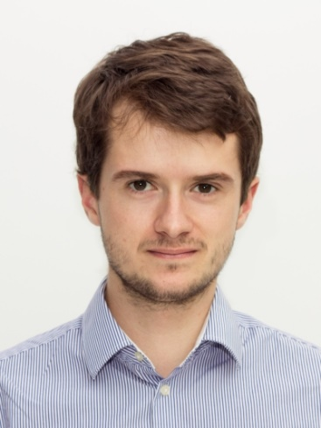
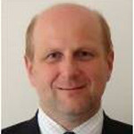
Welcome
JOHANNES GOELLNER
Room n. 550 (5th floor)
johannes.goellner@meinesteuerberatung.at
Consultations:
Fri before HIS lectures
(send an e-mail ahead)
MICHAL JIRÁSEK
Room n. 548 (5th floor)
mijirasek@mail.muni.cz
Consultations:
No regular consultation hours
(send an e-mail ahead)

Slide 3
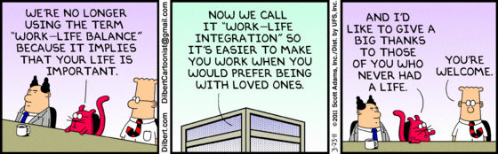

Hr management
Both hated…
… and loved
WHY?

Slide 4
Today‘s lecture
Introduce yourself
Course schedule
Course Syllabus
Project assignment
SWOT analysis
Teams
Case study
The challenge
Takeaways

Slide 5
Introduce yourself
Switch your seats!
5+5 minute interviews
  Name, country, year of study, field of study…
  Hobbies
  Expectations from HR Management Course
  Like/dislike about Brno
Introduce each other

Slide 6
Course
SCHEDULE
Find it in Syllabus
10 lectures with DI. Goellner
3 lectures with me – including this one
Exams
Company visit (Austria) – whole day

Slide 7
Requirements oVERALL
Attendance:
  80 % participation on lectures
  Required: Mid-term project meeting, Project presentations, Excursion to Austria
Assignments
  One during lectures of DI. Goellner
  Three connected to projects
Final Exam
  Handled by me, but made and checked by DI. Goellner

Slide 8
Requirements projects
All assignments are teamwork!
  Division of points by team
Argument using literature (journals, books,…), surveys etc.
SWOT analysis + peer feedback
Functional strategy + peer feedback
Project presentation

Slide 9

SWOT
ANALYSIS
What is SWOT analysis?
How it is conducted?
What is important?
Two important parts?

Slide 10
SWOT analysis
Not just SWOT matrix
S/W stem from inside a company, O/T from the outside
S/W/O/T always relative – what is a benchmark?
It is analysis – use it in the future strategy!
ARGUMENT!
SWOT analysis exercise

Slide 11

LET‘S
Summarize

Slide 12
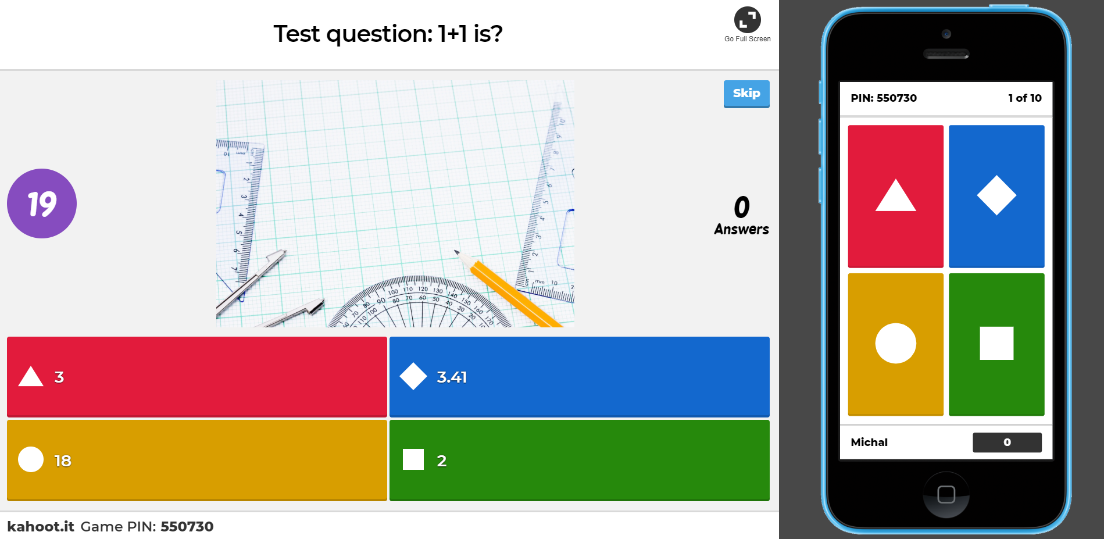
LET‘S
Summarize
kahoot.it
True/False + Multiple answers questions
Time limit

Slide 13
LET‘S MAKE
TEAMS
Any groups already?
Not having a group, stand up and find one!
Complete team? Write your names on the board!

Slide 14

Case study
PAC Resources, Inc.
Lot of problems for a new HR team (you!)
US background – take it into account, but no extra deep knowledge required
5 HR teams
  HR Development
  Compensation and Benefits
  Staffing
  Safety and Security
  Employee Relations

Slide 15

The challenge

Slide 16
Choose your function
HR Development
Compensation and Benefits
Staffing
Safety and Security
Employee Relations

Slide 17
takeways
Requirements > look at Syllabus
Something not clear > ask a lecturer (mijirasek@mail.muni.cz)
Next Friday – start of DI. Goellner‘s lectures
First deliverable for projects November 1st > set a meeting day for your team!

