Slide 1
Introduction to MS Dynamics
(Customer Relationship Management)
Ing.J.Skorkovský,CSc.
MASARYK UNIVERSITY BRNO, Czech Republic
Faculty of economics and business administration
Department of corporate economy

Slide 2
CRM – Customer Relationship Management
PROs
  It enables us to keep track of all prospective customer (suspects and prospects)
  Improve sales and marketing service
  The company can promote the work it has done for its customers to approach prospects
CONs
  CRM software may not integrate well with other email and accounting systems
  Another disadvantage to a newly implemented CRM software is the learning curve.

Slide 3
CRM – Customer Relationship Management
Relationship management is a customer-oriented feature with service response based on customer input, one-to-one solutions to customers’ requirements, direct online communications with customer and customer service centers that help customers solve their issues.
Salesforce automation
  Sales promotion analysis
    Advertising
    Personal selling
    Direct marketing
    Public relations
  Automate tracking of a client’s account history
  Use of technology (ERP->MS Dynamics NAV)
Opportunity Management (see an extra picture related to so-called Business Rainbow)

Slide 4
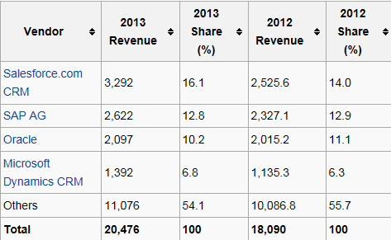

Market leaders (home study)
figures in millions of US dollars
Source:

Slide 5

Only Czech course
BPH_PIS 1| 2 !!!!,
MPH_RIOP pouze část
(kontakty, profily,..)
Partially for MPH_AOMA-AOPR
Vendor
Statistic :
Costs/Revenue
Customer Entries
Customer
Interaction
Log
Entries
Contact
Card
Salesperson
To-Do
Card
Profile (parameters)
(To-Do)
Assigned
activities
Statistics:
Interactions, Stages,
Chances, Values,..
ABC (Pareto)
Analysis
Opportunity
Activity
code
Sales Cycle
Stage
Partial Activities
Meeting /Telephone call
Interaction Log
Entries
Stage number
Activity

Slide 6
Objects necessary valid for
MPH-AOMA-AOPR (see preceding slide)
Contact card- company ->Vendor (Customer)
Contact card- person ->Vendor (Customer)
Contact Character– profiles, technologies,..
Interactions
Business Opportunities (estimated close date and value, probability,.. )
Sales Cycles
Customer Card creation from Contact card
Quotes
Interaction entries

Slide 7
ERP-CRM
Only Czech course BPH_PIS1| 2 !!!! a MPH_RIOP
20000
70%
Meeting
Task1
Task22
Task p
Opportunity
ERP n
CRM
Customer
Card
QUOTE
ERP 2
ERP 1
Products
Task p+1
Task p+2
Task q
Opportunity
Financial
estimation
Success estimation
in %
Interactions

Slide 8
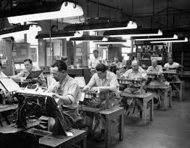
Contact cards
Contact card- company
Contact card- person
Contact Character– profiles, technologies,..
Interactions
Business Opportunities (estimated close date and value, probability,.. )
Sales Cycles
Customer Card creation from Contact card
Quotes

Slide 9
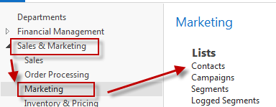
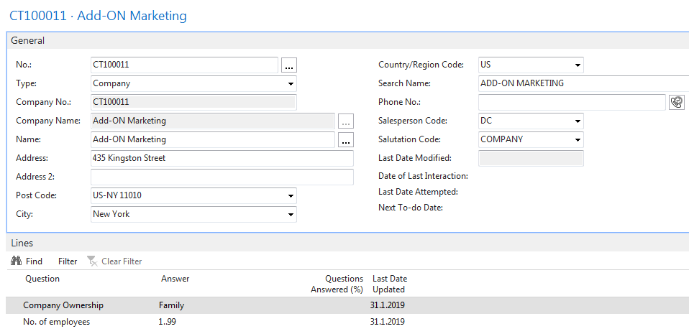
Contact card – company - (Header of the contact card)
Company Contact Card
Eric Clapton
Luciano Pavarotti
Paul McCartney
Charles Aznavour
Contact persons type card

Slide 10
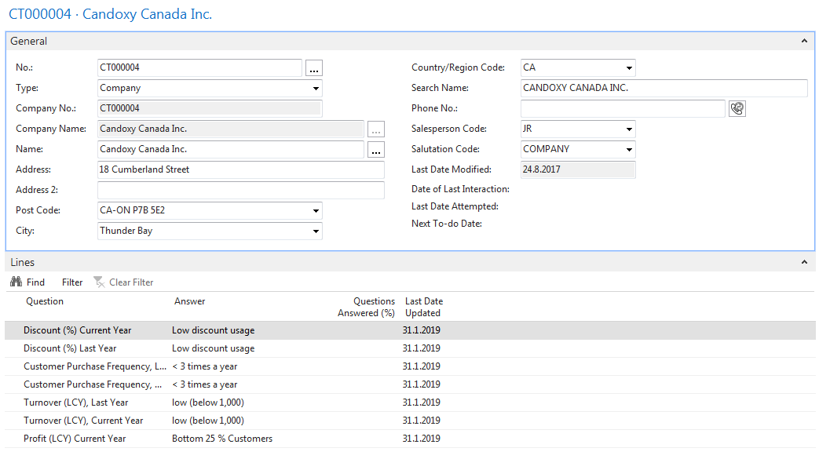
Contact Card-company
Profile

Slide 11
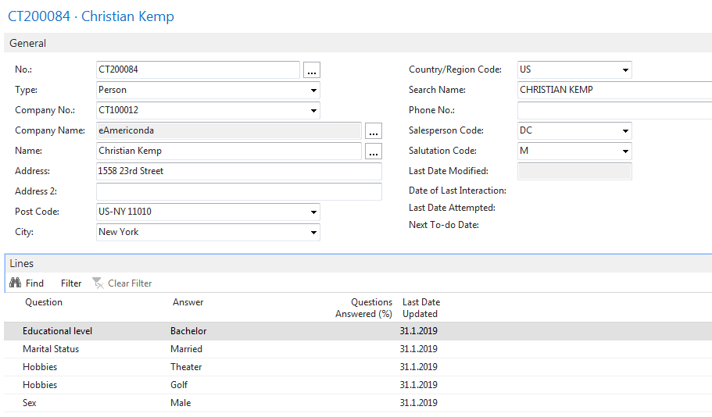
Contact Card- Person
Profile

Slide 12
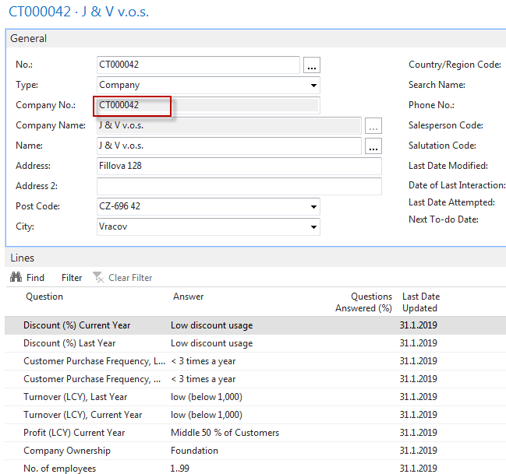
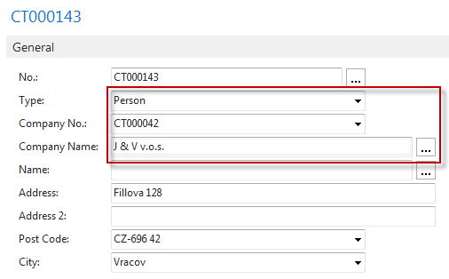
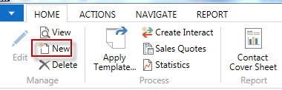
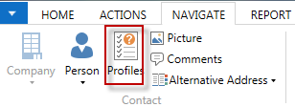
Contact Card- Company-new person - (created from Company card)
See profile settings

Slide 13
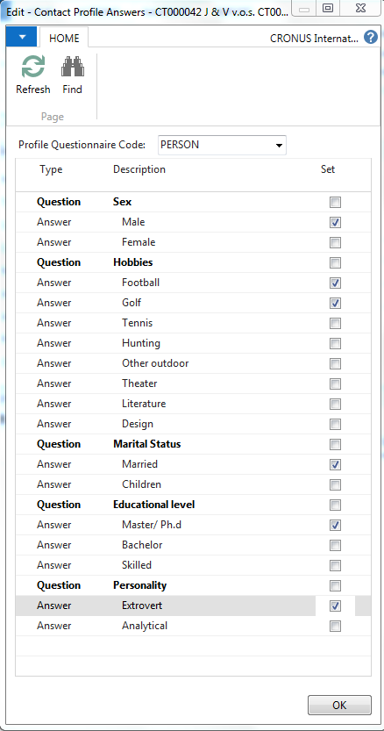
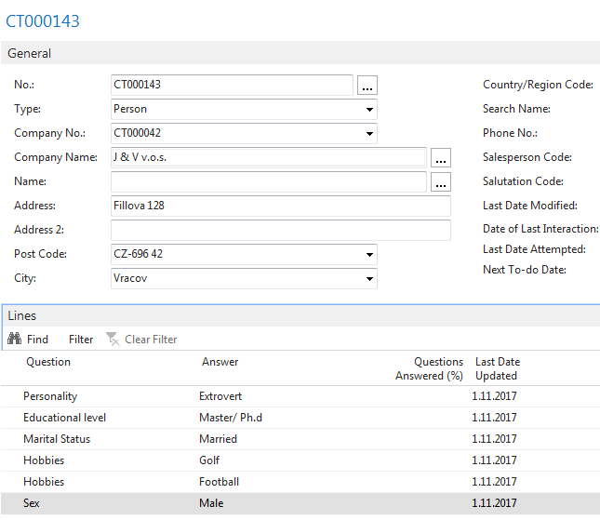
Contact Card- Company-new person - (creation from Company card)

Slide 14
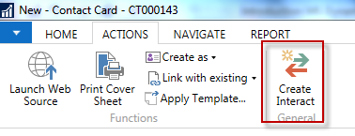
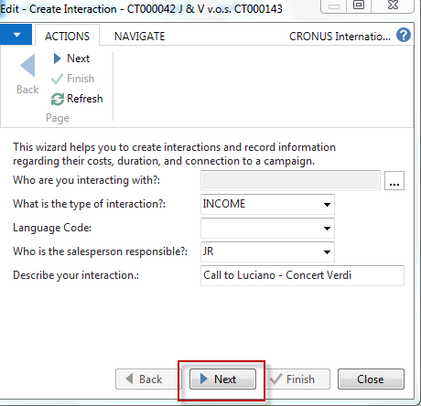
New interaction- use of wizard

Slide 15
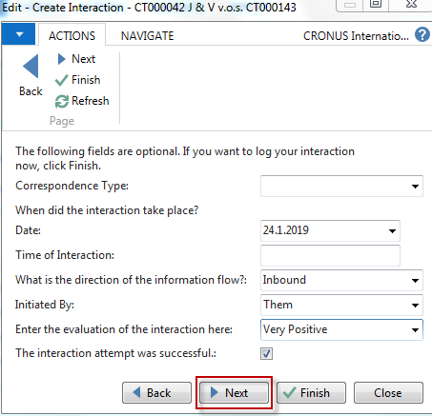
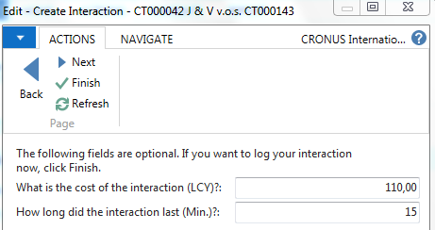

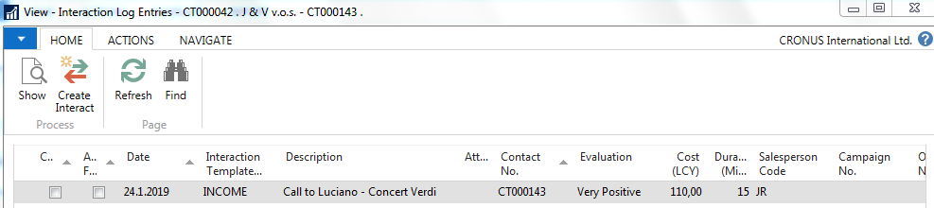
New interaction- use of wizard
Click finish ( do not take any optional information into consideration) and Ctrl-F7

Slide 16
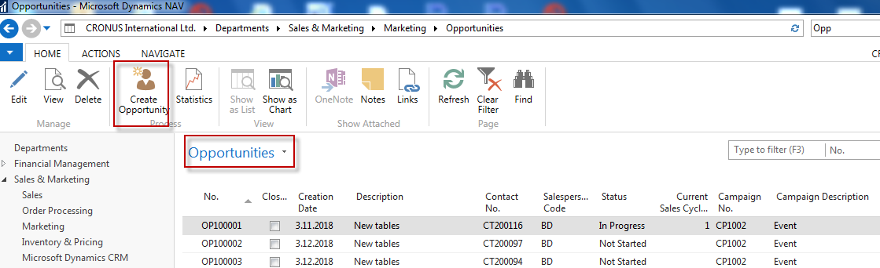
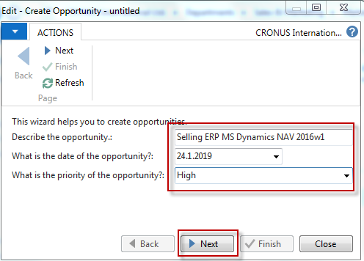
Another CRM area : Opportunity
From searching window

Slide 17
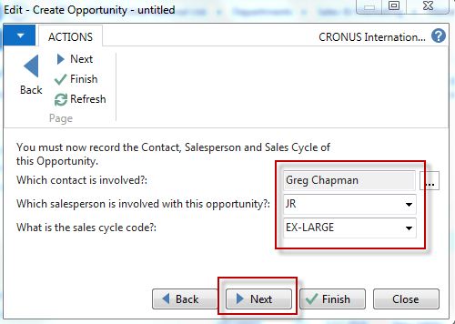
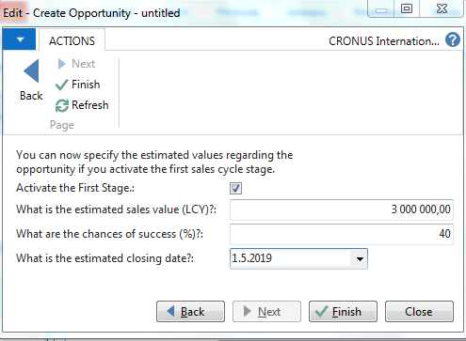
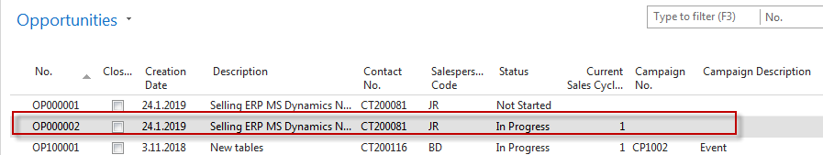
Another CRM area: Opportunity

Slide 18
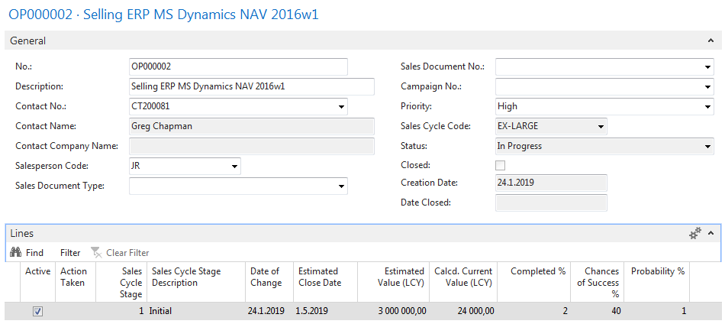
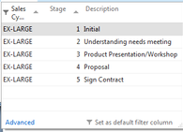
Another CRM area : Opportunity
From here you can create variously
To-Dos and change Sales Cycle Stages….

Slide 19
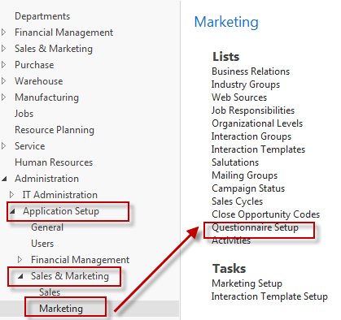
Personal profile creation

Slide 20
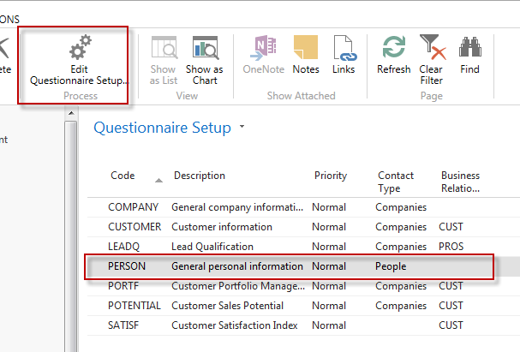
Personal profile creation

Slide 21
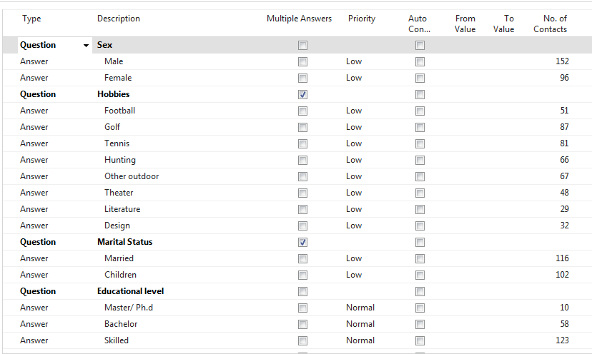
Personal profile creation

Slide 22
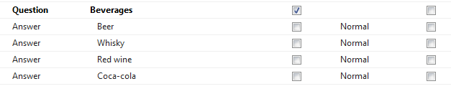
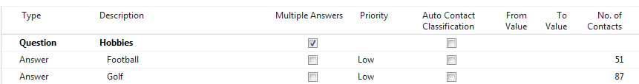
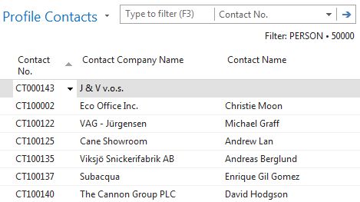
Personal profile creation
We have entered
several lines
All 51 contacts
playing football

Slide 23
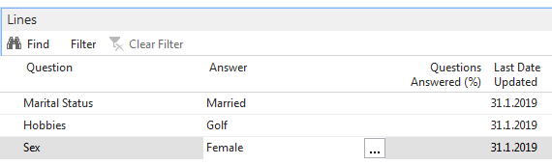
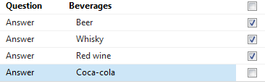
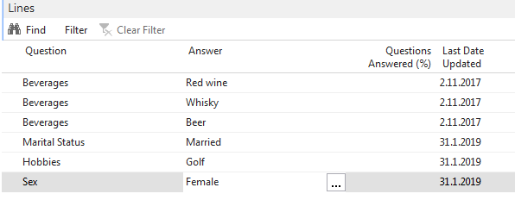
Personal profile creation
Profile of one chosen contact card (type person)

Slide 24
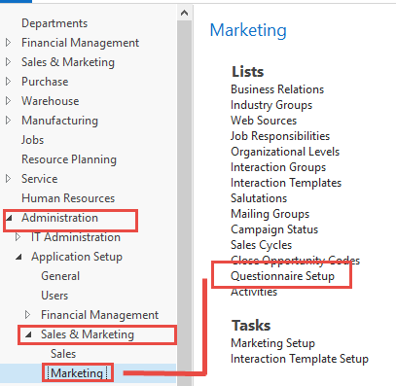
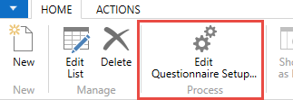
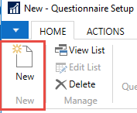
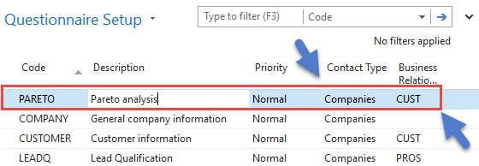
Pareto analysis-see extra example material

Slide 25
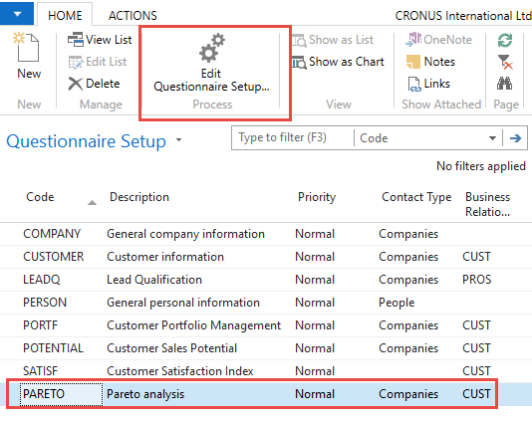
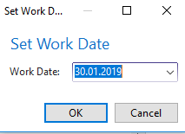
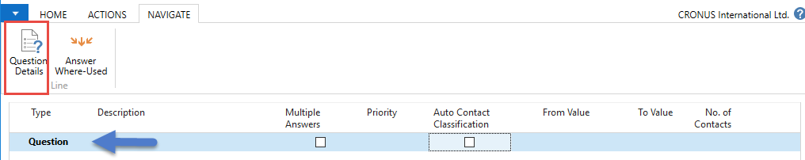
Pareto analysis –specification of questionnaire

Slide 26
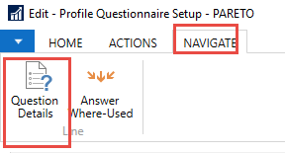
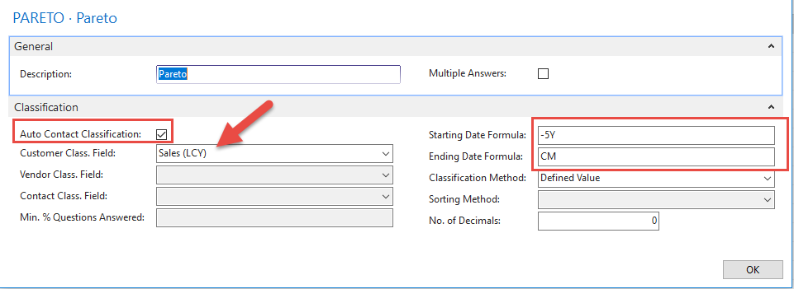
Pareto analysis-specification of question (details)
Starting Date Formula = -5Y means NAV will trace back all entries
five years backward. Could be also CM-5Y

Slide 27
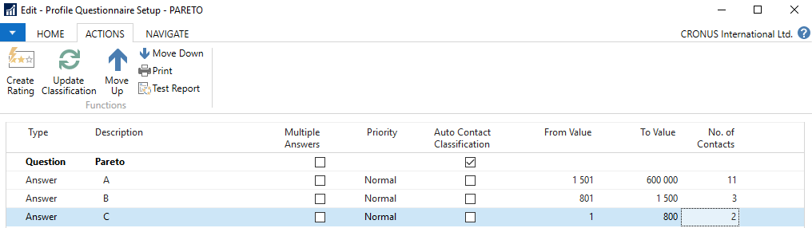
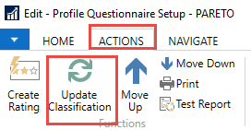
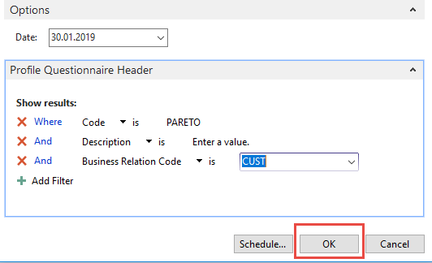
Pareto analysis
Limits for different levels (A-C)

Slide 28
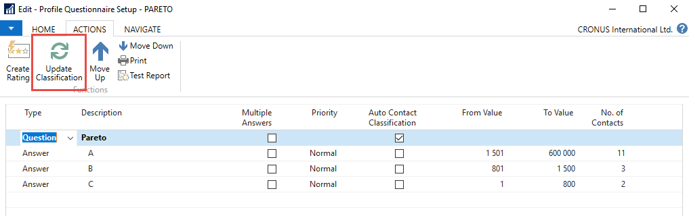
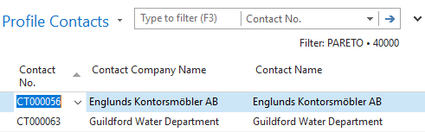
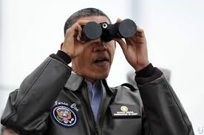
Pareto analysis –results of updated questionnaire

Slide 29
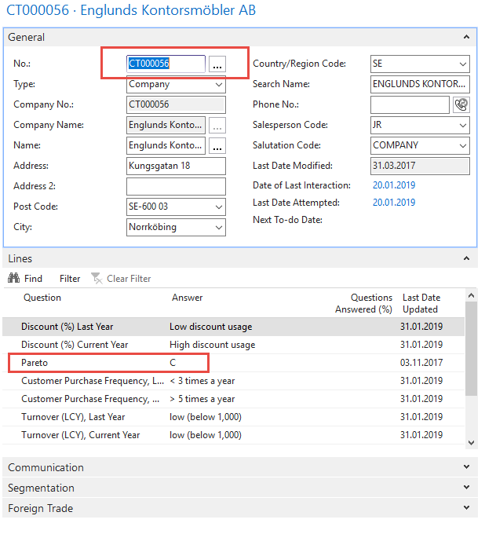
One of Contact Cards marked by code C

Slide 30
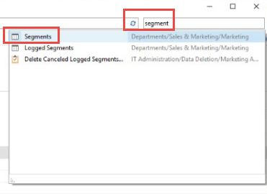

Segments-see extra example (hands on in lab)

Slide 31

Segments

Slide 32

Segments (entering values..)

Slide 33

Segments

Slide 34

End of the section – used in extra picture
(Customer Relationship Management)

