Slide 1
Break-even point analysis
Jaromír Skorkovský
Department of corporate economy

Slide 2
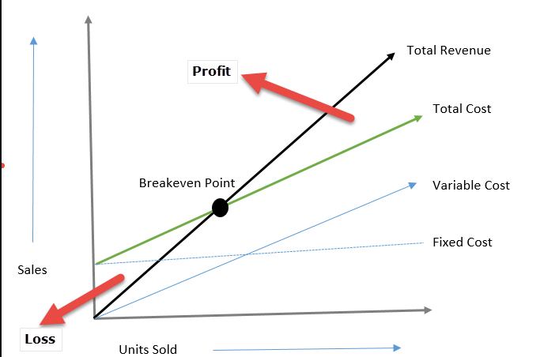
Graphical representation
P x Q
F + VC = TC
VC
Costs
F

Slide 3
BEP- Basic Statements
Break-Even Point (sometimes called break-even point) is the amount of product at which total costs are equal to total returns. From this point, the company or project begins to generate profit.
The break-even point, in its classic form, tells you how much product to sell to generate profit. It is a volume indicator.
The break-even point in related currency thus basically means 0.
In the next slides, we present a formula, where it is also possible to incorporate the required rate of profit (in related currency) into the calculation.
As a result, we will shift to the right along the X-axis (sales volume) in the graph and the resulting Q (X pieces) will be higher than at the "classic" break-even point, where the profit is zero.

Slide 4

Calculation I
The basic calculation of the break-even point is not complicated. All you have to do is put together the Price, Costs and possibly the Required profit.
However, the challenge is to get to these aggregated variables. The data for partial calculations are obtained utilizing financial analysis, using data from accounting. Good financial management considers the break-even point analysis to be an absolute must. It is not just a “lesson from microeconomics” or “theoretical exercise”

Slide 5
Calculation II
Profit = Price x Sold Products - Total Costs
Total Costs = F+VCxQ
Profit = P x Q - F- VC x Q
If BEP then Profit=0
Profit = Q x (P-VC) - F = 0
Q= F/(P-VC)
VC- cost for one product unit

Slide 6

Simple example
What is the turning point in practice can be shown in a model example?
Let's imagine that you want to start confectionery production. How do you know how many cakes you have to sell to make a profit?
  - Real capacity consideration
  - Price conditions analysis
  - List of all costs
  - Calculations and modeling
  Let's assume that the total input costs (fixed costs) will be 250,000 CZK.
  Set the selling price of the cake at 750, - CZK
  Variable costs for 1 cake = 300, - CZK
  CZK=Czech crown
Q= F/(P-VC)
BEP = 555 cakes [calculation: 250.000 / (750 – 300)].

Slide 7


