Slide 1
Contacts-Pareto-Segments-Campaigns
Related to Complex example II – MPH-AOPR-AOMA-EPS1
J.Skorkovský

Slide 2
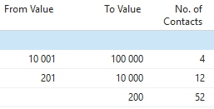

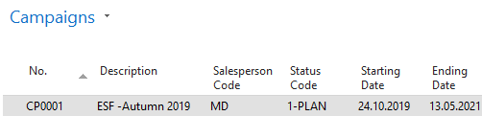
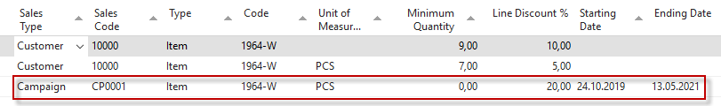
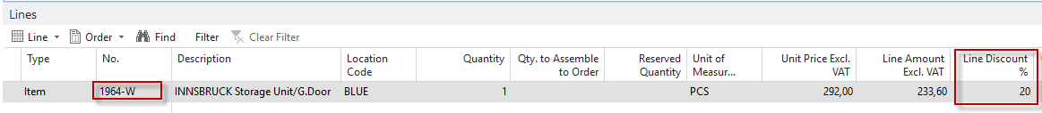
Customer 1
Customer n
Customer m
Pareto
Profiles updated
Contact 1
Contact n
Contact m
A
B
C
Segment A
A
B
C
A
A
Line discount setup for Campaign
Sales line (Customer with profile A)
=profile

Slide 3
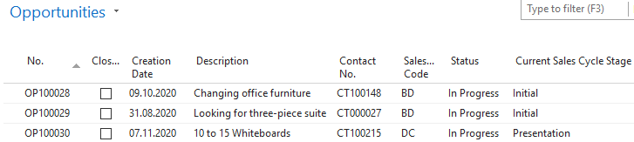
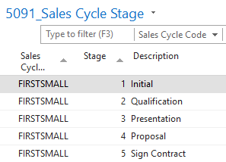
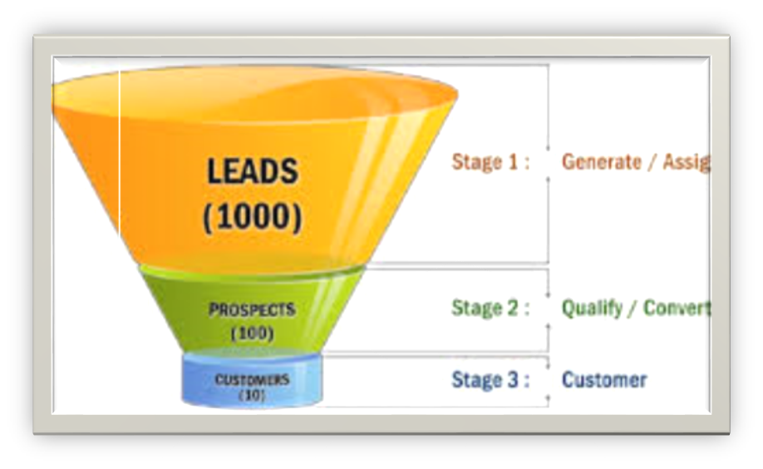
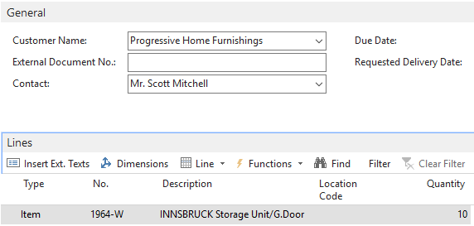

Business „rainbow“
Progress in Sales Cycle Time
COMPANIES
Contact 1
c
Contact n
c
Contact m
c
Requirements
TOC-CRT-EC-FRT
Contact 1
c
Contact n
Contact m
Personal profile
Kepner-Tregoe
PERSONS
Balanced Scorecard
Profil 1
Profil n
Profil m
Chosen
Methods
Decision Tools
CUSTOMER n
Sales Order
QUOTATION
Contact n
c
PARETO Analysis
Item 1964-W
Marketing
(Leads Creation)
Contact n
Profil n
A
Segment creation
Created and activated Campaign
Segment A
A
A
Final result in selling line

