Slide 1
Introduction to MS Dynamics NAV Purchase example and impacts (Inventory, Vendor Ledger Entries and General Ledger)
Ing.J.Skorkovský,CSc.
MASARYK UNIVERSITY BRNO, Czech Republic
Faculty of economics and business administration
Department of corporate economy

Slide 2
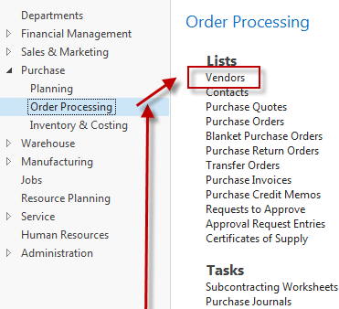
Vendor Card
Click
List of
vendors
See next slide in reality

Slide 3
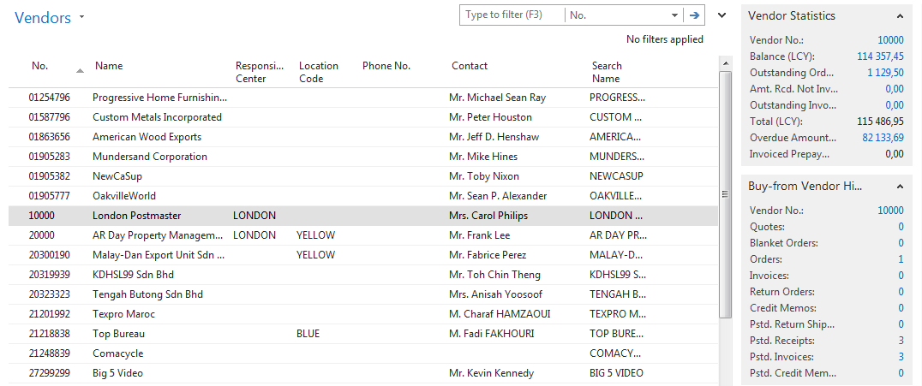
List of Vendors
See balance (calculated field ) and explain !
See business history and explain !
Use Edit icon in order to open chosen Vendor card

Slide 4
Vendor Card
See following tabs :
General - basic fields (country, purchase, balance,..)
Communication – basic fields (e-mail,home page,…)
Invoicing - basic fields (posting groups- will be part of accounting section of this course)
Payments – basic fields (payment terms- enter new one by use of formula date)
Receiving – basic fields (location)
Foreign trade – basic fields (currency code and language)
Syntax for date formula :
1 day=1D
1 week =1W
1 month=1M
1 year = 1Y
Current month = CM
Current month period
1.1.2020
21.1.2020->today
31.1.2020

Slide 5
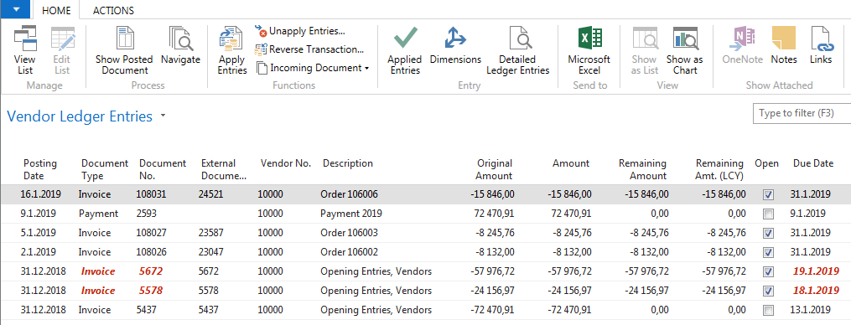
Vendror Ledger Entries
Vendor
Ledger
Entries
Vendor card
Ctrl-F7

Slide 6
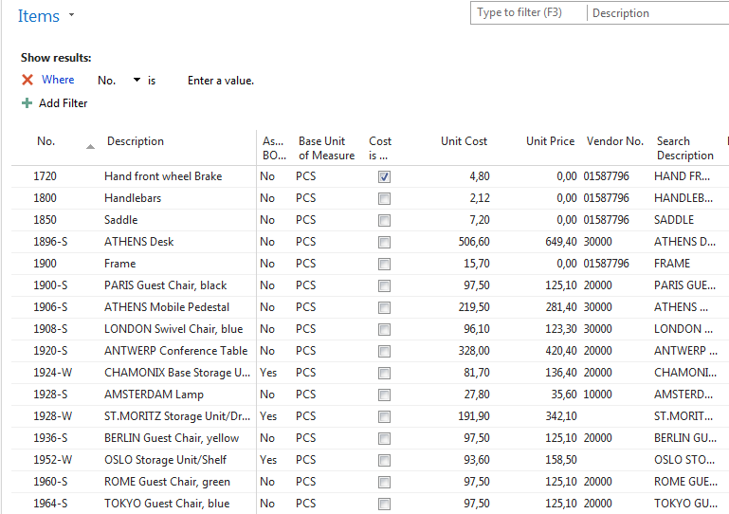
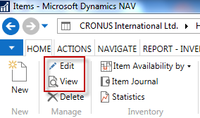
Item list (use search window)

Slide 7
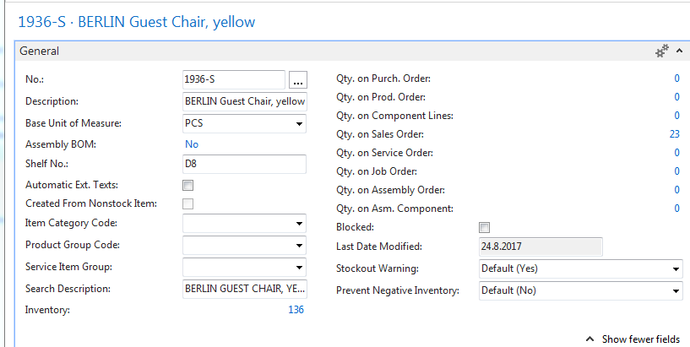
Item Card
See basic fields (Inventory, Quantity on Sales and Purchase orders,…)

Slide 8
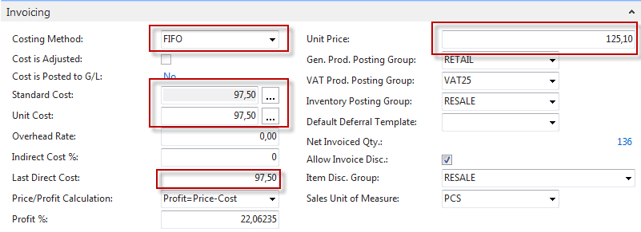
Item Card
Product posting group will be explained later (impact to accounting)

Slide 9
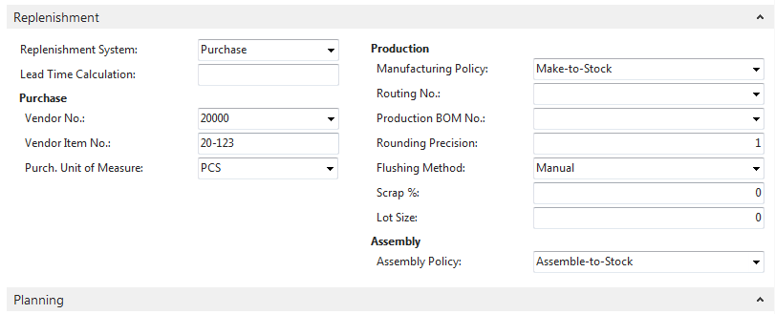
Item Card

Slide 10
Item Ledger Entries
Ctrl-F7
By removing filter value see other entry types (purchases, transfers sales,…) !

Slide 11
Purchase Order creation
Vendor
Ctrl-N
Purchase Order
Insert required quantity !!!
3
Item

Slide 12
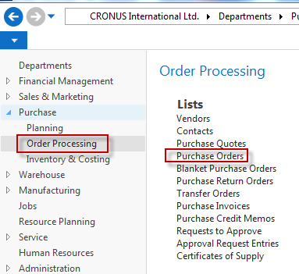
Purchase Order creation

Slide 13
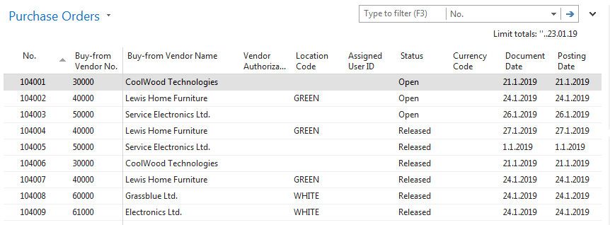
List of already existing Purchase Orders

Slide 14
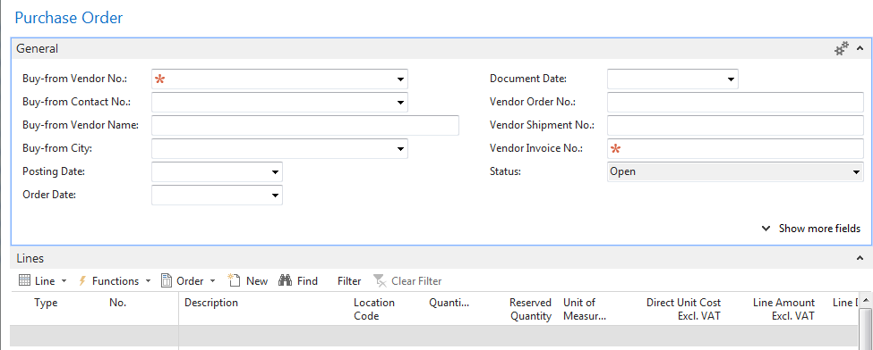
Purchase Order (PO) - new
Double click in order to opne PO structure
Empty form of PO structure
You must enter data to the fields marked by *

Slide 15
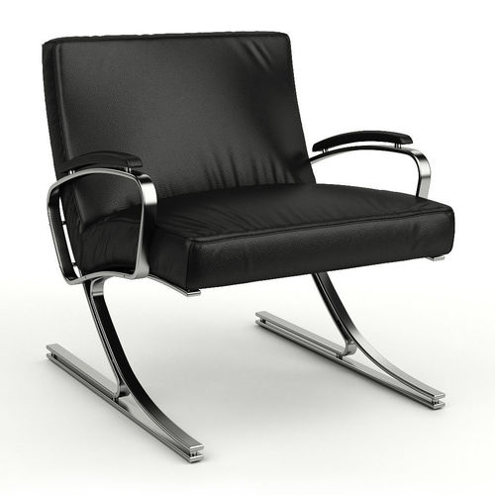
Purchase Order (PO) – new (To enter data use F4 or mouse)
Fields with default data are marked by orange *
Enter chosen vendor and confirm by key ENTER !
Enter type of the purchase order line = Item (in our example)
Enter chosen item (Berlin chair 1936-S) and confirm by key ENTER !
Enter quantity 10 and stock location= BLUE !!!!
After delivery (before posting enter Vendor invoice number ->any string- e.g. B1)
See next slide

Slide 16
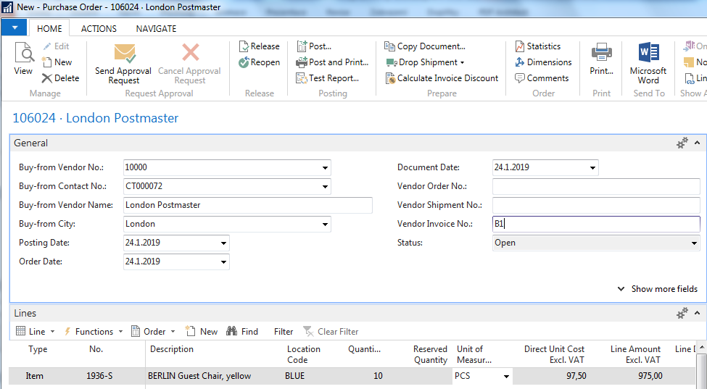
Purchase Order (PO)

Slide 17
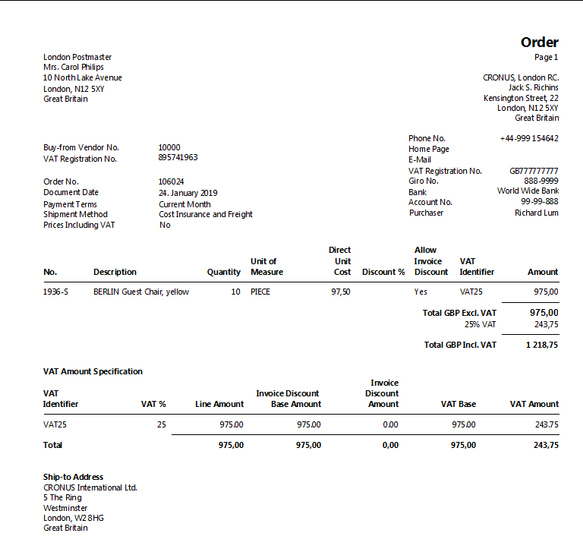
Print (Preview)

Slide 18
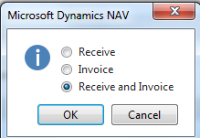
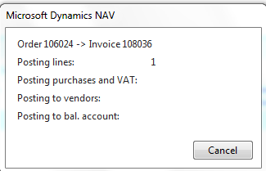
Post PO by use of key F9 (or icon)
See Vendor Ledger entries:
Search window
Vendor
Filter to vendor 10000
Icon Ledger Entries –Option Entries

Slide 19
Vendor Ledger Entries
See next slide

Slide 20
Item Ledger Entries
See Item Ledger Entries :
Search window
Item
Filter to Item 1936-S
Find icon Entries ->Option=Entries
See next slide

Slide 21
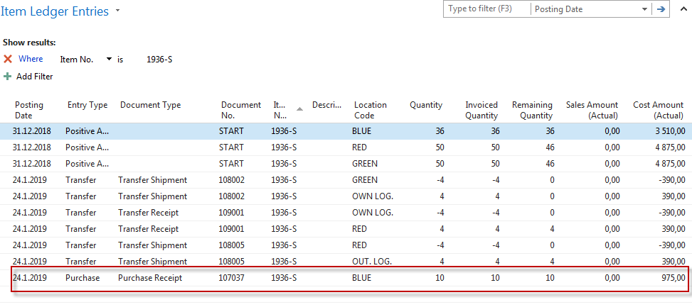
Item Ledger Entries
Inventory increased by 10 !!

Slide 22
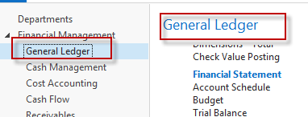
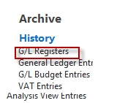
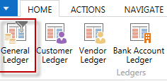
Impacts in General Ledger
Go to last line of G/L register
Go to icon General Ledger

Slide 23
Impacts in General Ledger
Purchase Retail
7110
Purchase VAT 25%
5630
Vendors Domestic
5410
975,00
243,75
1 218,75
1218,75 =975+243,75

Slide 24
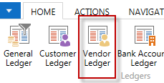
Use of Navigate tool
Go to Icon Vendor Ledger Entries (from the same working space

Slide 25
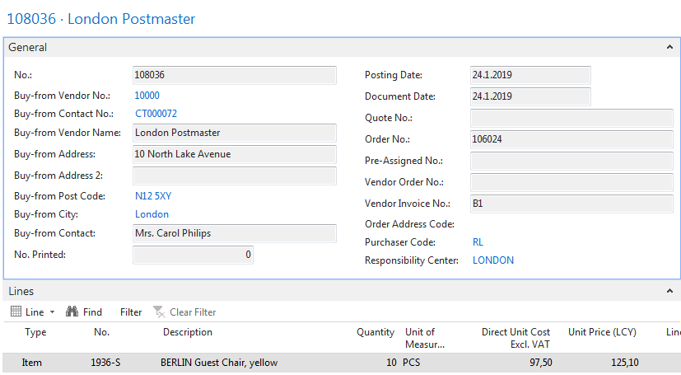
Result of Navigation

Slide 26
End of the section Purchase example and impacts (inventory, Vendor Ledger Entries and General Ledger)

