Slide 1
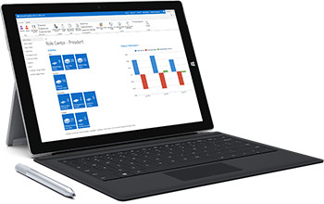
MS Dynamics NAV Intro 1
Ing.J.Skorkovský,CSc.
Department of Corporate Economy
Faculty of Economics and Administration
MASARYK UNIVERSITY
Czech Republic

Slide 2
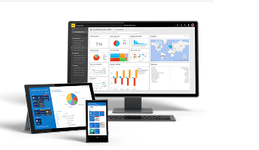
What is MS Dynamics NAV
If your business is growing and ready to take on more opportunities, Dynamics NAV can help. An easily adaptable enterprise resource planning (ERP) solution, it helps your business automate and connect your sales, purchasing, operations, accounting, and inventory management
Microsoft Dynamics NAV enables every individual in your company to turn hunches (intuitions, feeling) into genuine insight, and insight into decisions. With access to real-time data and a wide range of analytical and reporting tools—including graphical displays, online analytical processing (OLAP) cubes, and Web-based delivery options—people can make informed, confident decisions that help drive business success.

Slide 3
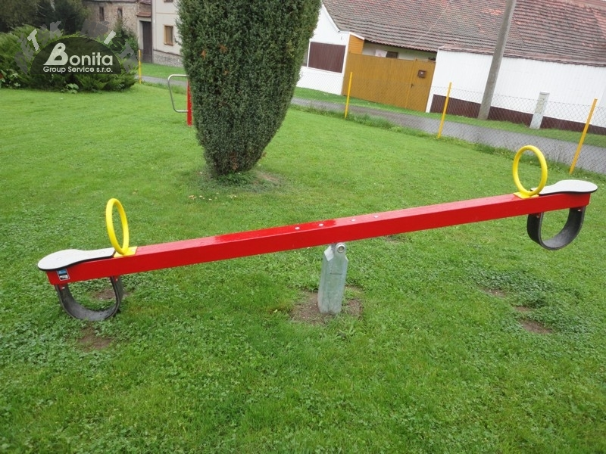
First approach
Theory of constraint mantra
Make money now and in the future
So we need appropriate items (services), all kind of resources (assets), good
marketing engine (CRM) to find a customer, create reasonable demand (ATP-CTP)
having enough knowledge about stock (replenishment algorithms),
production capacities and vendors (delivery procedures) and many, many more.
Demand
Supply
ATP=Available-To-Promise, CTP=Capable-To-Promise

Slide 4
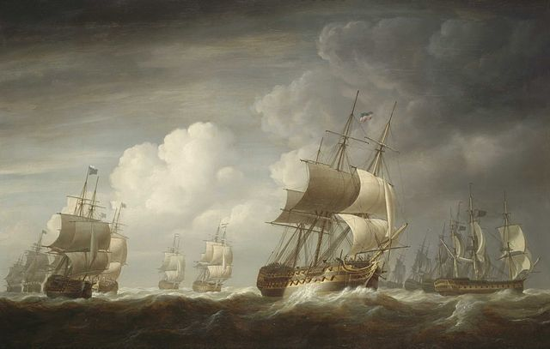
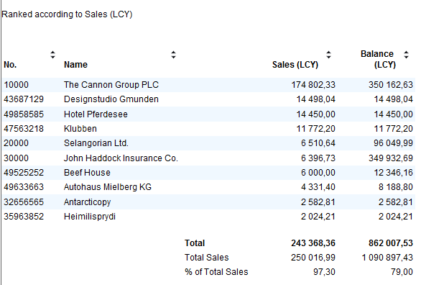
Navigation (NAV)
To find the way in the see of big data and to get important information
Information = Data + Structure

Slide 5
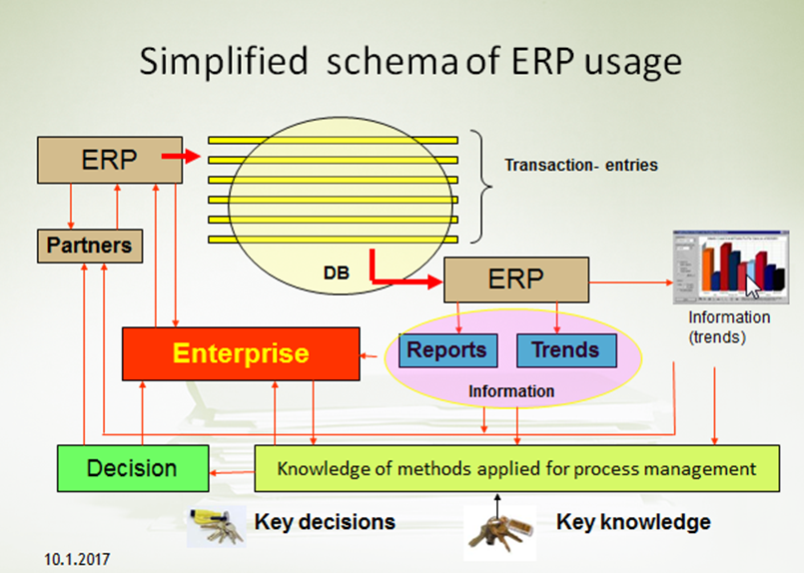
Feedback to control all processes

Slide 6
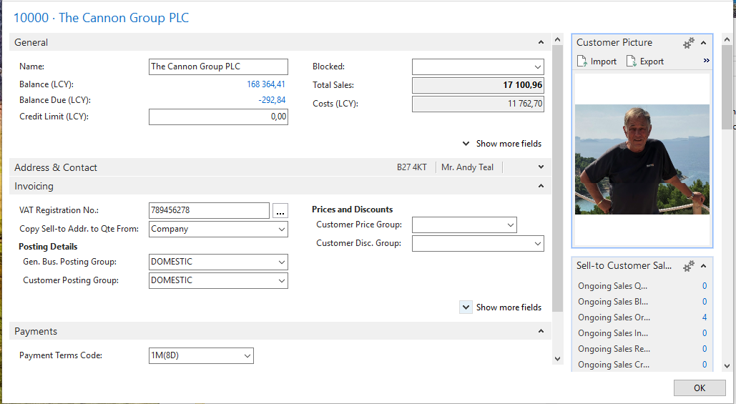
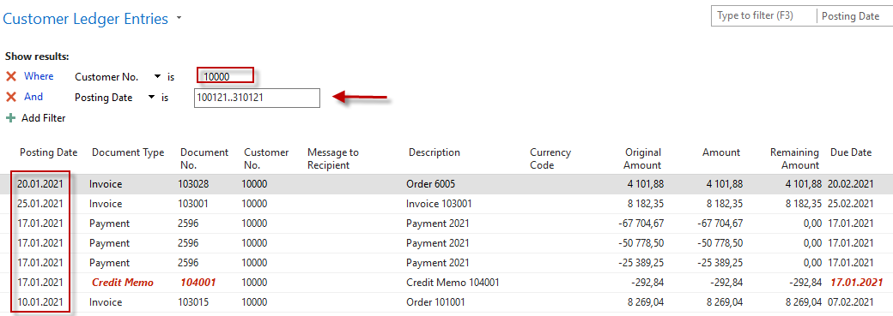
Explanation about symbols in previous slide
Transactions – in MS Dynamic NAV terminology=Entries
The entry represents all actions in ERP related
for instance to Customer (Item, General Ledger Account,..)

Slide 7
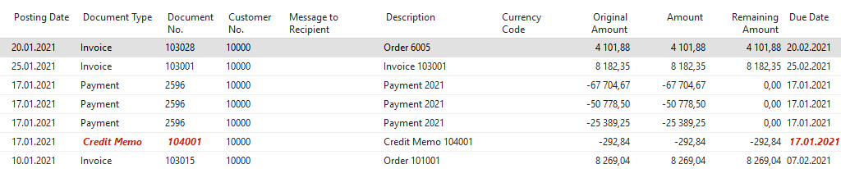
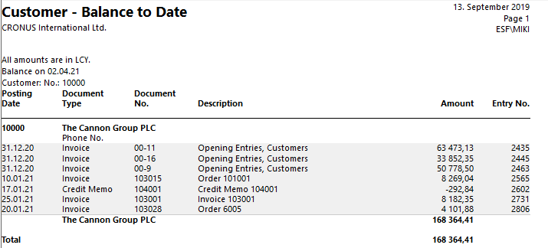
Explanation about symbols (objects) in the previous slide
(Feedback to control all processes) - Reports
Report and source data = Entries (will be shown again in the simplified sales process)

Slide 8
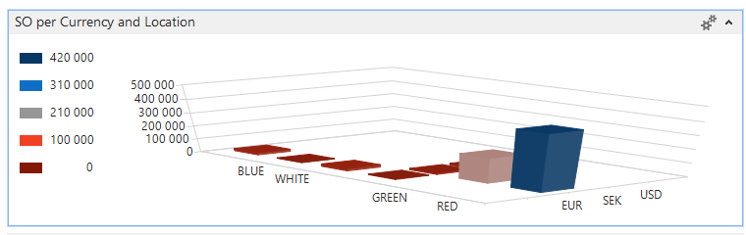
Explanation about symbols (objects) in the previous slide
(Feedback to control all processes) – Trends (graphics)

Slide 9
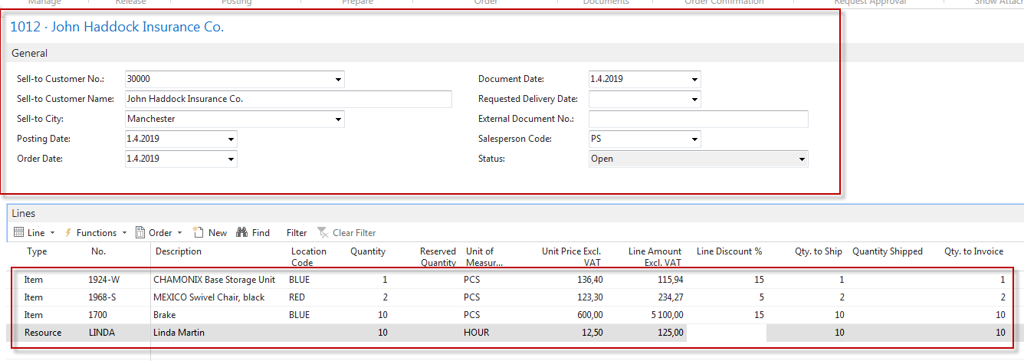
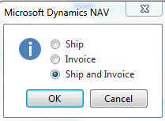
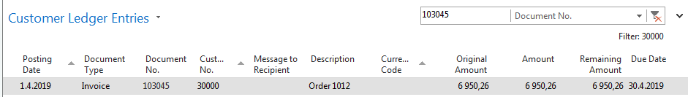
Sales Order
HEADER (Business parter)
to whom is will be sold
Lines (what is sold)
Post ->
Fields (different types of data)

Slide 10
The most important data types
Description (text) -> The Chair
Number (decimal or integer) – >3,23
Alphanumeric code -> A123D)
Date -> 18.9.2019=180919
Boolean ->yes or no = checked or not checked
Period type = data formula= 1 week=1W, 3 Days=3D,…)
Time – >8:00

Slide 11
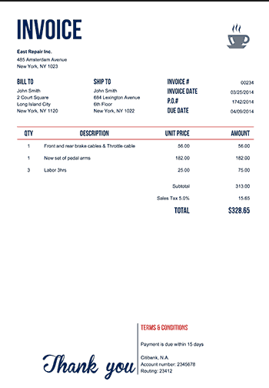

Transaction=Entry (Terminology)
Fields
Original document
Navigate
Data
Transactions= Entries
Transaction=Entries
which has been created by ERP
when the Sales Order hase been posted
(transactions)

Slide 12
INTRO 1
Explain the concept of ERP and Microsoft Dynamics NAV 2016w1 or NAV 2018w1
ERP = Enterprise Resource Planning System
Resources = financial resources, machines, people, items,…….
Data = transactions having origin in :
  Posted documents (invoices, credit notes, deliveries, stock movement..)
  Hence the type of these transactions-> entries
    Customer
    Vendor
    Item (Inventory)
    General Ledger (Accounts)
Linked to : Simple scenario of the first and second ERP Microsoft Dynamics NAV session I.

Slide 13
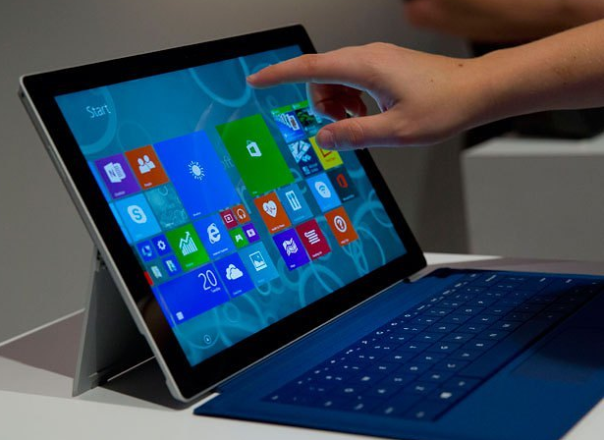
INTRO 2
Customer number | Customer name | Balance | Payment condition | Currency
10000 | SW Kings | 20000 | 1M | USD
20000 | China computers | 432444 | 21D | USD
30000 | Navertica | 902 | 14D | CZK
40000 | Berlin Experts | 20002 | 1W | EUR
Data
How to
see
data
(Window)

Slide 14
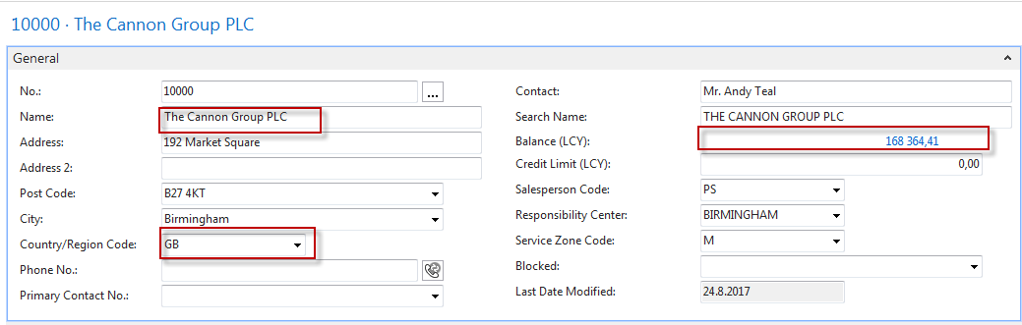
INTRO 3 – Customer card –part of it
Fields
Important information having origin in transactions-entries
Data + Structure = Information

Slide 15
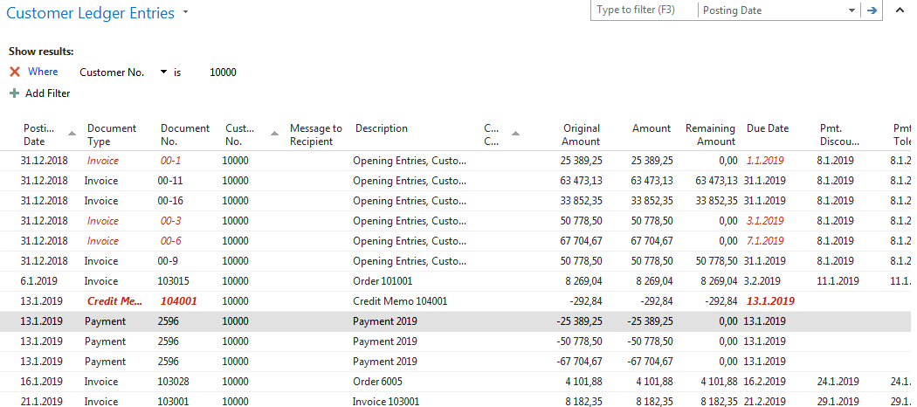
INTRO 4 – Customer entries
(Customer card)
What has been posted in the past
168364,41=25389,25+63473,13+…….+8182,35

Slide 16
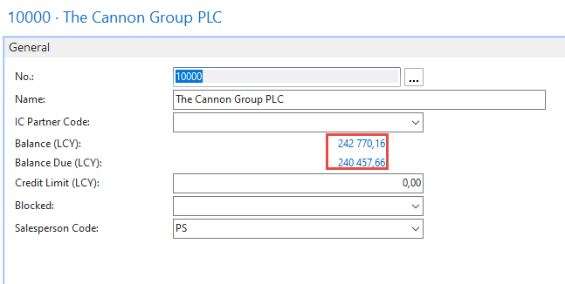
Flow field (calculated field) – the main principle
Amount =1
Amount =2
Customer entries
Amount =3
Amount =-4
Balance = 2 = (1+2+3-4)
Customer card

Slide 17
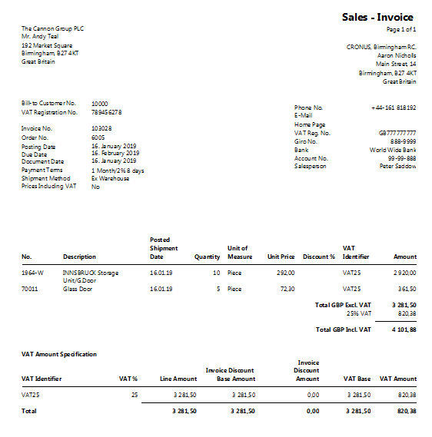
INTRO 5 – Customer document- Navigation
From entry to document
(Cause->Effect)

Slide 18
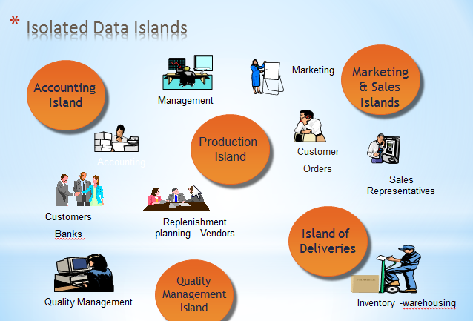
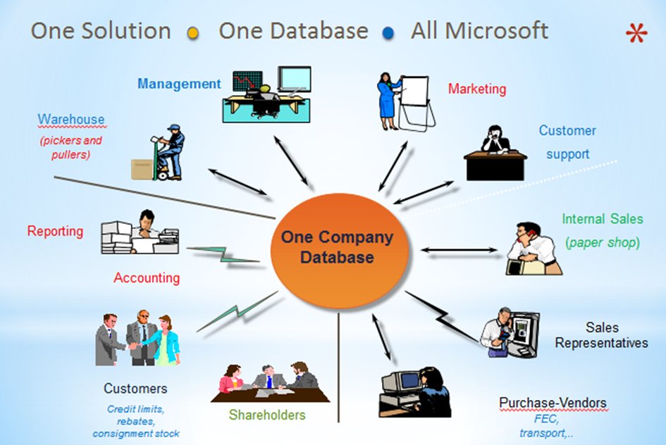
INTRO 6 – What is ERP 1
So our Microsoft Dynamics NAV is an ERP system. But why is it an ERP system? What are the main features of an ERP systém, and how do we recognize these in Microsoft Dynamics NAV?
Let's have a look at the overview slide. So one of the challenges that some companies might have to address is one of island systems.

Slide 19
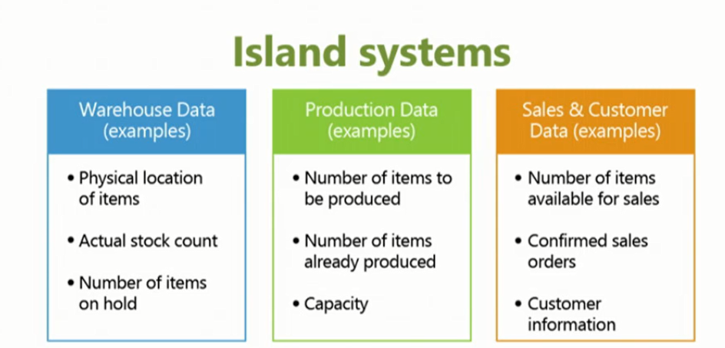
INTRO 7 – What is ERP 2

Slide 20
INTRO 8 – What is ERP 3
So everyone working with the system, for example, the bookkeeper in financial management, the sales representative in sales and marketing, the warehouse worker in the warehouse management, the HR manager in human resources and so on, so they all work with the system in their specific application department but with a common database. And that's very, very important. That's one of the main features of an ERP system.

Slide 21
INTRO 9 – Basics of working space
Card (one record) | Worksheet (to enter data)
List (many records) | Confirmation dialog
Role Center
Card part (tab) | Navigate page (wizard)
List part | Standard dialog
Document
Will be shown by tutor and examined on demo student databases by them

Slide 22
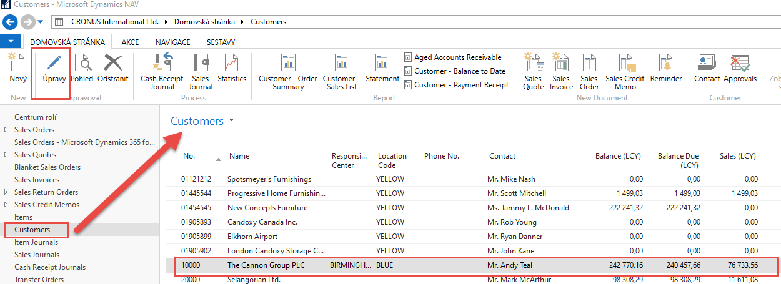
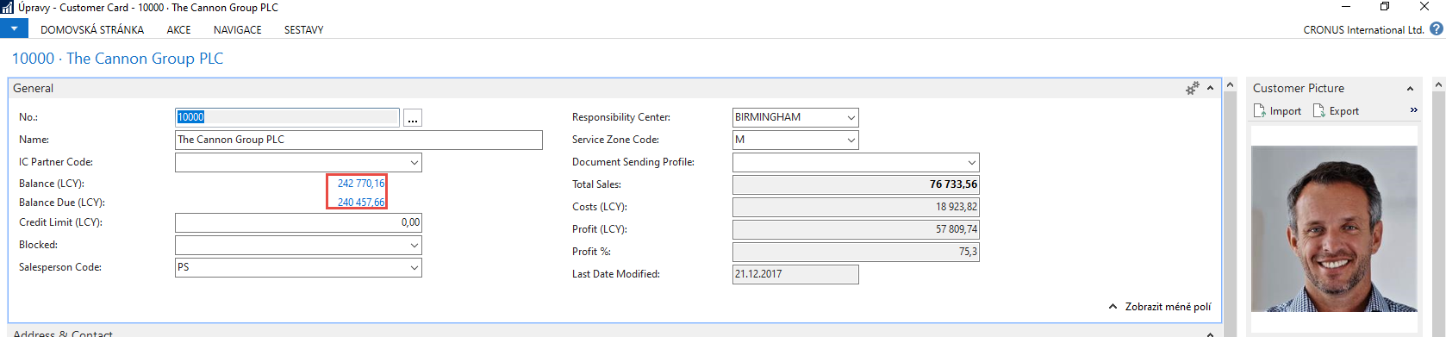
Card and list examples
Click on Edit (in our example Úpravy) to get chosen Customer Cardk

Slide 23
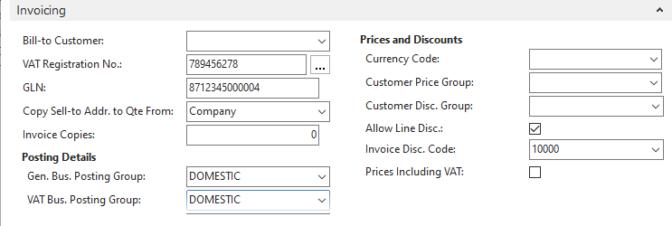
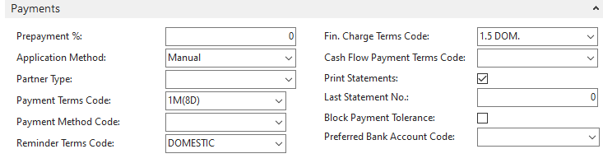
Every card has several Tabs
The reason : to see as much as possible fields .
Every tab contains fields, which serve to control
subfunctions such a payment, shipment, and so on.

Slide 24
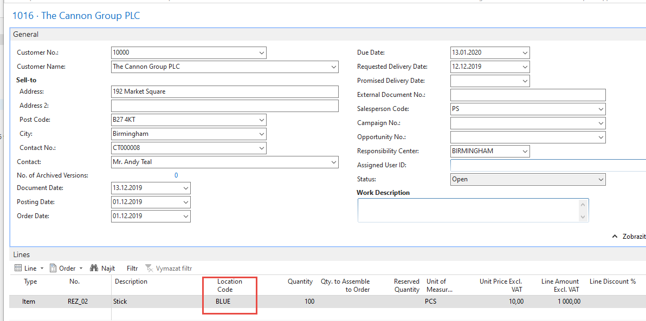
Relations between tables
Location
Calednar code

Slide 25

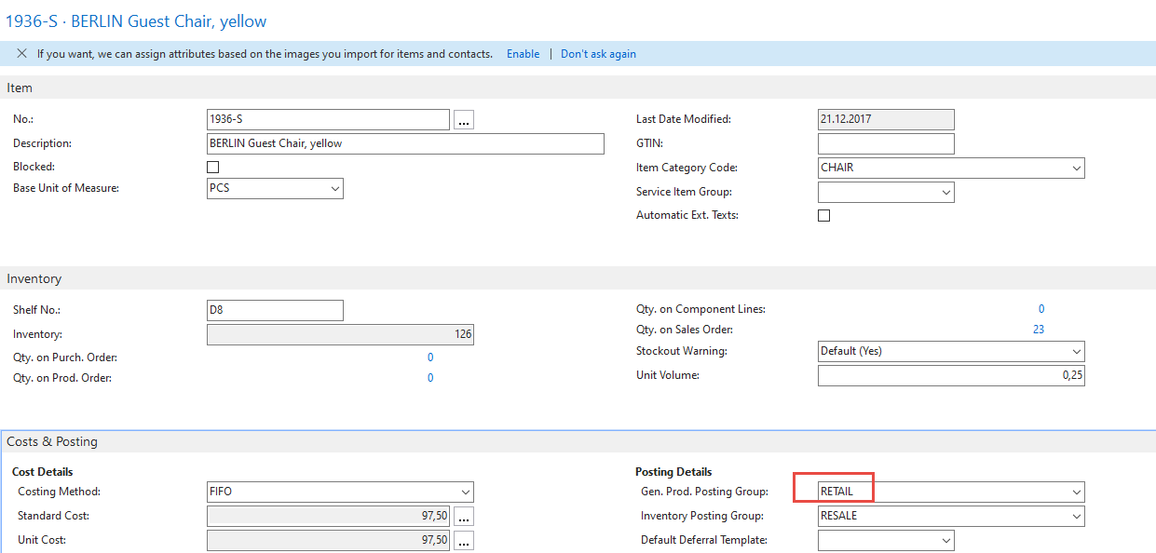
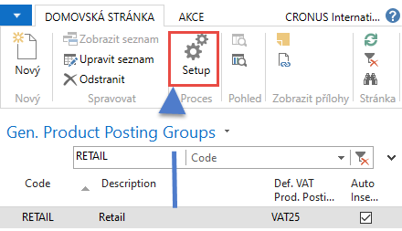
Relations between tables
Item card

Slide 26
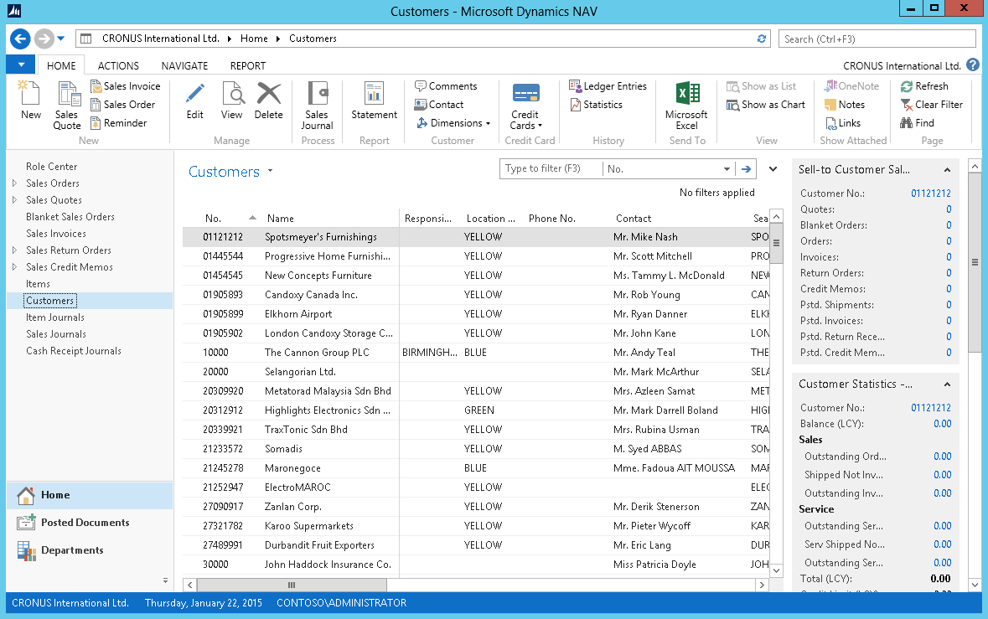
Pages
List Page Windows Client
Ribbon
Filter pane
List
FactBox pane
1
2
4
3
Notes:
After showing this slide and explaining the different components of a list page, go to the application and show some examples of list pages.
Remember to only focus on the interface. Topics such as personalization, filter, search, … are covered in other modules.

Slide 27
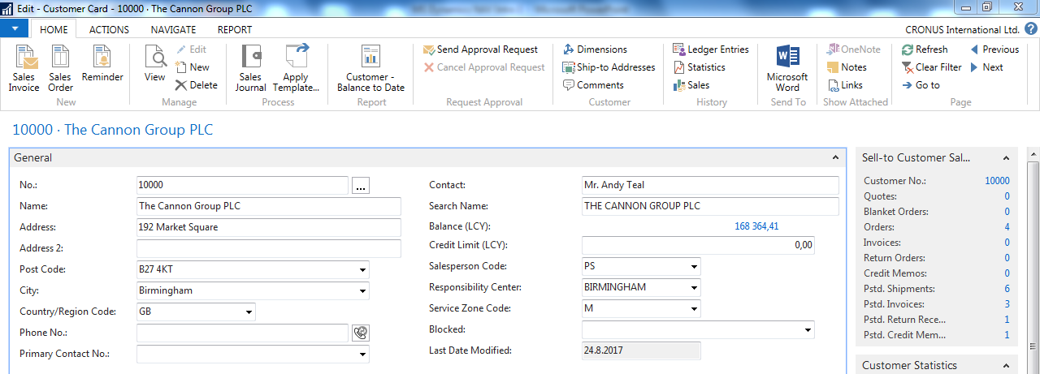
Card page – first tab only

Slide 28
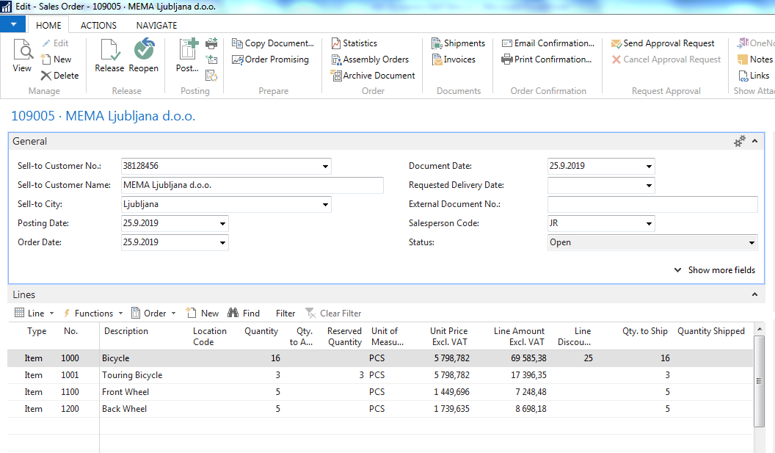
Document page
Header
Lines

Slide 29
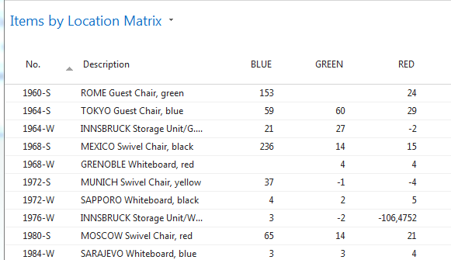
Matrix window (form)
Stock locations

Slide 30
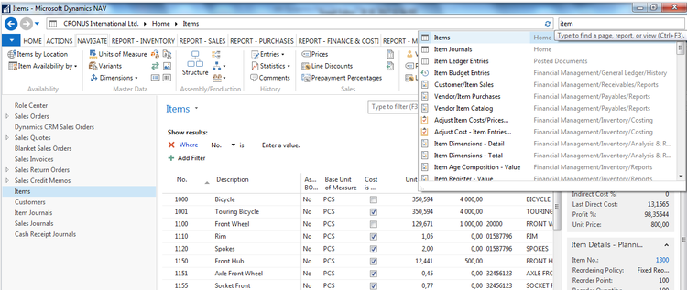
INTRO 10 – Searching window
(„NAV Google search engine“)
Will be shown by the tutor and examined on demo student databases by them
(Find Vendor, Item, Customer, General Ledger Account, Profile and so on)

Slide 31
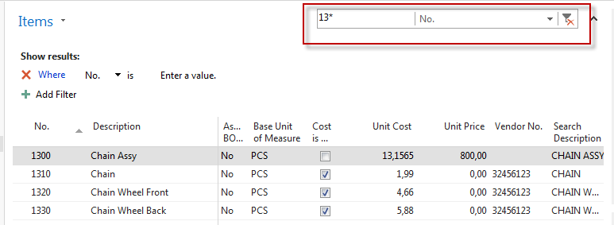
Simple filter
* = any alphanumeric character

Slide 32
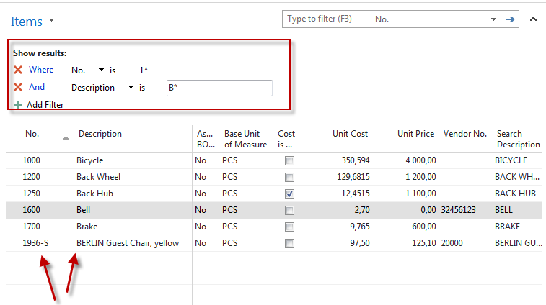
Multiple filter

Slide 33
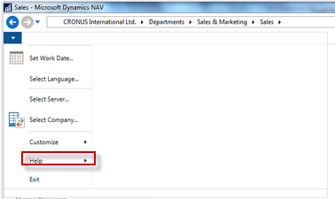
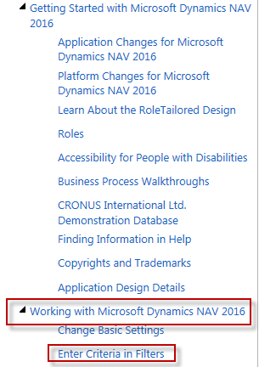
Example of using help _filter criteria)

Slide 34
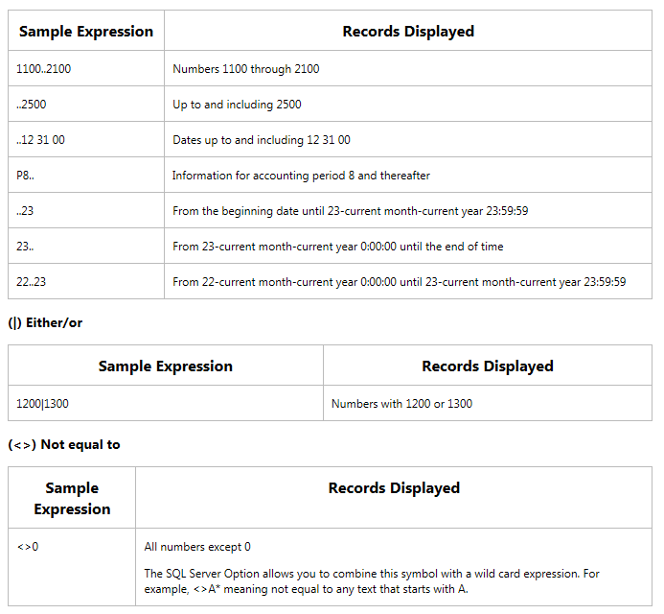
Example of using help _filter criteria)
Only part of it !
Will be presented
by tutor and
experienced by
students ….

Slide 35
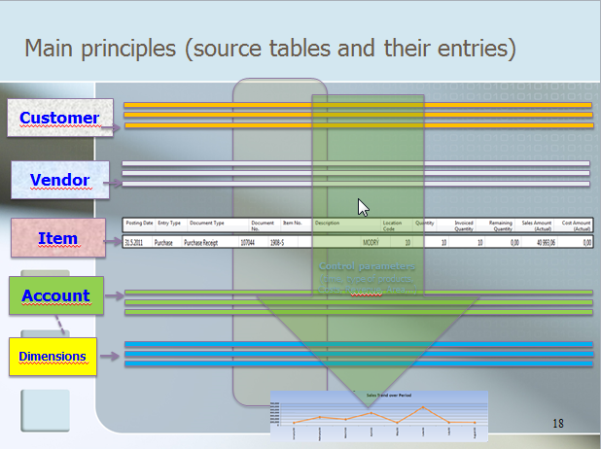
Entries and their use

Slide 36
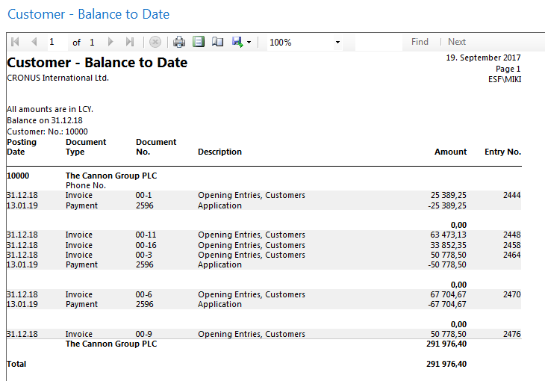
Report – example (data resource - Customer Ledger Entries)

Slide 37
TEXT document related to this PWP show
Only to page 9 !!!

Slide 38
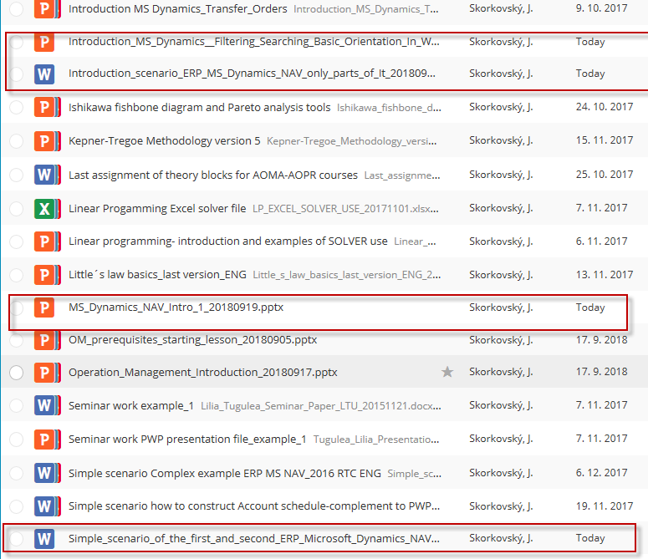
Study material for this (16.9. or 18.9) and probably next session

