Slide 1
Yield Management (OM) Introduction
Ing.J.Skorkovský, CSc,
Department of Corporate Economy
FACULTY OF ECONOMICS AND ADMINISTRATION
Masaryk University Brno
Czech Republic

Slide 2
Some OM methods
Theory of Constraints
Balanced Scorecard
Project Management methods (Critical Chain, SCRUM,…)
Material Requirement Planning and Just-in-Time
CONWIP
Six Sigma – quality management
Boston, SWOT and Magic Quadrant Matrices
Little ´s Law (relations between WIP, Throughput and Cycle time)
Linear programming (will be presented 25.11.)
Yield Management (will be presented 25.11.)
Kepner-Tregoe (support of decision making)
Decision Trees (will be presented 2.12.)
Drum-Buffer-Rope (will be presented 25.11.)

Slide 3

Another point of view
This will be modified in following South African project show (use of Balanced Score Card)
Project management
Theory of constraints
Production
Linear programming
Total quality
management
Product postitioning
Business Intelligence
Workflow
Critical chain
Drum –Buffer-Rope
MRP-MRP-II,JIT,APS
Cutting, blending
Pareto, ishikawa
Boston Matrix
Gartner QM
Decision
Making
SCRUM
CONWIP
Logistics
Pareto, Ishikawa
Product Life Cycle
Kepner-Tregoe
EOQ and BEP analysis
Six Sigma
Yield management
Hurwitz
ABC
Prospect Theory
LEAN
Function block Logistic more in detail
will be presented later in this show
Little´s law
Used abbreviations : QM– Quadrant Matrix; CONWIP – Constant Work in Progress; EOQ – Economic Order Quantity ; MRP - Material Requirement Planning

Slide 4
Yield Management (YM)-definition
YM seeks to maximize yield or profit from time-sensitive products and services.
Used in industries with flexible and expensive capacities, perishable products and uncertain demand. It is part of revenue management.
Type of problems :
  overbooking (airlines, hotel industry,..)
  partitioning demand into fare classes
  single order quantities
YIELD : to produce or furnish (payment, profit, or interest): a trust fund that yields ten percent interest annually; That investment will yield a handsome return.

Slide 5
Yield Management (YM)-definition
Simply put, the purpose of Yield Management is to achieve maximum revenue/profit.
To do this, a yield management strategy needs to be both reflective and forward-looking. That is, yield managers should attain a clear yet detailed understanding of what has happened before, and what is happening now.
The most efficient way to do this is to draw from historical data to predict what may then happen in the future. So, the process of effective yield management involves understanding, anticipating and reacting to consumer behavior (to ultimately maximize revenue!).

Slide 6
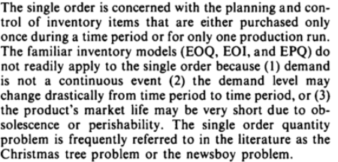
Single Order Quantity
Newsboy problem – see next slide and slide number 11 as well !!!

Slide 7

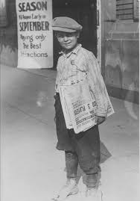

Newsboy problem
Often managers have to make decisions about inventory level over a very limited period, This is the case, for example with seasonal goods such as Christmas cards that should satisfy all demand in December, but any cards left in January have almost no value. These single-period decision models are phrased as the Newsboy Problem. For a newsboy who sells papers on a street corner, the demand is uncertain, and the newsboy must decide how many papers to buy from his supplier.
If he buys too many papers he is left with unsold papers that have no value at the end of the day.
If he buys too few papers he has lost the opportunity of making a higher profit.

Slide 8
Prices and demand
Prices can be determined by:
  Service
  Group of services
  Market (consumer type or geographical area) or
  A combination of the above
And the demand side is characterized with:
  Variability of demand
  Variability of value

Slide 9
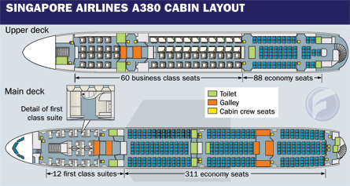
Overbooking (hotels, airlines,..)
7 % out of 311=22
10%-30 % of no-show (traveler reserved ticket, but cancel it at the last minute)
So airline companies overbook their capacities. The no-show ratio is sometimes
lower than overbooking ratio, so „bumped“ client will be compensated by providing
the free of charge service at another time or place. They are so called „offloaded“ to other routes.
Example:
311 economy seats, estimation of 10 % no-show-> 31 places would be lost (only 280 seats occupied).
If overbooked by 10 % (31 more tickets offered) and no-show ratio on reality is only 7 %->only 22 clients
cancelled - > 311-22=289 seats occupied ->289 + 31=320->320-311=9 clients have to be „bumped“
(or 31-22=9) and provided by free air tickets, which is better than the loss of not sold 31 places.
You have to calculate loss of 31 places -22 sold tickets =amount which must cover expenses for 9 bumped clients

Slide 10
Ovebooking<->No-show
Full aircraft
Planned
No-show
Planned
No-show
Overbooked
Reality
NS
Overbooked
Final status
OB
B
B
= bumped client
Overbooked
NS
= no show passangers
OB
B
OB
= overbooked passangers
Cost of B < Cost of NS

Slide 11

Overbooking - claims
Do not settle! Instead get up to €600 +hotel +meals +expenses +new ticket !!
Delta Air Lines has increased the amounts passengers can be offered to give up their seats to up to almost US$10,000 in extreme cases — something passengers can take advantage of if they act in collusion (secret deal).

Slide 12


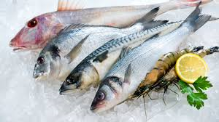
Single order quantities
Newspapers
Magazines
Florists
Bakeries
Fresh fishes

Slide 13


Single order quantities
N = number of items that can be sold
X = number of items ordered
C0 = Cost of overestimating demand (rest of the flowers faded and are not sold)
Cu = Cost of underestimating demand (customers like to buy more and you do not have enough of roses)
Cu>= C0
P(N<X) = probability of overestimating demand or no-show
P(X<=N)= probability of underestimating demand or no-show
P(X<=N)*Cu >= P(N<X)*C0
P(X<=N) +P(N< X) =1 -> P(X<=N) = 1-P(X<N)
(1-P(X<N))*Cu >= P(N<X) * C0 -> OPTIMUM PROBABILITY
Cu
P(N<X) <= ----------
Cu + C0
(1-p)*Cu>=pCo
Cu+pCu >=pCo
Cu>=>p(Cu+Co)
Final formula for over estimating demand

Slide 14
Example 1 ->Single Order Quantity (hotel industry)
Manager Simon Stein of the Best Western in Las Vegas is tired of customers who make
reservation and do not show up. Rooms rent is 100 USD a nigh and cost 25 USD to maintain
per day. Overflow („bumped“) customers can be sent to Motel 7 for 70 USD a night.
Simon´s records of no-show over past six months are given below. Should Best Western start overbooking If so, how many rooms should be overbooked?
No-Show | Probability
0 | 0,15
1 | 0,25
2 | 0,30
3 | 0,30
Solution : C0 = 70 USD - cost of overestimating demand
Cu = 100 USD-25 USD =75 USD - cost of underestimating demand
Cu
P(N<X) <= ---------- = 75/(75+70)=75/145 = 0,517 Cu + C0
No-Show | Probability | P(N<X)
0 | 0,15 | 0,00
1 | 0,25 | 0,15
2 | 0,30 | 0,40
3 | 0,30 | 0,70
Probabilities are cumulating and choice in 0,40->0,517
Optimal probability of no-show falls between
0,40 and 0,70. So if we take less of equal to 0,517,
so next lower value is 0,40. So two rooms have to be overbooked !!!
0,15+0,25=0,40 and 0,40+0,30=0,70…

Slide 15
Example 2 ->Single Order Quantity ( Airlines )
FlyUS Airlines is unhappy with the number of empty seats (same with hotel rooms) on its NY-Miami flights. To remedy the problem, the airline is offering a special discounted rate of 89 USD instead of standard fare 169 USD, but only for 7-days advance purchases and for a limited number of seats per flight. The aircraft flown from NY to Miami holds max 100 passengers. Last month´s distribution of full-fare passengers is shown below. How many seats FlyUS reserve for full–fare passengers ?
Aircraft capacity |  |  | 100
Full fare | No-Show | Frequency | Probability | P(N<X)
50 | 50 | 15 | 0,15 | 0,00
55 | 45 | 20 | 0,20 | 0,15
60 | 40 | 35 | 0,35 | 0,35
65 | 35 | 20 | 0,20 | 0,55
70 | 30 | 10 | 0,10 | 0,65
Cu = 169-89=80,Co =89
P(N<X) <=Cu/(Cu+Co)=80/169=0,473
So 60 full-fare passengers have to be
reserved
50+50 = 55+45=60+40=65+35…

Slide 16
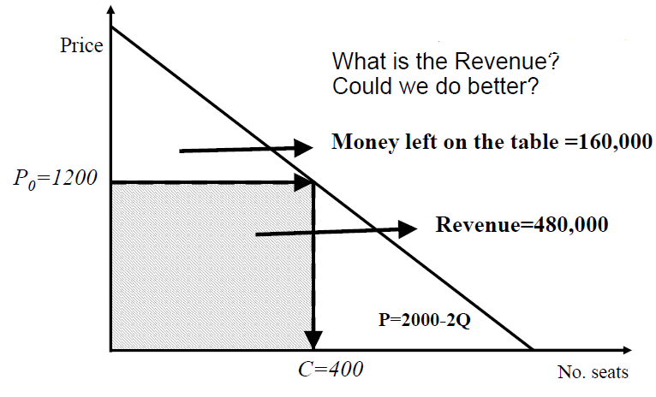
Demand curve – extra service
2000
P=2000-2*400=2000-800=1200, REV=1200*400=480000
Max seats =400 see next slide.
https://www.utdallas.edu/~metin/FuJen/Folios/scpricing_s.pdf

Slide 17
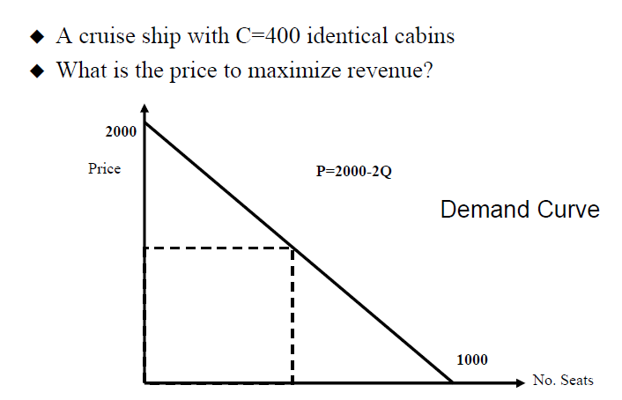
Demand curve – extra service
Segmentation by extra service

Slide 18
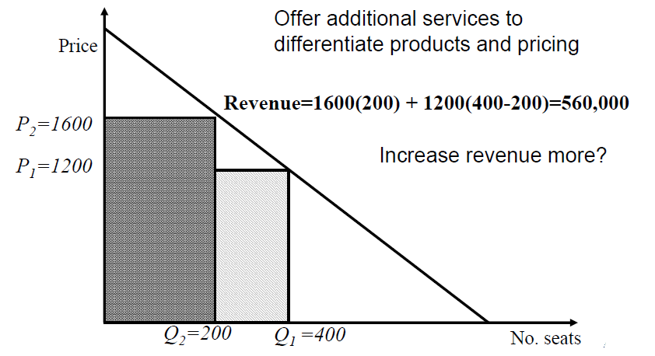
Demand curve – extra service
2000

Slide 19
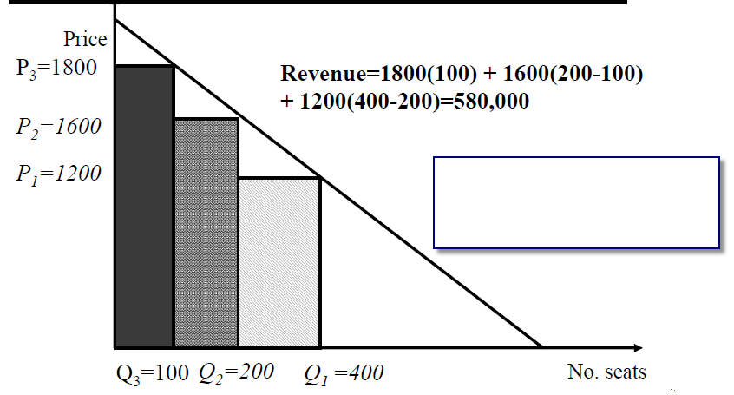

Demand curve – extra service

Slide 20

Thanks for your attention

