Slide 1
Nonprofit-government relations: The public policy and advocacy perspectives

Slide 2
Nonprofit organizations
What are nonprofit organizations?
Functions
  Social capital
  Economic role
  Religious role
  Service
  Policy
  Advocacy
  Global importance
Interactions with the state – very different environments simultaneously, different stakeholders, very complex, dynamic shifts

Slide 3
NNO-government relations
Legal perspective
Public policy perspective
Advocacy perspective

Slide 4
NNO-government relations
Legal perspective
Public policy perspective
Advocacy perspective

Slide 5
Public policy perspective

Slide 6
Public policy perspective
Embeddedness in welfare state arrangements
Main question: To what extent governments and public administration cooperate with NPOs?
Different models of nonprofit-government relations
    Four-C model (Najam, 2000)
    A triangular model (Young, 2000)
    Social origins (Salamon and Anheier, 1998)

Slide 7
Public policy perspective
Embeddedness in welfare state arrangements
Main question: To what extent governments and public administration cooperate with NPOs?
Different models of nonprofit-government relations
    Four-C model (Najam, 2000)
    A triangular model (Young, 2000)
    Social origins (Salamon and Anheier)

Slide 8
Four-C model
Based on institutional interests and preferences for policy ends and means
2 main hypotheses
  1) NPOs constitute a distinct institutional sector with particular motivations and structural preferences
  2) NPOs have an abiding interest in public policy
 |  | Goals
 |  | Similar | Dissimilar
Means | Similar | Cooperation | Co-optation
 | Dissimilar | Complementarity | Confrontation

Slide 9
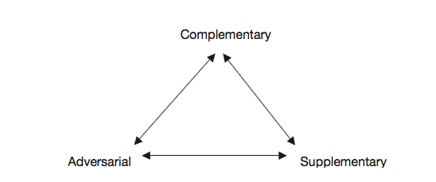
A triangular model
Refers to economic theories of NPOs
Refers to NPOs as service providers
Notes:
Refers specifically to economic theories of nonprofit organizations
Based on the underlying assumption that output improvement (particularly of social service delivery) constitutes the core rationale for government-nonprofit sector relations
Refers to NPOs as service providers

Slide 10
Social origins model
Focus explicitly on broader social and political relationships
 |  | Nonprofit scale
 |  | Low | High
Government social welfare spending | Low | Statist | Liberal
 | High | Social democratic | Corporatist

Slide 11
Advocacy perspective

Slide 12
Advocacy perspective
How and to what extent citizens make use of the public sphere by engaging in civic activities?
Whether and how civil society organizations give citizens a voice and provide avenues for a political participation?
NPOs mediate/facilitate civic participation
NPOs engage in public-interest advocacy activities

Slide 13
Social movement theory argument
Civil society and the state are deeply intertwined, but also have conflictual relationship
Social movements as informal networks created by a multiplicity of individuals, groups, and organizations, engaged in political or cultural conflicts on the basis of a shared collective identity (Diani 1992)

Slide 14
Social movement theory argument II
A relationship cycle:
    SMO translates private into public concerns
    SMO gives impetus for the creation of NPO
    Succesful NPO influences government policy
    Government responds by directly addressing the issue or funds nonprofits
    1. Nonprofit addresses public concerns and tries to influence again
Examples of such successful movements?

Slide 15
Public interest advocacy
Public interest = NPO’s crucial civic function
Goal: To influence government decisions; to influence government policy (not to govern); or to encourage political participation
Voicing a broader set of public interests
Ideal vs. reality

Slide 16
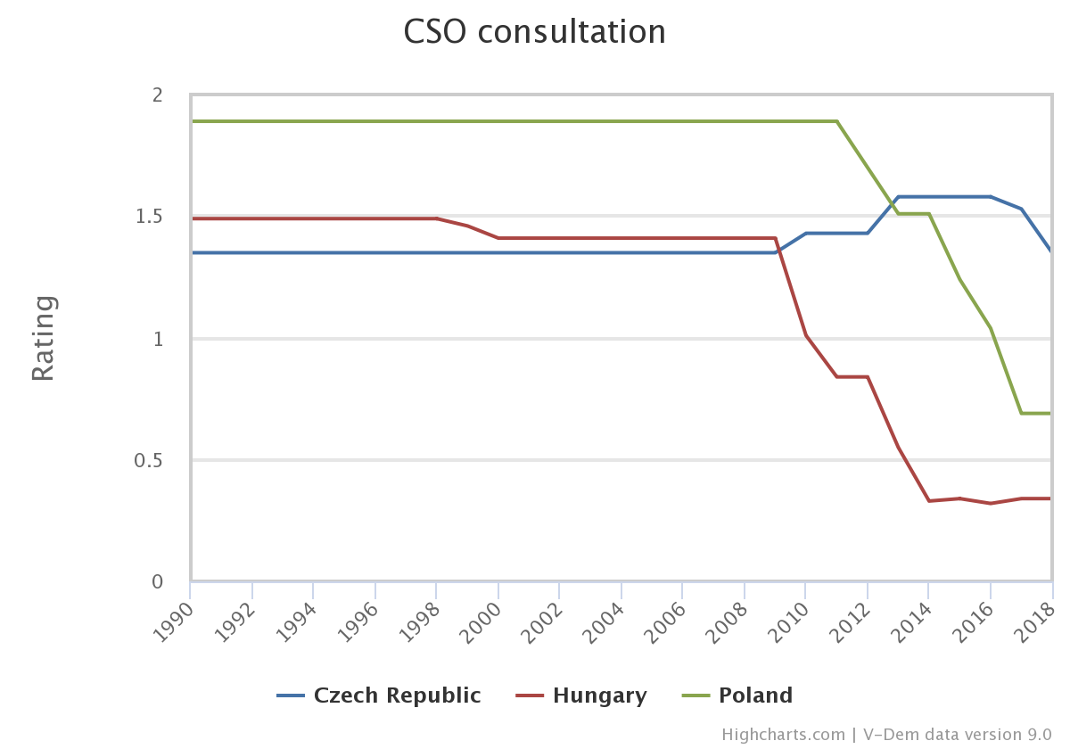
Are major civil society organizations (CSOs) routinely consulted by policymakers on policies relevant to their members?

Slide 17
Advocacy
Why should NPO participate in policies and policy-making? Reasons to advocate?
Targets of advocacy activities?

Slide 18
What affects advocacy
Declining civic engagement
Government regulation
Growing business competition
Public perception
Elite discourse

Slide 19
Public perception and elite discourse
How is civil society organizations (CSOs) and NPOs framed by the political elites?
What is a public image of CSOs?
  In CEE: Recent political developments in contemporary democracies suggest that civil and political actors are undergoing significant transformations, post-1989 (neo)liberal consensus have been openly questioned and criticized by the new political actors

Slide 20
NPOs as the enemy of the people
CSOs = NPOs, human rights/liberal organizations
By populists often framed as „agents of neomarxism and liberalism“ threatening the nation and its culture (in Central and Eastern Europe)
Puppets of foreign interests (Soros and his ‘plan’) – the case of Central European University
HUN/POL: „government-friendly“ (conservative) or oppositional (liberal) CSOs – governments organized campaigns againts CSO
CZ: “ngo-ism” (Václav Klaus)

Slide 21
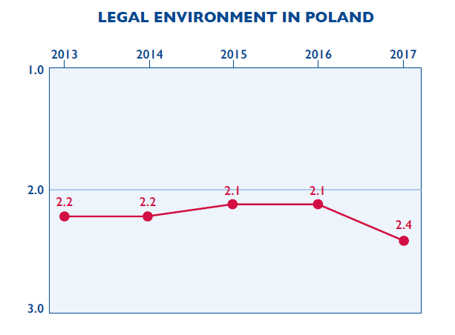
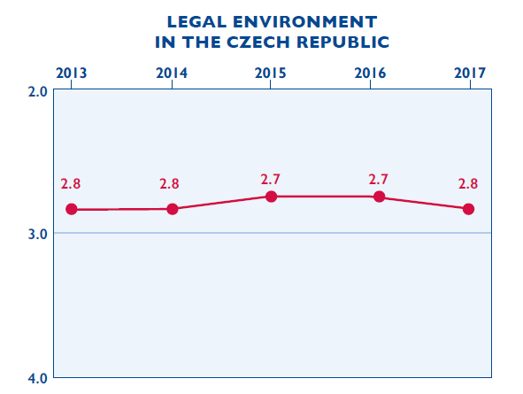
Legal environment
Source: 2017 CSO Sustainability Index
Notes:
Hungary – “on the transparency of organizations supported from abroad” – “foreign funded” organizations
Strongly biased public funding of CSO
Poland – centralized supervision body (2017)
Czech Republic – discoursive threats to limit public funding

Slide 22
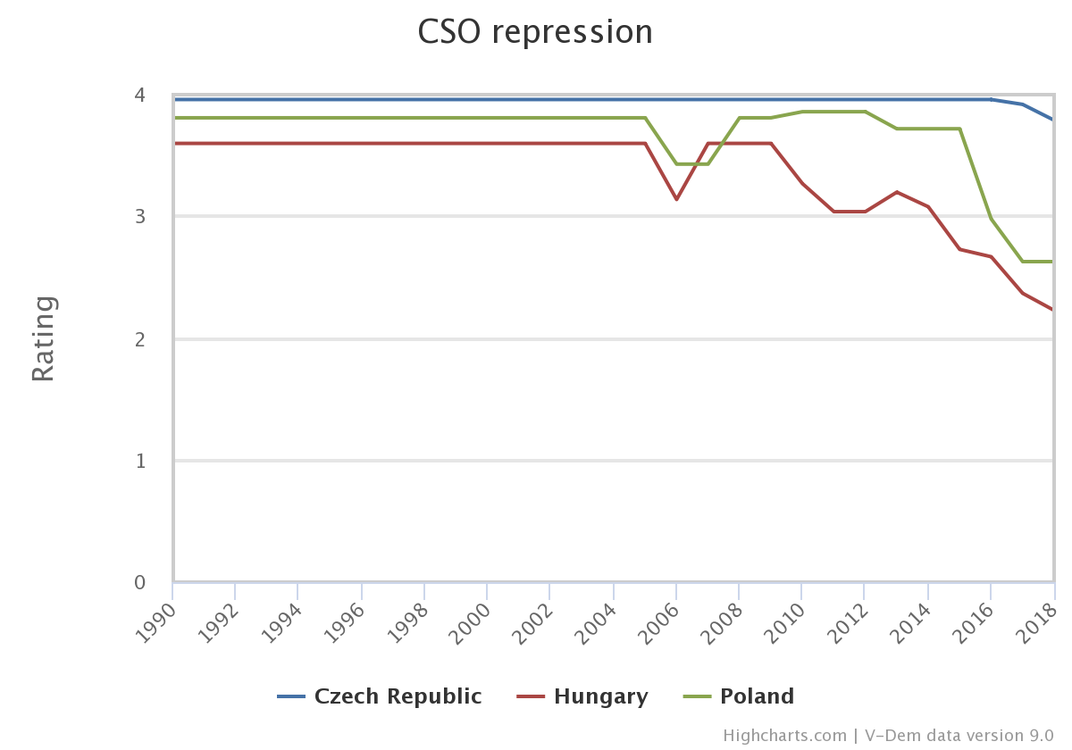
Does the government attempt to repress civil society organizations (CSOs)?

Slide 23
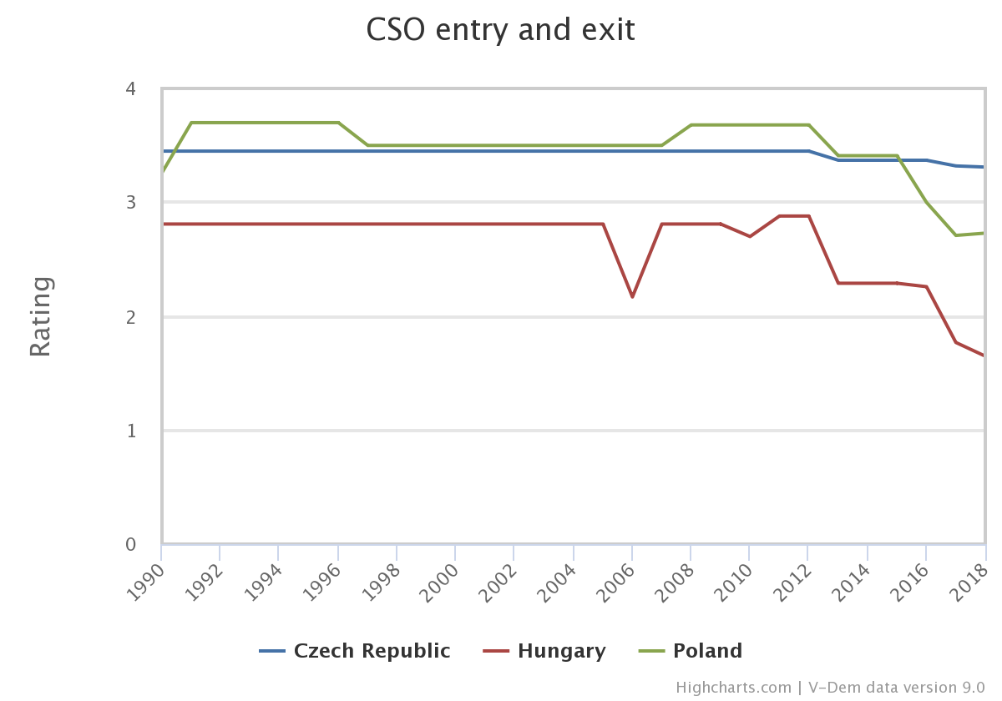
To what extent does the government achieve control over entry and exit by civil society organizations (CSOs) into public life?

Slide 24
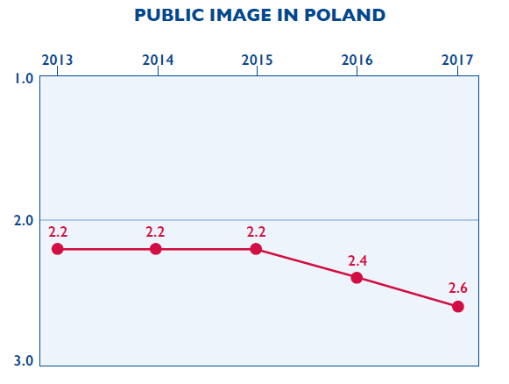
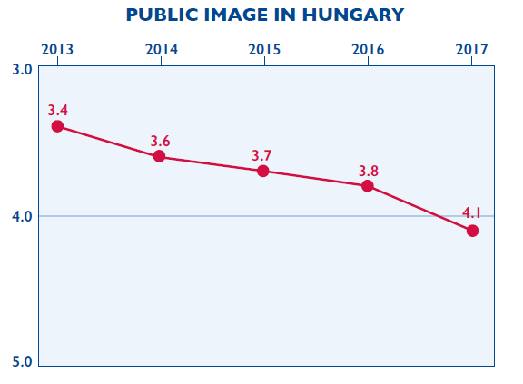
Public image of CSOs
Source: 2017 CSO Sustainability Index

Slide 25
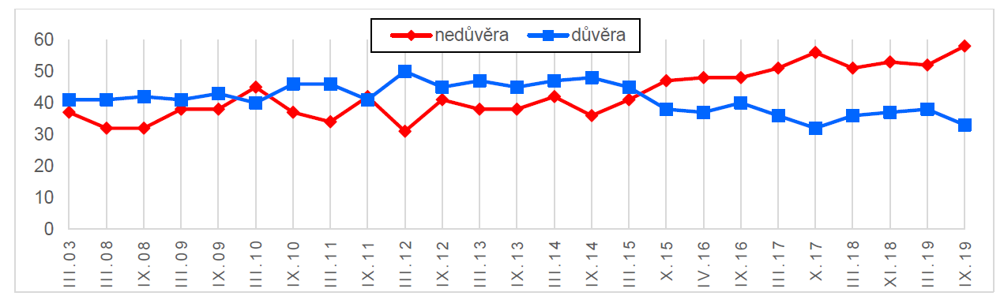
Trust in non-profit organizations (CZE)

Slide 26
Nonprofit responses
Have had to become more sophisticated
Created more complex organizational structures
Take advantage of new technologies – Internet activism fundamentally altered civic participation and advocacy
Invested in effective research
Increasingly turned to collaborations, including some with business organizations

Slide 27
Forms: How to advocate?
Lobbying (direct, grassroots, administrative)
Research and analysis
Education of the public on crucial issues
Legal advocacy in the courts
Media
Social media: „Tweeting social change“
Public events and direct action (calls for boycotts and demonstrations)
Expert testimony (testifying before governmental bodies)
Talks with governments
Petition letters, participation in referenda or initiative campaigns
Grassroots organizing and communication with local leaders

Slide 28
Public funding and its impact on nonprofit advocacy
Relationship between public funding and nonprofit engagement in advocacy (Neumayr at al. 2015)
2 main lines of the argument:
    Resource dependence theory: NPOs that receive public funding will eventually reduce their advocacy activities or even refrain from them altogether for fear of losing their funding
    NPOs who receive public funding will increase their engagement in advocacy

Slide 29
So does it affect…?
Empirical studies: mixed results, mostly on US
E.g. Austria (Neumayr at al. 2015)
    No significant relationship between advocacy and the receipt of public funding or the proportion of an organization’s total revenue coming from public funding
    The degree to which nonprofits engage in advocacy is influenced by the geographic range of operation and field of activity

Slide 30
Citizen Lobbying: How Your Skills Can Fix Democracy
By Alberto Alemanno (at TEDxBrussels)
https://www.youtube.com/watch?v=WqNf2OPdu8c

Slide 31
Going the Digital Route
By Marci Harris, a former congressional staffer, founded Popvox, a non-partisan platform to engage digitally with Congress https://www.youtube.com/watch?v=5aKyYR-iWpc

Slide 32
Advocacy Through Social Media: Why Trending Topics Matter
By Karen McAlister (at TEDxUTA)
https://www.youtube.com/watch?v=o4sGLLaLq-Q

Slide 33
Thank you for participation

