Slide 1
Impact of the Populist Radical Right

Slide 2
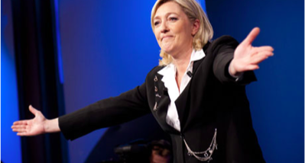
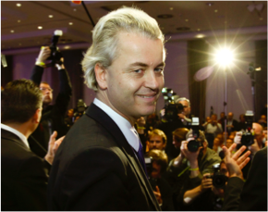
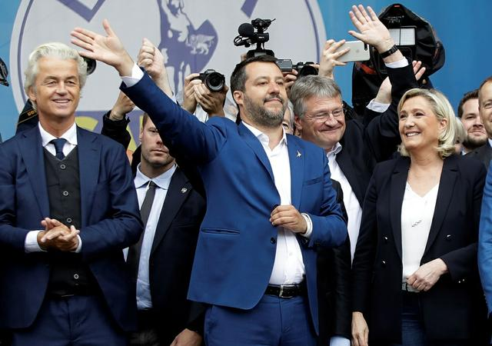
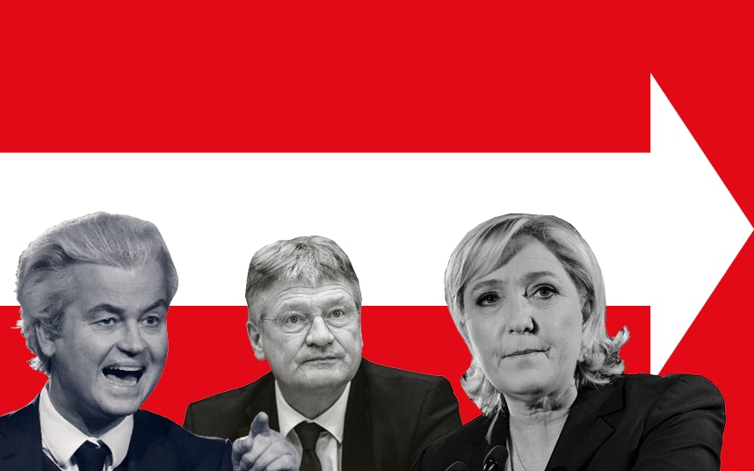

Slide 4
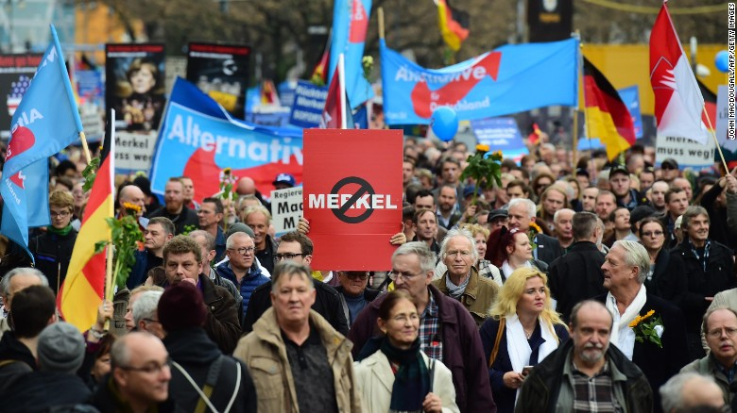

Slide 5
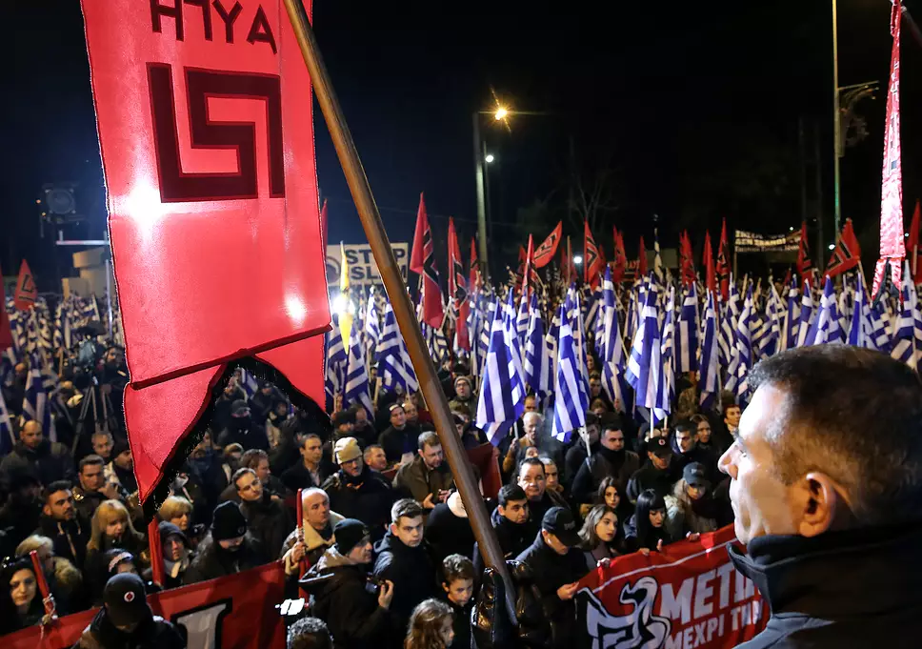

Slide 6
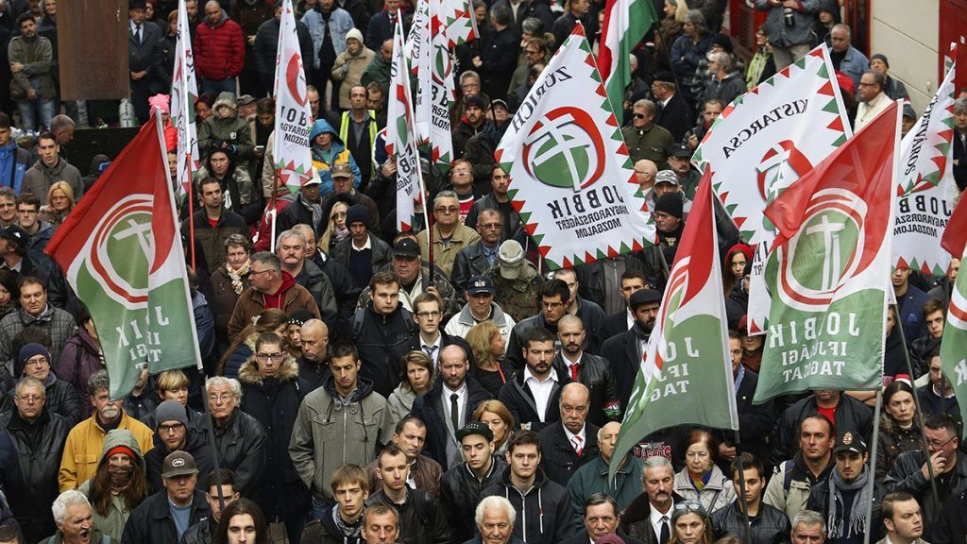
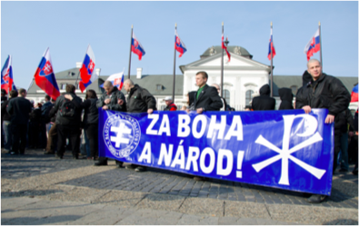

Slide 7
John Oliver on European far right in 2016 EP elections
https://www.youtube.com/watch?v=hjShnTFpRs4

Slide 8
Populist radical right
The “new right” (Ignazi 1992): links to xenophobia and anti-political establishment populism
Electoral and mobilizing growth
Increasing challenge in Europe (and the West in general)
Mostly abiding by the democratic rules (not trying to overturn democracy): defenders of „true democracy“ (Betz, 1994)
Terminology: extreme right, radical right, far right, populist radical right, …

Slide 9
Ideology of PRR parties
Ideology: nativism, populism, authoritarianism (Mudde, 2007)
Nativism: nationalism and xenophobia
Authoritarianism: the belief in a strictly ordered society
Populism: wisdom of a ‘little man’ - considers society to be ultimately separated into two homogeneous and antagonistic groups, “the pure people” versus “the corrupt elite,” and which argues that politics should be an expression of the general will of the people
Who are “the people”?
“The heartland”, the “common sense” of the people (Taggart (2000) - a place ‘in which, in the populist imagination, a virtuous and unified population resides’ - a mythical and constructed sub-set of the whole population
Enemy-building/making: “us”-“them” (friend-enemy) dichotomy

Slide 10
Research on extreme right (parties)
Issues and ideologies
Reasons (the causes) for electoral gains
Demand for radical politics
Consequences
Responses: How to deal with ER parties and movements

Slide 11
What is in the impact?
Consequences and responses
Impact OF PRR parties:
How ERP influence the political agenda and policies
How ERP influence public opinion
Their impacts when in power
Impact ON PRR parties:
How the government or established political parties respond to PRR parties
What strategies mainstream parties employ against PRR parties

Slide 12
Impact OF extreme right parties
Potential influence:
Political agenda: influence on other political actors
“People’s frame of thought” (Rydgren, 2003): increase in racism, xenophobia, intolerance
Media discourse
Policy impact
Party impact
Social impact

Slide 13
Policy impact
Direct impact
ERP adopting policies (immigration, minority rights, law and order)
Local level
symbolic policies, cultural policies (e.g. street names)
Junior coalition partners (often lacking experience)
Affecting immigration, minority policies
FPÖ and LN instumental in introducing more restrictive immigration policy (Austria and Italy) (Zaslove 2004)
Either introduction of new agenda, or radicalization of an older agenda

Slide 14
Party impact
Competing with PRR: adopting arguments, language, rhetoric
„Contamination“: style of leadership, type of political discourse, relationship between leaders and followers
Re-politization of some issues (immigration, Europe and the EU)
Legitimisation of the PRR: no need for „copy“, when original is available – increase in support for PRR
Bale (2003): „By adopting some of the far right’s themes, it legitimised them and increased both their salience and the seats it brought into an expanded right bloc. Once in office, the centre-right has demonstrated its commitment to getting tough on immigration, crime and welfare abuse, not least to distract from a somewhat surprising turn toward market liberalism.“

Slide 15
Party impact II
Impact on use of populism by other political parties
Strongest effect: discourse – populist Zeitgeist – most political parties express some elements of populism
Has populism become mainstream in WE?
Mixed evidence
Not supported (Rooduijn, de Lange, van der Brug 2011)
Populist parties change their own discourse after being successful: Their initial success makes them more moderate

Slide 16
Party impact III
Impact on policy positions of other parties
Direct effect of the party competition
Reacting to same cues from the media and society
Effect of real-world developments, e.g. refugee crisis
„Issue ownership“ of the topic
Contagion effect (Van Spanje, 2010):
Opposition parties are more vulnerable to the contagion effect than parties in the government
Anti-immigration parties are able to influence policy output in their political systems without entering government

Slide 17
Social impact
Public atttitudes:
On immigration, integration, minority issues, citizenship laws, or national identity
Increase in tolerance of intolerance
Affect and interact with the media discourse, through which the PRR seeks to be perceived as effective and legitimate
Usually not changes in direction of attitudes, but increase in salience of that attitude
Violence: Level of nativist or racist violence - the xenophobic rhetoric often spilling over into violence
Research: PRR success correlates with ethnic prejudice

Slide 18
Italian elections 2018
https://www.youtube.com/watch?v=LdhQzXHYLZ4
Five star movement: 32.68%
Democratic party: 18.76%
League: 17.35%
Forza Italia: 14.00%

Slide 19
Impact on PRR: responses of established parties
„Adaptation dilemma“
to function fully within a liberal democratic context the PRR must moderate, but to keep its unique position and ensue the lyoalty of its hardcore support it must remain radical
Different legal, political, social contexts leading to different dilemmas – e.g. impact of refugee crisis and radicalization of mainstream political discourse
2 poles of reactions:
coalition (the most accomodative)
cordon sanitaire (the most adversarial)

Slide 20
Constraining and contesting the ER
The impact of restrictive policies is mixed
Some PRR successful despite (FN, VB), some because of cordon sanitaire
Ostracism (van Spanje and Weber, 2017):
A strategic problem for established actors: Immediate policy impact of PRR can be averted by ostracizing them (i.e. refusing any cooperation), but this strategy may sway public opinion further in their favor

Slide 21
Constraining and contesting the ER II
Can behave as victims, those trying to help ordinary people despite being „punished“ or „persecuted“ (debate on free speech)
Hate speech prosecution (van Spanje and de Vreese, 2013)
A common phenomenon (Nick Griffin in Britain, Jean-Marie Le Pen in France)
Does hate speech prosecution of politicians affect the electoral support for their party?
Dutch voters interviewed before and after the unexpected court decision to prosecute MP Geert Wilders
The decision substantially enhanced his party’s appeal
The role of the ERP itself:
Issue ownership (PRR as established, credible political actor that owns certain salient issue (e.g. immigration), it is immune to counter-strategies of other political actors (including media, social movements)

Slide 22
How to deal with PRR in government: strategies
„Militant democracy“: Karl Löwenstein, 1930s, a strong constitutional order, which should ban political parties that do not respect liberal democratic principles
Problem with democratic paradox: possibility of a democracy destroying itself in the process of defending itself (populists not against democracy, but at odds with liberal democracy)
Cappoccia (2013):
Militancy: implementation of legal measures to limit the civil and political rights of extremist actors
Incorporation: convert semi-loyal into loyal political actors
Purge: prosecute the architects and administrators of anti-democratic activities
Education: strengthen democratic beliefs by, for instance, developing forms of civic education and designing programmes aimed at integrating activists who want to abandon extremist parties

Slide 23
Strategies II (Rummens and Abts 2010)
“Concentric model of containment”: the employment of a dual strategy whereby actors take an inclusive stance to take into account concerns of extremist voters in devising policies, on the one hand, and where they, on other hand, prepare to adopt an exclusive line in pressuring extremist parties to push out pernicious radical elements from the process of decision-making
Anti-extremist legislation (banning parties)
The use of public funding to bind in extremist parties by making it conditional on accepting certain norms
Isolating extremist forces through principled non-cooperation

Slide 24
Strategies III
Along two dimensions – 1. between engagement and disengagement, 2. between militancy and accommodation (Downs 2012)
4 strategies:
Ban/isolate
Co-opt
Ignore
Collaborate
Policies “of isolation, ostracism and demonization prove surprisingly ineffective at rolling back or even containing threats to the democratic order from party-based extremism“

Slide 25
Thank you for listening and participating!

