Slide 1
Seminar 3 Solutions

Slide 2
Problem 1
Hours | Quantity of fish | Marginal Product | Total cost
0 | 0 |  | 10
1 | 10 | 10 | 15
2 | 18 | 8 | 20
3 | 24 | 6 | 25
4 | 28 | 4 | 30
5 | 30 | 2 | 35
Suppose that a fisherman exhibits the relationship between hours spent fishing and the quantity of fish caught as above.
What is the marginal product of each hour spent fishing?
Use this data to graph the fisherman’s production function. Explain its shape. Answ: diminishing marginal product. See graph on the next slide.
The fisherman has a fixed cost of 10$ (his pole). The opportunity cost of his time is $5 per hour. Graphs the fisherman’s total-cost curve. Explain its shape.

Slide 4
Problem 2
When the marginal product of labor increases as the amount of labor employed increases,
a) the additional worker has made other workers more productive
b) the firm also must have increased the amount of capital
c) the firm is experiencing economies of scale
d) there has been an improvement in the available technology

Slide 5
Problem 3
The table above gives the short-run and long-run total costs for various levels of output of a certain firm.
a) Which column, TC1 or TC2, gives long-run total cost, and which gives short-run total cost? How do you know? Answ: TC₁ is long run, TC₂ short run.

Slide 6
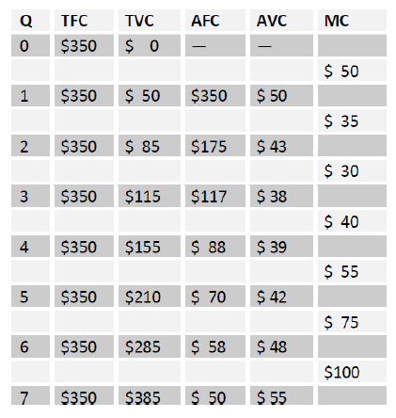
Problem 3
b) For each level of output, find short-run TFC, TVC, AFC, AVC, and MC .

Slide 7
Problem 3
c) At what output level would the firm’s short-run and long-run input mixes be the same? Answ: Q=3
d) Starting from producing two units, the firm’ managers decide to double production to four units. So they simply double all of their inputs in the long run. Comment on their managerial skills. Answ: starting from 2 unit of output until 4, marginal cost is decreasing in the long run, therefore, it makes sense to increase production.

Slide 8
Problem 3
e) Over what range of output do you see economies of scale? Diseconomies of scale? Constant returns to scale? Answ: ATC₂ declines as output raises, therefore it exhibits economies of scale.

Slide 9
Problem 4
Suppose the table above represents the long run total costs of three different firms. Does each of these firms experience economies of scale or diseconomies of scale?

Slide 10
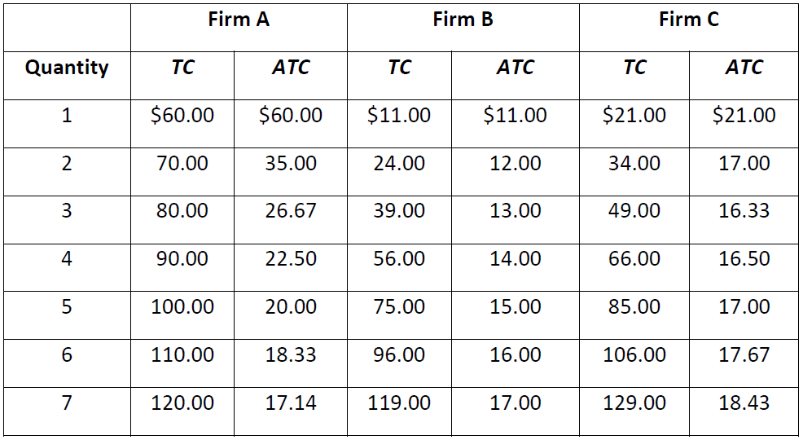
Problem 4 - Solution
Firm A has economies of scale because average total cost declines as output increases. Firm B has diseconomies of scale because average total cost rises as output rises. Firm C has economies of scale from one to three units of output and diseconomies of scale for levels of output beyond three units.

Slide 11
Problem 5
Labor | Output | Marginal Product | Variable Cost | Fixed Cost
0 | 0 | -- | $0 | $10
1 | 200 | 200 | $20 | $10
2 | 350 |  | $40 | $10
3 | 450 |  | $60 | $10
4 |  | 50 | $80 | $10
5 |  | 25 | $100 | $10
6 | 530 |  | $120 | $10
Complete the table

Slide 12
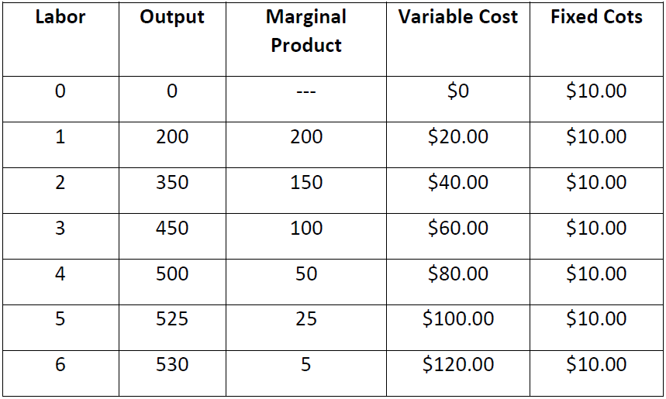
Problem 5 - Solution

Slide 13
Problem 6 solution
For a given level of output, the short-run total cost of production
a. always falls below the long-run total cost of production
b. always exceeds the long-run total cost of production
c. always equals the long-run total cost of production
d. may exceed or equal the long-run total cost of production
e. may exceed or fall below the long-run total cost of production

Slide 14
Problem 7 solution
If Papagna's Pizza Parlor knows that the marginal cost of the 500th pizza is $3.00 and that the average total cost of making 499 pizzas is $3.30, then
a. average costs are rising at Q = 500
b. average costs are falling at Q = 500
c. total costs are falling at Q = 500
d. average variable costs must be falling
e. average variable costs must be rising

Slide 15
Problem 8 solution
Klara has been working for an engineering firm and earning an annual salary of $80,000. She decides to open her own engineering business. Her annual expenses will include $15,000 for office rent, $3,000 for equipment rental, $1,000 for supplies, $1,200 for utilities, and a $35,000 salary for a secretary/bookkeeper. Klara will cover her start-up expenses by cashing in a $20,000 certificate of deposit on which she was earning annual interest of $500.
What is Klara’s annual implicit cost? Answer: 80,000$+500$=80,500$
What is Klara’s annual accounting cost? Answer: 15,000$+3,000$+1,000$+1,200$+35,000$=55,200$..
What is Klara’s annual economic cost? Answer: 55,200$+80,500$=135,700$
According to Klara’s accountant, what is the revenue that will yield her business $50,000 in profits? Answer: 55,200$+50,000$=105,200$.
According to an economist, what is the revenue that will yield Klara’s business $50,000 in economic profits? Answer: 135,700$+50,000$=187,500$.

