Slide 1
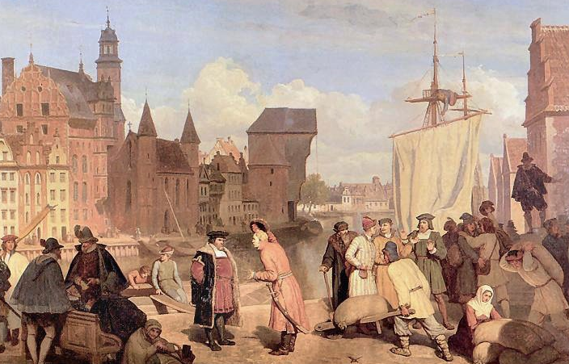
Masaryk University
Microeconomics 1
Dali Laxton
Wojciech Gerson (1831-1901)
Public Goods and Common Resources
Chapter 11
Lecture
8

Slide 2
In this chapter, look for the answers to these questions
What are public goods?
What are common resources?
Give examples of each.
Why do markets generally fail to provide the efficient amounts of these goods?
How might the government improve market outcomes in the case of public goods or common resources?

Slide 3
Introduction
We consume many goods without paying:
parks, national defense, clean air & water.
When goods have no prices, the market forces that normally allocate resources are absent.
The private market may fail to provide the socially efficient quantity of such goods.
One of the Ten Principles from Chapter 1:
Governments can sometimes
improve market outcomes.
Notes:
2

Slide 4
Important Characteristics of Goods
A good is excludable if a person can be prevented from using it.
  Excludable: fish tacos, wireless Internet access
  Not excludable: AM/FM radio signals, national defense
A good is rival in consumption if one person’s
use of it diminishes others’ use.
  Rival: fish tacos
  Not rival:
  An MP3 file of RHCP’s latest single
Notes:
3

Slide 5
The Different Kinds of Goods
Private goods: excludable, rival in consumption
  Example: food
Public goods: not excludable, not rival
  Example: national defense
Common resources: rival but not excludable
  Example: fish in the ocean
Club goods: excludable but not rival
  Example: cable TV
Notes:
4

Slide 6
ACTIVE LEARNING ₁
Categorizing roads
A road is which of the four kinds of goods?

Slide 7
ACTIVE LEARNING ₁
Answers
Rival in consumption? Only if congested.
Excludable? Only if a toll road.
Four possibilities:
Uncongested non-toll road: public good
Uncongested toll road: club good
Congested non-toll road: common resource
Congested toll road: private good

Slide 8
The Different Kinds of Goods
This chapter focuses on public goods and common resources.
For both, externalities arise because something of value has no price attached to it.
So, private decisions about consumption and production can lead to an inefficient outcome.
Public policy can potentially raise economic
well-being.
Notes:
7

Slide 9
Public Goods
Public goods are difficult for private markets to provide because of the free-rider problem.
Free rider: a person who receives the benefit of a good but avoids paying for it
  If good is not excludable, people have incentive to be free riders, because firms cannot prevent non-payers from consuming the good.
Result: The good is not produced, even if buyers collectively value the good higher than the cost of providing it.
Notes:
8

Slide 10
Public Goods
If the benefit of a public good exceeds the cost of providing it, govt should provide the good and pay for it with a tax on people who benefit.
Problem: Measuring the benefit is usually difficult.
Cost-benefit analysis: a study that compares
the costs and benefits of providing a public good
Cost-benefit analyses are imprecise, so the efficient provision of public goods is more difficult than that of private goods.
Notes:
9

Slide 11
Some Important Public Goods
National defense
Knowledge created through basic research
Fighting poverty
Notes:
10

Slide 12
Common Resources
Like public goods, common resources are not excludable.
  Cannot prevent free riders from using
  Little incentive for firms to provide
  Role for govt: seeing that they are provided
Additional problem with common resources:
rival in consumption.
  Each person’s use reduces others’ ability
  to use
  Role for govt: ensuring they are not overused
Notes:
11

Slide 13
The Tragedy of the Commons
A parable that illustrates why common resources get used more than is socially desirable.
Setting: a medieval town where sheep graze on common land.
As the population grows, the # of sheep grows.
The amount of land is fixed,
the grass begins to disappear from overgrazing.
The private incentives (using the land for free) outweigh the social incentives (using it carefully).
Result: People can no longer raise sheep.
Notes:
12

Slide 14
The Tragedy of the Commons
The tragedy is due to an externality:
Allowing one’s flock to graze on the common land reduces its quality for other families.
People neglect this external cost, resulting in overuse of the land.
Notes:
13

Slide 15
ACTIVE LEARNING ₂
Policy options for common resources
What could the townspeople
(or their government)
have done to prevent the tragedy?
Try to think of two or three options.

Slide 16
ACTIVE LEARNING ₂
Answers
Impose a corrective tax on the use of the land
to “internalize the externality.”
Regulate use of the land (the “command-and-control” approach).
Auction off permits allowing use of the land.
Divide the land, sell lots to individual families; each family will have incentive not to overgraze its own land.

Slide 17
Policy Options to Prevent
Overconsumption of Common Resources
Regulate use of the resource.
Impose a corrective tax to internalize the externality.
  Example: hunting & fishing licenses,
  entrance fees for congested national parks
Auction off permits allowing use of the resource.
  Example: spectrum auctions by the
  U.S. Federal Communications Commission
If the resource is land, convert to a private good
by dividing and selling parcels to individuals.
Notes:
16

Slide 18
Some Important Common Resources
Clean air and water
Congested roads
Fish, whales, and other wildlife
Notes:
17

Slide 19
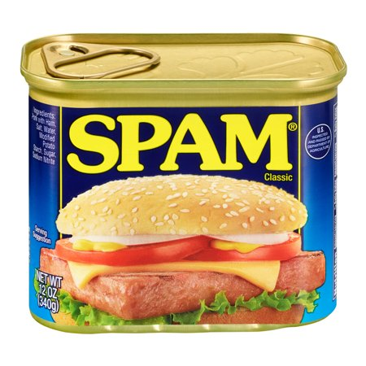
CASE STUDY:
“You’ve Got Spam!”
Some firms use spam e-mails
to advertise their products.
Spam is not excludable:
Firms cannot be prevented
from spamming.
Spam is rival: As more
companies use spam, it becomes less effective.
Thus, spam is a common resource.
Like most common resources, spam is overused – which is why we get so much of it!
©Paul Maguire/Shutterstock.com
“Spam” email is named after everyone’s
favorite delicacy.
Notes:
18

Slide 20
CONCLUSION
Public goods tend to be under-provided, while common resources tend to be over-consumed.
These problems arise because property rights
are not well-established:
  Nobody owns the air, so no one can charge polluters. Result: too much pollution.
  Nobody can charge people who benefit from national defense. Result: too little defense.
The govt can potentially solve these problems
with appropriate policies.
Notes:
19

Slide 21
Summary
A good is excludable if someone can be prevented from using it. A good is rival in consumption if one person’s use reduces others’ ability to use the same unit of the good.
Markets work best for private goods,
which are excludable and rival in consumption. Markets do not work well for other types of goods.

Slide 22
Summary
Public goods, such as national defense and fundamental knowledge, are neither excludable nor rival in consumption.
Because people do not have to pay to use them, they have an incentive to free ride, and firms have no incentive to provide them.
Therefore, the government provides public goods, using cost-benefit analysis to determine how much to provide.

Slide 23
Summary
Common resources are rival in consumption but not excludable. Examples include common grazing land, clean air, and congested roads.
People can use common resources without paying, so they tend to overuse them.
Therefore, governments try to limit the use of common resources.

