Slide 1
Introduction to management
Evolution of management (thought)
Lecture 1

Slide 2
Agenda for today
Why study management?
What is management?
  Process
  People
  Discipline
Historical background and the evolution of management (thought)

Slide 3
Why study management?
Organizations are everywhere
Organization is a systematic arrangement of people to accomplish some specific purpose.

Slide 4
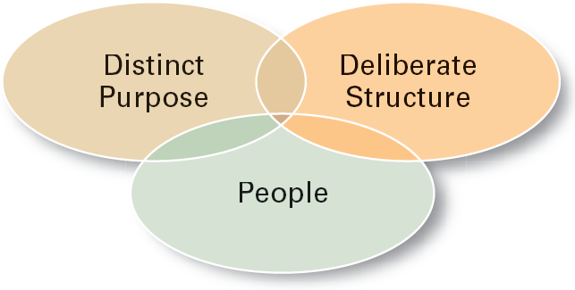
Characteristics of organizations

Slide 5
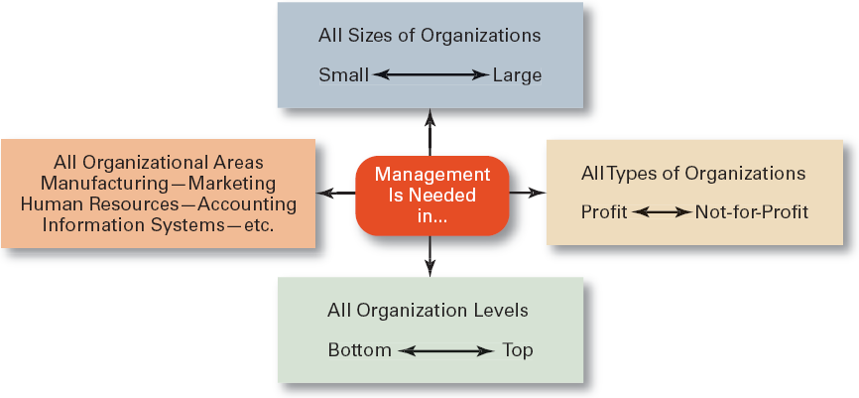
The need for management is universal…

Slide 6
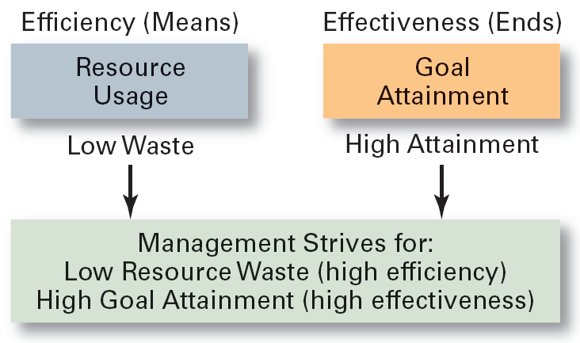
Two vital managerial concepts
EFFICIENCY VS. EFFECTIVENESS
Doing things right vs. Doing the right things

Slide 7
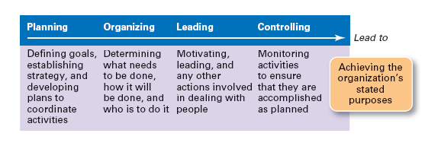
Management as a process
Management is the process undertaken by one or more persons to coordinate the activities of other persons to achieve results not attainable by any one person acting alone.

Slide 8
Managerial functions

Slide 9
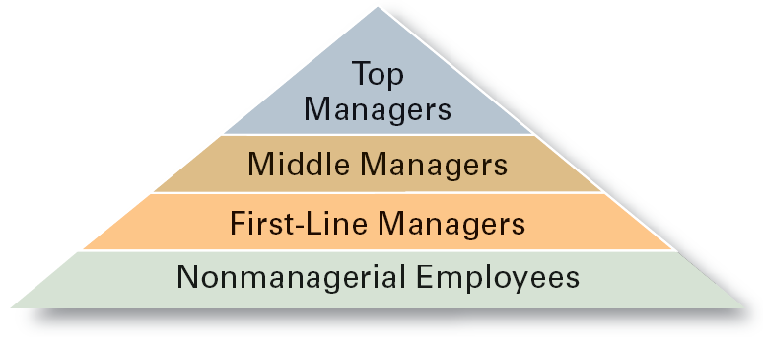
Management = the people
Manager
  Someone who coordinates and oversees the work of other people so that organizational goals can be accomplished.
Top Managers
  Individuals who are responsible for making organization-wide decisions and establishing plans and goals that affect the entire organization.
Middle Managers
  Individuals who manage the work of first-line managers.
First-line Managers
  Individuals who manage the work of non-managerial employees.

Slide 10
Managerial specialization
Given the size of organizations and the level of complexity, managers must be specialized in order to be efficient.
vertical specialization = assigning the tasks of supervising subordinates to another person;
  first-line managers
  middle managers
  top managers
  horizontal specialization = assigning certain tasks (production, marketing, finance) to another person;
    =>functional managers - the function refers to what activities the manager usually oversees as the result of horizontal specialization process.

Slide 11
What do managers do?
When fulfilling management functions, managers perform ten different, but interrelated managerial roles:
  Interpersonal roles
    Figurehead, leader, liaison
  Informational roles
    Monitor, disseminator, spokesperson
  Decisional roles
    Disturbance handler, resource allocator, negotiator

Slide 12
Managerial competencies
In order to be able to perform managerial roles, managers must posses and further develop certain critical competencies (=knowledge, skills, abilies/traits).
  Technical = knowledge and proficiency in a specific field
  Human = ability to work well with other people
  Conceptual = ability to think and conceptualize about abstract and complex situations concerning the organization

Slide 13
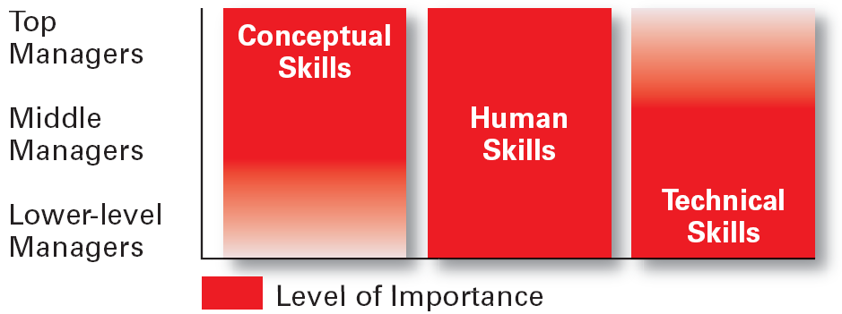
Competencies vs. management levels

Slide 14
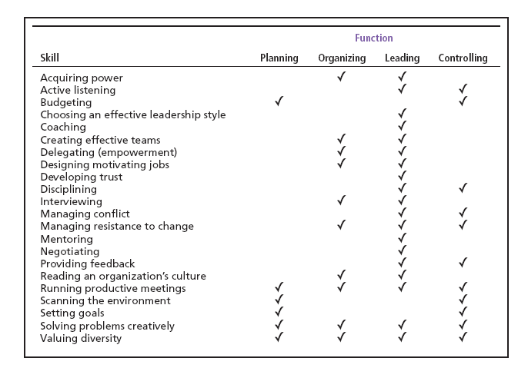
Competencies vs. management functions

Slide 15
Management as a discipline
accumulated body of knowledge that can be learned.
a subject with principles, concepts, and theories that can be learned and applied in the process of managing.

Slide 16
Historical background
  division of labor ⇒ increase in efficiency
  industrial revolution – the beginning of 20th century
      machine power
      mass production
      efficient transportation
the size of companies increased and management of large companies required certain managerial skills.
  managerial revolution – 30’s – 70’s of 20th century
      United States
          NYSE crash in 1939
          F.D.R.’s New Deal - stock market reform
          the emergence of corporations
      Europe
          after WW II
          nationalization of companies
⇒ the need for professional managers.
the division of ownership and management executive.
  current trends and issues – since 1970’s
    economic integration
    globalization
    turbulence
    customer’s market → change and innovation

Slide 17
Evolution of management thought
the way people were thinking about management was happening with respect to the changes in overall economic environment.
Classical Approaches
basic assumptions about people: perfect rationality, responsiveness to economic incentives
main focus: management of work / activities (simplification, norms, planning), administration (Fayol’s principles), bureaucracy (Max Weber)
Behavioral Approaches
basic assumptions about people: responsiveness to other then economic incentives (social relationships, group pressure), search for personal fulfillment
main focus: people’s actions and their groundings (motivation, psychology, sociology, anthropology), relationships among people (Hawthorne studies)
Management Science
main focus: productions and operations management, new more sophisticated methods (mainly mathematical)

Slide 18
CLASSICAL APPROACHES | BEHAVIOURAL APPROACHES (HUMAN RESOURCES APPROACH) | MANAGEMENT SCIENCE
Scientific Management | Human Relations Approach | Operations / Productions Management
the use of scientific methods to define “one best way” for a job to be done concentration on the physical environment of the job concept of “economic man” | concentration on the social environment managers should recognize the need of employees for recognition and social acceptance satisfied worker will be more productive | quantitative analytical modeling / experimenting techniques to improve decision making
Frederick Taylor Frank + Lilian Gilbreth Henry Gantt (Gantt chart) | Abraham Maslow (hierarchy of needs) Douglas Mc Gregor (theories X and Y)
Classical Organization Theory | Behavioral Science
principles of management functions of management theory of bureaucracy | concept of “social man” scientific approach to study human behavior (psychology, sociology) concept of work as a means to fulfill human needs (which are more complex than jus economic)
Henri Fayol Max Weber | Victor Vroom (motivation theory) Frederick Herzberg (motivation theories)
 | SYSTEMS APPROACH
 | a theory that sees an organization as a set of interrelated and interdependent parts open vs. closed systems
 | Chester Barnard
 | CONTINGENCY APPROACH
 | recognizing and responding to situational variables as they arise: organization size, routine ness of technology, environmental uncertainty, individual differences

Slide 19
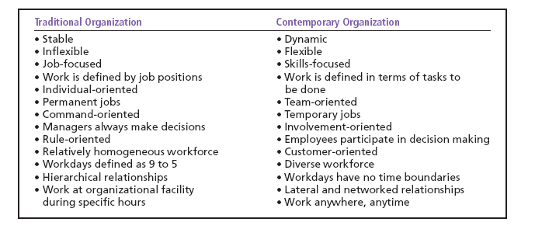
The changing organization

Slide 20
Current trends
Changes in the real world
Impact on managers
Changing technology (digitization)
Increased security threats
Encreased Emphais on Organizational (and Managerial) Ethics
Increased Competitiveness
Virtual workplaces
More flexible workforce
Flexible work arrangements
Empowered employees
Risk management
(De)globalizaton concerns
Redefined values
Rebuilding trust
Increased Accountability
Customer service
Innovation
Globalization
Competition => Efficiency / productivity

Slide 21
Must know - keywords
manager
first-line managers
middle managers
top managers
management
efficiency
effectiveness
planning
organizing
leading
controlling
management roles
interpersonal roles
informational roles
decisional roles
technical skills
human skills
conceptual skills
organization
managerial revolution
scientific management
principles of management
contingency approach

