Slide 1
Controlling
Lecture 10

Slide 2
Agenda for today
What Is Control and Why Is It Important?
The Control Process
Controlling Organizational Performance
Controlling Tools and Techniques
Selected Contemporary Issues of Control

Slide 3
Where are we?

Slide 4
What Is Control?
The three control systems
The Purpose of Control
  To ensure that activities are completed in ways that lead to accomplishment of organizational goals.
Controlling
  The process of monitoring activities to ensure that they are being accomplished as planned and of correcting any significant deviations.
Market Control
  Emphasizes the use of external market mechanisms to establish the standards used in the control system.
    External measures: price competition and relative market share
Bureaucratic Control
  Emphasizes organizational authority and relies on rules, regulations, procedures, and policies.
Clan Control
  Regulates behavior by shared values, norms, traditions, rituals, and beliefs of the firm’s culture.

Slide 5
Characteristics of Three Approaches to Control Systems
Type of Control | Characteristics
Market | Uses external market mechanisms, such as price competition and relative market share, to establish standards used in system. Typically used by organizations whose products or services are clearly specified and distinct and that face considerable marketplace competition.
Bureaucratic | Emphasizes organizational authority. Relies on administrative and hierarchical mechanisms, such as rules, regulations, procedures, policies, standardization of activities, well-defined job descriptions, and budgets to ensure that employees exhibit appropriate behaviors and meet performance standards.
Clan | Regulates employee behavior by the shared values, norms, traditions, rituals, beliefs, and other aspects of the organization’s culture. Often used by organizations in which teams are common and technology is changing rapidly.

Slide 6
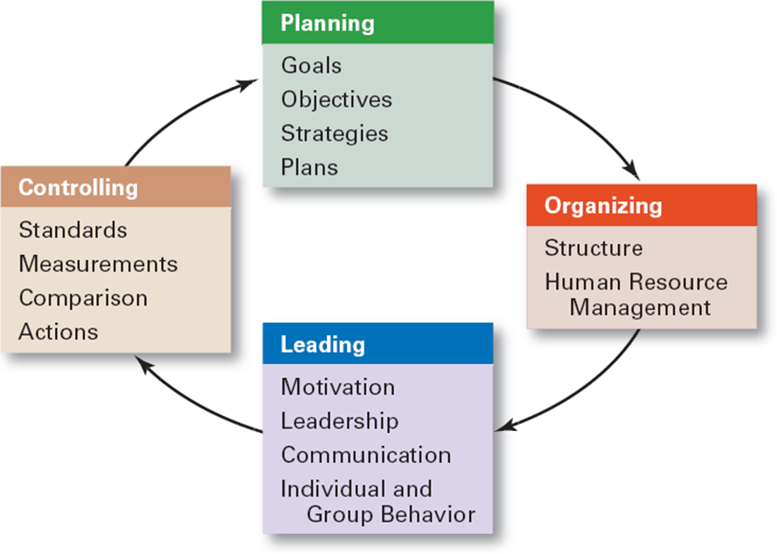
Why Is Control Important?
The Planning–Controlling Link
As the final link in management functions:
  Planning
    Controls let managers know whether their goals and plans are on target and what future actions to take.
  Empowering employees
    Control systems provide managers with information and feedback on employee performance.
  Protecting the workplace
    Controls enhance physical security and help minimize workplace disruptions.

Slide 7
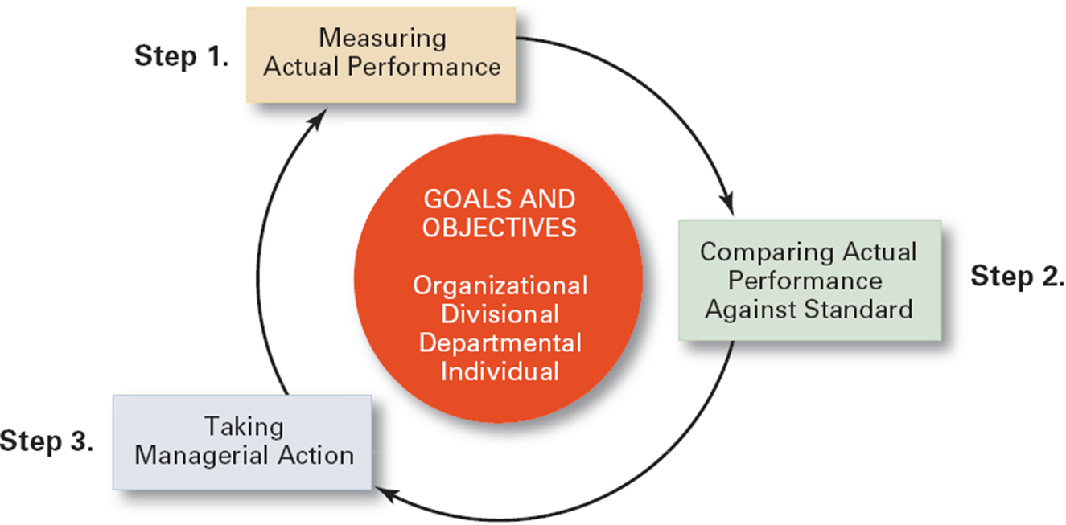
The Control Process
  Measuring actual performance.
  Comparing actual performance against a standard.
  Taking action to correct deviations or inadequate standards.

Slide 8
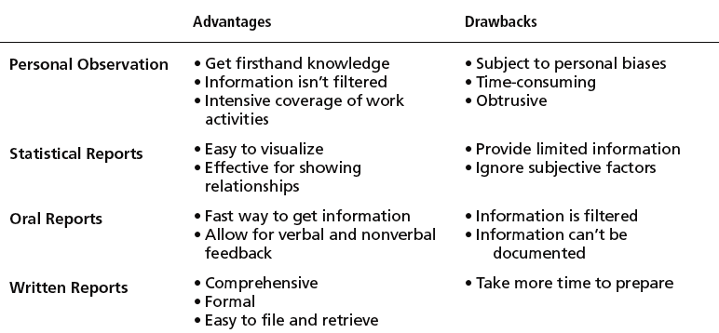
Measuring
Sources of Information (How)
  Personal observation
  Statistical reports
  Oral reports
  Written reports
Control Criteria (What)
  Employees Budgets
    Satisfaction Costs
    Turnover Output
    Absenteeism Sales

Slide 9
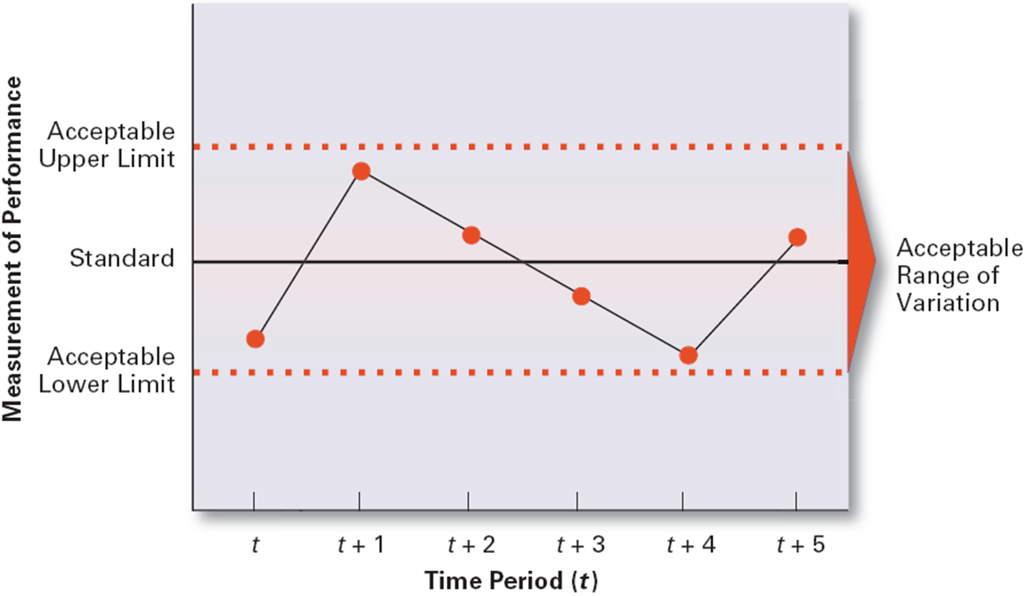
Comparing
= determining the degree of variation between actual performance and the standard (e.g. planned value).
  Significance of variation is determined by:
    The acceptable range of variation from the standard (forecast or budget).
    The size (large or small) and direction (over or under) of the variation from the standard (forecast or budget).

Slide 10
Taking Managerial Action
  “Doing nothing”
  Only if deviation is judged to be insignificant.
  Correcting actual (current) performance
  Immediate corrective action to correct the problem at once.
  Basic corrective action to locate and to correct the source of the deviation.
  Corrective Actions
      change strategy, structure, compensation scheme, or training programs
      redesign jobs
      fire / hire employees
  Revising the standard
  Examining the standard to ascertain whether or not the standard is realistic, fair, and achievable.
      => Upholding the validity of the standard.
      => Resetting goals that were initially set too low or too high.

Slide 11
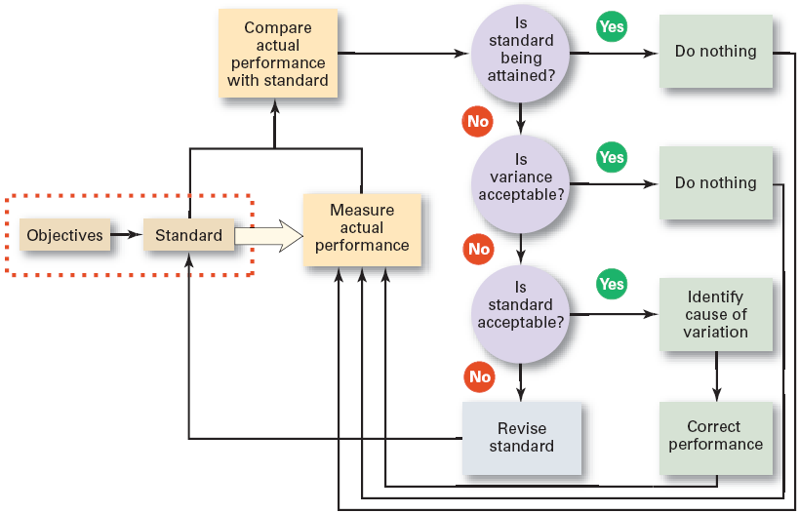
Managerial Decisions in the Control Process

Slide 12
Controlling for Organizational Performance
(Organizational) performance defined
Performance measures
What Is Performance?
  The end result of an activity
ORGANIZATIONAL Performance
  The accumulated end results of all of the organization’s work processes and activities
Organizational Effectiveness
  Measuring how appropriate organizational goals are and how well the organization is achieving its goals.
    Systems resource model
      The ability of the organization to exploit its environment in acquiring scarce and valued resources.
    The process model
      The efficiency of an organization’s transformation process in converting inputs to outputs.
    The multiple constituencies model
      The effectiveness of the organization in meeting each constituencies’ needs.
Organizational Productivity
  Productivity: the overall output of goods and/or services divided by the inputs needed to generate that output.
    Output: sales revenues Inputs: costs of resources
  Ultimately, productivity is a measure of how efficiently employees do their work.

Slide 13
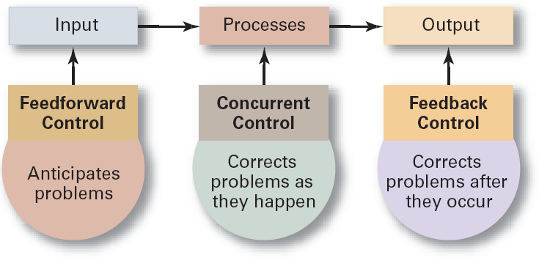
Types of control
Feedforward Control
  = a control that prevents anticipated
  problems before actual occurrences
  of the problem.
    Building in quality through design.
    Requiring suppliers conform to ISO 9002.
Concurrent Control
  = a control that takes place while the monitored activity is in progress.
    Direct supervision: management by walking around.
Feedback Control
  = a control that takes place after an activity is done.
    Corrective action is after-the-fact, when the problem has already occurred.
  Advantages of feedback controls:
    Provide managers with information on the effectiveness of their planning efforts.
    Enhance employee motivation by providing them with information on how well they are doing.

Slide 14
Selected Tools and Techniques
Management Information Systems (MIS)
Benchmarking (of Best Practices)
  A system used to provide management with needed information on a regular basis.
    Data: an unorganized collection of raw, unanalyzed facts (e.g., unsorted list of customer names).
    Information: data that has been analyzed and organized such that it has value and relevance to managers.
Benchmark
  The standard of excellence against which to measure and compare.
Benchmarking
  Is the search for the best practices among competitors or noncompetitors that lead to their superior performance.
  Is a control tool for identifying and measuring specific performance gaps and areas for improvement.

Slide 15
Implementing an Internal Benchmarking Best Practices Program
Connect best practices to strategies and goals.
Identify best practices throughout the organization.
Develop best practices reward and recognition systems.
Communicate best practices throughout the organization.
Create a best practices knowledge-sharing system.
Nurture best practices on an ongoing basis.

Slide 16
Contemporary Issues in Control (1/2)
Cross-Cultural Issues
Workplace Concerns
  The use of technology to increase direct corporate control of local operations
  Legal constraints on corrective actions in foreign countries
  Difficulty with the comparability of data collected from operations in different countries
  Workplace privacy versus workplace monitoring:
    E-mail, telephone, computer, and Internet usage
    Productivity, harassment, security, confidentiality, intellectual property protection
  Employee theft
    The unauthorized taking of company property by employees for their personal use.
  Workplace violence
    Anger, rage, and violence in the workplace is affecting employee productivity.

Slide 17
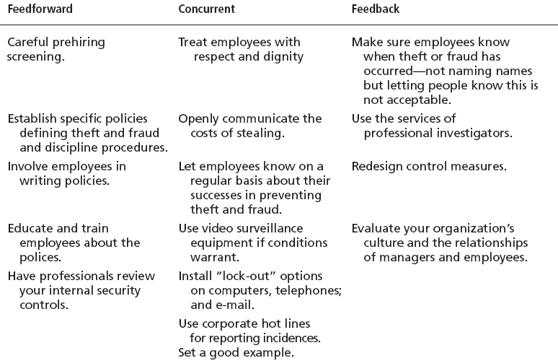
Control Measures for Employee Theft / Fraud
Sources: Based on A.H. Bell and D.M. Smith. “Protecting the Company Against Theft and Fraud,” Workforce Online (www.workforce.com) December 3, 2000; J.D. Hansen. “To Catch a Thief,” Journal of Accountancy, March 2000, pp. 43–46; and J. Greenberg, “The Cognitive Geometry of Employee Theft,” in Dysfunctional Behavior in Organizations: Nonviolent and Deviant Behavior, eds. S.B. Bacharach, A. O’Leary-Kelly, J.M. Collins, and R.W. Griffin (Stamford, CT: JAI Press, 1998), pp. 147–93.

Slide 18
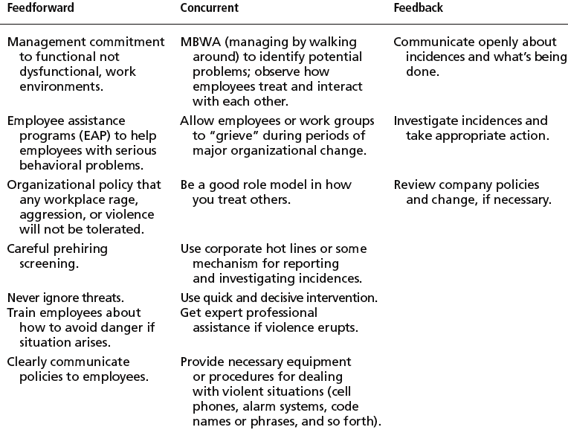
Control Measures for Deterring or Reducing Workplace Violence
Sources: Based on M. Gorkin, “Five Strategies and Structures for Reducing Workplace Violence,” Workforce Online (www.workforce.com). December 3, 2000; “Investigating Workplace Violence: Where Do You Start?” Workforce Online (www.forceforce.com), December 3, 2000; “Ten Tips on Recognizing and Minimizing Violence,” Workforce Online (www.workforce.com), December 3, 2000; and “Points to Cover in a Workplace Violence Policy,” Workforce Online (www.workforce.com), December 3, 2000.

Slide 19
Contemporary Issues in Control (2/2)
Customer Interactions
Corporate Governance
  Service profit chain
    Is the service sequence from employees to customers to profit.
  Service capability affects service value which impacts on customer satisfaction that, in turn, leads to customer loyalty in the form of repeat business (profit).
  The system used to govern a corporation so that the interests of the corporate owners are protected.
    Changes in the role of boards of directors
    Increased scrutiny of financial reporting (Sarbanes-Oxley Act of 2002)
      More disclosure and transparency of corporate financial information
      Certification of financial results by senior management

Slide 20
Terms to Know
controlling
market control
bureaucratic control
clan control
control process
range of variation
immediate corrective action
basic corrective action
performance
organizational performance
productivity
organizational effectiveness
feedforward control
concurrent control
management by walking around
feedback control
management information system (MIS)
data
information
balanced scorecard
benchmarking
corporate governance

