Slide 1
Organizational Culture
External Environment
Lecture 2

Slide 2
Agenda for today
Managerial discretion – constraints on management
Organizational culture
  Definition
  Sources
  Impact
  Current issues
External environment
  Components
  Environmental uncertainty
  Methods of analysis
  Stakeholder approach

Slide 3
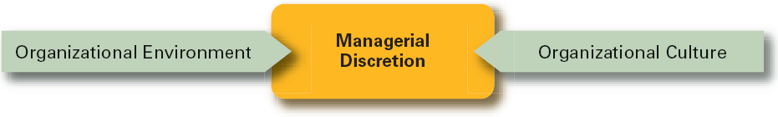
Managerial discretion
Managers are not „omnipotent“
The ability of managers to affect outcomes is influenced and constrained by external factors => much of an organization’s success or failure is due to external forces outside of managers’ control.

Slide 4
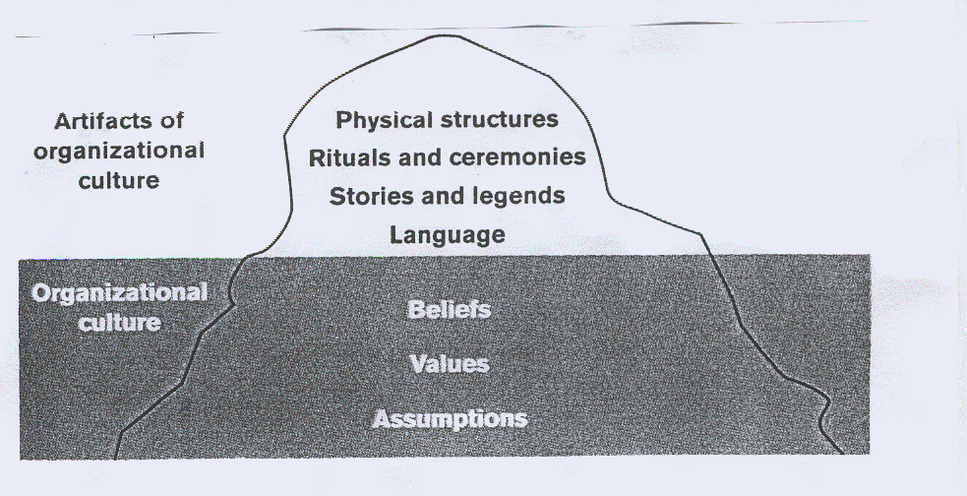
Organizational culture defined
A system of shared meanings and common beliefs held by organizational members that determines, in a large degree, how they act towards each other.
„The way we do things around here.”

Slide 5
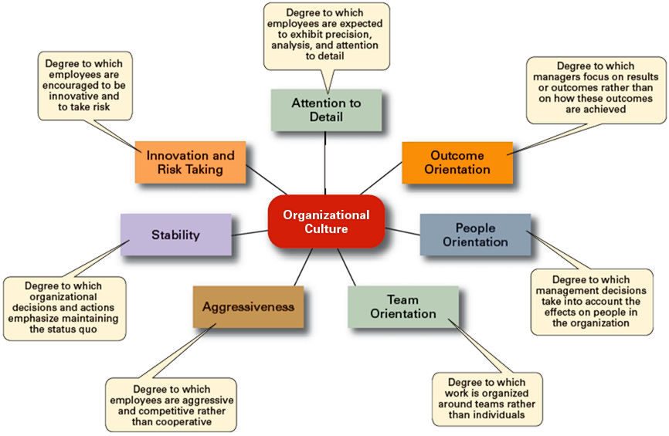
Dimensions of organizational culture

Slide 6
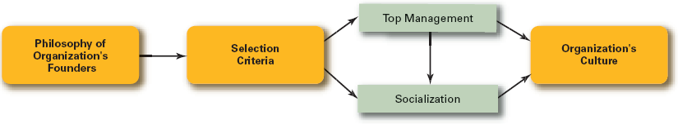
Sources of organizational culture
Sources of Organizational Culture
  Vision and mission (of the organization‘s founder)
  Past best practices (of the organization)
  The behavior of the top-management
Organizational culture‘s continuation and development
  Recruitment of like-minded employees (who „fit“)
  Socialization of new employees => adapting people to the culture
    Stories
    Rituals
    Material symbols
    Language

Slide 7
Impact of OC on management
  Whatever managerial actions the organization recognizes as proper or improper on its behalf
  Whatever organizational activities the organization values and encourages
  The overall strength or weakness of the organizational culture

Slide 8
Strong vs. Weak organizational cultures
Strong Cultures
  Key values are deeply held and widely held.
  => strong influence on organizational members.
Factors Influencing the Strength of OC
  Size of the organization
  Age of the organization
  Rate of employee turnover
  Strength of the original culture
  Clarity of cultural values and beliefs
Benefits of a Strong Culture
Creates a stronger employee commitment to the organization.
Aids in the recruitment and socialization of new employees.
Fosters higher organizational
performance by instilling and
promoting employee initiative.
BUT: beware of the CULTURE VS. STRATEGY issues

Slide 9
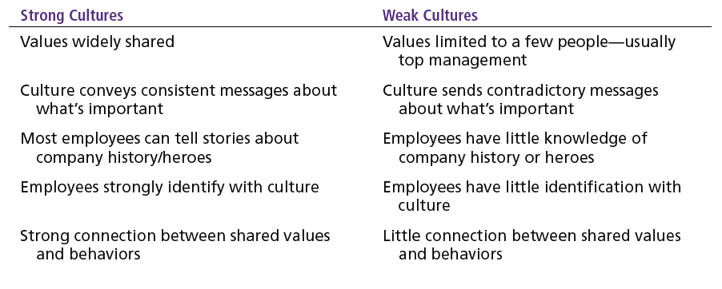
Strong vs. Weak organizational cultures

Slide 10
Current issues related to OC
Creating a Customer-Responsive Culture
Creating an Innovative Culture
Creating an Ethical Culture
  Hiring the right type of employees (ones with a strong interest in serving customers)
  Having few rigid rules, procedures, and regulations
  Using widespread empowerment of employees
  Challenge and involvement
  Conflict resolution
  Debates
  Risk-taking
  Focus on means as well as outcomes

Slide 11
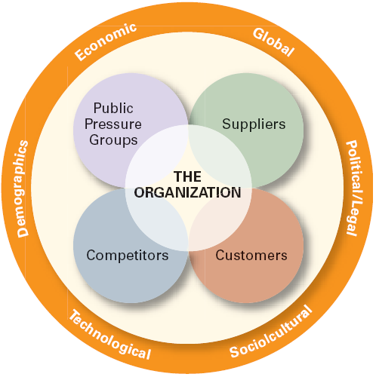
External environment
Those factors and forces outside the organization that affect the organization’s performance.
Components of the External Environment
  General environment: broad economic, socio-cultural,
  political/legal, demographic, technological, and global
  conditions that may affect the organization.
  Specific environment: external forces that have
  a direct and immediate impact on the organization.

Slide 12
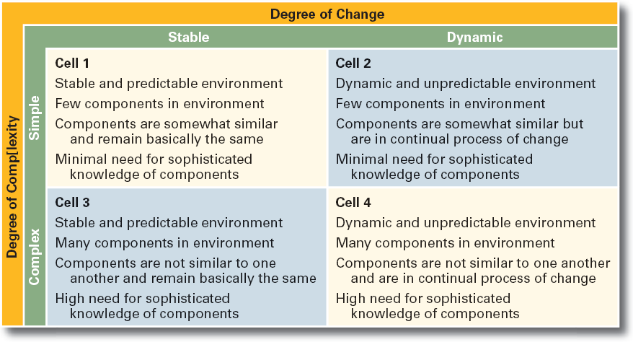
Environmental uncertainty
How the environment affects managers?
Environmental uncertainty matrix
  The extent to which managers have knowledge of and are able to predict change their organization’s external environment is affected by:
    Complexity of the environment: the number of components in an organization’s external environment.
    Degree of change in environmental components: how dynamic or stable the external environment is.

Slide 13
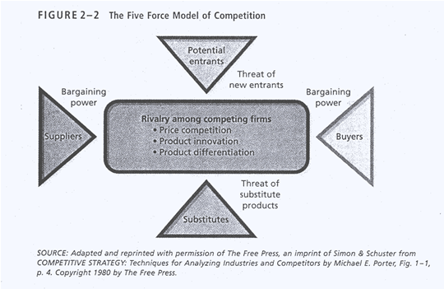
Methods of environmental analysis
General environment
Specific environment
SLEPT analysis
  Social segment
  Legal segment
  Economic segment
  Political segment
  Technological segment
analysis techniques
  scanning
  monitoring
  forecasting
  assessing

Slide 14
Stakeholder approach
Any constituencies in the organization’s environment that are affected by the organization’s decisions and actions.
Managing stakeholder relationships
=> the interdependence of the organization and its external stakeholders
=> improved organizational performance;
Identify the organization’s external stakeholders.
Determine the particular interests and concerns of the external stakeholders.
Decide how critical each external stakeholder is to the organization.
Determine how to manage each individual external stakeholder relationship.

Slide 15
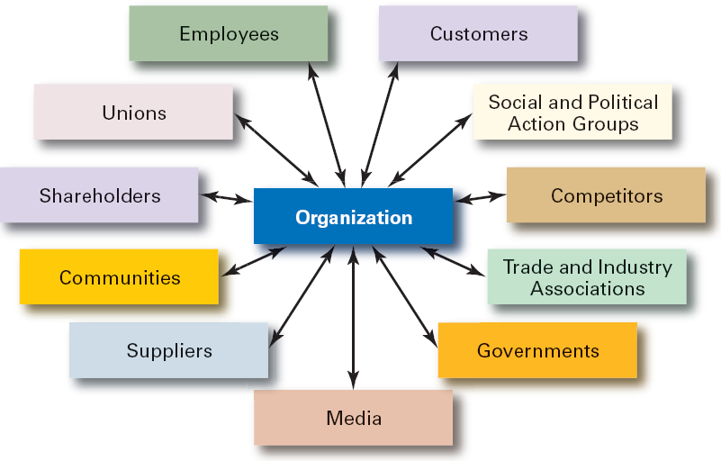
Organizational stakeholders

Slide 16
Must know - keywords
organizational culture
strong cultures
socialization
artifacts of organizational culture
values
beliefs
external environment
specific environment
general environment
environmental uncertainty
environmental complexity
SLEPT analysis
5 force model of competition
stakeholders

