Slide 1
Decision making
Lecture 3

Slide 2
Agenda
The decision making process
  Define decision and decision-making process.
The manager as decision maker
  (full) rationality vs. bounded rationality
  decision making styles
Structuring the decision making problem
Methods of decision making
  One-time decisions
  Sequential decisions

Slide 3
Where are we?

Slide 4
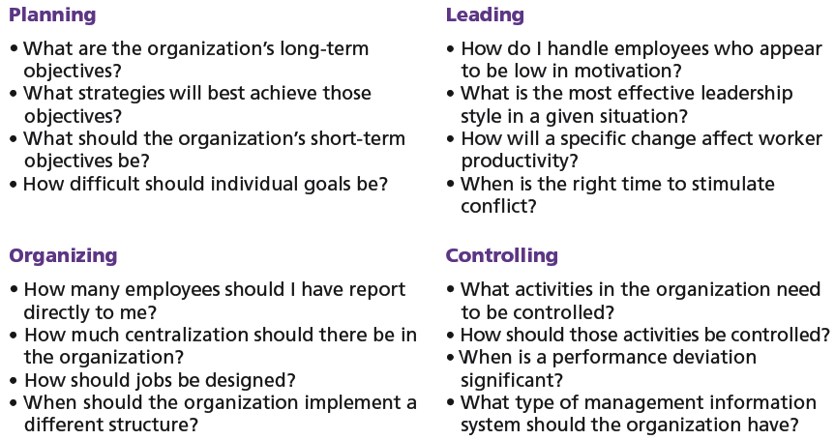
Decisions in the management functions

Slide 5
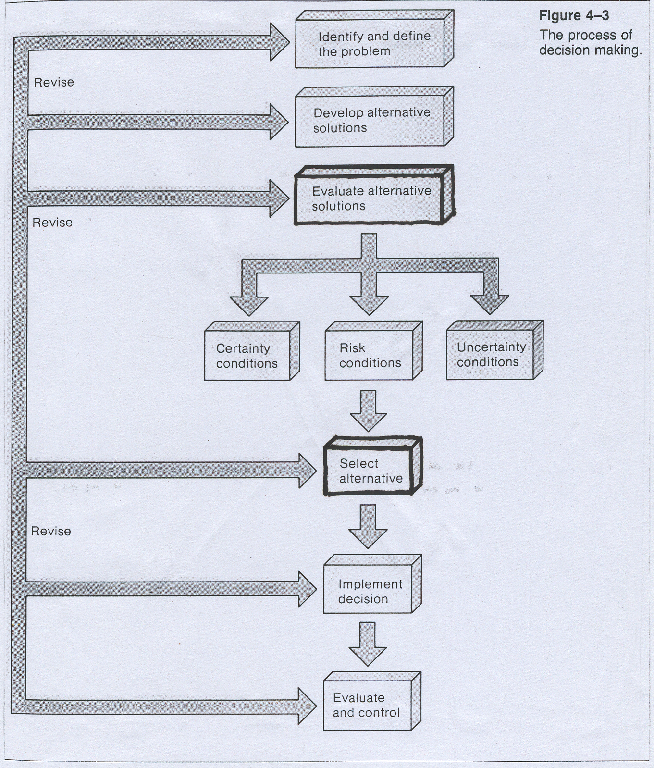
Decision + decision making process
Decision defined
Decision making process
making a choice from two or more alternatives (= alternative solutions to a problem).
„problem“ = discrepancy between an existing and desired state of affairs.

Slide 6
The rational decision making
(Full) Rationality
Bounded rationality
  Managers make consistent, value-maximizing choices with specified constraints.
  Assumptions are that decision makers:
    Are perfectly rational, fully objective, and logical.
    Have carefully defined the problem and identified all viable alternatives.
    Have a clear and specific goal
    Will select the alternative that maximizes outcomes in the organization’s interests rather than in their personal interests.
  Managers make decisions rationally, but are limited (bounded) by their ability to process information.
  Assumptions are that decision makers:
    Will not seek out or have knowledge of all alternatives
    Will satisfice — choose the first alternative encountered that satisfactorily solves the problem — rather than maximize the outcome of their decision by considering all alternatives and choosing the best.
  Influence on decision making
    Escalation of commitment: an increased commitment to a previous decision despite evidence that it may have been wrong.

Slide 7
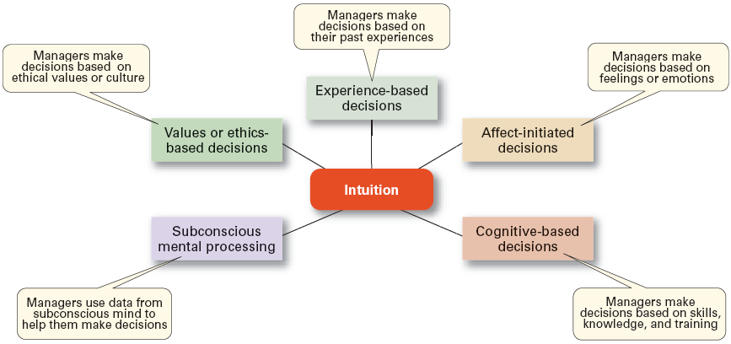
Intuitive decision making
making decisions based on experience, feelings, and accumulated judgment.

Slide 8
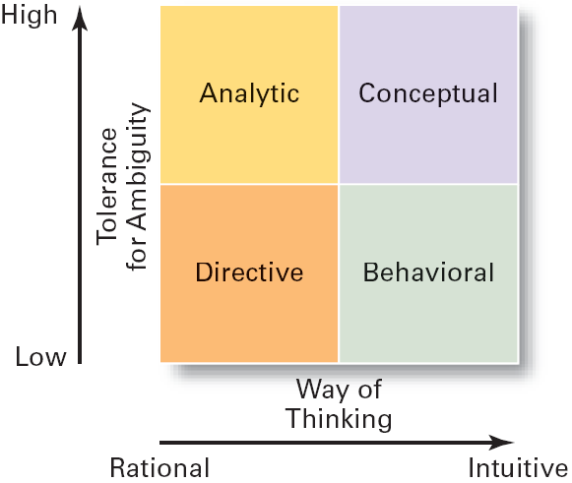
Decision making styles
Dimensions
  Ways of thinking
    Rational, orderly, and consistent
    Intuitive, creative, and unique
  Tolerance for ambiguity
    Low tolerance: require consistency and order
    High tolerance: multiple thoughts simultaneously
Types of Decision Makers
  Directive
    Use minimal information and consider few alternatives.
  Analytic
    Make careful decisions in unique situations.
  Conceptual
    Maintain a broad outlook and consider many alternatives in making decisions.
  Behavioral
    Avoid conflict by working well with others and being receptive to suggestions.

Slide 9
Structured vs. unstructured problems
Structured
Unstructured
Structured Problems
  Involve goals that clear.
  Are familiar (have occurred before).
  Are easily and completely defined—information about the problem is available and complete.
Programmed Decision
  A repetitive decision that can be handled by a routine approach.
  Policy
    A general guideline for making a decision about a structured problem.
  Procedure
    A series of interrelated steps that a manager can use to respond (applying a policy) to a structured problem.
  Rule
    An explicit statement that limits what a manager or employee can or cannot do.
Unstructured Problems
  Problems that are new or unusual and for which information is ambiguous or incomplete.
  Problems that will require custom-made solutions.
Nonprogrammed Decisions
  Decisions that are unique and nonrecurring.
  Decisions that generate unique responses.

Slide 10
Structuring a problem
Characteristics of a DM problem
Decision making matrix
List of alternatives = possible decisions
  available
  mutually exclusive
  collectively exhaustive
States of nature = future conditions of events
  possible to happen
  mutually exclusive
  collectively exhaustive
Degree of certainty = the level of knowledge of decision maker about the states of nature.
Decision criterion = a factor relevant in a decision.
Payoffs = the value of decision criterion associated with each decision and state of nature.
Criterion | States of nature
 | Assesment of degree of certainty
Alternatives | Payoffs | Alternative’s score (according to the method used)

Slide 11
Decision making conditions
Certainty
  A situation in which a manager can make an accurate decision because the outcome of every alternative choice is known.
Risk
  A situation in which the manager is able to estimate the likelihood (probability) of outcomes that result from the choice of particular alternatives.
Uncertainty
  Limited information prevents estimation of outcome probabilities for alternatives associated with the problem and may force managers to rely on intuition, hunches, and “gut feelings”.

Slide 12
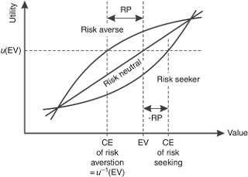
Attitude towards risk

Slide 13
Methods of decision making
Uncertainty
Maximin = conservative strategy
selecting the best alternative of the worst payoffs;
pessimistic view because the decision maker must assume that the worst will occur;
it may be viewed as the protection against the worst, even though you neither expect them nor want them to occur.
Maximax = optimistic strategy
selecting the best alternative of the highest payoffs;
you choose the alternative with the best possible payoff.
Principle of Insufficient Reason
under uncertainty, there is now reason to treat the states of nature differently ⇒ no reason to focus on high or low payoffs;
alternative states of nature are all equally likely;
selecting the highest row average;
Payoffs | S₁ | S₂ | S₃ | S₄ | Maximin | Maximax
 | --- | --- | --- | ---
A₁ | 50 | 40 | 30 | 35 | 30 | 50
A₂ | 25 | -30 | 65 | 40 | -30 | 65
A₃ | 45 | 15 | -10 | 55 | -10 | 55
Payoffs | S₁ | S₂ | S₃ | S₄ | Insufficient reason (row averages)
 | 0,25 | 0,25 | 0,25 | 0,25
A₁ | 50 | 40 | 30 | 35 | 38,75
A₂ | 25 | -30 | 65 | 40 | 25,00
A₃ | 45 | 15 | -10 | 55 | 26,25

Slide 14
Methods of decision making
Risk
Expected (monetary) value
takes into account the weighted average payoff for each alternative
k
EMV_{i} =  P_{j} * V_{ij}
i = 0
selecting maximum average payoff;
Expected value of perfect information
represents an upper bound on the amount of money a decision maker would be justified in spending to obtain perfect information.
EPVI = EPC – EMV
That leads to decision under certainty…

Slide 15
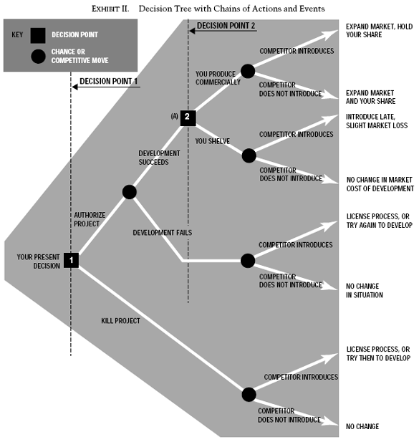
Sequential decisions
Oriented chart
Decision trees can be used instead of decision matrix in order to structure the decision problems.
Decision trees are used as a method of portraying these sequential decisions.
decision fork → alternatives
chance fork → states of nature

Slide 16
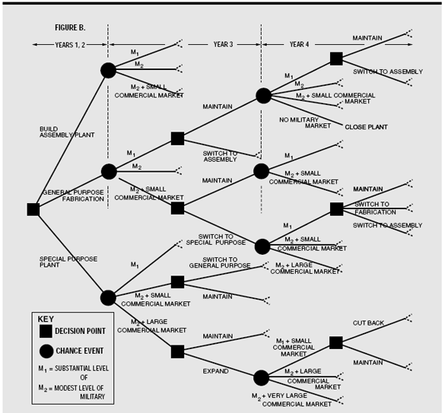
Complex sequential decision (example)

Slide 17
Must know - keywords
decision
decision-making process
problem
decision criteria
state of nature
payoff
risk
uncertainty
decision style
(bounded) rationality
satisficing
attitude towards risk
mini-max
maxi-max
expected value
decision tree
decision matrix

