Slide 1
Planning
Lecture 4

Slide 2
Agenda for today
What is planning?
Goals (objectives) and plans
Planning process
Planning tools and techniques

Slide 3
Where are we?

Slide 4
What is planning?
  A primary managerial activity that involves:
    Defining the organization’s goals
    Establishing an overall strategy for achieving those goals
    Developing plans for organizational work activities.
  Types of planning
    Informal: not written down, short-term focus; specific to an organizational unit.
    Formal: written, specific, and long-term focus, involves shared goals for the organization.

Slide 5
Why do managers plan?
Purposes of planning
Planning vs. Performance
  Provides direction
  Reduces uncertainty
  Minimizes waste and redundancy
  Sets the standards for controlling
  Formal planning is associated with:
    => Higher profits and returns on assets.
    => Positive financial results.
  The quality of planning and implementation affects performance more than the extent of planning.
  The external environment can reduce the impact of planning on performance,
  Formal planning must be used for several years before planning begins to affect performance.

Slide 6
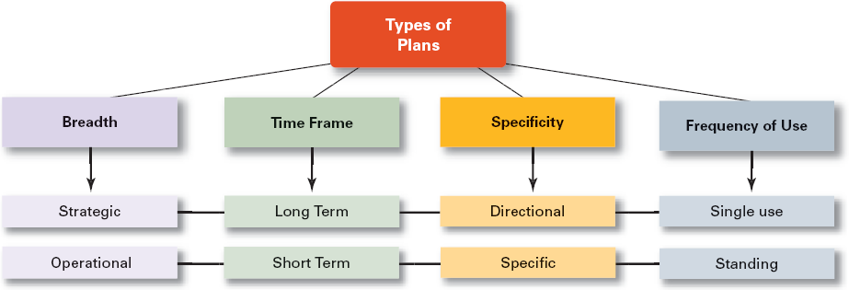
Elements of planning
GOALS (Objectives)
PLANS
Desired outcomes for individuals, groups, or entire organizations
Provide direction and evaluation performance criteria
they specify future conditions that are deemed satisfactory (by the organization itself and also by the environment).
objectives should be measurable (S.M.A.R.T.);
management initiates planning to determine the priority and timing of objectives;
    Documents that outline how goals are to be accomplished
    Describe how resources are to be allocated and establish activity schedules

Slide 7
The planning process

Slide 8
Setting objectives
You can make better plans if you can predict the future.
  realistic objectives can be set;
  feasible course of action can be planned;
  resource costs can be minimized;
⇒ no major corrections will be needed in the future.
Qualitative approach to forecasting
  Delphi method
  estimates of salespeople
  consumer panels
  historical analogy
Quantitative approach to forecasting
  time series analysis = extrapolative methods
    naïve model
    averages
    exponential smoothing
  causal methods = to suggest causes of behavior of independent variables
    regression
    econometric models
You must balance the cost of obtaining better forecasts against the benefit of the improved decision.

Slide 9
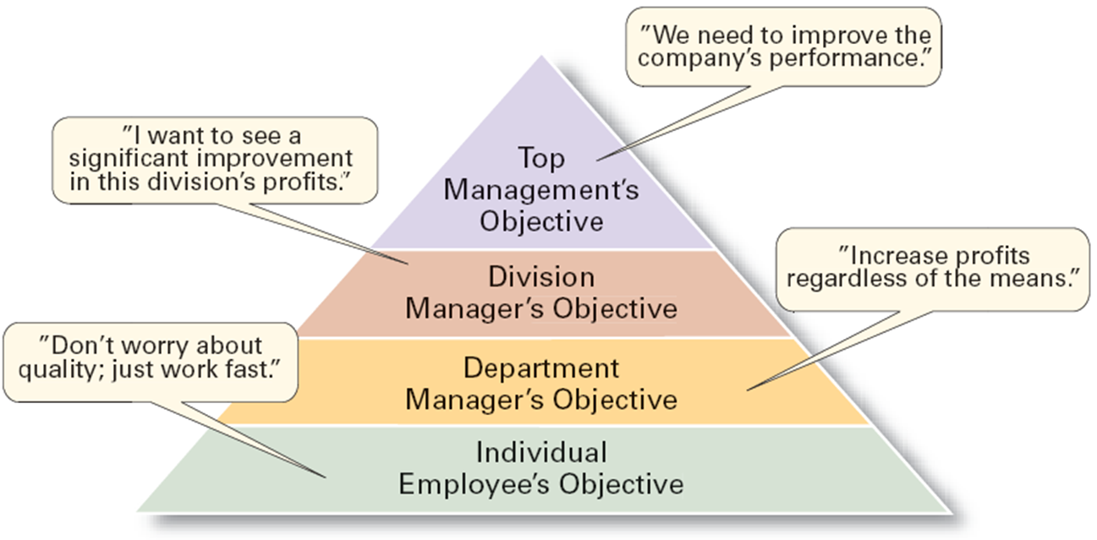
Traditional goal setting vs. MBO
Traditional goal setting
Management By Objectives
  Broad goals are set at the top of the organization.
  Goals are then broken into subgoals for each organizational level.
  Assumes that top management knows best because they can see the “big picture.”
  Goals are intended to direct, guide, and constrain from above.
  Goals lose clarity and focus as
  lower-level managers
  attempt to interpret
  and define the
  goals for their
  areas of
  responsibility.
  Specific performance goals are jointly determined by employees and managers.
  Rewards are allocated on the basis of periodically reviewed progress towards the goals.
    Goal specificity, participative decision making, an explicit performance/evaluation period, feedback
  Top management commitment and involvement
  Potential Problems with MBO Programs
    Not as effective in dynamic environments that require constant resetting of goals.
    Overemphasis on individual accomplishment may create problems with teamwork.

Slide 10
Goals are interrelated…
Means – ends chain
The integrated network of goals that results from establishing a clearly-defined hierarchy of organizational goals.
Achievement of lower-level goals is the means by which to reach higher-level goals (ends).
Supportive goals
Conflicting goals (=> trade-off)
Independent goals

Slide 11
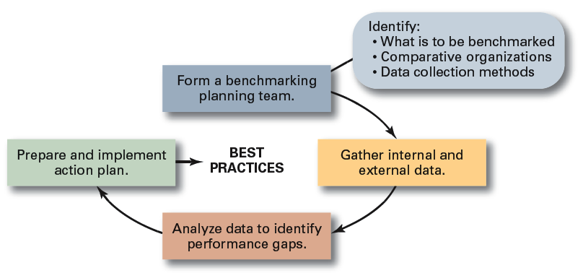
Planning tools and techniques (1/2)
Assessing the environment
Environmental Scanning
  The screening of large amounts of information to anticipate and interpret change in the environment.
  Competitor Intelligence = The process of gathering information about competitors — who they are; what they are doing = but rather careful attention to readily accessible information from employees, customers, suppliers, the Internet, and competitors themselves (=>NOT spying)
  May involve reverse engineering of competing products to discover technical innovations.
Forecasting (see slide no. 8)
Benchmarking
The search for the best practices among competitors and noncompetitors that lead to their superior performance.
By analyzing and copying these practices, firms can improve their performance.

Slide 12
Planning tools and techniques (2/2)
Allocating Resources
Resources are assets of the organization
  Financial: debt, equity, and retained earnings
  Physical: buildings, equipment, and raw materials
  Human: experiences, skills, knowledge, and competencies
  Intangible: brand names, patents, reputation, trademarks, copyrights, and databases
are constraints on the courses of action
Budgeting
Capacity planning
Production planning
Materials (inventory) planning
Schedulling
Human Resources Planning

Slide 13
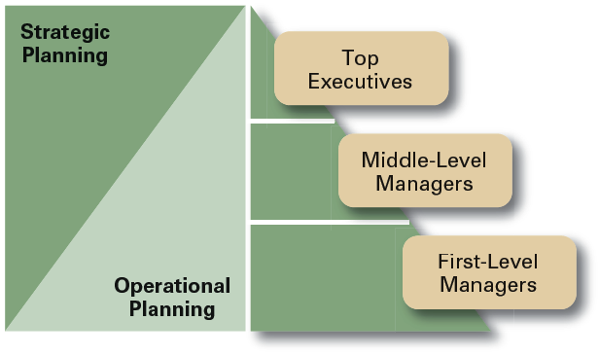
Planning within an organizational setting
Organizational approaches to planning
Establishing a formal planning department
  A group of planning specialists who help managers write organizational plans.
  Planning is a function of management; it should never become the sole responsibility of planners.
Involving organizational members in the process
  Plans are developed by members of organizational units at various levels and then coordinated with other units across the organization.

Slide 14
Contemporary Issues in Planning
Effective Planning in Dynamic Environments
Criticisms of Planning
  Develop plans that are specific but flexible.
  Understand that planning is an ongoing process.
  Change plans when conditions warrant.
  Persistence in planning eventually pay off.
  Flatten the organizational hierarchy to foster the development of planning skills at all organizational levels.
  Planning may create rigidity.
  Plans cannot be developed for dynamic environments.
  Formal plans cannot replace intuition and creativity.
  Planning focuses managers’ attention on today’s competition not tomorrow’s survival.
  Formal planning reinforces today’s success, which may lead to tomorrow’s failure.

Slide 15
Must know - keywords
planning
goals
plans
strategic plans
operational plans
long-term plans
short-term plans
specific plans
traditional goal setting
means-ends chain
management by objectives (MBO)
commitment concept
benchmarking
reverse engineering
competitor intelligence
environmental scanning
forecasting

