Slide 1
Organizing
Lecture 5

Slide 2
Agenda for today
Organizational structures
Organizational design
Contingency factors
Types of org. structures

Slide 3
Where are we?

Slide 4
Organizing and organizational structures
Purposes of organizing
Assigns tasks and responsibilities associated with individual jobs.
Divides work to be done into specific jobs and departments.
Coordinates diverse organizational tasks.
Clusters jobs into units.
Establishes relationships among individuals, groups, and departments.
Establishes formal lines of authority.
Allocates and deploys organizational resources.
Organizational Structure
  = the formal arrangement of jobs within an organization.

Slide 5
Organizational design
  A process involving decisions about six key elements:
    Work specialization
    Departmentalization
    Chain of command
    Span of control
    Centralization and decentralization
    Formalization

Slide 6
Work specialization
  = The degree to which tasks in the organization are divided into separate jobs with each step completed by a different person.
  => creating jobs
  Overspecialization can result in human diseconomies from boredom, fatigue, stress, poor quality, increased absenteeism, and higher turnover.

Slide 7
Departmentalization
Departmentalization defined
Types of deartmentalization
= grouping jobs into departments
=> creating departments
Functional
  by functions performed
Product
  by product line
Geographical
  on the basis of territory or geography
Process
  on the basis of product or customer flow
Customer
  by type of customer and needs

Slide 8
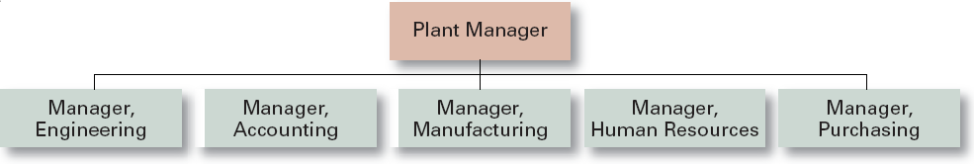
Functional Departmentalization
Advantages
  Efficiencies from putting together similar specialties and people with common skills, knowledge, and orientations
  Coordination within functional area
  In-depth specialization
Disadvantages
  Poor communication across functional areas
  Limited view of organizational goals

Slide 9
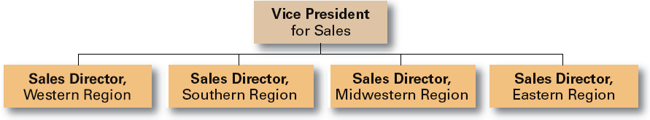
Geographical Departmentalization
Advantages
  More effective and efficient handling of specific regional issues that arise
  Serve needs of unique geographic markets better
Disadvantages
  Duplication of functions
  Can feel isolated from other organizational areas

Slide 10
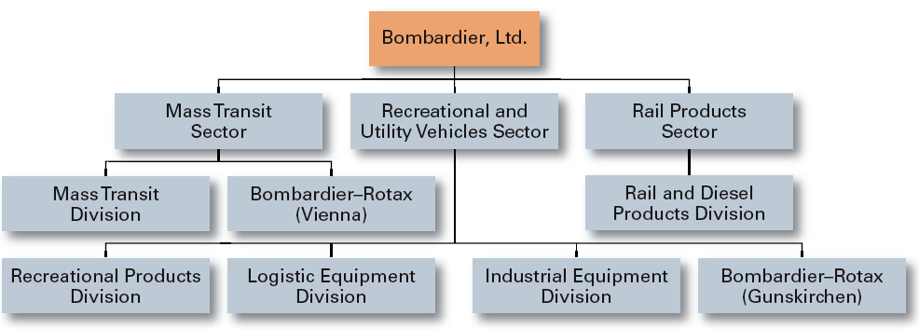
Product Departmentalization
Advantages
  Allows specialization in particular products and services
  Managers can become experts in their industry
  Closer to customers
Disadvantages
  Duplication of functions
  Limited view of organizational goals

Slide 11
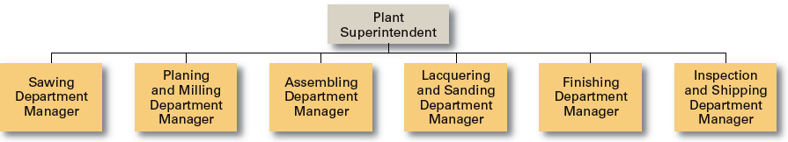
Process Departmentalization
Advantages
  More efficient flow of work activities
Disadvantages
  Can only be used with certain types of products

Slide 12
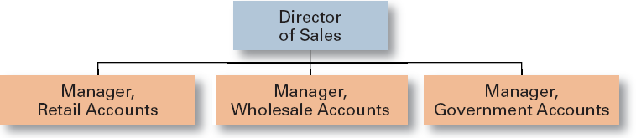
Customer Departmentalization
Advantages
  Customers’ needs and problems can be met by specialists
Disadvantages
  Duplication of functions
  Limited view of organizational goals

Slide 13

Chain of Command
  The continuous line of authority that extends from upper levels of an organization to the lowest levels of the organization and clarifies who reports to who.
Authority
  The rights inherent in a managerial position to tell people what to do and to expect them to do it.
Responsibility
  The obligation or expectation to perform.
Unity of Command
  The concept that a person should have
  one boss and should report only to that person.

Slide 14
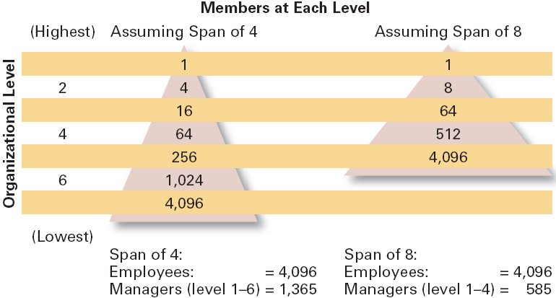
Span of Control
  = the number of employees (who can be effectively and efficiently) directly supervised by a manager.
  Width of span is affected by:
    Skills and abilities of the manager
    Employee characteristics
    Characteristics of the work being done
    Similarity of tasks
    Complexity of tasks
    Physical proximity of subordinates
    Standardization of tasks

Slide 15
Centralization vs. Decentralization
Level (amount of) centralization
  = degree to which decision-making is concentrated at a single point in the organizations.
  Centralized organizations
  = top managers make all decisions, lower level staff just carries them out.
  Factors supporting more centralization:
  Environment is stable.
  Lower-level managers are not as capable or experienced at making decisions as upper-level managers.
  Lower-level managers do not want to have a say in decisions.
  Decisions are relatively minor.
  Organization is facing a crisis or the risk of company failure.
  Company is large.
  Effective implementation of company strategies depends on managers retaining say over what happens.
  Decentralized organizations
  = decision making pushed to lower levels (authority delegated)
  Factors supporting more centralization:
  Environment is complex, uncertain.
  Lower-level managers are capable and experienced at making decisions.
  Lower-level managers want a voice in decisions.
  Decisions are significant.
  Corporate culture is open to allowing managers to have a say in what happens.
  Company is geographically dispersed.
  Effective implementation of company strategies depends on managers having involvement and flexibility to make decisions.
Employee Empowerment
Increasing the decision-making authority (power) of employees.

Slide 16
Formalization
  = the degree to which jobs within the organization are standardized and the extent to which employee behavior is guided by rules and procedures.
    Highly formalized jobs offer little discretion over what is to be done.
    Low formalization means fewer constraints on how employees do their work.

Slide 17


Mechanistic vs. Organic organization
• High specialization
• Rigid departmentalization
• Clear chain of command
• Narrow spans of control
• Centralization
• High formalization
• Cross-functional teams
• Cross-hierarchical teams
• Free flow of information
• Wide spans of control
• Decentralization
• Low formalization

Slide 18
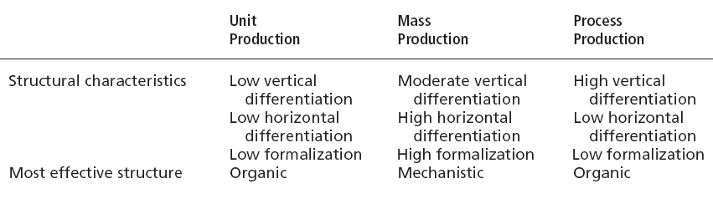
Contingency Factors
Structural decisions are influenced by:
  Overall strategy: Organizational structure always follows strategy.
    Achievement of strategic goals is facilitated by changes in organizational structure that accommodate and support change.
  Size of the organization
    Firms change from organic to mechanistic organizations as they grow in size =>increasing specialization, departmentalization, centralization, and rules and regulations.
  Technology: Firms adapt their structure to the technology they use.
    Routine technology = mechanistic organizations
    Non-routine technology = organic organizations
  Degree of environmental uncertainty
    Dynamic environments require organic structures; mechanistic structures need stable environments.

Slide 19
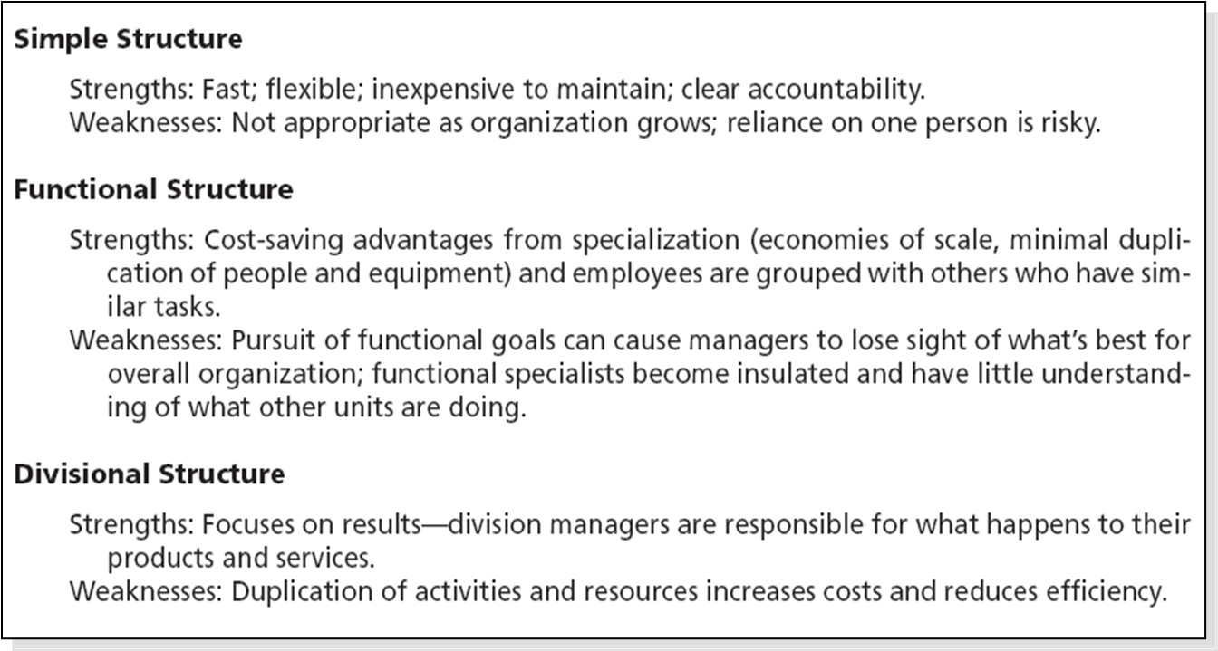
Traditional Organizational Designs
  Simple structure
    Low departmentalization, wide spans of control, centralized authority, little formalization
  Functional structure
    Departmentalization by function (operations, finance, human resources, and product research and development)
  Divisional structure
    Composed of separate business units or divisions with limited autonomy under the coordination and control the parent corporation.

Slide 20
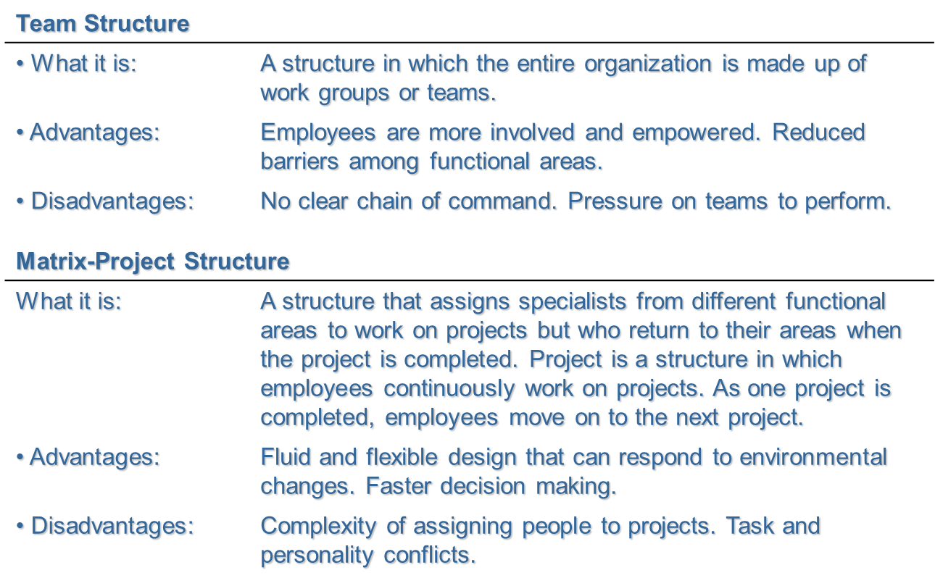
Contemporary Organizational Designs
  Team structures
    The entire organization is made up of work groups or self-managed teams of empowered employees.
  Matrix and project structures
    Specialists from different functional departments are assigned to work on projects led by project managers.
    Matrix and project participants have two managers (dual chain of command)
    In project structures, employees work continuously on projects; moving on to another project as each project is completed.

Slide 21
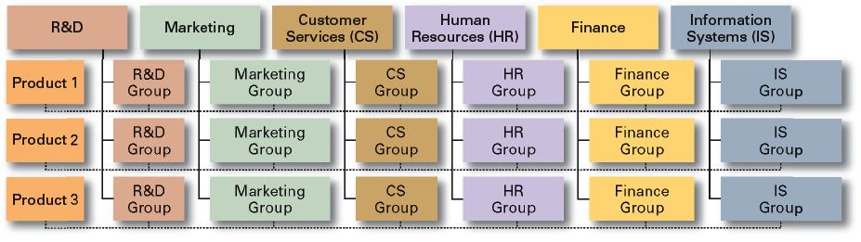
Matrix Organization (Example)

Slide 22
Terms to Know
organizing
organizational structure
organizational design
work specialization
departmentalization
functional departmentalization
product departmentalization
geographical departmentalization
process departmentalization
customer departmentalization
chain of command
authority
matrix structure
project structure
organizational chart
responsibility
unity of command
span of control
centralization
decentralization
employee empowerment
formalization
mechanistic organization
organic organization
unit production
mass production
process production
simple structure
functional structure
divisional structure
team structure

