Slide 1
Managing Groups and Teams
Lecture 7

Slide 2
Agenda for today
Groups vs. Teams
Group work behaviour
Creating effective teams
Current challenges in managing teams

Slide 3
Where are we?

Slide 4
Groups vs. Teams (1/2)
Groups
Teams
Work Group
  Two or more people interacting and interdependent individuals who come together to achieve specific goals.
  Formal groups
    Work groups defined by the organization’s structure that have designated work assignments and tasks.
      Appropriate behaviors are defined by and directed toward organizational goals.
  Informal groups
    Groups that are independently formed to meet the social needs of their members.
Work Team
  A group whose members work intensely on a specific common goal using their positive synergy, individual and mutual accountability, and complementary skills.
  purposefulness = common objective / goal
  mutual accountability of members = interdependence
  self perception = “US” vs. “THEM”

Slide 5
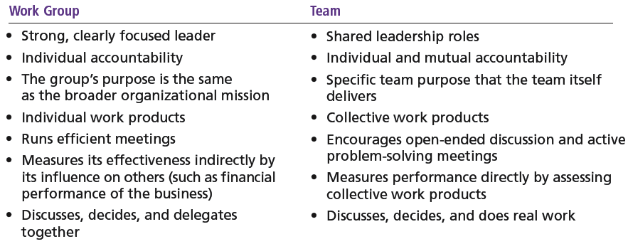
Groups vs. Teams (2/2)

Slide 6
Types of groups / teams
Command Groups
  Groups that are determined by the organization chart and composed of individuals who report directly to a given manager.
Task Groups
  Groups composed of individuals brought together to complete a specific job task; their existence is often temporary because once the task is completed, the group disbands.
Cross-Functional Teams
  Groups that bring together the knowledge and skills of individuals from various work areas or groups whose members have been trained to do each others’ jobs.
Self-Managed Teams
  Groups that are essentially independent and in addition to their own tasks, take on traditional responsibilities such as hiring, planning and scheduling, and performance evaluations.
Problem-solving Teams
  Employees from the same department and functional area who are involved in efforts to improve work activities or to solve specific problems.
Self-managed Work Teams
  A formal group of employees who operate without a manager and responsible for a complete work process or segment.

Slide 7
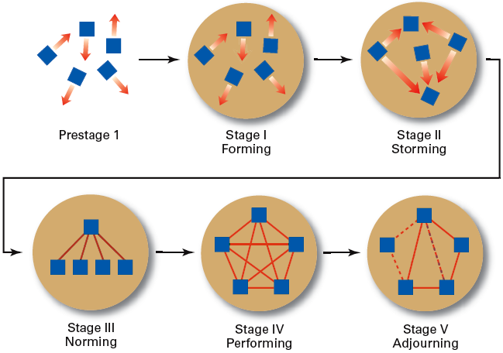
Stages in Group Development
Forming
  Members join and begin the process of defining the group’s purpose, structure, and leadership.
Storming
  Intragroup conflict occurs as individuals resist control by the group and disagree over leadership.
Norming
  Close relationships develop as the group becomes cohesive and establishes its norms for acceptable behavior.
Performing
  A fully functional group structure allows the group to focus on performing the task at hand.
Adjourning
  The group prepares to disband and is no longer concerned with high levels of performance.
Group | FORMING | = the process of socialization
 | STORMING | = members compete for leadership and other roles in the teams = establishing norms of appropriate behavior and performance standards
Team | NORMING | = developing team cohesion = developing common knowledge structure to regulate behavior of team members.
Effective team | PERFORMING | = higher task orientation as relationships are already developed.

Slide 8
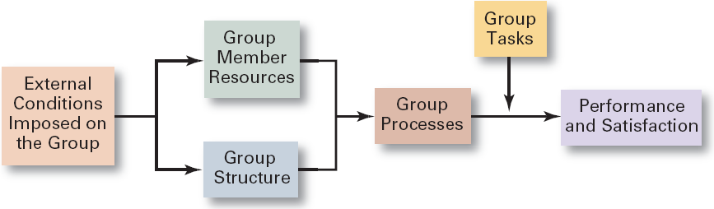
Group Behavior Model

Slide 9
Factors Affecting Group Behavior
External (Organizational) Conditions
Internal Group Variables
  Overall strategy
  Authority structures
  Formal regulations
  Available organizational resources
  Employee selection criteria
  Performance management (appraisal) system
  Organizational culture
  General physical layout
  Tasks -> individual competencies and traits of members
  Group structure
    Roles
    Norms
    Cohesiveness
    Level of (intragroup) conflict
    Conformity
    Status system
  Size of the group

Slide 10
Group Structure: Tasks
  = a piece of work to be done or undertaken
  clear
  easy to implement
  Interdependent
  => KSA needed
  => team diversity (homogenoous vs. heterogenous teams)
Highly complex and interdependent tasks require:
  Effective communications => discussion among group members
  Controlled conflict => more interaction among group members

Slide 11
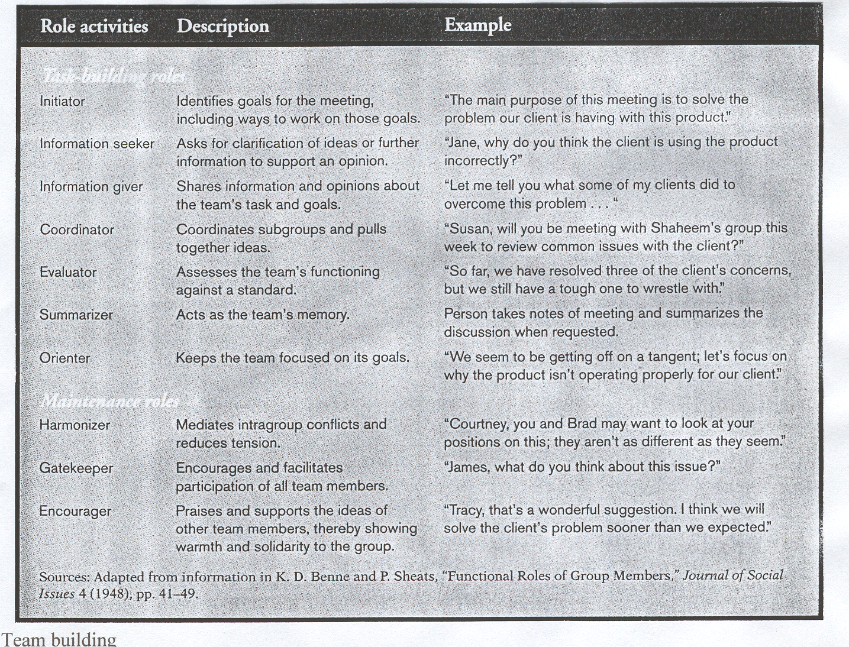
Group Structure: Roles
Roles defined
Team roles
  The set of expected behavior patterns attributed to someone who occupies a given position in a social unit that assist the group in task accomplishment or maintaining group member satisfaction.
  Role conflict: experiencing differing role expectations
  Role ambiguity: uncertainty about role expectations

Slide 12
Group Structure: Norms
  = acceptable standards or expectations that are shared by the group’s members.
Common types of norms:
  Effort and performance -> output levels, absenteeism, promptness, socializing
  Dress
  Loyalty

Slide 13
Group Structure: Conformity
  Individuals conform in order to be accepted by groups.
  Group pressures can have an effect on an individual member’s judgment and attitudes.
  The effect of conformity is not as strong as it once was, although still a powerful force.
  Groupthink
    The extensive pressure of others in a strongly cohesive or threatened group that causes individual members to change their opinions to conform to that of the group.

Slide 14
Group Structure: Status system
  = the formal or informal prestige grading, position, or ranking system for members of a group that serves as recognition for individual contributions to the group and as a behavioral motivator.
    Formal status systems are effective when the perceived ranking of an individual and the status symbols accorded that individual are congruent.

Slide 15
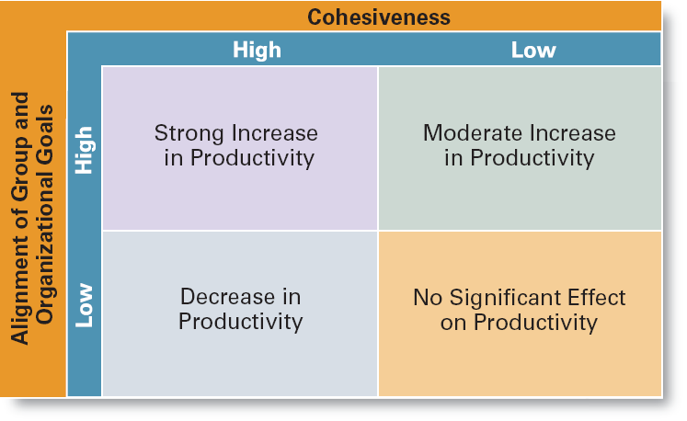
Cohesiveness
  The degree to which members are attracted to a group and share the group’s goals.
  Highly cohesive groups are more effective and productive than less cohesive groups when their goals aligned with organizational goals.
Factors of team cohesiveness | MORE COHESIVE | LESS COHESIVE
- member similarity | homogenous | heterogeneous
- team size | small | large
- member interaction | interdependent tasks | independent tasks
- barriers to entry | some barriers | no barriers
- team success | success | failure
- external competition and challenges | high competition challenging tasks | low competition easy tasks

Slide 16
Group Size
Small groups
  Complete tasks faster than larger groups.
  Make more effective use of facts.
Large groups
  Solve problems better than small groups.
  Are good for getting diverse input.
  Are more effective in fact-finding.
Social Loafing
  The tendency for individuals to expend less effort when working collectively than when work individually.

Slide 17
Group Processes: Conflict Management
Conflict = the perceived incompatible differences in a group resulting in some form of interference with or opposition to its assigned tasks.
    Traditional view - conflict must be avoided.
    Human relations view - conflict is a natural and inevitable outcome in any group.
    Interactionist view - conflict can be a positive force and is absolutely necessary for effective group performance.
Categories of Conflict
  Functional conflicts are constructive.
  Dysfunctional conflicts are destructive.
Types of Conflict
  Task conflict: content and goals of the work
  Relationship conflict: interpersonal relationships
  Process conflict: how the work gets done

Slide 18
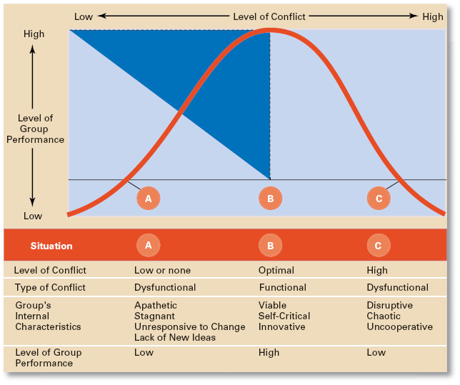
Conflict and Group Performance

Slide 19
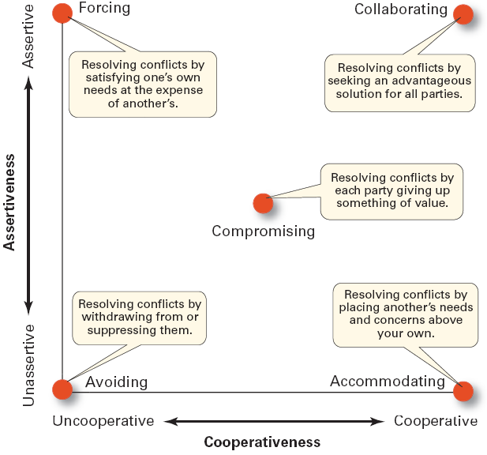
Conflict Management Techniques
  Avoidance
  Accommodation
  Forcing
  Compromise
  Collaboration

Slide 20
Advantages of Using Teams
Teams outperform individuals.
Teams provide a way to better use employee talents.
Teams are more flexible and responsive.
Teams can be quickly assembled, deployed,
refocused, and disbanded.

Slide 21
Characteristics of effective teams
Have a clear understanding of their goals.
Have competent members with relevant technical and interpersonal skills.
Exhibit high mutual trust in the character and integrity of their members.
Are unified in their commitment to team goals.
Have good communication systems.
Possess effective negotiating skills
Have appropriate leadership
Have both internally and externally supportive environments

Slide 22
Current Challenges in Managing Teams
Getting employees to:
  Cooperate with others
  Share information
  Confront differences
  Sublimate personal interest for the greater good of the team

Slide 23
Informal groups and teams - understanding social networks
Social Network = the patterns of informal connections among individuals within groups
The Importance of Social Networks
  Relationships can help or hinder team effectiveness
  Relationships improve team goal attainment and increase member commitment to the team.

Slide 24
Terms to Know
group
forming
storming
norming
performing
adjourning
role
norms
groupthink
status
social loafing
group cohesiveness
conflict
traditional view of conflict
human relations view of conflict
interactionist view of conflict
functional conflicts
dysfunctional conflicts
task conflict
relationship conflict
process conflict
work teams
problem-solving team
self-managed work team
cross-functional team
virtual team
social network structure

